Slide 1


Hotel Management System

Slide 2
Prepared by :-
Name : Dhairya Amitkumar Dave (24002171210039)
Batch : A4
Branch : CSE

Slide 3
Project Outline :-
Purpose Of The Project
FlowChart
ER Diagram
Use Case Diagram
Functionalities Of Project Related To Particular Subject
Tools Used
Merits & Demerits
Future scope
Conclusion

Slide 4
Purpose Of The Project :-
The main purpose of this project is to create a software that helps a hotel manage its daily work easily and quickly.
This system saves time, reduces mistakes, and makes the hotel work smoother. It also helps guests get better service.
Instead of doing everything by hand, the hotel staff can use this system to:
1.Book rooms
2.Order food
3.keep records of guests and bookings
4.convenient billing system

Slide 5
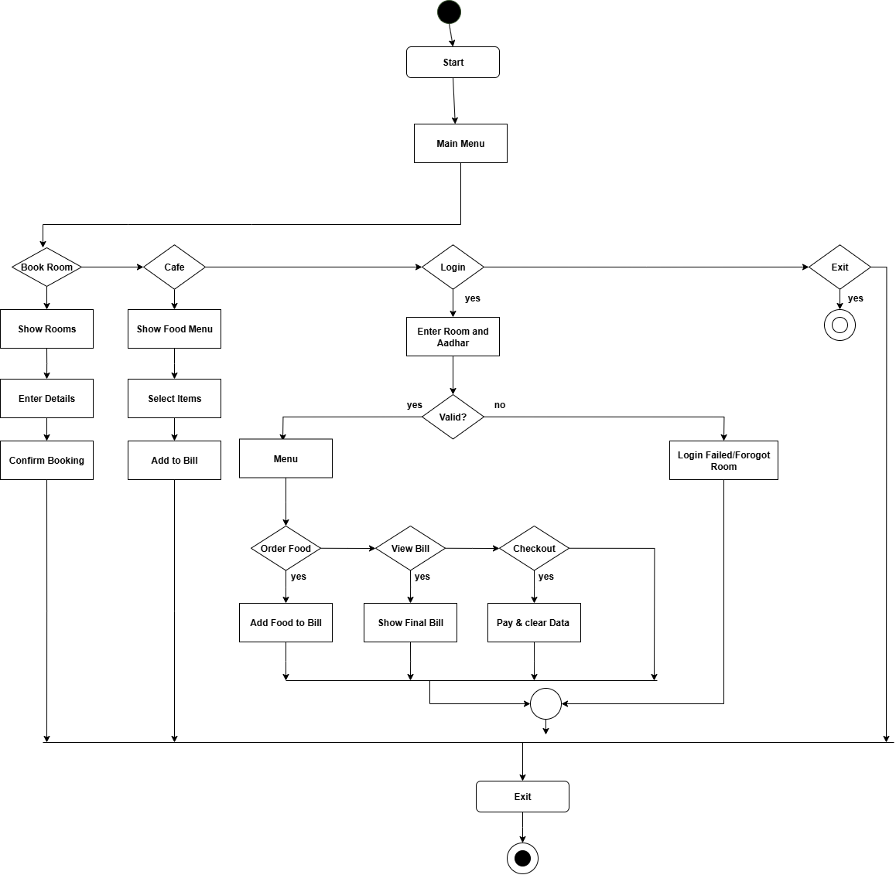
Flow-Chart

Slide 6
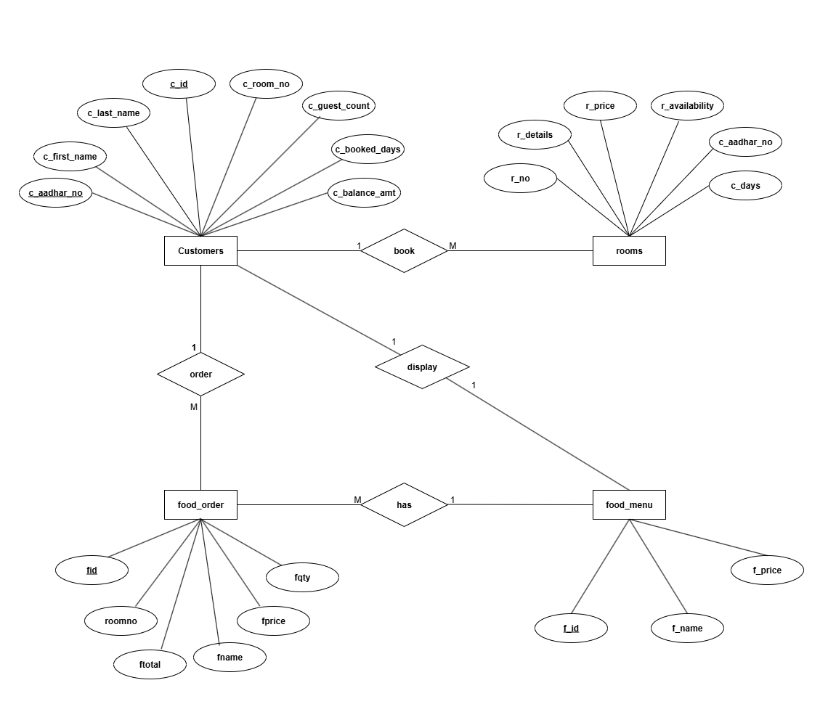
E-R Diagram

Slide 7
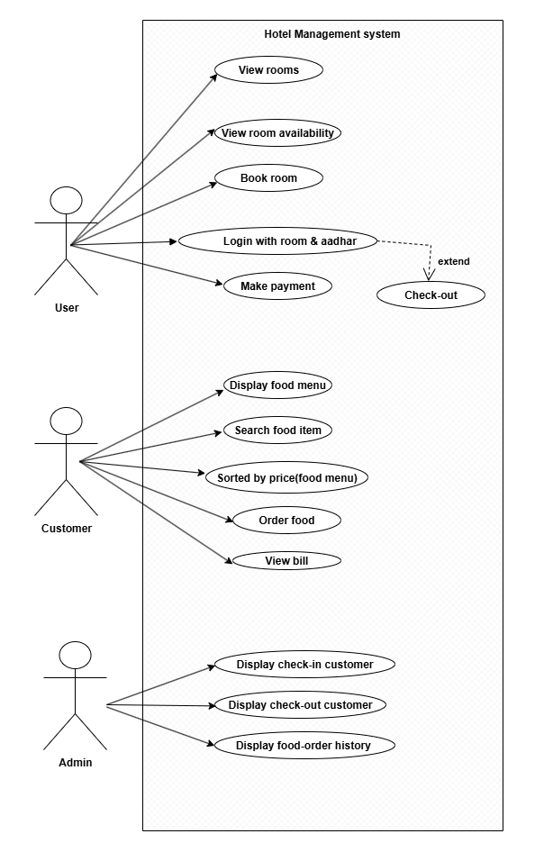
Use Case Diagram

Slide 8
Functionalities Of Project Related To Particular Subject
Data Structure Using Java | Java-II | Database Managemant System
Singly LinkedList | Object-Oriented Programming 1 encapsulation 2 abstraction | Data Definition Language (DDL) Create
 | File I/O | Data Manipulation Language(DML) Select Insert Update Delete
 |  | PL/SQL Concepts Functions Procedures

Slide 9
Merit
Easy to use for booking rooms and ordering food.
Saves time by doing billing and tracking automatically.
Keeps all data safe in one place(data base)
Separate parts for hotel and cafe make it simple to manage
Demerits
Works only on one computer(not online)
No advanced features like online payment or mobile app
Menu and room prices must be changed manually

Slide 10
Tools Used
Programming Language : Java
Database :PosgreSQL
Debugging java code:IDE(Intellij idea)

Slide 11
Future scope
Make it online so people can book from their phone
Create a mobile app version
Add stock tracking for food and room items
Show reports like monthly income or top-selling items
Add Gujarati or Hindi language for easy use

Slide 12
Conclusion
The system provides a unified solution for managing hotel, guest house, and cafe services.
Ensures customer satisfaction with transparency in billing.
It also saves time and reduces manual work by doing many tasks automatically.

Slide 13
Thank you…

