Slide 1
PROBLEM STATEMENT ID · SIH26043
SMART INDIA HACKATHON
JharSetu
TEAM NAME
Computer Smashers
झारसेतु
TEAM ID [SIH26043]
See a need. Form a team. Close the loop.
TEAM LEADER
PROBLEM STATEMENT
R
Rakshit
Team Leader
A digital platform to crowdsource societal challenges and facilitate collaborative problem solving through universities and industry partnerships
TEAM MEMBERS
K
Kahan
D
Dhairya
THEME
CATEGORY
ORGANISATION
S
Soham
D
Disha
[Disaster Management]
Software
Government of Jharkhand
S
Shreya
Working prototype: citizen report → verified → college solution → funded → delivered.
Notes:
Introduce the team and the problem statement: SIH26043, a platform that turns citizen-reported problems into college-built, company- and NGO-funded solutions.

Slide 2
IDEA INTRODUCTION & PROBLEM ADDRESSED
Local problems are seen by many, but solved by no one
The real-world problem
OUR IDEA
One bridge from a citizen's report to finished work
1
Reports get lost. Broken culverts, lightning deaths and unsafe water are raised on WhatsApp, calls and paper — scattered, untracked, often in local languages.
Citizens report in their own language by voice, text or SMS. AI ranks, de-duplicates and verifies with cited evidence. Colleges propose solutions, companies and NGOs fund them in parts, and every step is tracked to done.
2
No trust signal. Officials can't tell a real, urgent problem from a duplicate or a false report, so everything waits.
3
Talent sits idle. Universities want real problems for students, but have no verified list and no route to the field.
Target audience / end users
Citizens
Verifiers
Colleges
4
Money can't find the need. CSR budgets and NGO funds rarely reach small local fixes, and donors can't see what their money did.
Villagers & residents — report without an account
District / disaster-management officers who confirm with evidence
Universities & polytechnics proposing solutions
5
Delays are invisible. Nobody records how long each step takes, so stalled work is never noticed.
Companies
NGOs
Admin / State
CSR teams supplying materials
Trusts & societies funding the work
System owner tracking SLAs & impact
JharSetu · SIH26043 · Team Computer Smashers
2 / 6
Notes:
Five failures: lost reports, no trust signal, idle university talent, CSR/NGO money that can't find small needs, invisible delays. JharSetu fixes all five in one chain with six roles.

Slide 3
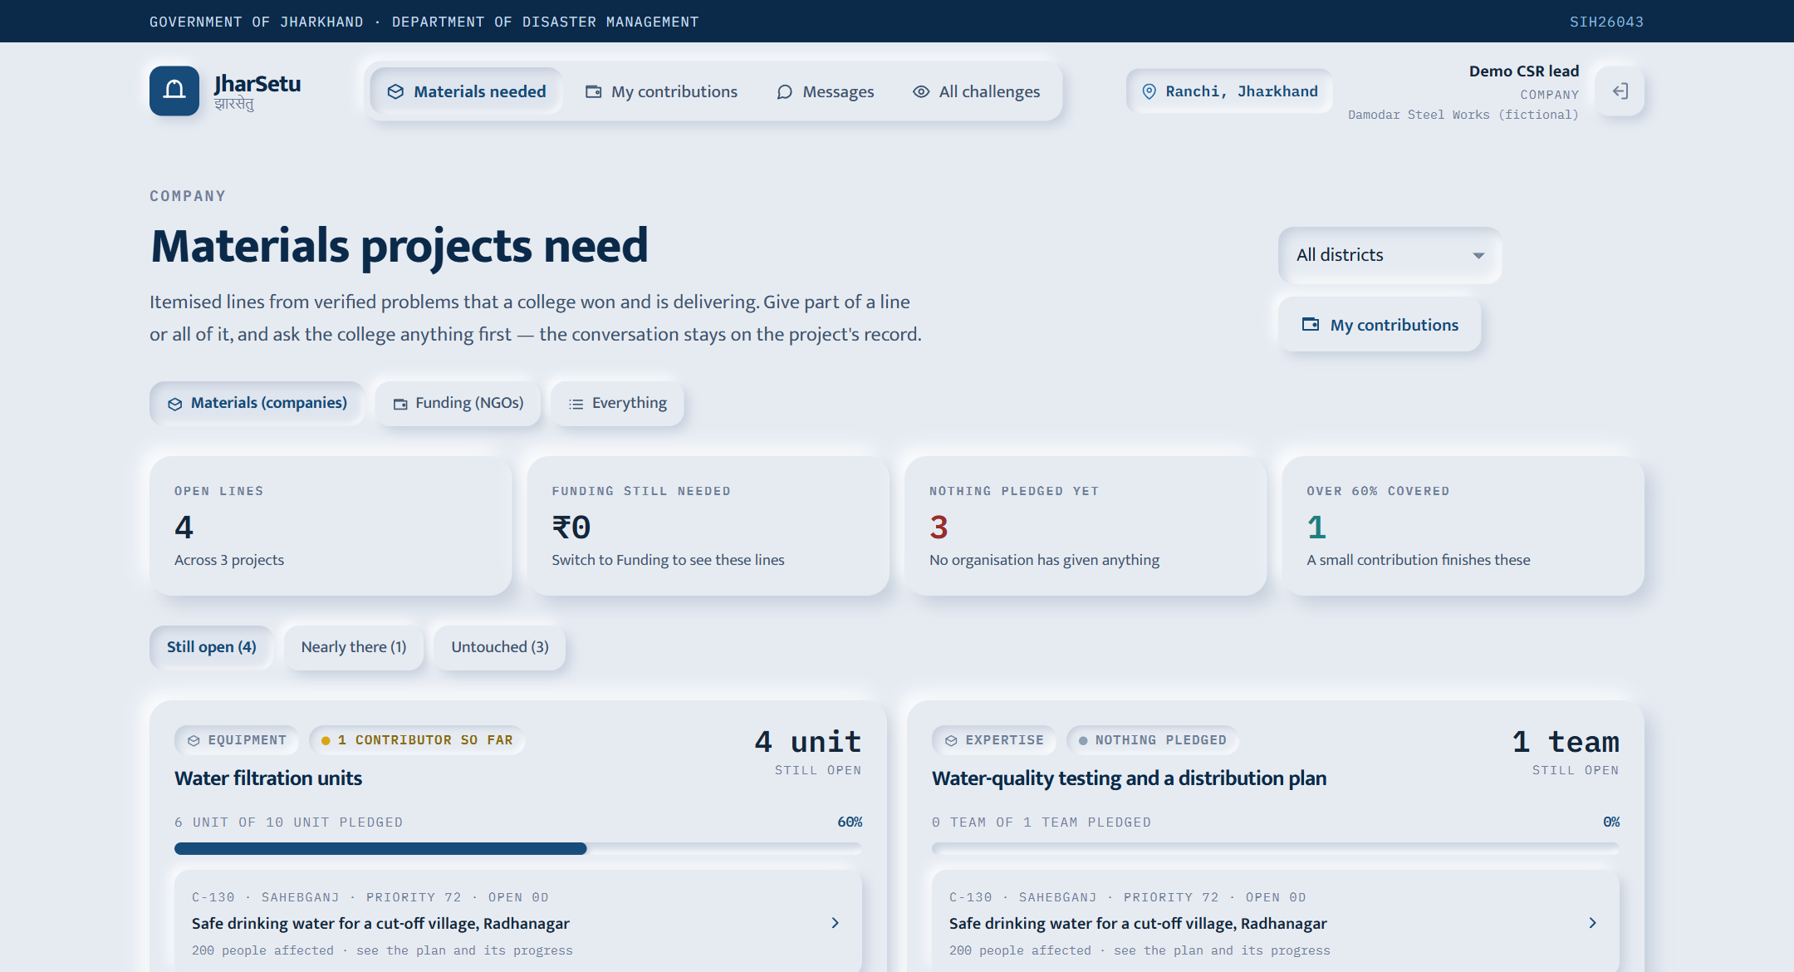
PROPOSED SOLUTION & CORE FEATURES
Six links, one closed loop — no link can do another's job
01
›
02
›
03
›
04
›
05
›
06
Report
AI compiles
Verify
College proposes
Fund in parts
Track to done
voice · text
translate · score · merge
AI evidence or officer
scored by AI
companies & NGOs
stages · receipts · photos
LIVE PROTOTYPE · NEEDS BOARD
Key features
Report in any language, no account: Hindi, Santali, Khortha, Nagpuri, English — voice, photo or text
Explainable AI priority score, every factor shown; duplicate reports from the same place merged automatically
Instant AI verification for disasters — checks ERA5 weather records, news and the web, and cites sources
Verifier console: confirm or reject with source links and field photos
AI proposal review: college scored on a rubric; non-viable ones rejected with reasons
Divisible pledges: 10 kg steel = 5 kg + 5 kg from two companies; NGOs fund in ₹
Project workspace: AI-drawn delivery stages, receipt confirmation, photo progress, chat with the college
Admin command centre: AI assistant that explains any case, SLA timings, severity metrics
WHAT MAKES IT DIFFERENT (USP)
✓ Evidence-first AI
cites sources; never decides alone
✓ Closes the loop
report → funded → delivered
✓ Works on a basic phone
SMS & low bandwidth
✓ Tamper-evident record
hash-chained ledger + step timings
JharSetu · SIH26043 · Team Computer Smashers
3 / 6
Notes:
Walk the six links left to right. Point at the screenshot: this is the real app. USP: AI that shows its evidence, and a loop that ends in delivered work, not a complaint number.

Slide 4
TECHNICAL APPROACH & ARCHITECTURE
An open, serverless stack with AI at every checkpoint
Technology stack
SYSTEM ARCHITECTURE
Frontend
Next.js 16 · React 19 · TypeScript · Tailwind CSS 4 · PWA
Users
Application
AI & domain services
Citizen PWA
voice · photo · text
Next.js 16 frontend
role-based UI
AI compiler Gemini + Whisper
Backend
Next.js 15 API routes · Node.js 22 · Zod validation · Vercel
Dedup & scoring pgvector + PostGIS
API gateway
Webapp
Next.js API
Zod validation · RBAC · rate limits · background jobs
Corroboration ERA5 · news · web
Database
Supabase Postgres · PostGIS · pgvector · Row-Level Security · Storage
Proposal reviewer PDF → score → stages
Google Gemini (model cascade) · Whisper speech-to-text · vector dedup · PDF text extraction
Role dashboards
verifier · college · company · NGO · admin
Resource swarm pledges · receipts
AI / ML
Admin assistant answers from record
Data APIs
Open-Meteo (ERA5 reanalysis) · NewsAPI · Tavily web search
Supabase
Postgres · Row-Level Security · Auth · private file storage · hash-chained ledger
Security
Supabase Auth · role-based access · photo GPS stripping · SHA-256 hash-chained ledger
Hardware
None needed — any smartphone
Step-by-step execution
1
2
3
4
5
Schema, RLS & roles
Intake, AI compiler & dedup
Verification & corroboration
Proposals, awards & pledges
Dashboards, assistant & E2E tests
JharSetu · SIH26043 · Team Computer Smashers
4 / 6
Notes:
Serverless Next.js on Supabase. Every AI step has a rule-based fallback, so the flow never breaks when a model is unavailable. Row-level security enforces what each role sees inside the database itself.

Slide 5
FEASIBILITY, USE CASES & IMPACT
Working today, built to scale across India
Feasibility
Impact
Scale & national alignment
Working prototype all 6 roles live
Societal
1
Pilot
one district in Jharkhand
Citizens heard in their own language
Disaster fixes reach cut-off villages faster
Students solve real local problems
54 / 54 end-to-end flow checks pass
2
State
all 24 districts of Jharkhand
Open-source stack low running cost
Multi-state
config-driven regions (Rajkot demo live)
3
CHALLENGES → HOW WE HANDLE THEM
Environmental
Flood, drought & lightning early-warning projects
Materials used where they are needed
Climate-risk hotspots mapped by village
4
National
open APIs for state disaster authorities
Poor rural connectivity
SMS intake, offline queue, lightweight pages
AI mistakes
must cite sources; rule fallback; human verifier
ALIGNS WITH
Digital India
Unnat Bharat Abhiyan
Fake or duplicate reports
geo + text dedup, evidence checks
Commercial / economic
CSR spend with proof of delivery
Lower cost of local repairs
Transparent, auditable public spending
CSR · Companies Act §135
NDMA & Sendai Framework
Partner adoption
fits CSR & university outreach, free onboarding
Bhashini (roadmap)
Viksit Bharat @2047
Data privacy
RLS, photo GPS stripped, DPDP-aligned
JharSetu · SIH26043 · Team Computer Smashers
5 / 6
Notes:
Feasibility: it already runs end to end, verified by an automated 54-step test. Seeded numbers are a simulated scenario. Scale by configuration: a new state is a new region, not a new product.

Slide 6
RESEARCH AND REFERENCES
Grounded in research, open data and official guidelines
Research papers & journals
Datasets & open-source frameworks
Official guidelines followed
[1] Brabham, D. C. (2008). Crowdsourcing as a Model for Problem Solving.
Convergence 14(1), 75–90 · doi:10.1177/1354856507084420
[2] Etzkowitz, H. & Leydesdorff, L. (2000). The Dynamics of Innovation: the Triple Helix of University–Industry–Government Relations.
Research Policy 29(2), 109–123 · doi:10.1016/S0048-7333(99)00055-4
[3] Hersbach, H. et al. (2020). The ERA5 Global Reanalysis.
Q. J. R. Meteorol. Soc. 146(730), 1999–2049 · doi:10.1002/qj.3803
[4] Lewis, P. et al. (2020). Retrieval-Augmented Generation for Knowledge-Intensive NLP Tasks.
NeurIPS 2020 · arXiv:2005.11401
[5] [Add: related patent / prior-art search]
e.g. InPASS, Indian Patent Office
[1] Open-Meteo Historical Weather API (ERA5)
open-meteo.com
[2] NewsAPI · Tavily Search API
newsapi.org · tavily.com
[3] Local Government Directory — districts & villages
lgdirectory.gov.in
[4] Next.js · React · Supabase · PostGIS · pgvector
nextjs.org · supabase.com · postgis.net · github.com/pgvector/pgvector
[5] OpenAI Whisper · pdf-parse
github.com/openai/whisper · npmjs.com/package/pdf-parse
[1] Smart India Hackathon guidelines & PS SIH26043
sih.gov.in
[2] NDMA — National Disaster Management Plan (2019)
ndma.gov.in
[3] Sendai Framework for Disaster Risk Reduction 2015–2030
undrr.org
[4] Digital Personal Data Protection Act, 2023
meity.gov.in
[5] GIGW 3.0 & WCAG 2.1 accessibility
guidelines.india.gov.in · w3.org/WAI
Acknowledgement We thank the Government of Jharkhand for the problem statement, our institute and mentors for their guidance, and the Smart India Hackathon team. Demo data shown is a simulated scenario.
JharSetu · SIH26043 · Team Computer Smashers
6 / 6
Notes:
Close by naming the guidelines followed and thanking the organisers. Offer the live demo.

