Slide 1

Unit-5 Searching & Sorting
Data Structure (DS)
#2301CS301
Prof. Shruti Maniar
Computer Engineering Department
shruti.maniar@darshan.ac.in
+91 97277 47317 (CE Department)

Slide 2

Looping
Topics to be covered
Searching
Linear Search
Binary Search
Sorting
Bubble Sort
Selection Sort
Insertion Sort
Bucket Sort
Radix Sort
Shell Sort
Counting Sort
Merge Sort
Quick Sort
Heap Sort
Sorting on multiple keys

Slide 3
Linear Search

Slide 4
Linear/Sequential Search
In computer science, linear search or sequential search is a method for finding a particular value in a list that consists of checking every one of its elements, one at a time and in sequence, until the desired one is found.
Linear search is the simplest search algorithm.
It is a special case of brute-force search.
Its worst case cost is proportional to the number of elements in the list.
Hence the worst case time complexity of Linear Search is O(n).

Slide 5
Sequential Search – Algorithm & Example
# Input: Array A, integer key
# Output: first index of key in A
# or -1 if not found
Algorithm: Linear_Search
for i = 0 to last index of A:
if A[i] equals key:
return i
return -1
Search for 1 in given array
2 | 9 | 3 | 1 | 8
Comparing value of i^{th} index with element to be search one by one until we get searched element or end of the array
Step 1: i=0
Step 1: i=2
2 | 9 | 3 | 1 | 8
2 | 9 | 3 | 1 | 8
i
i
Step 1: i=1
Step 1: i=3
2 | 9 | 3 | 1 | 8
2 | 9 | 3 | 1 | 8
1
i
i
Element found at i^{th} index, i=3

Slide 6
Binary Search

Slide 7
Binary Search
If we have an array that is sorted, we can use a much more efficient algorithm called a Binary Search.
In binary search each time we divide array into two equal halves and compare middle element with search element.
Thus the worst case time complexity of Binary Search is O(log₂n).
For the best kind of input, the search element could be found in one comparison only. So that the best case time complexity is O(1).
Searching Logic
If middle element is equal to search element then we got that element and return that index
if middle element is less than search element we look right part of array
if middle element is greater than search element we look left part of array

Slide 8
Binary Search – Algorithm (Iterative Approach)
# Input: Sorted Array A, integer key
# Output: first index of key in A,
# or -1 if not found
Algorithm: Binary_Search (A, left, right)
left = 0, right = n-1
while left <= right
middle = index halfway between left, right
if A[middle] matches key
return middle
else if key less than A[middle]
right = middle -1
else
left = middle + 1
return -1

Slide 9
Binary Search - Algorithm
Search for 6 in given array
-1 | 5 | 6 | 18 | 19 | 25 | 46 | 78 | 102 | 114
Index
0 | 1 | 2 | 3 | 4 | 5 | 6 | 7 | 8 | 9
left
right
Key=6, No of Elements = 10, so left = 0, right=9
Step 1:
middle index = (left + right) /2 = (0+9)/2 = 4
middle element value = a[4] = 19
Key=6 is less than middle element = 19, so right = middle – 1 = 4 – 1 = 3, left = 0
-1 | 5 | 6 | 18 | 19 | 25 | 46 | 78 | 102 | 114
Index
0 | 1 | 2 | 3 | 4 | 5 | 6 | 7 | 8 | 9
left
right

Slide 10
Binary Search - Algorithm
Step 2:
middle index = (left + right) /2 = (0+3)/2 = 1
middle element value = a[1] = 5
Key=6 is greater than middle element = 5, so left = middle + 1 =1 + 1 = 2, right = 3
-1 | 5 | 6 | 18 | 19 | 25 | 46 | 78 | 102 | 114
Index
0 | 1 | 2 | 3 | 4 | 5 | 6 | 7 | 8 | 9
left
right
Step 3:
middle index = (left + right) /2 = (2+3)/2 = 2
middle element value = a[2] = 6
Key=6 is equals to middle element = 6, so element found
-1 | 5 | 6 | 18 | 19 | 25 | 46 | 78 | 102 | 114
6
Index
0 | 1 | 2 | 3 | 4 | 5 | 6 | 7 | 8 | 9
Element Found

Slide 11
Binary Search – Algorithm (Recursive Approach)
# Input: Sorted Array A, integer key
# Output: first index of key in A,
# or -1 if not found
Algorithm: Binary_Search (A, left, right, key)
left = 0, right = n-1
if left <= right
middle = index halfway between left, right
if A[middle] matches key
return middle
else if key less than A[middle]
return Binary_Search (A, left, middle - 1, key)
else
return Binary_Search (A, middle + 1, right, key)
return -1

Slide 12
Linear Search vs. Binary Search
Aspect | Linear Search | Binary Search
Prerequisites | Can work on both sorted and unsorted arrays. | It requires the input array to be sorted only.
Efficiency | Less efficient comparatively. | More efficient than linear search, especially for large datasets.
Algorithm Complexity | O(n) | O(log₂n)

Slide 13
Selection Sort

Slide 14
Selection Sort
Selection sort is a simple sorting algorithm.
The list is divided into two parts,
The sorted part at the left end and
The unsorted part at the right end.
Initially, the sorted part is empty and the unsorted part is the entire list.
The smallest element is selected from the unsorted array and swapped with the leftmost element, and that element becomes a part of the sorted array.
This process continues moving unsorted array boundary by one element to the right.

Slide 15
Selection Sort
This algorithm works well with small data sets.
This algorithm is not suitable for large data sets as its average/best/worst case complexities are of Ο(n²), where n is the number of items.
This algorithm is not stable algorithm, as it doesn’t preserve the relative order of items with equal keys.
It is an in-place algorithm, as it doesn’t require any extra space.

Slide 16
Selection Sort
Unsorted Array
5 | 1 | 12 | -5 | 16 | 2 | 12 | 14
Step 1 :
Unsorted Array
5 | 1 | 12 | -5 | 16 | 2 | 12 | 14
0 | 1 | 2 | 3 | 4 | 5 | 6 | 7
Step 2 :
Unsorted Array (elements 0 to 7)
Min index = 0, value = 5
5
-5
1
12
-5
5
16
2
12
14
Find min value from
Unsorted array
Index = 3, value = -5
0
1
2
3
4
5
6
7
Swap

Slide 17
Selection Sort
Step 3 :
Min index = 1, value = 1
Unsorted Array (elements 1 to 7)
Find min value from
Unsorted array
Index = 1, value = 1
-5
1
1
12
5
16
2
12
14
0
1
2
3
4
5
6
7
No Swapping as min value is already at right place
Step 4 :
Unsorted Array
(elements 2 to 7)
Min index = 2, value = 12
-5
1
12
2
5
16
2
12
12
14
Find min value from
Unsorted array
Index = 5, value = 2
0
1
2
3
4
5
6
7
Swap

Slide 18
Selection Sort
Step 5 :
Unsorted Array
(elements 3 to 7)
Min index = 3, value = 5
-5
1
2
5
5
16
12
12
14
Find min value from
Unsorted array
Index = 3, value = 5
0
1
2
3
4
5
6
7
No Swapping as min value is already at right place
Step 6 :
Unsorted Array
(elements 5 to 7)
Min index = 4, value = 16
-5
1
2
5
16
12
12
16
12
14
Find min value from
Unsorted array
Index = 5, value = 12
0
1
2
3
4
5
6
7
Swap

Slide 19
Selection Sort
Step 7 :
Unsorted Array
(elements 5 to 7)
Min index = 5, value = 16
-5
1
2
5
12
16
12
12
16
14
Find min value from
Unsorted array
Index = 6, value = 12
0
1
2
3
4
5
6
7
Swap
Step 8 :
Unsorted Array
(elements 6 to 7)
Min index = 6, value = 16
-5
1
2
5
12
12
16
14
14
16
Find min value from
Unsorted array
Index = 7, value = 14
0
1
2
3
4
5
6
7
Swap

Slide 20
SELECTION_SORT(K,N)
Given a vector K of N elements
This procedure rearrange the vector in ascending order using Selection Sort
The variable i denotes the pass index and position of the first element in the vector
The variable MIN_INDEX denotes the position of the smallest element encountered
The variable j is used to index elements

Slide 21
SELECTION_SORT(K,N)
1. [Loop on the Pass index]
Repeat thru step 4 for i = 0,1,…….., N-2
2. [Initialize minimum index]
MIN_INDEX ← i
3. [Make a pass and obtain element with smallest value]
Repeat for j = i + 1, i + 2, …………….., N-1
If K[j] < K[MIN_INDEX]
Then MIN_INDEX ← j
4. [Exchange elements]
IF MIN_INDEX <> i (not equals to)
Then K[i] ←→ K[MIN_INDEX] (swap elements)
5. [Finished]
Return

Slide 22
Bubble Sort

Slide 23
Bubble Sort
Unlike selection sort, instead of finding the smallest record and performing the interchange, two records are interchanged immediately upon discovering that they are out of order.
During the first pass R₁ and R₂ are compared and interchanged in case of our of order, this process is repeated for records R₂ and R₃, and so on.
This method will cause records with small key to move “bubble up”.
After the first pass, the record with largest key will be in the n-1th position. On each successive pass, the records with the next largest key will be placed in position n-2, n-3 ….., 2,1 respectively.
This approach requires at most n–1 passes.

Slide 24
Bubble Sort
This is stable sorting algorithm, as the elements with the same keys maintain their relative order in the sorted output as well.
This is in-place algorithm as it doesn’t require ant extra space to sort the elements.
This seems slow for large data sets as the worst case time complexity of bubble sort is O(n²).
For the input list which is already sorted (best case), the algorithm can get early exist.
So the best case time complexity is O(n).

Slide 25
Bubble Sort
Unsorted Array
45 | 34 | 56 | 23 | 12
Pass 1 :
Pass 2 :
Pass 3 :
Pass 4 :
34
34
34
34
23
23
23
45
12
34
swap
34
34
34
swap
swap
34
45
45
12
23
23
23
34
12
34
23
45
45
45
45
swap
swap
12
23
23
34
45
45
56
56
56
12
12
34
23
swap
23
swap
12
12
12
45
23
23
23
45
45
45
56
56
12
swap
12
12
12
12
56
56
56
56
56
56
56

Slide 26
BUBBLE_SORT(K,N)
Given a vector K of N elements.
This procedure rearrange the vector in ascending order using Bubble Sort.
The variable i & LAST denotes the pass index and position of the first element in the vector.
The variable j is used to index elements.
The variable EXCHS is used to count number of exchanges made on any pass

Slide 27
Procedure: BUBBLE_SORT (K, N)
1. [Initialize]
LAST ← N-1
2. [Loop on pass index]
Repeat thru step 4 for i = 0, 1, 2, …. , N-2
3. [Initialize exchange counter for this pass]
EXCHS ← 0
4. [Perform pairwise comparisons on unsorted elements]
Repeat for j = 0, 1, 2, ……….., LAST – 1
IF K[j] > K [j+1]
Then K[j] ⬅➔ K[j+1]
EXCHS ← EXCHS + 1
5. [Any exchange made in this pass?]
IF EXCHS = 0
Then Return (Vector is sorted, early return)
ELSE LAST ← LAST - 1
6. [Finished]
Return

Slide 28
Insertion Sort

Slide 29
Insertion Sort
In insertion sort, every iteration moves an element from unsorted portion to sorted portion until all the elements are sorted in the list.
Steps for Insertion Sort
1
Assume that first element in the list is in sorted portion of the list and remaining all elements are in unsorted portion.
2
Select first element from the unsorted list and insert that element into the sorted list in order specified.
3
Repeat the above process until all the elements from the unsorted list are moved into the sorted list.

Slide 30
Insertion Sort
Insertion sort is efficient sorting algorithm for smaller list and nearly sorted list.
This algorithm is inefficient for large data sets.
The worst case time complexity of this algorithm is O(n²).
If the list already sorted, then only n comparisons would be required. So the best case time complexity is O(n).
This is stable sorting algorithm, as the elements with the same keys maintain their relative order in the sorted output as well.
This is in-place algorithm as it doesn’t require ant extra space to sort the elements.

Slide 31
Algorithm : Insertion Sort (A,N)
i ← 1
while i < N
key ← A[i]
j ← i-1
while j >= 0 and A[j] > key
A[j+1] ← A[j]
j ← j - 1
end while
A[j+1] ← key
i ← i + 1
end while

Slide 32
Example : Insertion Sort
Unsorted Array
29 | 10 | 14 | 37 | 13
Step 1 :
Unsorted Array
N = 5
29 | 10 | 14 | 37 | 13
0 | 1 | 2 | 3 | 4
Step 2 :
i= 1
i<5 → True
key = A[i] = 10
J = i-1 = 1-1 = 0
J>=0 → True
A[j]>key → 29>10 → True
A[1] = A[0]
J-- → j=-1
J = -1
J>=0 → False
29
10
14
37
13
10
29
0
1
2
3
4
A[j+1] = key
A[-1+1] = 10
A[0] = 10

Slide 33
Example : Insertion Sort
Step 3 :
i= 2
i<5 → True
key = A[i] = 14
J = i-1 = 2-1 = 1
J>=0 → True
A[j]>key → 29>14 → True
A[2] = A[1]
J-- → j=0
J>=0 → True
A[j]>key → 10>14 → False
10
14
29
37
13
29
14
0
1
2
3
4
A[j+1] = key
A[0+1] = 14
A[1] = 14

Slide 34
Example : Insertion Sort
Step 4 :
i= 3
i<5 → True
key = A[i] = 37
10
14
29
37
13
0
1
2
3
J = i-1 = 3-1 = 2
J>=0 → True
A[j]>key → 29>37 → False
4
A[j+1] = key
A[2+1] = 37
A[3] = 37

Slide 35
Example : Insertion Sort
Step 5 :
J = i-1 = 4-1 = 3
J>=0 → True
A[j]>key → 37>13 → True
A[4] = A[3]
J-- → j=2
J>=0 → True
A[j]>key → 29>13 → True
A[3] = A[2]
J-- → j=1
J>=0 → True
A[j]>key → 14>13 → True
A[2] = A[1]
J-- → j=0
J>=0 → True
A[j]>key → 10>13 → False
i= 4
i<5
key = A[i] = 13
14
10
14
29
37
13
13
14
29
37
0
1
2
3
4
A[j+1] = key
A[0+1] = 13
A[1] = 13

Slide 36
Example : Insertion Sort
Step 6 :
i= 5
i<5 → False
10
13
37
13
14
29
37
0
1
2
3
4
Sorted Array
10 | 13 | 14 | 29 | 37
0 | 1 | 2 | 3 | 4

Slide 37
Shell Sort

Slide 38
Shell Sort - Example
Sort the following elements in ascending order using shell sort.
This algorithm avoids large shifts as in case of insertion sort, if the smaller value is to the far right and has to be moved to the far left.
80
93
60
12
42
30
68
85
10
Step 1: Divide input array into segments, where Initial Segmenting Gap = 4 (n/2)
$$1$$ | $$2$$ | $$3$$ | $$4$$ | $$5$$ | $$6$$ | $$7$$ | $$8$$ | $$9$$
80
93
60
12
42
30
68
85
10
Each segment is sorted within itself using insertion sort
$$1$$ | $$2$$ | $$3$$ | $$4$$ | $$5$$ | $$6$$ | $$7$$ | $$8$$ | $$9$$
10
93
60
12
42
30
68
85
80

Slide 39
Shell Sort - Example
Sort the following elements in ascending order using shell sort.
80
93
60
12
42
30
68
85
10
Step 1: Divide input array into segments, where Initial Segmenting Gap = 4 (n/2)
$$1$$ | $$2$$ | $$3$$ | $$4$$ | $$5$$ | $$6$$ | $$7$$ | $$8$$ | $$9$$
10
30
60
12
42
93
68
85
80
$$1$$ | $$2$$ | $$3$$ | $$4$$ | $$5$$ | $$6$$ | $$7$$ | $$8$$ | $$9$$
Each segment is sorted within itself using insertion sort
10
30
60
12
42
93
68
85
80
$$1$$ | $$2$$ | $$3$$ | $$4$$ | $$5$$ | $$6$$ | $$7$$ | $$8$$ | $$9$$
10
30
60
12
42
93
68
85
80

Slide 40
Shell Sort - Example
Sort the following elements in ascending order using shell sort.
80
93
60
12
42
30
68
85
10
Step 2: Now, the Segmenting Gap = 2 (4/2)
$$1$$ | $$2$$ | $$3$$ | $$4$$ | $$5$$ | $$6$$ | $$7$$ | $$8$$ | $$9$$
10
30
60
12
42
93
68
85
80
$$1$$ | $$2$$ | $$3$$ | $$4$$ | $$5$$ | $$6$$ | $$7$$ | $$8$$ | $$9$$
Each segment is sorted within itself using insertion sort
10
30
42
12
60
93
68
85
80
$$1$$ | $$2$$ | $$3$$ | $$4$$ | $$5$$ | $$6$$ | $$7$$ | $$8$$ | $$9$$
10
12
42
30
60
85
68
93
80

Slide 41
Shell Sort - Example
Sort the following elements in ascending order using shell sort.
80
93
60
12
42
30
68
85
10
Step 3: Now, the Segmenting Gap = 1 (2/2)
$$1$$ | $$2$$ | $$3$$ | $$4$$ | $$5$$ | $$6$$ | $$7$$ | $$8$$ | $$9$$
10
12
42
30
60
85
68
93
80
Each segment is sorted within itself using insertion sort
$$1$$ | $$2$$ | $$3$$ | $$4$$ | $$5$$ | $$6$$ | $$7$$ | $$8$$ | $$9$$
10
12
30
42
60
68
80
85
93
The entire array is sorted now.

Slide 42
Algorithm : Shell Sort (A,N)
for(gap=N/2 ; gap>=1 ; gap=gap/2)
{
for(j=gap ; j<n; j++)
{
for(i=j-gap ; i>=0 ; i=i-gap)
{
if(a[i+gap] > a[i])
break;
else
swap(A[i+gap], A[i])
}
}
}

Slide 43
Shell Sort - Complexity
Time complexity of shell sort is O(n²).
Given upper bound for each loop you get O((log n)n²) for the worst-case.
But add another variable for the gap size g.
The number of compare/exchanges needed in the inner loop is now <= n/g.
The number of compare/exchanges of the middle loop is <= n²/g.
Add the upper-bound of the number of compare/exchanges for each gap together:
n² + n²/2 + n²/4 + ... <= 2n² , there for time complexity is of the order O(n²).

Slide 44
Counting Sort

Slide 45
Counting Sort
Counting sort is a non-comparison based algorithm.
This algorithm works well when there is a limited range of input values.
The basic idea is to count the frequency of each distinct element in the input array and use this information to place the elements in their correct position.
Time Complexity: O(N+M), where N and M are the size of input array and count array respectively.
Counting sort is not an In-place sorting algorithm, It uses extra space for sorting the array elements.
Counting sort is a stable algorithm.
It is used as a subroutine in Radix Sort

Slide 46
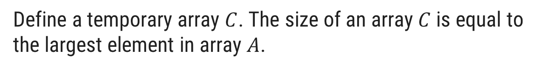
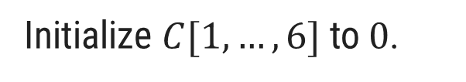
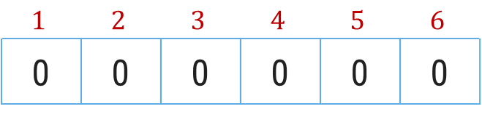
Counting Sort – Example
Sort the following elements in Ascending order using counting sort.
3 | 6 | 4 | 1 | 3 | 4 | 1 | 4 | 2
Step 1
Given elements are stored in an input array $A[1,…,9]$
Index
$$1$$ | $$2$$ | $$3$$ | $$4$$ | $$5$$ | $$6$$ | $$7$$ | $$8$$ | $$9$$
Elements
3 | 6 | 4 | 1 | 3 | 4 | 1 | 4 | 2
Step 2
Define a temporary array $C$. The size of an array$C$is equal to the largest element in array $A$.
Initialize $C[1,…,6] \text{to} 0$.
Index
$$1$$ | $$2$$ | $$3$$ | $$4$$ | $$5$$ | $$6$$
0 | 0 | 0 | 0 | 0 | 0
Elements

Slide 47

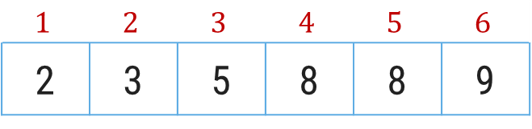
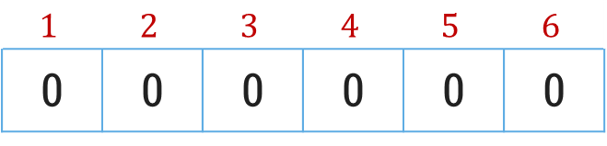
Counting Sort – Example
Sort the following elements in Ascending order using counting sort.
Input array$A$
3 | 6 | 4 | 1 | 3 | 4 | 1 | 4 | 2
Step 3
Update an array C with the occurrences of each value of array 𝐴
Index
$$1$$ | $$2$$ | $$3$$ | $$4$$ | $$5$$ | $$6$$
0 | 0 | 0 | 0 | 0 | 0
Elements
2
1
2
3
0
1
+
+
Step 4
In array 𝐶, from index 2 to 𝑛 add the value with previous element
Index
$$1$$ | $$2$$ | $$3$$ | $$4$$ | $$5$$ | $$6$$
2 | 3 | 5 | 8 | 8 | 9
Elements

Slide 48
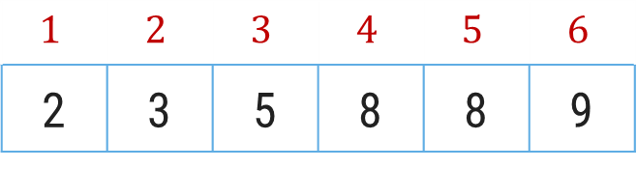
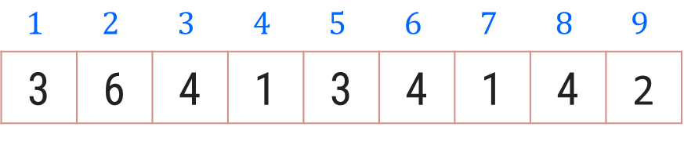

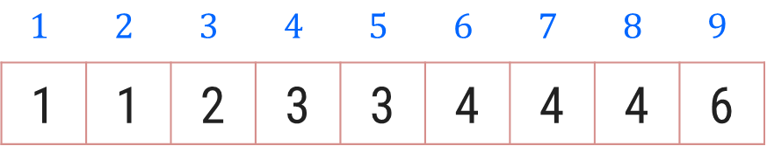
Counting Sort – Example
Create an output array 𝐵[1…9]. Start positioning elements of Array 𝐴 𝑡𝑜 𝐵 as shown below.
$$1$$ | $$2$$ | $$3$$ | $$4$$ | $$5$$ | $$6$$ | $$7$$ | $$8$$ | $$9$$
3 | 6 | 4 | 1 | 3 | 4 | 1 | 4 | 2
Input array$A$
$$1$$ | $$2$$ | $$3$$ | $$4$$ | $$5$$ | $$6$$
2 | 3 | 5 | 8 | 8 | 9
Temporary Array C
1
2
4
6
7
0
3
5
8
$$1$$ | $$2$$ | $$3$$ | $$4$$ | $$5$$ | $$6$$ | $$7$$ | $$8$$ | $$9$$
1 | 1 | 2 | 3 | 3 | 4 | 4 | 4 | 6
Output Array B

Slide 49
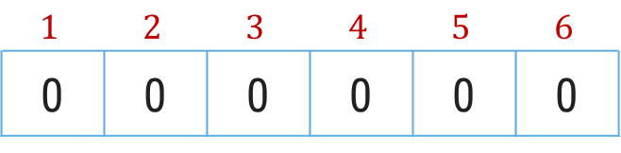
Algorithm: Counting_Sort(A[1,…,n],k)
# Input: Array : A, Largest value from A : k
# Output: Sorted array A
for i ← 1 to k do
c[i] ← 0
for j ← 1 to n do
c[A[j]] ← c[A[j]] + 1
for i ← 2 to k do
c[i] ← c[i] + c[i-1]
for j ← n downto 1 do
B[c[A[j]]] ← A[j]
c[A[j]] ← c[A[j]] - 1
i
$$1$$ | $$2$$ | $$3$$ | $$4$$ | $$5$$ | $$6$$
0 | 0 | 0 | 0 | 0 | 0
C :
j
$$1$$ | $$2$$ | $$3$$ | $$4$$ | $$5$$ | $$6$$ | $$7$$ | $$8$$ | $$9$$
A :
3 | 6 | 4 | 1 | 3 | 4 | 1 | 4 | 2
j = 1
A[j] = 3
c[3] = c[3] + 1
c[3] = 0+1 = 1
i = 2
c[2] = c[2] + c[1]

Slide 50
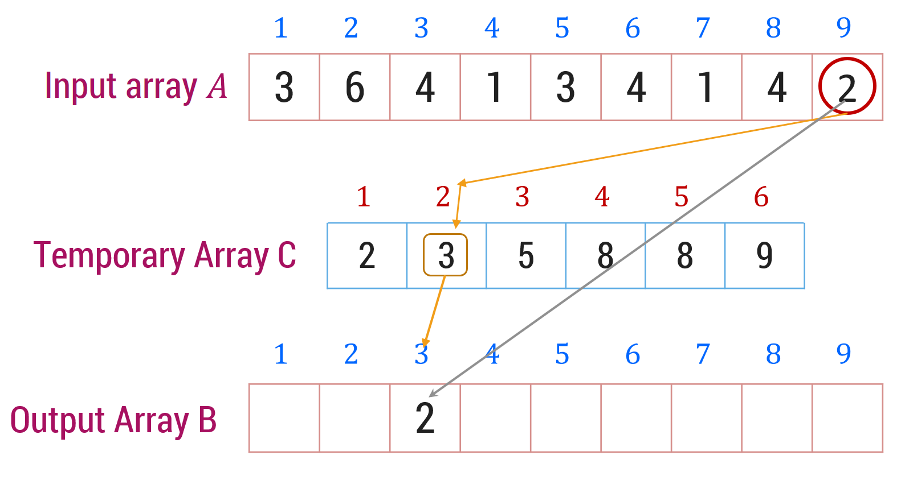
Algorithm: Counting_Sort(A[1,…,n],k)
# Input: Array : A, Largest value from A : k
# Output: Sorted array B
for i ← 1 to k do
c[i] ← 0
for j ← 1 to n do
c[A[j]] ← c[A[j]] + 1
for i ← 2 to k do
c[i] ← c[i] + c[i-1]
for j ← n downto 1 do
B[c[A[j]]] ← A[j]
c[A[j]] ← c[A[j]] - 1
2

Slide 51
Radix Sort

Slide 52
Radix Sort
Radix Sort is a linear sorting algorithm that sorts elements by processing them digit by digit.
It assumes that sorting numbers digit by digit will eventually result in a fully sorted list.
Time complexity of Radix sort is O(n*d), where n is the number of elements in the input array and d is the number of digits in the largest number.

Slide 53
Radix Sort
Find the largest element in the array.
m = getMAx(arr, n) : 788
place = 1 ; 788/1 > 0 : Countsort(arr,7,1)
place = 1 * 10 = 10 ; 788/10 > 0 : Countsort(arr,7,10)
place = 10 * 10 = 100 ; 788/100 > 0 : Countsort(arr,7,100)
place = 100*10 = 1000; 788/1000 < 0
0 | 1 | 2 | 3 | 4 | 5 | 6
121 | 432 | 564 | 23 | 1 | 45 | 788
void radixsort(int arr[], int n)
{
int m = getMax(arr, n);
// Do counting sort for every digit.
for (int place = 1; m / place > 0; place *= 10)
countSort(arr, n, place);
}

Slide 54
Radix Sort
arr[ ] :
0 | 1 | 2 | 3 | 4 | 5 | 6
121 | 432 | 564 | 23 | 1 | 45 | 788
Place = 1
Countsort(arr,7,1)
( 121 / 1 ) % 10
121 % 10 = 1
(432/1) % 10
432 % 10 = 2
(564/1)%10
564 % 10 = 4
(23/1)%10
23 % 10 = 3
(1 / 1)%10
1 % 10 = 1
(45/1)%10
45 % 10 = 5
(788 / 1)%10
788 % 10 = 8
(arr[i]/place)%10
arr[ ] :
0 | 1 | 2 | 3 | 4 | 5 | 6
121 | 432 | 564 | 023 | 001 | 045 | 788
arr[ ] :
0 | 1 | 2 | 3 | 4 | 5 | 6
121 | 001 | 432 | 023 | 564 | 045 | 788

Slide 55
Radix Sort
arr[ ] :
Place = 10
Countsort(arr,7,10)
( 121 / 10 ) % 10
12 % 10 = 2
(1 / 10)%10
0 % 10 = 0
(432/10) % 10
43 % 10 = 3
(23/10)%10
2 % 10 = 2
(564/10)%10
56 % 10 = 6
(45/10)%10
4 % 10 = 4
(788 / 10)%10
78 % 10 = 8
0 | 1 | 2 | 3 | 4 | 5 | 6
121 | 1 | 432 | 23 | 564 | 45 | 788
(arr[i]/place)%10
arr[ ] :
0 | 1 | 2 | 3 | 4 | 5 | 6
121 | 001 | 432 | 023 | 564 | 045 | 788
arr[ ] :
0 | 1 | 2 | 3 | 4 | 5 | 6
001 | 121 | 023 | 432 | 045 | 564 | 788

Slide 56
Radix Sort
arr[ ] :
Place = 100
Countsort(arr,7,100)
(1 / 100)%10
0 % 10 = 0
( 121 / 100 ) % 10
1 % 10 = 1
(23/100)%10
0 % 10 = 0
(432/100) % 10
4 % 10 = 4
(564/100)%10
5 % 10 = 5
(45/100)%10
0 % 10 = 0
(788 / 100)%10
7 % 10 = 7
0 | 1 | 2 | 3 | 4 | 5 | 6
001 | 121 | 023 | 432 | 045 | 564 | 788
(arr[i]/place)%10
arr[ ] :
0 | 1 | 2 | 3 | 4 | 5 | 6
001 | 121 | 023 | 432 | 045 | 564 | 788
arr[ ] :
0 | 1 | 2 | 3 | 4 | 5 | 6
001 | 023 | 045 | 121 | 432 | 564 | 788

Slide 57
Radix Sort
void countSort(int arr[], int n, int place)
{
int output[] = new int[n];
int i;
int count[] = new int[10];
for (i = 0; i < 10; i++)
count[i]=0;
for (i = 0; i < n; i++)
count[(arr[i] / place) % 10]++;
for (i = 1; i < 10; i++)
count[i] += count[i - 1];
for (i = n - 1; i >= 0; i--)
{
output[count[(arr[i] / place) % 10] - 1] = arr[i];
count[(arr[i] / place) % 10]--;
}
for (i = 0; i < n; i++)
arr[i] = output[i];
}

Slide 58
Merge Sort

Slide 59
Merge Sort
The operation of sorting is closely related to process of merging.
Merge Sort is a divide and conquer algorithm.
It is based on the idea of breaking down a list into several sub-lists until each sub list consists of a single element.
Merging those sub lists in a manner that results into a sorted list.
Procedure
Divide the unsorted list into N sub lists, each containing 1 element.
Take adjacent pairs of two singleton lists and merge them to form a list of 2 elements. N will now convert into N/2 lists of size 2.
Repeat the process till a single sorted list of obtained.
Time complexity is O(n log n)

Slide 60
Merge Sort
Unsorted Array
724 | 521 | 2 | 98 | 529 | 31 | 189 | 451
0 | 1 | 2 | 3 | 4 | 5 | 6 | 7
Step 1: Split the selected array (as evenly as possible)
0
1
2
3
4
5
6
7
724
521
2
98
529
31
189
451
724
521
2
98
529
31
189
451
0
1
2
3
4
5
6
7

Slide 61
Merge Sort
Step: Select the left subarray, Split the selected array (as evenly as possible)
0
1
2
3
4
5
6
7
724
521
2
98
529
31
189
451
0
1
2
3
4
5
6
7
724
521
2
98
529
31
189
451
0
1
2
3
4
5
6
7
724
521
2
98
529
31
189
451
521
724
2
98
31
529
189
451
2
98
521
724
31
189
451
529
2
31
98
189
451
521
529
724

Slide 62
Merge Sort
Algorithm: mergesort(low, high)
global array a[low : high]; [having high-low+1 elements]
if low < high then
mid = floor((low + high)/2);
mergesort(low, mid);
mergesort(mid+1, high);
merge(low, mid, high);
end

Slide 63
Algorithm: merge(low, mid, high)
global array a[low : high];
local integer h, i, j, k;
local array b[low : high];
h ← low;
i ← low;
j ← mid+1
while h <= mid and j <= high do
if a[h] <= a[j] then
b[i] ← a[h];
h ← h+1
else
b[i] ← a[j];
j ← j+1
end
i ← i+1
end

Slide 64
[ we should handle any remaining elements]
if h > mid then
for k ← j to high do
b[i] ← a[k];
i ← i+1;
end
else
for k ← h to mid do
b[i] ← a[k];
i ← i+1;
end
end
[copy merged array back to a[] ]
for k ← low to high do
a[k] ← b[k];
end

Slide 65
Quick Sort

Slide 66
Quick Sort
Quick sort is a highly efficient sorting algorithm and is based on partitioning of array of data into smaller arrays.
Quick Sort is divide and conquer algorithm.
At each step of the method, the goal is to place a particular record in its final position within the table.
In doing so all the records which precedes this record will have smaller keys, while all records that follows it have larger keys.
This particular records is termed pivot element.
The same process can then be applied to each of these subtables and repeated until all records are placed in their positions

Slide 67
Quick Sort
There are many different versions of Quick Sort that pick pivot in different ways.
Always pick first element as pivot. (in our case we have consider this version).
Always pick last element as pivot (implemented below)
Pick a random element as pivot.
Pick median as pivot.
Quick sort partitions an array and then calls itself recursively twice to sort the two resulting sub arrays.
This algorithm is quite efficient for large-sized data sets
Its average and worst case complexity are of Ο(n²), where n is the number of items.

Slide 68
Quick Sort
Sort Following Array using Quick Sort Algorithm
We are considering first element as pivot element, so Lower bound is First Index and Upper bound is Last Index
We need to find our proper position of Pivot element in sorted array and perform same operations recursively for two sub array
Pivot
Element
0
1
2
3
4
5
6
7
8
9
42
23
74
11
65
58
94
36
99
87
LB
UB

Slide 69
Quick Sort
FLAG ← true
IF LB < UB
Then
I ← LB
J ← UB + 1
KEY ← K[LB]
Repeat While FLAG = true
I ← I+1
Repeat While K[I] < KEY
I ← I + 1
J ← J – 1
Repeat While K[J] > KEY
J ← J – 1
IF I<J
Then K[I] ←---→ K[J]
Else FLAG ← FALSE
K[LB] ←---→ K[J]
0
1
2
3
4
5
6
7
8
9
42
23
74
11
65
58
94
36
99
87
I
J
Swap
42
23
74
36
11
65
58
94
36
74
99
87
I
J
Swap
42
11
23
36
11
42
65
58
94
74
99
87
I
J
LB = 0, UB = 9
KEY = 42
I=
0
J=
10
FLAG=
true

Slide 70
Quick Sort
FLAG ← true
IF LB < UB
Then
I ← LB
J ← UB + 1
KEY ← K[LB]
Repeat While FLAG = true
I ← I+1
Repeat While K[I] < KEY
I ← I + 1
J ← J – 1
Repeat While K[J] > KEY
J ← J – 1
IF I<J
Then K[I] ←---→ K[J]
Else FLAG ← FALSE
K[LB] ←---→ K[J]
LB
UB
0
1
2
3
4
5
6
7
8
9
11
23
36
42
65
58
94
74
99
87
11
11
23
36
I
J
LB
UB
11
23
36
42
65
58
94
74
99
87
23
23
36
I
J
LB
UB
11
23
36
36
42
65
58
94
74
99
87

Slide 71
Quick Sort
FLAG ← true
IF LB < UB
Then
I ← LB
J ← UB + 1
KEY ← K[LB]
Repeat While FLAG = true
I ← I+1
Repeat While K[I] < KEY
I ← I + 1
J ← J – 1
Repeat While K[J] > KEY
J ← J – 1
IF I<J
Then K[I] ←---→ K[J]
Else FLAG ← FALSE
K[LB] ←---→ K[J]
UB
LB
4
5
6
7
8
9
11
23
36
42
65
58
94
72
99
87
Swap
65
65
58
58
65
94
72
99
87
I
J
LB
UB
65
65
58
58
65
94
72
99
87
LB
UB
11
23
36
42
65
65
58
65
94
72
99
87

Slide 72
Quick Sort
FLAG ← true
IF LB < UB
Then
I ← LB
J ← UB + 1
KEY ← K[LB]
Repeat While FLAG = true
I ← I+1
Repeat While K[I] < KEY
I ← I + 1
J ← J – 1
Repeat While K[J] > KEY
J ← J – 1
IF I<J
Then K[I] ←---→ K[J]
Else FLAG ← FALSE
K[LB] ←---→ K[J]
LB
UB
Swap
94
94
72
99
87
87
99
I
J
Swap
94
94
87
72
87
94
99
I
J
LB
UB
Swap
87
87
72
72
87
94
99
I
J
LB
LB
UB
UB
11
23
36
42
58
65
72
72
87
94
99
99

Slide 73
Algorithm: QUICK_SORT(K,LB,UB)
1. [Initialize]
FLAG ← true
2. [Perform Sort]
IF LB < UB
Then I ← LB
J ← UB + 1
KEY ← K[LB]
Repeat While FLAG = true
I ← I+1
Repeat While K[I] < KEY
I ← I + 1
J ← J – 1
Repeat While K[J] > KEY
J ← J – 1
IF I<J
Then K[I] ←---→ K[J]
Else FLAG ← FALSE
K[LB] ←---→ K[J]
CALL QUICK_SORT(K,LB, J-1)
CALL QUICK_SORT(K,J+1, UB)
3. [Finished]
Return

Slide 74
Heap Sort

Slide 75
Heap Sort
Heap sort is a comparison-based sorting algorithm.
It is known for its efficiency and is particularly suited for large datasets.
Heap sort uses a data structure called a binary heap.
The time complexity of heap sort is O(n log n) in all three cases (best case, average case, and worst case).

Slide 76
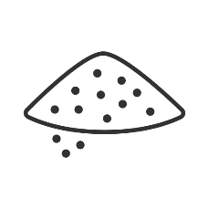
What is Heap?
It is a data structure which is a complete binary tree.
All the levels are completely filled except the last level.
Heap has some order of values to be maintained between parents and their children.
There are 2 variations of heap possible:
MIN HEAP
Here the value of parent is always less than the value of its children
Hence root will be the minimum in the entire heap
MAX HEAP
Here the value of parent is always more than the value of its children
Hence root will be the maximum in the entire heap

Slide 77
What is Heap sort?
It is one of the efficient sorting algorithm based on heap data structure
Here the given array to be sorted is assumed to be a heap
So for i^{th} index
The left child will become the element present at the 2*i+1 index in the array
The right child will become the element present at the 2*i+2 index in the array
Parent of the i^{th} index will be element present at (i-1)/2 index in the array

Slide 78

Heap Sort – Example
Sort the following elements in Ascending order
4 | 10 | 3 | 5 | 1
Step 1 : Create Complete Binary Tree
4
$$0$$ | $$1$$ | $$2$$ | $$3$$ | 4
4 | 10 | 3 | 5 | 1
10
3
Now, a binary tree is created and we have to convert it into a Heap.
5
1

Slide 79

Heap Sort – Example
Sort the following elements in Ascending order
4 | 10 | 3 | 5 | 1
Step 2 : Create Max Heap
4
10
10 is greater than 4
So, swap 10 & 4
$$0$$ | $$1$$ | $$2$$ | $$3$$ | $$4$$
4 | 10 | 3 | 5 | 1
10
4
10
3
4
Swap
In a Max Heap, parent node is always greater than or equal to the child nodes.
5
1

Slide 80
Heap Sort – Example
Sort the following elements in Ascending order
4 | 10 | 3 | 5 | 1
Step 2 : Create Max Heap
10
5 is greater than 4
So, swap 5 & 4
$$0$$ | $$1$$ | $$2$$ | $$3$$ | $$4$$
10 | 4 | 3 | 5 | 1
5
4
4
3
5
Swap
In a Max Heap, parent node is always greater than or equal to the child nodes.
5
1
4
Max Heap is created

Slide 81

Heap Sort – Example
Sort the following elements in Ascending order
4 | 10 | 3 | 5 | 1
Step 3 : Apply Heap Sort
10
1
$$0$$ | 1 | $$2$$ | $$3$$ | $$4$$
10 | 5 | 3 | 4 | 1
1
10
5
3
Swap
Swap the first and the last nodes and
Delete the last node.
4
1
10

Slide 82
Heap Sort – Example
Sort the following elements in Ascending order
4 | 10 | 3 | 5 | 1
Step 3 : Apply Heap Sort
1
5
Max Heap Property is violated so, create a Max Heap again.
$$0$$ | $$1$$ | $$2$$ | $$3$$ | $$4$$
1 | 5 | 3 | 4 | 10
5
1
1
4
5
3
1
4
Swap
4
1

Slide 83

Heap Sort – Example
Sort the following elements in Ascending order
4 | 10 | 3 | 5 | 1
Step 3 : Apply Heap Sort
5
1
Max Heap is created
$$0$$ | $$1$$ | 2 | $$3$$ | $$4$$
5 | 4 | 3 | 1 | 10
1
5
4
3
Swap
Swap the first and the last nodes and
Delete the last node.
1
5

Slide 84
Heap Sort – Example
Sort the following elements in Ascending order
4 | 10 | 3 | 5 | 1
Step 3 : Apply Heap Sort
1
Create Max Heap again
3
4
$$0$$ | $$1$$ | $$2$$ | $$3$$ | $$4$$
1 | 4 | 3 | 5 | 10
4
1
4
3
Max Heap is created
4
3
1
4
Swap
Swap the first and the last nodes and
Delete the last node.

Slide 85
Heap Sort – Example
Sort the following elements in Ascending order
4 | 10 | 3 | 5 | 1
Step 3 : Apply Heap Sort
3
Already a Max Heap
1
$$0$$ | $$1$$ | $$2$$ | $$3$$ | $$4$$
3 | 1 | 4 | 5 | 10
1
3
1
3
Swap
Swap the first and the last nodes and
Delete the last node.

Slide 86
Heap Sort – Example
Sort the following elements in Ascending order
4 | 10 | 3 | 5 | 1
Step 3 : Apply Heap Sort
1
Already a Max Heap
$$0$$ | $$1$$ | $$2$$ | $$3$$ | $$4$$
1 | 3 | 4 | 5 | 10
1
Remove the last element from heap and the sorting is over.

Slide 87
What is Heap sort?
Heapsort(arr)
{
buildMaxHeap(arr)
for (int i = n - 1; i >= 0; i--)
{
swap(&arr[0], &arr[i]);
heapify(arr,i,0);
}
}

Slide 88
What is Heap sort?
There are 2 major operations which are responsible for maintaining the heap
Build MAXHEAP or MINHEAP:
This is the first function which is called to build the heap
It starts from the last parent in the tree because that is the first instance where the order may get disturbed
So it iterates from i=n/2-1 to 0 and call heapify on every parent
buildMaxHeap(arr)
for(int i = n / 2 - 1; i >= 0; i--)
heapify(arr, n, i);

Slide 89
What is Heap sort?
There are 2 major operations which are responsible for maintaining the heap
Heapify:
If we are dealing with the max heap, it will find the index having max value among the node and its children
If the index holding max value is not the parent, it will swap the parent with the child having the max value

Slide 90
What is Heap sort?
heapify(arr , n, i) (i is the parent index)
maxIndex = i;
leftChild = 2*i + 1;
rightChild = 2*i + 2;
if( leftChild<n && arr[leftChild] > arr[maxIndex])
maxIndex = leftChild;
if( rightChild<n && arr[rightChild] > arr[maxIndex])
maxIndex = rightChild;
if(i != maxIndex)
swap(arr[i], arr[maxIndex])
heapify(arr, n, maxIndex) //heapify the affected sub-tree recursively

Slide 91
Bucket Sort

Slide 92
Bucket Sort
Technique that involves dividing elements into various groups or bucket.
This bucket are formed by uniformly distributing the elements
Once the elements are divided into buckets , they can be sorted using one other sorting algorithm like insertion sort
Time Complexity for best and average cases is O(n+k), and for worst cases is O(n²). Here n is total no. of elements and k is the no. of the bucket.
Commonly used
With floating point values
When input is distributed uniformly over a range

Slide 93
Bucket Sort Cont.
Unsorted Array
0.79
0.13
0.64
0.72
0.20
0.25
0.17
0.78
0.45
0.56
0.58
0.23
0.68
Step 1 :
Take 10 buckets
0
1
2
3
4
5
6
7
8
9

Slide 94
Bucket Sort Cont.
Input array:
0.79
0.13
0.64
0.72
0.20
0.25
0.17
0.78
0.45
0.56
0.58
0.23
0.68
Step 2 :
now multiply elements of the array by 10(size of Input array) and insert that element in bucket of index of element’s integer number
0
1
2
3
4
5
6
7
8
9
0.79*10 = 7.9 so insert 0.79 to the bucket of index 7
0.13
0.13*10 = 1.3 so insert 0.13 to the bucket of index 1
0.64*10 = 6.4 so insert 0.64 to the bucket of index 6
0.64
0.79

Slide 95
Bucket Sort Cont.
Input array:
0.79
0.13
0.64
0.72
0.20
0.25
0.17
0.78
0.45
0.56
0.58
0.23
0.68
Step 3 :
If there is two number in one bucket then we have apply insertion sort internally
0
1
2
3
4
5
6
7
8
9
Here we have 0.72 which goes to bucket number 7 so we have to apply insertion sort between 0.79 and 0.72
0.13
0.64
0.72
0.79
0.79
0.72

Slide 96
Bucket Sort Cont.
Input array:
0.79
0.13
0.64
0.72
0.20
0.25
0.17
0.78
0.45
0.56
0.58
0.23
0.68
0
1
2
3
4
5
6
7
8
9
0.20*10 = 2.0 so 0.20 goes into bucket number 2
0.13
0.17
0.25*10 = 2.5 so 0.25 goes into bucket number 2
0.20
0.25
0.17*10 = 1.7 so 0.17 goes into bucket number 1 and have to apply insertion sort between 0.17 and 0.13
0.45
0.78*10 = 7.8 so 0.78 goes into bucket number 7 and we have to apply insertion sort between 0.78 and 0.79
0.64
0.45*10 = 4.5 so 0.45 goes into bucket number 4
0.72
0.78
0.79
0.79
0.78

Slide 97
Bucket Sort Cont.
Input array:
0.79
0.13
0.64
0.72
0.20
0.25
0.17
0.78
0.45
0.56
0.58
0.23
0.68
0
1
2
3
4
5
6
7
8
9
0.56*10 = 5.6 so 0.56 goes into bucket number 5
0.13
0.17
0.58*10 = 5.8 so 0.58 goes into bucket number 5 and we have to apply insertion sort between 0.56 and 0.58
0.20
0.23
0.25
0.25
0.23
0.23*10 = 2.3 so 0.23 goes into bucket number 2 and we have to apply insertion sort between 0.25 and 0.23
0.45
0.56
0.58
0.64
0.68
0.68*10 = 6.8 so 0.68 goes into bucket number 6 and we have to apply insertion sort between 0.68 and 0.64
0.72
0.78
0.79
0.13 | 0.17 | 0.20 | 0.23 | 0.25 | 0.45 | 0.56 | 0.58 | 0.64 | 0.68 | 0.72 | 0.78 | 0.79

Slide 98
Bucket Sort
BucketSort(a[], n)
Create 'n' empty buckets
Do for each array element a[i]
Put array elements into buckets, i.e. insert a[i] into bucket[n*a[i]]
Sort the elements of individual buckets by using the insertion sort
At last, gather or concatenate the sorted buckets
End BucketSort

Slide 99
Sorting on multiple keys

Slide 100
Sorting with Multiple Keys
Thus far, we have been considering sorting depend on single keys. However, in real life applications, we may desire to sort the data on several keys.
Let assume, We have some key K1, K2, K3 . . .
Process :-
Sort data with key K1,
If K1 is same for a part of data then sort that particular part with key K2,
If K1 & K2 is same for a part of data then sort that particular part with key K3,
Continue so on . . .

Slide 101
Sorting with Multiple Keys Cont.
Use Selection Sort for sorting .
First sort data by key K1
K1 | K2 | K3
K1 | K2 | K3
K1 | K2 | K3
K1 | K2 | K3
0
5
4
6
0
-5
0
3
0
-5
0
3
0
-5
0
3
1
5
4
18
1
5
4
18
1
5
4
18
1
5
4
18
Swap
2
10
4
1
2
10
4
1
2
10
4
1
2
5
4
6
Unsorted Array (elements 0 to 5)
Swap
3
-5
0
3
3
5
4
6
3
5
4
6
3
10
4
1
Unsorted Array (elements 1 to 5)
Unsorted Array
4
15
-6
9
4
15
-6
9
4
15
-6
9
4
15
-6
9
Unsorted Array
5
10
3
2
5
10
3
2
5
10
3
2
5
10
3
2

Slide 102
Sorting with Multiple Keys Cont.
K1 | K2 | K3
K1 | K2 | K3
K1 | K2 | K3
K1 | K2 | K3
0
-5
0
3
0
-5
0
3
0
-5
0
3
0
-5
0
3
1
5
4
18
1
5
4
18
1
5
4
6
1
5
4
18
K1(1) == K1(2)
K2(1) == K2(2)
K3(1) > K3(2)
Swap
2
5
4
6
2
5
4
6
2
5
4
18
2
5
4
6
3
10
4
1
3
10
4
1
3
10
4
1
3
10
3
2
K1(3) == K1(4)
K2(3) > K2(4)
Swap
4
15
-6
9
4
10
3
2
4
10
3
2
4
10
4
1
Swap
Unsorted Array
5
10
3
2
5
15
-6
9
5
15
-6
9
5
15
-6
9
Sorted data with Multiple Key

Slide 103

Data Structure (DS)
#2301CS301
Prof. Shruti Maniar
Computer Engineering Department
shruti.maniar@darshan.ac.in
+91 97277 47317 (CE Department)

