Slide 1


Unit-01 HTML
Web Technology-I
DU#2301CS363
Prof. Dharmik P Vasiyani
Computer Engineering Department
dharmik.vasiyani@darshan.ac.in
9924664064

Slide 2

Outline HTML
Introduction to HTML
What is a Web Page?
My First HTML Page
HTML Code Formatting
Basic HTML Tags
Heading
Paragraph
Color
Font
List
Anchor
Image
HTML Tables
HTML Meta tags
HTML Formatting Tags
HTML Forms
Introduction to HTML5
Semantic Elements of HTML5
HTML 5 tags and validation
Fieldset and Legend
Media tags
Looping

Slide 3
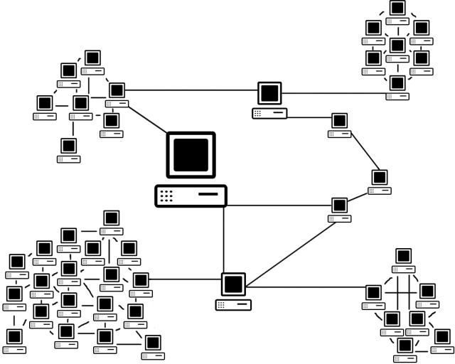
What is Internet?
The Internet is a massive network of networks, a networking infrastructure.
It connects millions of computers together globally, forming a network in which any computer can communicate with any other computer as long as they are both connected to the Internet.
Information that travels over the Internet uses many different set of rules which are known as protocols.

Slide 4
What is WWW?
WWW stands for World Wide Web.
A technical definition of the WWW is − All the resources and users on the Internet that are using HTTP.
HTTP stands for Hypertext Transfer Protocol which is a text-based request-response protocol.
HTTP is an application layer protocol that allows web-based applications to communicate and exchange the data.
HTTP is a TCP/IP based protocol, so it also is a connectionless and stateless protocol.
After making the request, the client disconnects from the server, then when the response is ready the server re-establish the connection again and deliver the response.
HTTP is the protocol being used to transfer hypertext documents that makes the World Wide Web possible.

Slide 5
What is a Web Page?
A web page or webpage is a document, commonly written in HTML, that is viewed in an Internet browser.
HTML – Hyper Text Markup Language is the notation for describing
document structure (semantic markup)
formatting (presentation markup)
A web page can be accessed by entering a URL address into a browser's address bar.
A web page may contain text, graphics, and hyperlinks to other web pages and files.
The first web page was created at CERN by Tim Berners-Lee on August 6, 1991.
You can visit and browse the first website and the first web page at the info.cern.ch address.

Slide 6



How the Web Works?
World Wide Web (WWW) use classical client / server architecture.
Server running Web Server Software (Apache, IIS, Tomcat, etc.)
Client running a Web Browser
HTTP
Page request
HTTP
Server response

Slide 7
HTTP request
The HTTP request message consist of following,
A request line (e.g. GET /index.php HTTP1.1)
Request header fields (e.g. Accept-Language: en)
An empty line (CRLF)
An optional message body
The request line and other header fields must end with CRLF (Carriage return, Line Feed) (/r/n)
A request line contains the method of request followed by the resource we want and at the end protocol version used.
HTTP Request Methods: GET, POST, PUT, DELETE etc...
There are many request header fields available with HTTP Request, some of are listed below
Accept : Media type(s) that is/are acceptable for the response. (e.g. Accept: text/html)
Accept-Charset: Character sets that are acceptable. (e.g. Accept-Charset: utf-8)
Date: The date and time at which the message was originated (e.g. Date: Tue, 15 Nov 1994 08:12:31 GMT)
Host: The domain name of the server (e.g. Host: darshan.ac.in)
User-Agent: details of the browser used (e.g. User-Agent: Mozilla/5.0 (Windows NT 10.0; Win64; x64) AppleWebKit/537.36 (KHTML, like Gecko) Chrome/88.0.4324.150 Safari/537.36)

Slide 8
HTTP Request (Example)
GET /index.php HTTP/1.1 |  | index.php is requested from server using GET method of HTTP version 1.1
User-Agent: Mozilla/5.0 (Windows NT 10.0; Win64; x64) AppleWebKit/537.36 (KHTML, like Gecko) Chrome/88.0.4324.150 Safari/537.36 |  | Version 5.0 of mozila browser is used on windows 10 (64 bit) while requesting the page from the server.
Host: www.darshan.ac.in |  | Host of the requested page is www.darshan.ac.in
Accept-Language: en-us |  | Client accepts US English locale while receiving the response from the server.
Accept: text/html |  | Client accepts text file containing the HTML in it while receiving the response from the server.

Slide 9
HTTP Response
After receiving and interpreting a HTTP request message, a server responds with an HTTP response message.
The HTTP response message consist of following,
Status-Line (format= HTTP-Version SP Status-Code SP Reason-Phrase CRLF)
*(( general-header | response-header | entity-header ) CRLF)
An empty line (CRLF)
An optional message body
Status-Line consist of
HTTP-Version, which can be HTTP/1.1
Status-Code is a 3 digit code which is in below format
1xx: Informational - Request received, continuing process
2xx: Success - The action was successfully received, understood, and accepted
3xx: Redirection - Further action must be taken in order to complete the request
4xx: Client Error - The request contains bad syntax or cannot be fulfilled
5xx: Server Error - The server failed to fulfill an apparently valid request
Reason-Phase is a textual representation of the status code in human readable format.

Slide 10
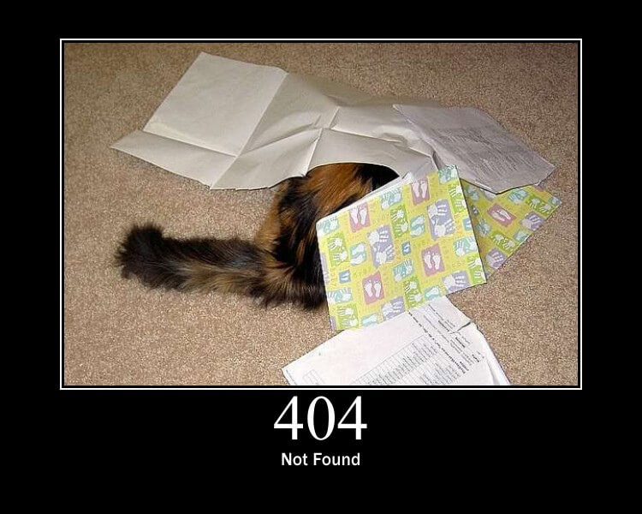
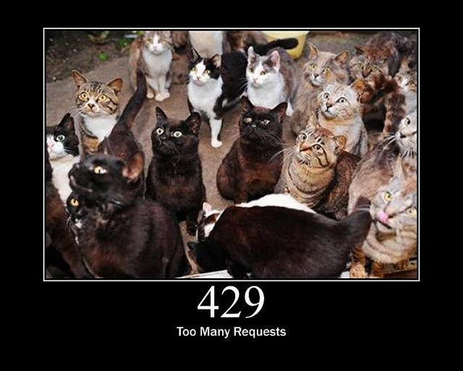
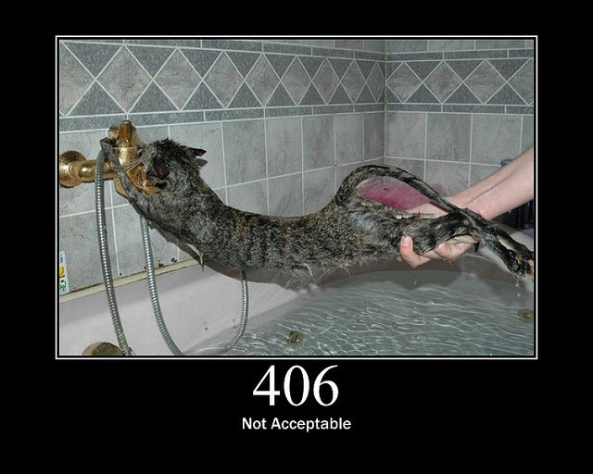
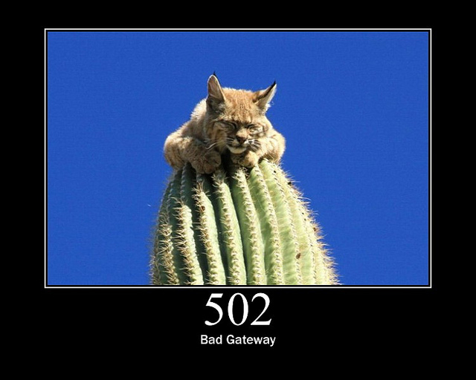
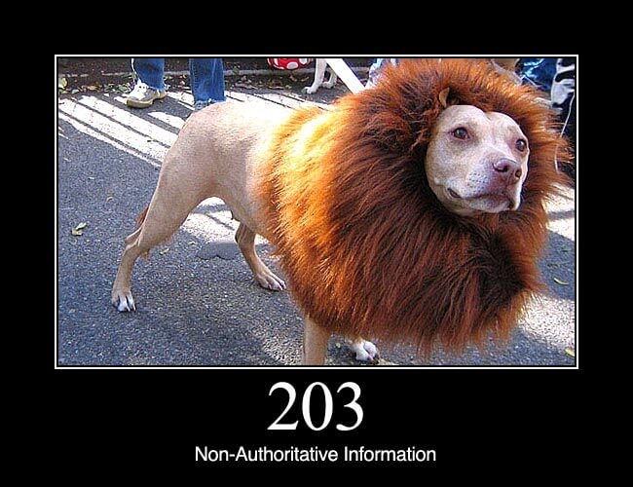
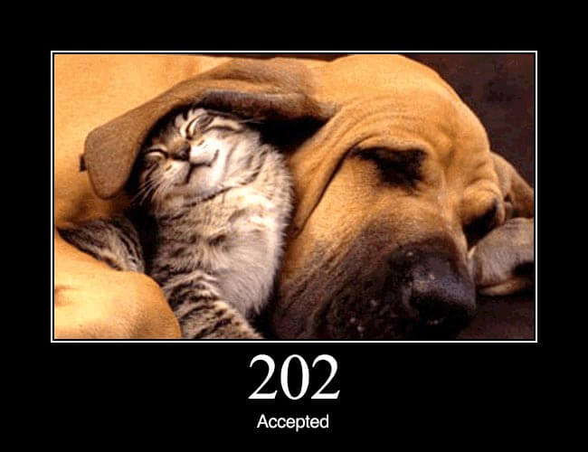
HTTP Status Codes with reason phrase
"100": Continue
"101": Switching Protocols
"200": OK
"201": Created
"202": Accepted
"203": Non-Authoritative Information
"204": No Content
"205": Reset Content
"206": Partial Content
"300": Multiple Choices
"301": Moved Permanently
"302": Found
"303": See Other
"304": Not Modified
"305": Use Proxy
"307": Temporary Redirect
"400": Bad Request
"401": Unauthorized
"402": Payment Required
"403": Forbidden
"404": Not Found
"405": Method Not Allowed
"406": Not Acceptable
"407": Proxy Authentication Required
"408": Request Time-out
"409": Conflict
"410": Gone
"411": Length Required
"412": Precondition Failed
"413": Request Entity Too Large
"414": Request-URI Too Large
"415": Unsupported Media Type
"416": Requested range not satisfiable
"417": Expectation Failed
"500": Internal Server Error
"501": Not Implemented
"502": Bad Gateway
"503": Service Unavailable
"504": Gateway Time-out
"505": HTTP Version not supported
Refer: https://www.w3.org/Protocols/rfc2616/rfc2616-sec6.html for more details on HTTP Status Code

Slide 11
HTTP Response (Example)
HTTP/1.1 200 OK |  | Response is 200 status code with OK message using HTTP1.1
Date: Mon, 27 Jul 2009 12:28:53 GMT |  | Response Date & Time
Server: Apache/2.2.14 (Win32) |  | Webserver used by server is Apache and version is 2.2.14 built for 32bit OS
Last-Modified: Wed, 22 Jul 2009 19:15:56 GMT |  | Last modified at Date & Time.
Content-Length: 88 |  | Content size of the response is 88 bytes
Content-Type: text/html |  | Content type of the response is text file containing HTML

Slide 12
Introduction to Web Technologies
HTML
HTML stands for Hypertext Markup Language.
It is used to design the front-end portion of web pages using a markup language.
HTML is the combination of Hypertext and Markup language. Hypertext defines the link between the web pages. The markup language is used to define the text documentation within the tag which defines the structure of web pages.
CSS
Cascading Style Sheets fondly referred to as CSS is a simply designed language intended to simplify the process of making web pages presentable.
CSS allows you to apply styles to web pages.
More importantly, CSS enables you to do this independent of the HTML that makes up each web page.
JavaScript
JavaScript is a famous scripting language used to create magic on the sites to make the site interactive for the user.
It is used to enhancing the functionality of a website to running cool games and web-based software.

Slide 13
Introduction to Web Technologies (Cont.)
Bootstrap
Bootstrap is the most popular HTML, CSS, and JavaScript framework for developing responsive, mobile-first websites.
Bootstrap is completely free to download and use! The primary purpose of adding it to a web project is to apply Bootstrap's choices of color, size, font and layout to that project.
As such, the primary factor is whether the developers in charge find those choices to their liking.
Once added to a project, Bootstrap provides basic style definitions for all HTML elements.
Material Design
Material is a design system created by Google to help teams build high-quality digital experiences for Android, iOS, Flutter, and the web.
Material Design is inspired by the physical world and its textures, including how they reflect light and cast shadows.

Slide 14
Creating HTML Pages
An HTML file must have an .htm or .html file extension
HTML files can be created with text editors:
NotePad, NotePad ++, PSPad
Or HTML editors (WYSIWYG Editors):
Microsoft FrontPage
Macromedia Dreamweaver
Netscape Composer
Visual Studio
Open any above mentioned editors and create a new file with .html extension and save the file.
After saving the file you can open the file with any Web Browser in order to view the output.

Slide 15
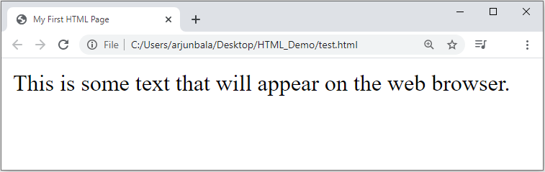
First HTML Page
test.html
<!DOCTYPE HTML>
<html>
<head>
<title>My First HTML Page</title>
</head>
<body>
<p>This is some text...</p>
</body>
</html>

Slide 16
HTML Structure
HTML is comprised of “elements” and “tags”
Begins with <html> and ends with </html>
Elements (tags) are nested one inside another:
Tags have attributes:
HTML describes structure using two main sections: <head> and <body>
The HTML source code should be formatted to increase readability and facilitate debugging.
Every block element should start on a new line.
Every nested (block) element should be indented.
Browsers ignore multiple whitespaces in the page source, so formatting is harmless.
For performance reasons, formatting can be sacrificed
<html> <head></head> <body></body> </html>
<img src="logo.jpg" alt="logo" />

Slide 17
First HTML Page
HTML header
<!DOCTYPE HTML>
<html>
<head>
<title>My First HTML Page</title>
</head>
<body>
<p>This is some text...</p>
</body>
</html>
Opening tag
Closing tag
HTML body

Slide 18
Basic HTML Tags
Headings
Paragraph
Fonts
List
Anchor Tag
Image
Table
Form

Slide 19
Headings
Headings are important because search engines use the headings to index the structure and content of your web pages.
<h1> text </h1> -- largest of the six
<h2> text </h2>
<h3> text </h3>
<h4> text </h4>
<h5> text </h5>
<h6> text </h6> -- smallest of the six
align="position" --left (default), center or right

Slide 20
<p> paragraph
The HTML <p> element represents a paragraph.
Paragraphs are usually represented in visual media as blocks of text separated from adjacent blocks by blank lines and/or first-line indentation, but HTML paragraphs can be any structural grouping of related content, such as images or form fields.
Paragraphs are block-level elements, and notably will automatically close if another block-level element is parsed before the closing </p> tag.
We can use align attribute of the paragraph tag to specify the text alignment for the text inside the paragraph, ex. <p align=“center”>our test</p>

Slide 21
Colors
We can use color values for mainly two attributes named bgcolor and color.
Possible values for the color are,
many are predefined (red, blue, green, ...)
all colors can be specified as a six character hexadecimal value: #RRGGBB
#FF0000 – red
#888888 – gray
#00FF00 –green
#000000 – black
For example, <body bgcolor=“#FF0000”> or <body bgcolor=“#888888”>

Slide 22
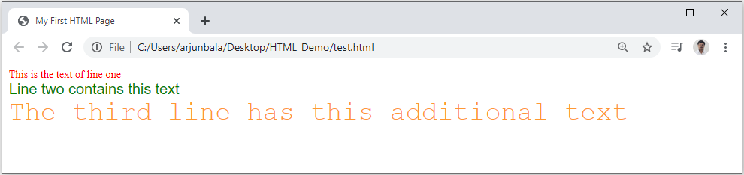
Fonts
The <font> tag specifies the font face, font size, and color of text.
The <font> tag is not supported in HTML5.
<font color="red" size="2" face="Times Roman">
This is the text of line one
</font>
<br/>
<font color="green" size="4" face="Arial">
Line two contains this text
</font>
<br/>
<font color="#FF9933" size="6" face="Courier">
The third line has this additional text
</font>

Slide 23
List
Ordered List
Block-A
Block-B
Block-C
Block-D
Unordered List
Block-A
Block-B
Block-C
Block-D
Defination List
Block-A
Block-B
Block-C
Block-D
Block-A
Block-B
Block-C
Block-D
Block-A
Block-B
Block-C
Block-D
Block-A
Block-B
Block-C
Block-D
Block-A
Block-B
Block-C
Block-D
Block-A
Block-B
Block-C
Block-D
HTML
Hyper Text Markup Language
WWW
World Wide Web

Slide 24
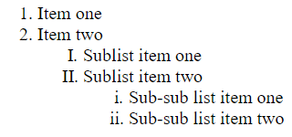
Ordered List (OL)
<ol>
<li> Item one </li>
<li> Item two </li>
<ol type="I">
<li> Sublist item one </li>
<li> Sublist item two </li>
<ol type="i">
<li> Sub-sub list item one </li>
<li> Sub-sub list item two </li>
</ol>
</ol>
</ol>
Types:
Type = 1 (default)
Type = a
Type = A
Type = I
Type = i
Output

Slide 25
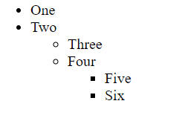
Unordered List (UL)
<ul>
<li> One </li>
<li> Two </li>
<ul type="circle">
<li> Three </li>
<li> Four </li>
<ul type="square">
<li> Five </li>
<li> Six </li>
</ul>
</ul>
</ul>
Types:
Type = disc (default)
Type = circle
Type = square
Output

Slide 26
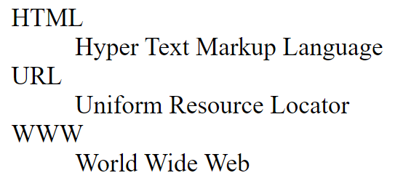
Definition / Description List (DL)
<dl>
<dt>HTML</dt>
<dd>Hyper Text Markup Language</dd>
<dt>URL</dt>
<dd>Uniform Resource Locator</dd>
<dt>WWW</dt>
<dd>World Wide Web</dd>
</dl>
Output

Slide 27
<a> Anchor Tag (Hyperlinks)
The <a> tag defines a hyperlink, which is used to link from one page to another.
An Anchor tag have 3 important attributes:
the href attribute (hypertext reference) defines the target address of the document.
the name attribute of the anchor tag can be used to enable users to “jump” to a specific point on a page.
the target attribute specifies how the destination page or the target document should be opened. target="_ blank" is used for opening of the target page in a new tab.
Link to an absolute URL:
Example, <a href="http://www.darshan.ac.in"> Darshan </a>.
Link to a relative URL:
Example, <a href=“./index.php"> Home </a>.
Link to a section within a URL:
Example, <a href=“#reference"> Reference Section. </a>.

Slide 28
Images
The HTML <img> element embeds an image into the document.
Syntax: <img src= "pathToImage" />
Attributes:
the src attribute is required, and contains the path to the image we want to embed.
the alt attribute holds a text description of the image, which isn't mandatory but is incredibly useful for accessibility (screen readers read this description out to their users so they know what the image means). Alt text is also displayed on the page if the image can't be loaded for some reason: for example, network errors, content blocking etc…
the width & height attribute can be in units of pixels or percentage of page or frame.
the align attribute (currently deprecated) will aligns the image with its surrounding context (Use the float and/or vertical-align CSS properties instead of this attribute).

Slide 29
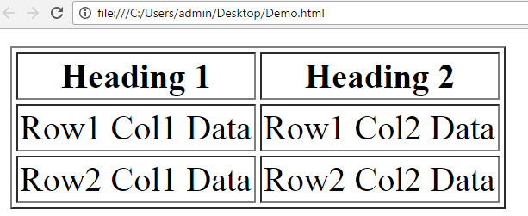
Table
<table border=1>
<caption>Table Caption</caption>
<tr>
<th>Heading1</th>
<th>Heading2</th>
</tr>
<tr>
<td>Row1 Col1 Data</td>
<td>Row1 Col2 Data</td>
</tr>
<tr>
<td>Row2 Col1 Data</td>
<td>Row2 Col2 Data</td>
</tr>
</table>
<table> table tag
<caption> optional table title
<tr> table row
<th> table header
<td> table data element
Output

Slide 30
META Tag
Metadata is data (information) about data.
The <meta> tag provides metadata about the HTML document.
Metadata will not be displayed on the page.
Meta elements are typically used to specify page description, keywords, author of the document, last modified and other metadata.
The metadata can be used by search engines (keywords), browsers (how to display content or reload page) or other web services.
Meta tag can be used to stop the page from being listed by search engines.
It can be used to set an expiry date so that the browser will fetch fresh copy from the server.
Meta tag can be used to stop the browser from caching a page.
1
<meta name="robots" content="noindex">
1
<meta http-equiv="expires" content=" Tue, 08 feb 2022 1:00:00 GMT">
1
<meta http-equiv="Cache-Control" content="no-store">

Slide 31
Meta Tag Attributes
Attribute | Value | Description
charset | character_set | Specifies the character encoding for the HTML document
name | author description keywords robots expires | Specifies a name for the metadata
http-equiv | content-type default-style refresh | Provides an HTTP header for the information/value of the content attribute
content | text | Gives the value associated with the http-equiv or name attribute
scheme | format/URI USA/Europe | Not supported in HTML5. Specifies a scheme to be used to interpret the value of the content attribute

Slide 32
HTML Formatting Tags
Tags | Description
<b> | Defines bold text
<i> | Defines italic text
<small> | Defines smaller text
<strong> | Defines important text
<sub> | The <sub> tag defines subscript text. Subscript text appears half a character below the baseline. Subscript text can be used for chemical formulas, like H₂O.
<sup> | The <sup> tag defines superscript text. Superscript text appears half a character above the baseline. Superscript text can be used for footnotes, like ^{WWW}
<mark> | Defines Highlighted text
<del> | Defines deleted text
<em> | Defines emphasized text
<tt> | The <tt> tag defines teletype text
<blink> | The <blink> tag is used for blinking the text.

Slide 33
HTML Forms
HTML forms are used to create GUIs on Web pages
Usually the purpose is to ask the user for information
The information is then sent back to the server
A form is an area that can contain form elements
The syntax is: <form parameters> ...form elements... </form>
Form elements include: buttons, checkboxes, text fields, radio buttons, drop-down menus, etc
Other kinds of HTML tags can be mixed in with the form elements
A form usually contains a Submit button to send the information in the form elements to the server
The form’s parameters tell browser how to send the information to the server (there are two different ways it could be sent)

Slide 34
The <form> Tag
The <form arguments> ... </form> tag encloses form elements (and probably other HTML as well)
The arguments to form tell what to do with the user input
action="url" (required)
Specifies where to send the data when the Submit button is clicked
method="get" (default)
Form data is sent as a URL with ?form_data info appended to the end
Can be used only if data is all ASCII and not more than 100 characters
method="post"
Form data is sent in the body of the URL request
Cannot be bookmarked by most browsers
target="target"
Tells where to open the page sent as a result of the request
target= _blank means open in a new window
target= _top means use the same window

Slide 35
Form Elements
Input
Select
Textarea
Button
Label
Fieldset
Legend
Etc…
Input Types (HTML4)
text
password
checkbox
radio
submit
button
reset
file
Input Types (HTML5)
number
email
search
url
tel
range
color
date
time
datetime-local
month
week

Slide 36
Introduction to HTML5
It stands for Hypertext markup language version 5.
HTML5 is the latest version of HTML.
HTML5 is cooperation between the World Wide Web Consortium (W3C) and the Web Hypertext Application Technology Working Group (WHATWG).
What is new in HTML5?
Support multimedia without flash player.
So, we can include audio, video in our web page without installing flash player.
We create drawing in our webpage using canvas without graphics software.
We can trace user’s location.
HTML5 coding structure is user friendly
HTML5 program is run in latest version of Google chrome, Mozilla Firefox, Opera, Internet explorer 9.0

Slide 37
Semantic Elements of HTML5
A semantic element clearly describes its meaning to both the browser and the developer.
Examples of non-semantic elements: <div> and <span> - Tells nothing about its content.
Examples of semantic elements: <form> and <table> - Clearly defines its content.
Many semantic elements which is used to develop any webpages are:
<header>
<nav>
<section>
<article>
<figure>
<footer>
<dialog>
<aside>

Slide 38
HTML5 Form Validation
Form validation is a “technical process where a web-form checks if the information provided by a user is correct.”
The form will either alert the user that something is not in correct format and need to fix to proceed, or the form will be validated and the user will be able to continue with their process.
Form can be validated both in Client-Side as well as Server-Side, it is recommended to validate the form in both the side.
Form validation generally performs two functions.
Basic Validation
Emptiness
Length Validation etc……
Data Format Validation
Secondly, the data that is entered must be checked for correct form and value.
Email Validation
Mobile Number Validation
Enrollment Number Validation etc….

Slide 39
Cont.
We can use required attribute in order to stop user sending empty data to server.
We can use pattern attribute in order to force some format on user before sending the data to server.
We can use title attribute for custom error message.
1
<input type="text" name="txtName" required/>
1
<input type="text" name="txtName" pattern="[0-9]{10}"/>
1
<input type="text" name="txtName"
pattern="[0-9]{10}"
title="Please enter 10 digit mobile number"
required/>

Slide 40
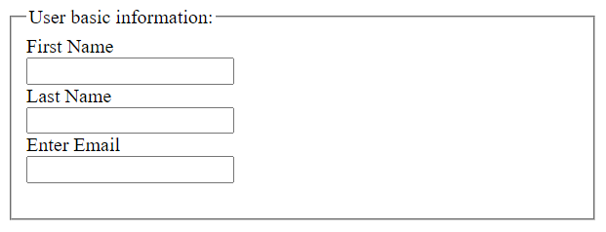
Fieldset and Legend
The HTML <fieldset> tag is used for grouping related form elements.
The use of this tag is optional while creating an HTML form but using <fieldset>, it is easy to understand the purpose of grouped elements of form.
The <legend> tag is used with the <fieldset> element as a first child to define the caption for the grouped related fields.
1
<form>
<fieldset>
<legend>User basic information:</legend>
<label>First Name</label><br>
<input type="text" name="fname"><br>
<label>Last Name</label><br>
<input type="text" name="lname"><br>
<label>Enter Email</label><br>
<input type="email" name="email"><br><br>
</fieldset>
</form>
Output

Slide 41
Media Tags
Video tag
Audio tag

Slide 42
Video Tag
The HTML <video> element is used to show a video on a web page.
The controls attribute adds video controls, like play, pause, and volume.
The width and height attributes are used to set width and height respectively.
The autoplay attribute start a video automatically.
The muted attribute will mute your video sound.
The <source> element allows you to specify alternative video files in src attribute which the browser may choose from. The browser will use the first recognized format.
The text written in between the <video> and </video> tags will display only if browser do not support the <video> element.
1
<video width="300" height="200" controls autoplay muted> <source src="video.mp4" type="video/mp4"> <source src="video.ogg" type="video/ogg"> The video tag is not supported in your browser. </video>

Slide 43
Audio Tag
The HTML <audio> element is used to play an audio file on a web page.
The controls attribute adds audio controls, like play, pause, and volume.
The autoplay attribute start a audio automatically.
The muted attribute will mute your audio sound.
The <source> element allows you to specify alternative audio files in src attribute which the browser may choose from. The browser will use the first recognized format.
The text written in between the <audio> and </audio> tags will display only if browser do not support the <audio> element.
1
<audio controls autoplay muted> <source src="myaudio.ogg" type="audio/ogg"> <source src="myaudio.mp3" type="audio/mpeg"> The audio tag is not supported in your browser. </audio>

Slide 44
Web Technology-I
DU#2301CS363
Prof. Dharmik P Vasiyani
Computer Engineering Department
dharmik.vasiyani@darshan.ac.in
9924664064

