Slide 1

Unit-1 (Part 1) Introduction to Data Structure
Data Structure (DS)
DU# 2301CS301
Prof. Shruti Maniar
Computer Engineering Department
Shruti.maniar@darshan.ac.in
+91 97277 47317 (CE Department)

Slide 2

Looping
Topics to be covered
Data Structure
Classification of Data Structure
Primitive vs. Non-Primitive Data Structure
Linear vs. Non-Linear Data Structures
Performance Analysis and Measurement
Analysis of algorithms
Time Complexity Calculation

Slide 3
Data Structure

Slide 4

What is Data?
Data is the basic fact or entity that is utilized in calculation or manipulation.
There are two different types of data : Numeric and Alphanumeric.
When a programmer collects such type of data for processing, he would require to store them in computer’s main memory.
The process of storing data items in computer’s main memory is called representation.
Data to be processed must be organized in a particular fashion, these organization leads to structuring of data, and hence the mission to study the Data Structures.

Slide 5

What is Data Structure?
Data Structure is a representation of the logical relationship existing between individual elements of data.
In other words, a data structure is a way of organizing all data items that considers not only the elements stored but also their relationship to each other.
We can also define data structure as a mathematical or logical model of a particular organization of data items.
Data Structure mainly specifies the following four things :
Organization of Data
Accessing Methods
Degree of Associativity
Processing alternatives for information

Slide 6
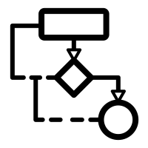

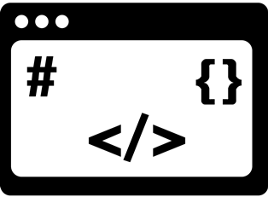
What is Data Structure? Cont.
The representation of a particular data structure in the memory of a computer is called Storage Structure.
The storage structure representation in auxiliary memory is called as File Structure.
Algorithm
Data Structure
Program

Slide 7
What is Data Structure? Cont.
In simple words, Data Structure is a way of organizing data in computer memory so that they can be accessed efficiently.
Data structures are responsible for storing, organizing, processing and accessing data efficiently.
There are different types of data structures available having their own characteristics, applications, advantages and disadvantages.
The programmer should identify the most suitable data structure from available data structures for the given problem definition.
In order to identify the suitable structure for the given problem, one needs to know the available data structures.

Slide 8
Classification of Data Structure

Slide 9
Classification of Data Structure
Data Structure
Primitive Data Structure
Non-Primitive Data Structure
Integer
Characters
Arrays
Lists
Files
Floating
Point
Pointers
Linear List
Non-Linear List
Stack
Queue
Graphs
Trees

Slide 10
Primitive vs. Non-Primitive Data Structures

Slide 11
Primitive and Non-Primitive Data Structures
Primitive Data Structures
Primitive data structures are basic structures and are directly operated upon by machine instructions.
Integers, floats, character and pointers are examples of primitive data structures.
Non primitive data structure
These are derived from primitive data structures.
The non-primitive data structures emphasize on structuring of a group of homogeneous or heterogeneous data items.
Examples of Non-primitive data type are Array, Stack, Queue, Linked List, Tree, Graph and File.

Slide 12
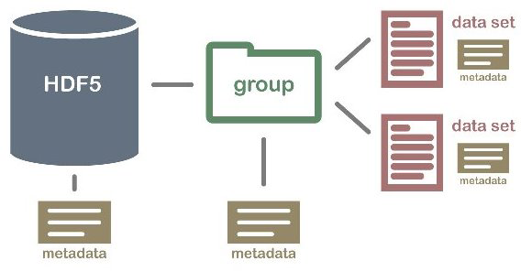
Non-Primitive Data Structure
Array: An array is a fixed-size sequenced collection of elements of the same data type.
List: An ordered set containing variable number of elements is called as Lists.
File: A file is a collection of logically related information. It can be viewed as a large list of records consisting of various fields.
Array
File
List

Slide 13
Primitive vs. Non-Primitive Data Structures
Aspect | Primitive Data Structure | Non-Primitive Data Structure
Definition | These are basic structures and are directly operated upon by machine instructions. | These are derived from primitive data structures.
Examples | Int, float, char, double, boolean, etc. | Array, Stack, Queue, Linked List, Tree, Graph, etc.
Size | Fixed and predefined by the programming language. | Dynamic and can be varied during runtime.
Operations | Limited to basic arithmetic and logical operations. | There are variety of operations can be performed depending upon the data structure.
Usage | Used for representing simple values and performing basic operations. | Used for organizing and managing data in more complex ways.

Slide 14
Primitive vs. Non-Primitive Data Structures
Aspect | Primitive Data Structure | Non-Primitive Data Structure
Definition | These are basic structures and are directly operated upon by machine instructions. | These are derived from primitive data structures.
Examples | Int, float, char, double, Boolean, etc. | Array, Stack, Queue, Linked List, Tree, Graph, etc.
Size | Fixed and predefined by the programming language. | Dynamic and can be varied during runtime.
Operations | Limited to basic arithmetic and logical operations. | There are variety of operations can be performed depending upon the data structure.
Usage | Used for representing simple values and performing basic operations. | Used for organizing and managing data in more complex ways.

Slide 15
Linear vs. Non-Linear Data Structures

Slide 16
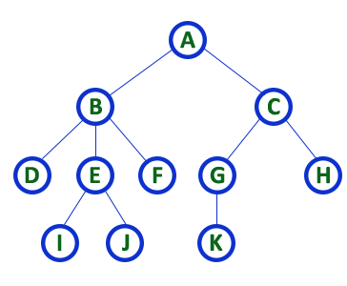
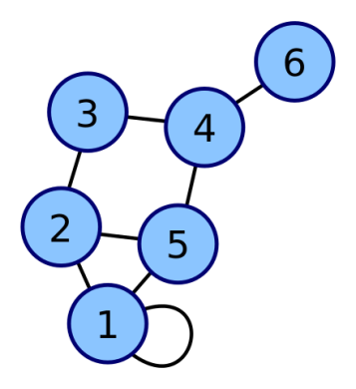
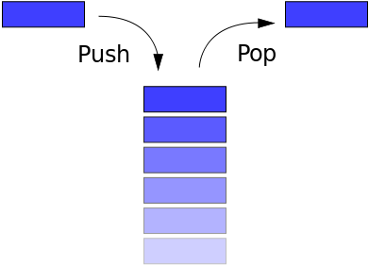
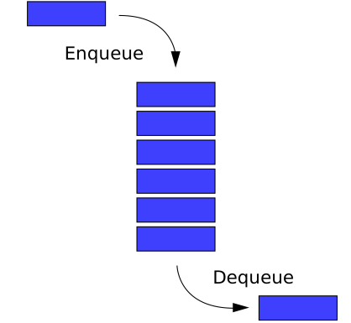
Linear / Non-Linear Data Structures
Linear Data Structures
A data structure is said to be Linear, if its elements are connected in linear fashion by means of logically or in sequence memory locations.
Examples of Linear Data Structure are Stack and Queue.
Non-Linear Data Structures
Nonlinear data structures are those data structure in which data items are not arranged in a sequence.
Examples of Non-linear Data Structure are Tree and Graph.
Stack
Queue
Tree
Graph

Slide 17
Aspect | Linear Data Structure | Non-Linear Data Structure
Order | Elements are arranged in a linear order where each and every element is attached to its previous and next adjacent. | Elements are not arranged in a sequence.
Level | Single level is involved. | Multiple levels are involved.
Implementation | Its implementation is easy in comparison to non-linear data structure. | Its implementation is complex in comparison to linear data structure.
Traversal | Data elements can be traversed in a single run only. | Data elements can’t be traversed in a single run only.
Examples | Array, Stack, Queue, Linked List, etc. | Trees and Graphs.

Slide 18
Linear vs. Non-Linear Data Structures
Aspect | Linear Data Structure | Non-Linear Data Structure
Order | Elements are arranged in a linear order where each and every element is attached to its previous and next adjacent. | Elements are not arranged in a sequence.
Level | Single level is involved. | Multiple levels are involved.
Implementation | Its implementation is easy in comparison to non-linear data structure. | Its implementation is complex in comparison to linear data structure.
Traversal | Data elements can be traversed in a single run only. | Data elements can’t be traversed in a single run only.
Examples | Array, stack, queue, linked list, etc. | Trees and graphs.

Slide 19
Operations of Data Structure
Create: It results in reserving memory for program elements.
Destroy: It destroys memory space allocated for specified data structure.
Selection: It deals with accessing a particular data within a data structure.
Updation: It updates or modifies the data in the data structure.
Searching: It finds the presence of desired data item in the list of data items.
Sorting: It is a process of arranging all data items in a data structure in a particular order.
Merging: It is a process of combining the data items of two different sorted list into a single sorted list.
Splitting: It is a process of partitioning single list to multiple list.
Traversal: It is a process of visiting each and every node of a list in systematic manner.

Slide 20
Analysis of Algorithm

Slide 21
What is Algorithm?
Algorithm is the sequence of steps to solve a problem.
Infinitely many correct algorithms are available for the same problem.
From the available algorithms, a programmer should choose the efficient one.
We need to learn how to compare the performance of different algorithms and choose the best one to solve a particular problem.
While analysing an algorithm, we mostly consider time complexity and space complexity.
Algorithm
Data Structure
Program

Slide 22
Time and Space Analysis of Algorithms
Time complexity of an algorithm estimates the amount of time taken by an algorithm to run as a function of the length of the input.
Space complexity of an algorithm estimates the amount of space or memory taken by an algorithm to run as a function of the length of the input.
Time & space complexity depends on lots of things like hardware, operating system, processors, etc.
However, we don't consider any of these factors while analysing the algorithm. We will only consider the execution time of an algorithm.

Slide 23
Worst-Best-Average Case Time Complexity
Worst-Case Analysis (Big-O Notation):
In Worst Case analysis upper bound on the running time of an algorithm is calculated.
This case causes a maximum number of operations to be executed.
It offers a simplified way to express the growth rate of an algorithm as input increases.
An algorithm’s worst-case time complexity is defined by the Big-O (O) notation.
For example in Linear Search, the worst case happens when the element to be searched is not present in the array.
For following given array worst case happens when 80 is not present in the array.
So the complexity would be O(n), as total n comparisons had to be done.
A :
50 | 60 | 30 | 20 | 10

Slide 24
Worst-Best-Average Case Time Complexity
Best-Case Analysis (Big- Ω Notation) :
In Best Case analysis lower bound on the running time of an algorithm is calculated.
This is the case that causes a minimum number of operations to be executed.
An algorithm’s best-case time complexity is defined by the Omega(Ω) notation.
In the Linear Search problem, the best case occurs when searching element is present at the first location.
For following given array best case happens when we are searching for 50 in the array.
So the complexity would be Ω(1), as only 1 comparison needs to be done.
A :
50 | 60 | 30 | 20 | 10

Slide 25
Worst-Best-Average Case Time Complexity
Average-Case Analysis (Big Ꝋ Notation):
In Average Case analysis, we take all possible inputs and calculate the average computing time for all of the inputs.
An algorithm’s average-case time complexity is defined by the Theta notation (Ꝋ).
This notation gives the estimated average amount of time an algorithm requires to consider all input values.
For Linear Search, this case happens when the search element is present somewhere in the middle of the array.

Slide 26
Time Complexity Calculation

Slide 27
Time Complexity of an Algorithm
In this era we have high configured resources, so immense amount of space would be available to us.
So here the concern is not to optimize space but to optimize time.
Hence Time Complexity is at the prime consideration.
Here we don’t measure the actual time required in executing each statement in the code, but we measure:
how many times each statements of the algorithm executes
the number of elementary functions performed by the algorithm
Since the algorithm's performance may vary with different types of input data, we usually use the worst-case Time complexity of an algorithm because that is the maximum time taken for any input size.

Slide 28
Calculating Time Complexity
Calculate Time Complexity of Sum of elements of List (One dimensional Array)
A is array, n is no of elements in array
SumOfList(A,n)
{
Line 1 total = 0
Line 2 for i = 0 to n-1
Line 3 total = total + A[i]
Line 4 return total
}
Line
Cost
No of Times
1
1
1
2
2
n + 1
3
2
n
4
1
1
TSumOfList = 1 + 2 (n+1) + 2n + 1
= 4n + 4
We can neglate constant 4
= n
Time complexity of given algorithm is n unit time

Slide 29
Calculating Time Complexity - Practice
Calculate Time Complexity of searching an element from an Array
SearchArray(A,n,x)
{
Line 1 for i = 0 to n-1
Line 3 if A[i] equals x
Line 4 return i
Line 5 return -1
}

Slide 30
Frequently asked questions:
Define Data Structure. Draw classification of Data Structure.
Differentiate between linear and nonlinear data structures.
Define Complexity. Explain Time and Space Complexity.
Explain a tradeoff between time and space complexity.
Calculate the time complexity for a given algorithm or problem.

Slide 31

Data Structure (DS)
DU #2301CS301
Prof. Shruti Maniar
Computer Engineering Department
Shruti.maniar@darshan.ac.in
+91 97277 47317 (CE Department)

