Slide 2

PowerPoint

Slide 3
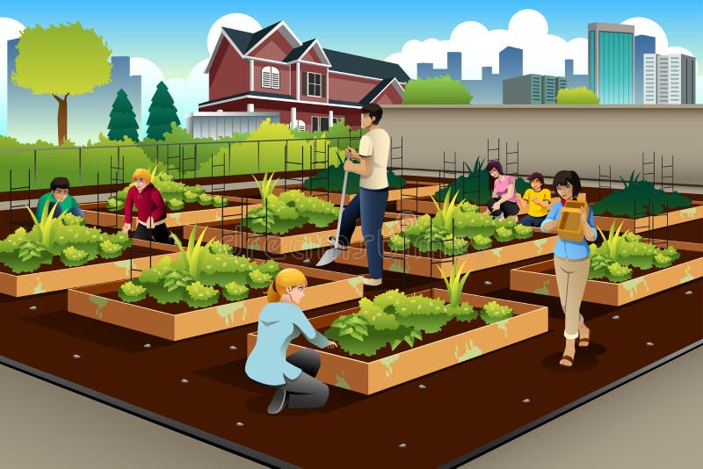
Community Garden Initiative
Growing Together for a Healthier Community

Slide 4
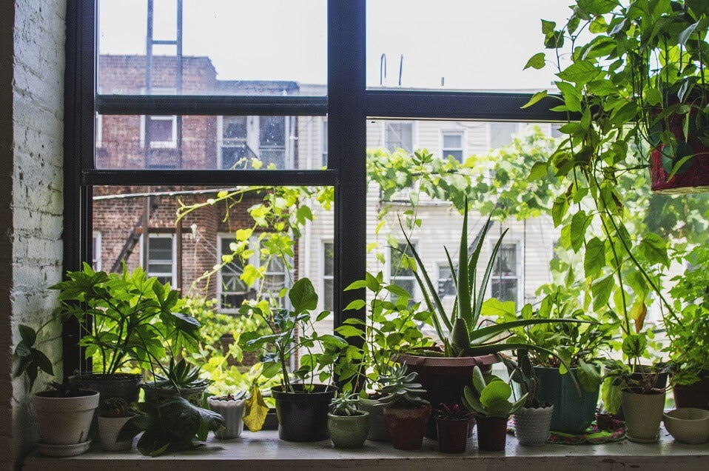
Introduction
a collaborative effort where individuals work together to transform shared spaces—such as vacant lots, rooftops, or public park areas—into productive green spaces for growing food, flowers, and herbs

Slide 5
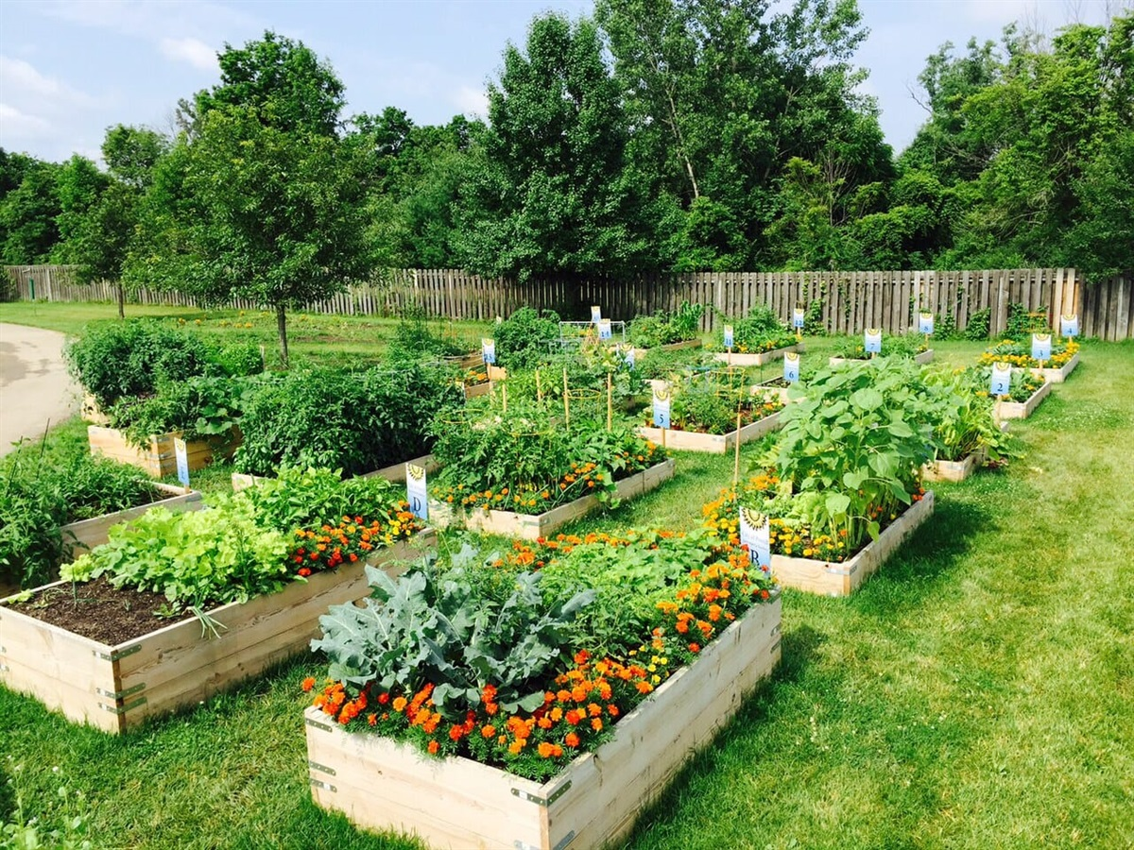
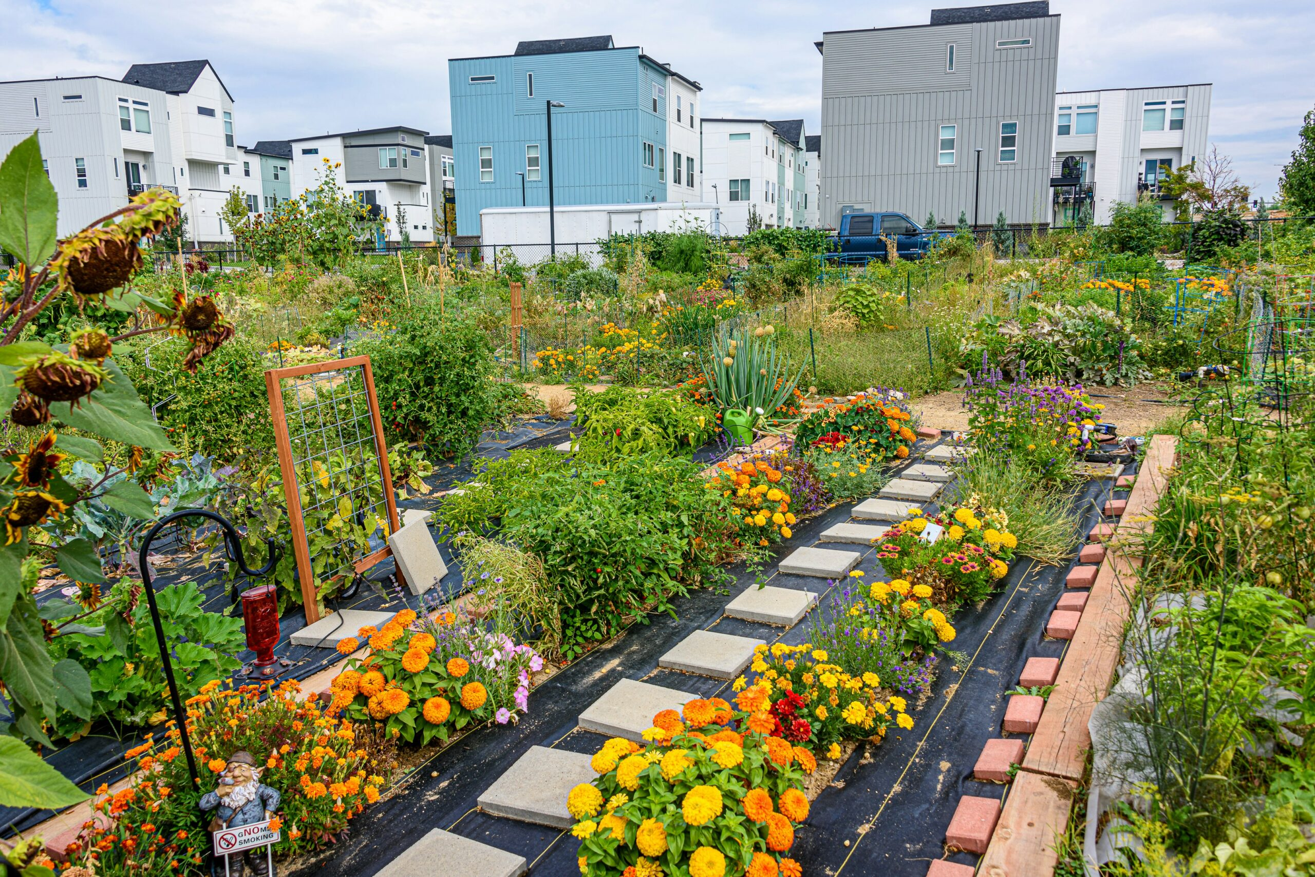
Why Do We Need Community Garden?
∙ Promoting mental well-being.
∙ Fostering social connections.
∙ Improving access to fresh.
∙ Affordable produce.

Slide 6
Project Goals
1. Increase access to fresh and healthy produce.
2. Educate the community about sustainable gardening practices
3. Foster community spirit and collabrotion.

Slide 7
Benefits of the community garden
Health Benefits: Access to fresh vegetables and fruits
Environmental Benefits: Promotes Biodiversity, reduces carbon footprint
Community Benefits: Brings People Together

Slide 8
Get Involved: volunteer opportunities
Planters: Help plants and plant seedlings
Caretakers: Watering weeding and general maintenance
Harvesters: Assist in Harvesting crops when ready

