Slide 1

Instagram Insights Using Business Intelligence
GROUP8
SHIVANG THAKER(110013338)
DHAIRYA CHAUHAN(110025738)
JAY PANDYA(110023841)
AGRETA GUPTA(105182704)
Course Name: ADVANCE DATABASE TOPICS
Submitted to: Dr. KALYANI SELVARAJAH
Master of applied Computing
University of Windsor

Slide 2
Instagram insights
Instagram insights allows user to know about their audience, and about how content performs with them which helps business account users to grab more followers.
We can view insights for post, stories ,total number of likes, comments and many more.
Why it is important?
According to survey nearly 40% of marketer claim that social media is best for advertising channel , so with this insights, business users of instagram can grow their business and understand about their followers interest.
It is also beneficial for private users to learn about more of their account likes , comments and many more.

Slide 3
Existing project
There are some application already developed for instagram insights some of them are Qmiran, insightly, rival IQ etc.
However this tools are limited to featuring top likes, online duration, top comment etc, and also these are monthly paid application.
In this project we apply many metrics which helps business users to grow their business, and individual users to improve awareness of their data on instagram.

Slide 4
Advance tools
Panoply:
Panoply is an AI-driven and autonomous cloud data warehouse, which allows us to gather data from various data sources like AWS S3, Google analytics etc, to one place and use that data for further processing by connecting to different BI tools like chartio, mode, tableau etc.
It was founded in 2015 and it is sun Francisco based company.

Slide 5
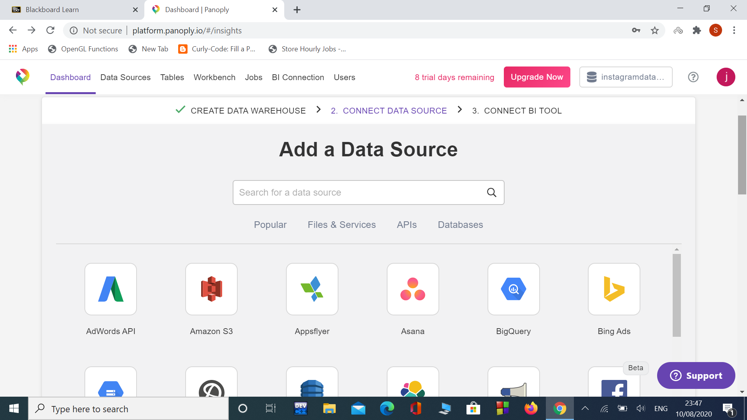
Panoply Understanding

Slide 6
Cont..
Tableau:
Tableau is very famous data visualization tool which people to observe and understand their data.
It provides good interactive data visualization with the purpose to help organizations solve their data problems.
How it works,
First connect it to panoply, then dragged data from it. This data can extracted to tableau server engine. Further we can analyze the data in graphical form.
Benefits: Fantastic visualization, easy to use, mobile support,
and large resources.

Slide 7
Computer Language
Python:
Python is an interpreted, object-oriented, high-level programming language with dynamic semantics.
That includes back end development, software development, data science and writing system scripts among other things.
Why we use it?
In this project we used python scripts for etracting data through Instgram Graph API.
Different instagram files use for different task, e.g get_insights.py with this python script we extract instagram user data which consist of engagement, impression, reach, saved

Slide 8
Cont..
In which engagement defines total numbers of like and count of comment, impression is how many time user visit media, reach defines distinguish user visits, and saved defines total media save entries.
The data extracted through this goes to excel which are shown below,

Slide 9
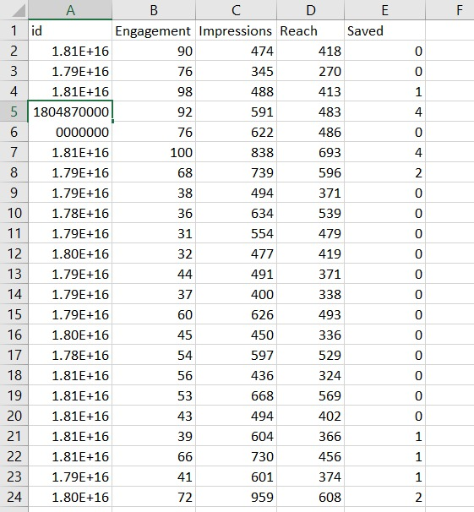
Cont..

Slide 10
Demo
Step by step procedure:
https://drive.google.com/file/d/1bGsPd1dIitFXuRGTX5BVuZ5E4oTf9OvJ/view?usp=sharing
Video Clip:
https://drive.google.com/file/d/1t4FFsVpHADByNU-h2XRfDFl3_KVxte7q/view?usp=sharing

Slide 11

Thank you all
Any questions ?

