Slide 1

iConnect
Team No: 17
Members:
Dhairya doctor (B00864868)
Shivangi bhatt (b00863408)
Aayushi Gandhi (b00890697)
Saurabh das (b00911733)
Client team number: 04

Slide 2
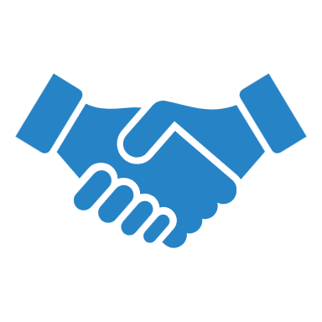
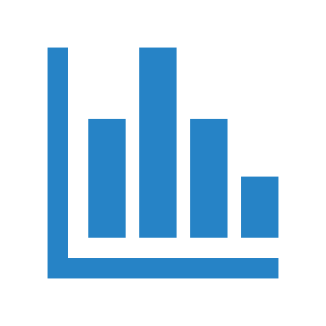



Table of Content
Summary of our Application
Project Dashboard Stats
Project Status w.r.t. Final Goals
Learning from the Project
Demo

Slide 3
Summary of our Application
A community for investors and ideators to connect and share ideas.
A platform where ideators can share their ideas and look for investments on their ideas by investors.
Whereas, investors can look for different ideas and can raise an investment on an idea they like.

Slide 4
Project Dashboard Stats
Total number of tasks: 23
Tasks completed by individuals with total story points:
Aayushi (24) | Dhairya (25) | Saurabh (26) | Shivangi (28)
Login | Registration | CI-CD Pipeline and setup | Oauth, Forget and Reset password
Display idea dashboard | Get and Edit user profile | Repayment Plan | Create idea
Search idea | Show all investments for a investor | Premium membership for investors | Delete and update the existing Idea
Contact the ideator | Show pending investments | Make installable PWA | Get received investments
View history of investments made on an idea | Accept or reject an investment | Adding QA and test coverage setup | Raise Investment
 | Integrate payment |  | Limit investor funding capacity
 |  |  | Selecting repayment plan by the investor

Slide 5
Project Status w.r.t. Final Goals
Final Goals | Status
Post, Get, Edit , Update and Search Ideas | Achieved
User Management | Achieved
Invest in Ideas | Achieved
Approve Investments made by Investors | Achieved
Funding cap on the investors based on their membership | Achieved
View History of Investments on a Idea | Achieved
Repayment Plan | Achieved
Change to Premium Membership | Achieved

Slide 6
Additional goals w.r.t. Final Goals
Additional Goals Achieved | Status
Payment using Stripe Payment Platform instead of dummy payment portal | Achieved
Make installable PWA | Achieved
Contact the Ideator | Achieved

Slide 7
Number of meetings
Meetings with | Total team
Our team (with TA) | 8
Internal meetings | 16
Client team | 8
Development team | 9

Slide 8
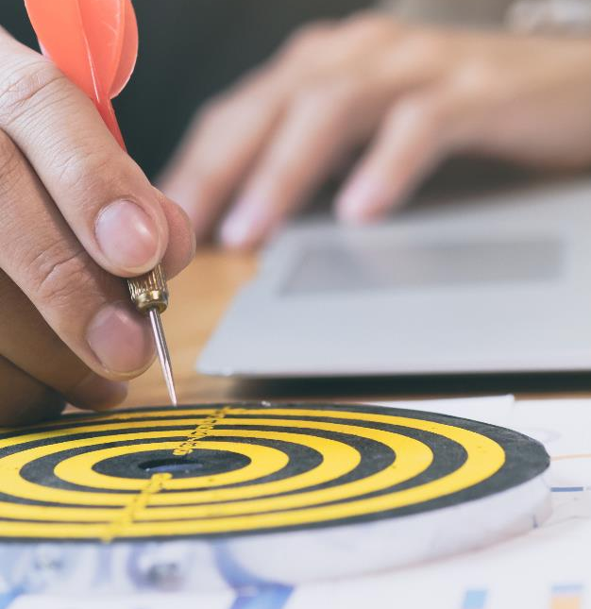
Learning from the Project
Setup common grounds between the team members so that consistency is maintained while coding.
Implementing SOLID principles in each commit so that debugging, and refactoring can be done easily.
Refactoring the code would make it easy to reuse and quite readable which will help in debugging the issues faster.

Slide 9
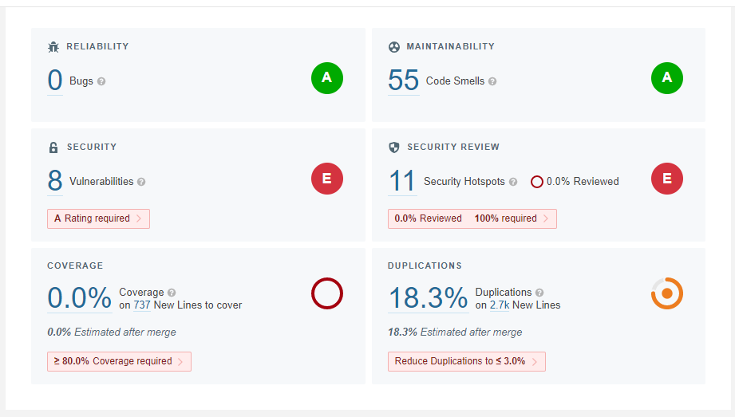
Smell Analysis before

Slide 10
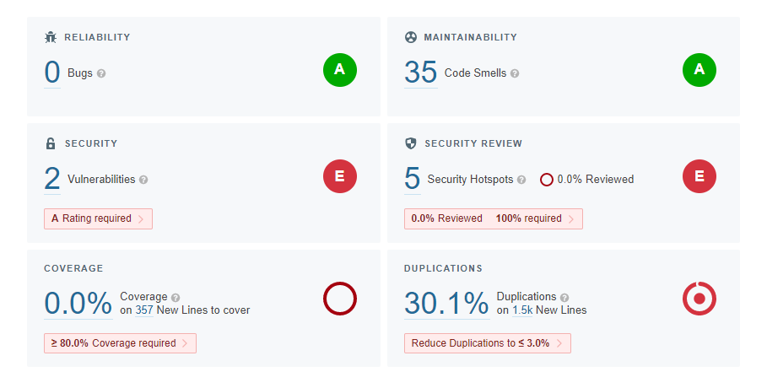
Smell Analysis After

Slide 11
Thank You!
Demo
https://iconnect-front-end-prod.herokuapp.com/

