Slide 1
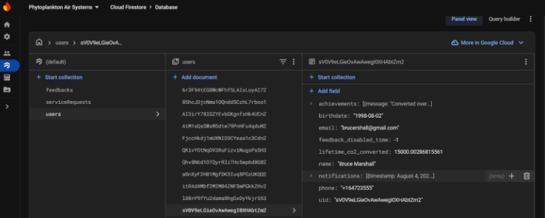
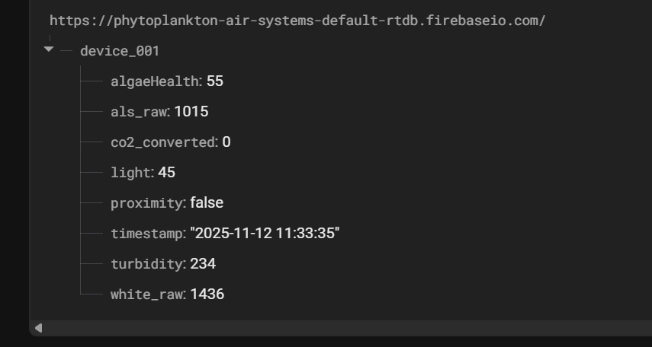
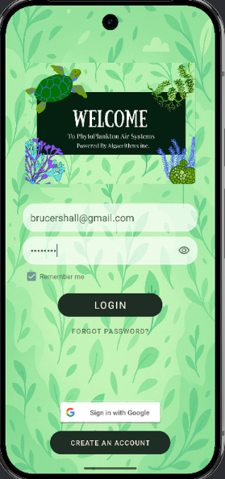
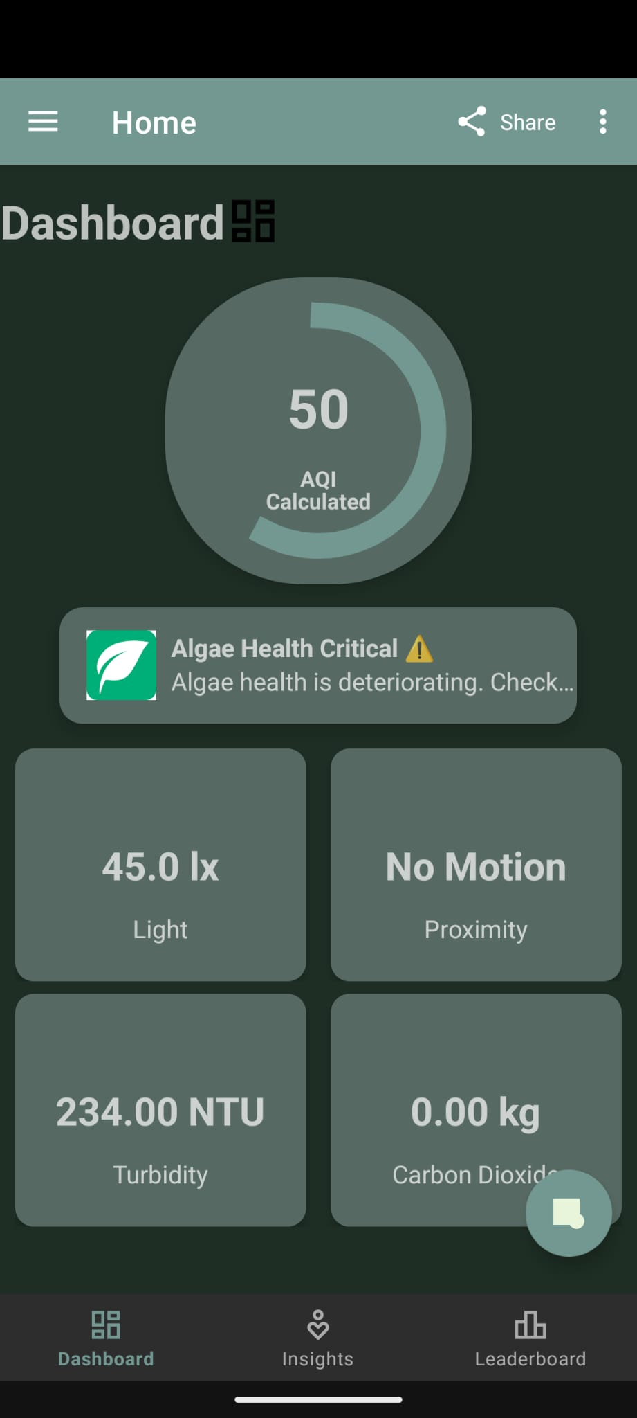
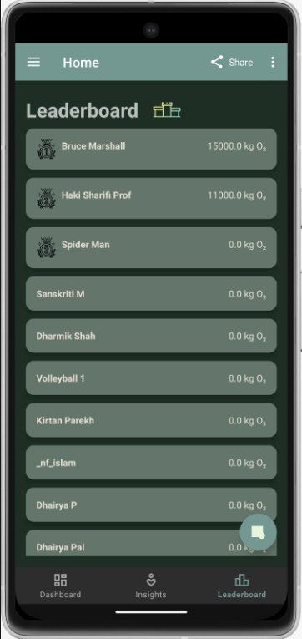
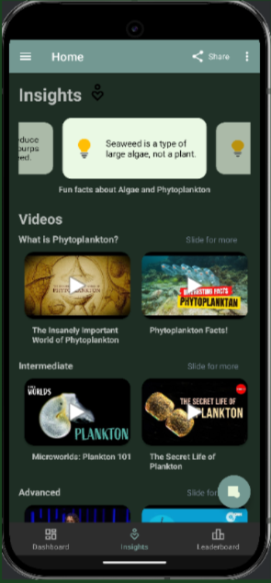
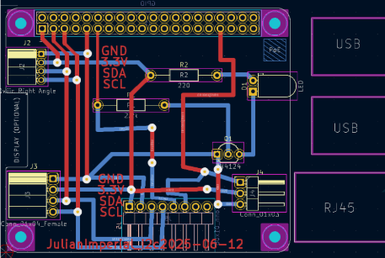
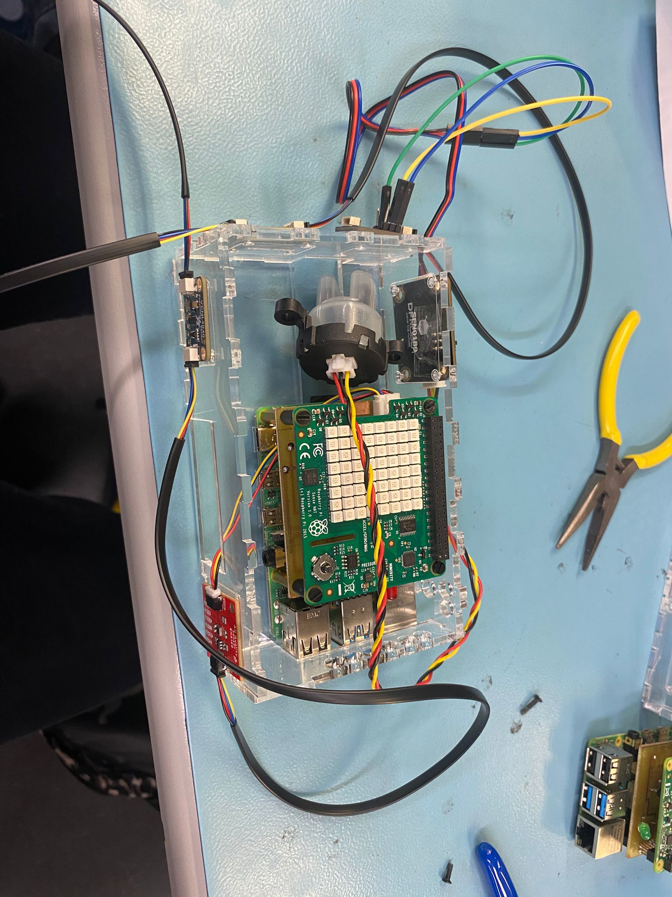
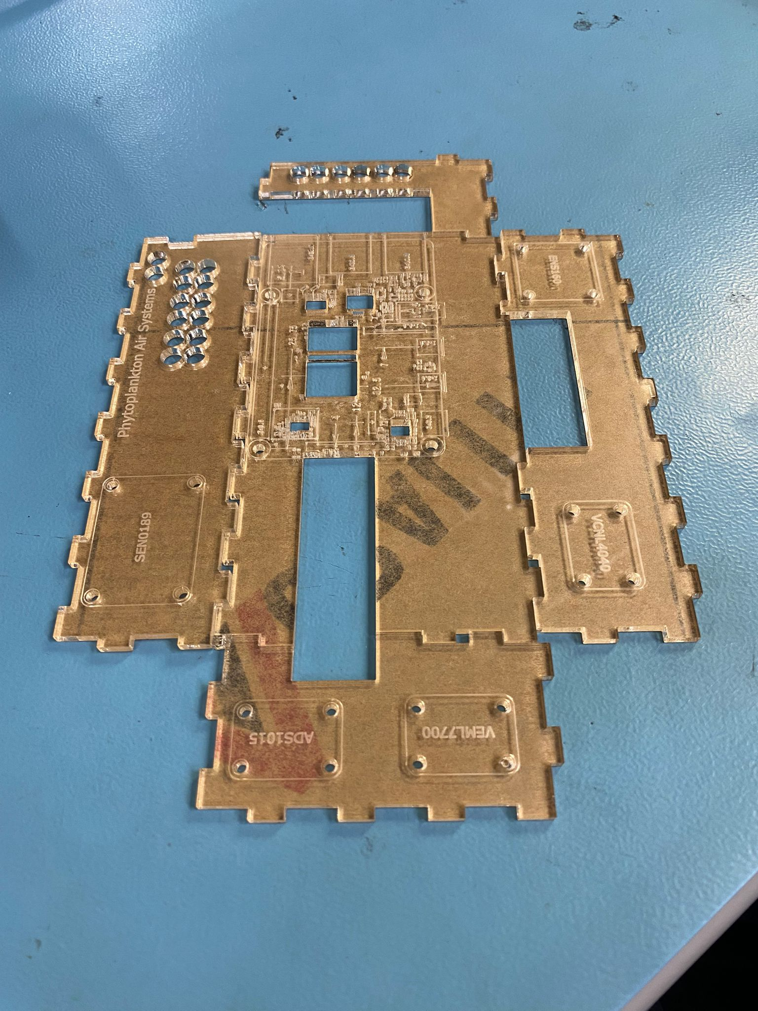
Phytoplankton Air Systems
Julian Imperial, Dharmik Shah, Dhairya Pal, Sanskriti Mansotra
INTRODUCTION
Phytoplankton Air Systems is an Internet of Things (IoT)–based air purification project that merges biological and digital innovation.
It utilizes phytoplankton’s natural photosynthetic process to convert carbon dioxide (CO₂) into oxygen, creating a sustainable and self-regulating air improvement system. The prototype integrates a Raspberry Pi with multiple sensors to monitor CO₂ levels, light intensity, water turbidity, and proximity.
These readings are transmitted wirelessly to an Android app for real-time visualization, automated alerts, and performance tracking through Firebase. This project demonstrates how eco-engineering and IoT can work together to promote cleaner air and environmental awareness, offering an educational and practical model for sustainable technology.
CIRCUIT PCB ASSEMBLY
The circuit that combines all the sensors together was transferred from the breadboard to a more permanent and reliable printed circuit board (PCB). This was done to improve durability, reduce wiring errors, and make the setup easier to manage. A PCB also helps reduce electrical noise and gives the project a more organized and professional look.
Each sensor module—turbidity, proximity, light, and CO₂—was connected to the Raspberry Pi using a daisy-chain layout. This allowed all sensors to share connections neatly without using too many wires. The design process was done in KiCad, where we defined the board size, routed traces, inserted vias, and placed holes for components and headers. Vias were used to connect traces between the top and bottom layers of the PCB, ensuring smooth current flow throughout the circuit. The fabricated PCB, created in the lab next to ours, included areas for an LED, transistors, and several resistors.
These components were used for signal control, current regulation, and visual status indication. Our group soldered all of these parts, making sure each connection was solid and free of shorts. We also soldered the headers that connect each sensor, which required precision to keep everything aligned and functional. After soldering, we tested the boards to confirm that all sensors and the LED worked properly with the Raspberry Pi. The LED acted as a quick visual indicator that the board was powered and functioning correctly.
The completed circuit proved to be much more stable than the breadboard version—it prevented loose connections, improved signal quality, and made the overall system easier to test and display. Overall, using the circuit board method turned our prototype into a more professional, durable, and efficient design. It combined multiple sensors, components, and connections into one clean layout that worked reliably for our final setup.
MOBILE APP RESULTS
For the entire duration of semester 5, (May 2025 – August 2025) we have been working to develop an Android application that is able to connect with our development platform to allow for the display of our sensor data management. Users are able to login using existing credentials, that are securely stored in a firebase database, users can access values such as, proximity, turbidity (clarity of liquid), alongside light levels and the overall air quality calculated through these other datapoints all through the Dashboard Screen, which is the home screen that users land on after logging in.
The other screens shown are the main screens alongside the Dashboard, allowing for a gamified and educational experience with the Leaderboard screen and Insights screen.
DATABASE
Our database is all on Firebase, and we have authentication for the user credentials and, we have the device of where the air system data is going to, we have all the datapoints that are shown in the application here under device_001.
Firebase Screenshots of Cloud Fire store, Authentication and Real-time database. (Fig 1.)
ENCLOSURE DESIGN
The Phytoplankton Air Systems enclosure was built to ensure safety, functionality, and sustainability while fitting within Humber’s project size limits (32.5 cm × 14 cm × 7 cm). The structure houses the Raspberry Pi 4, power supply, and four environmental sensors in an organized layout that maintains proper airflow and component separation. Each sensor—air quality, light, proximity, and turbidity—is mounted for optimal data collection and easy maintenance through modular Qwiic connections.
The design includes ventilation openings to regulate temperature and humidity for phytoplankton growth while protecting electronics from moisture exposure. All circuits operate under 16 Vrms with total power below 20 W for safety compliance. The enclosure’s clear sections allow visual observation of the phytoplankton chamber, highlighting both its biological and electronic integration.
TESTING
We had testing phases throughout Semester 5 (May 2025 - Aug 2025) all the way up until now in Semester 6 (Sept 2025 – Nov 2025 Current).
So during the Semester 5 we were mainly testing for any test cases in the mobile application that we have, whilst also working on our individual sensors, ensuring that they are soldered, and the code runs without error.
Android Studio. (2025).
Screenshot from PAS (Phytoplankton Air systems) login screen of PAS mobile application. (Fig 1.)
Android Studio. (2025).
Screenshot from PAS (Phytoplankton Air systems) Dashboard screen of PAS mobile application. (Fig 2.)
OUR UNIQUE ANGLE
Our project goes beyond typical app development - we integrated a real algae system to bring biology and tech together. We built for impact, not just function, adding a climate education screen, gamified tracking, and real-world service features. Every detail, from reusable algae pods to user-focused design, was made to create a product that’s sustainable, engaging, and built to last.
KiCad Schematic design of PCB example from one of the team members, as an example. (Fig 1.)
ACKNOWLEDGEMENTS
Professors, etc.
Enclosure with Raspberrypi and all sensors put together. (Fig 1.)
Enclosure before assembly (Fig 2.)
Android Studio. (2025).
Screenshot from PAS (Phytoplankton Air systems) Leaderboard screen of PAS mobile application. (Fig 3.)
Android Studio. (2025).
Screenshot from PAS (Phytoplankton Air systems) Insights screen of PAS mobile application. (Fig 4.)
Notes:
Section Start Slide

