Slide 1

Module 6 Project - Data Analysis
Guided BY: dr. Mohammad Shafiqul Islam
Project By: Dhairya Dave

Slide 2
Table Content
Explaining the business case
Dataset and Data dictionary
Data cleaning
Analyzing data and its snippets.
Conclusion
Reference

Slide 3
Explaining business case
The dataset provided serves the data regarding the failure of the banks of all type which includes Savings, Savings Association and Federal. The data is available since 1934 to the time after the Great Depression at USA.
This dataset has 12 attribute and around 3000 rows in it which were totally uncleaned and needs to be pre-processed before applying analyzation tools.

Slide 4
Dataset and Data dictionary
Data Dictionary
Financial Institution Number | Institution Name | Institution Type | Charter Type | Headquarters | Failure Date | Insurance Fund | Certificate Number | Transaction Type | Total Deposits | Total Assets | Estimated Loss (2015)
States the unique number given to a Financial Institute | Name of the Financial Institute | whether it is commercial, savings or savings association. | Displays the type of charter | Where the bank is originally from | The date when the failure noted | In which mode of insurance does it fall into | unique number to all the Institutes | Type of transaction. | Gross deposits | Gross assests | Loss noted in the year 2015

Slide 5
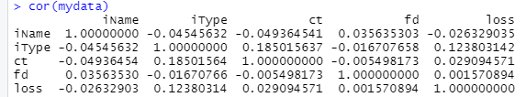
Data cleaning
This how the correlation between all other attribute relates after cleaning the data.
Simple omit function was used to clean the data. Basically, the rows were dropped using this function

Slide 6
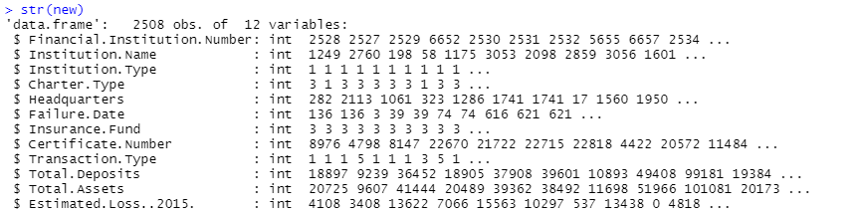
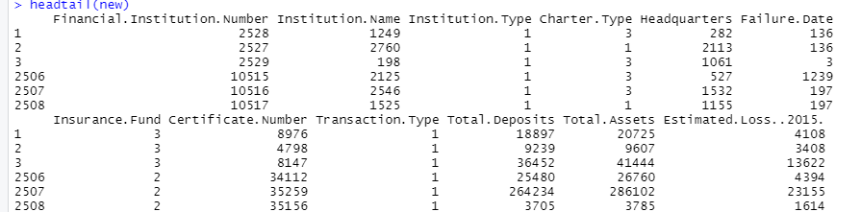
Continue
The following two picture depicts the data type of the following attributes in a dataset and also the head and tail of the dataset of each attributes separately.
The string values need to be changed into int so that further the Analysis can happen.

Slide 7
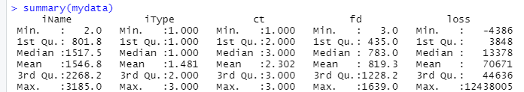
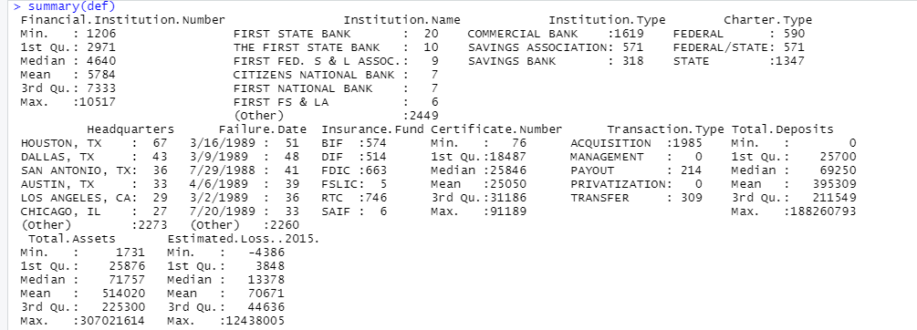
Continue
This depicts the summary of two subsets of the datasets which were used differently for different purposes. Where mydata dataset is subset of def dataset.

Slide 8
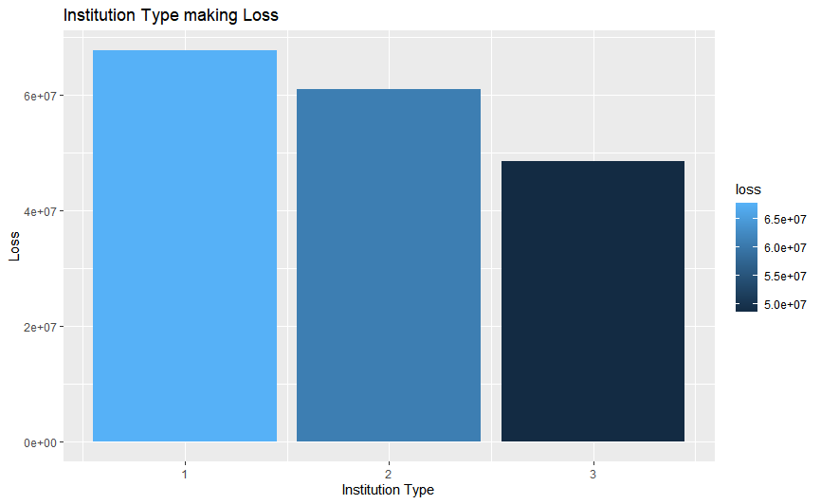

Analyzing data and its snippets.
This graph here shows and resolves the first question of that data which is. What type of institution is making the highest loss.
One(1) that is “COMMERCIAL BANK” are making the highest loss.

Slide 9
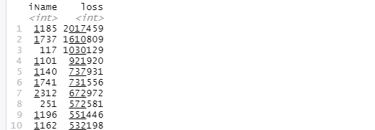
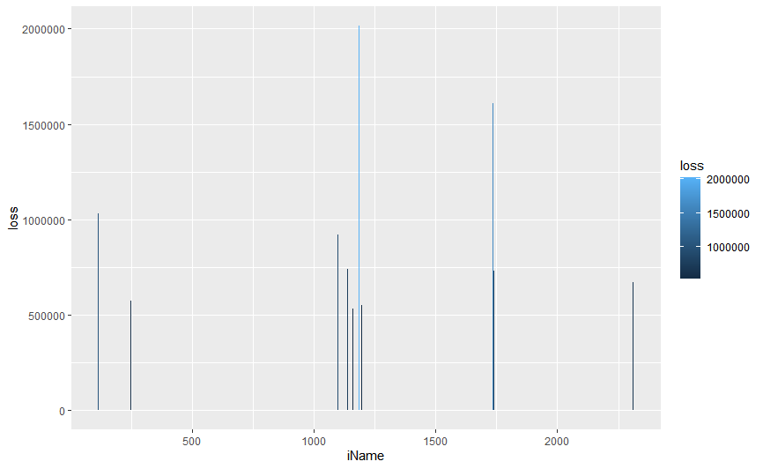
Analyzing continues
This resolves the second question of the dataset which is what commercial bank failure cost the federal government the most to resolve?
This loss vs institute name where its is seen that “FIRST REPUBLICBANK-DALLAS, N.A” shows the highest loss-making bank

Slide 10
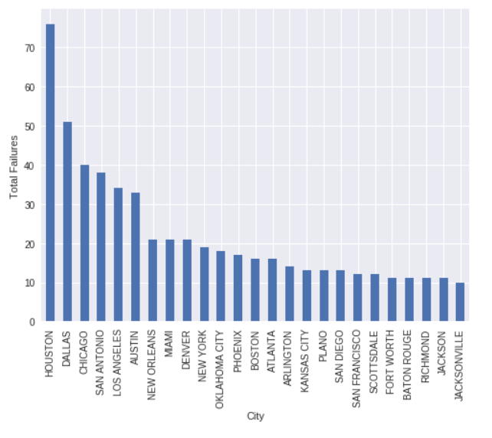
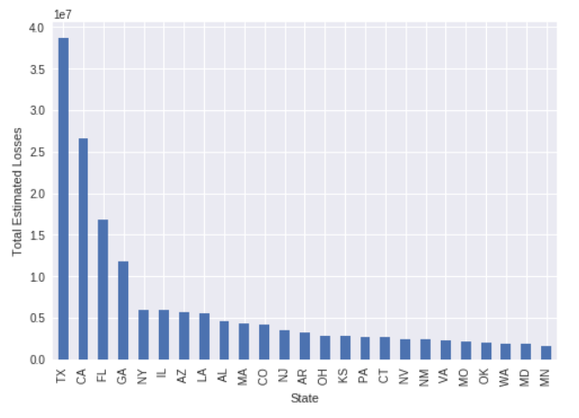
Analyszing Continue
This graph depicts the failure that happened where more prone in which place.
This depicts that most failure of banks occur at Texas state and at Houston city. Also shows this varies from place to place.

Slide 11
Conclusion
I would like to end this on a note that this analysis came to a conclusion that Commercial Banks were affected most in the state and city of Texas and Houston the most whereas the FIRST REPUBLICBANK-DALLAS, N.A. got affected the highest which made the highest loss in the given period. The Failure rates were highest in the year 1989.

Slide 12
Refrences
Kaggle.(2017). Commercial Bank Failures, 1934-Present Every bank failure in the United States since the Great Depression. https://www.kaggle.com/fdic/bank-failures (Links to an external site.)
] r-bloggers (2018). R-Bloggers. https://www.r-bloggers.com/2021/04/how-to-clean-the-datasets-in-r/

Slide 13
THANK YOU

