Slide 1

Loan Default Prediction
Dhaivat Naik Sanjeet Naik

Slide 2
Problem Statement and Tech Stack
Problem Statement: Loan defaults cost lenders billions each year. Identifying high-risk borrowers early can reduce financial losses and improve credit decisions.
Objective: Build a machine learning model to predict loan default using LendingClub application and performance data.
Tech Stack:
Google Cloud Storage: Stored raw datasets
BigQuery: Hosted cleaned tables, enabled scalable SQL queries
Vertex AI Workbench: Managed JupyterLab for experimentation and modeling
pandas & pandas-gbq: Data wrangling and data transfer
scikit-learn: Preprocessing and model training
seaborn & matplotlib: Visual data exploration and feature analysis
Notes:
Loan defaults are a major loss point for lenders. Our goal was to predict whether a loan will default before it’s approved, using LendingClub data.
We built the entire pipeline on Google Cloud — using GCS for storage, BigQuery for querying, and Vertex AI Workbench for modeling.
Data was processed with pandas, models trained with scikit-learn, and EDA done through seaborn and matplotlib.

Slide 3
Data Overview and Partitioning
Datasets Used:
Accepted Loans: ~2.26 million rows, 151 features including loan performance
Rejected Loans: ~27 million rows, 12 features focused on application data
Preprocessing :
Removed high-null and ID columns (e.g., member_id, hardship fields)
Standardized categorical formats and parsed date fields
Engineered binary loan_default label for accepted loans
0by selecting the 12 overlapping features for consistency between accepted and rejected datasets
Modeling Strategy:
Trained separate models: • Accepted Loans: Supervised classification • Rejected Loans: Risk profiling using shared features
Applied stratified 70/30 split on accepted data to preserve class balance
Notes:
We worked with two datasets — accepted loans with full performance info, and rejected loans with application-only data.
The accepted dataset had over 150 features; rejected had just 12. So we dropped unnecessary or null-heavy columns and focused on 12 overlapping features.
For accepted loans, we created a binary label: loan_default.
Finally, we used a stratified 70/30 train-test split to preserve the default/non-default ratio during modeling.

Slide 4
Data Cleaning
Handling Missing Data:
Dropped columns with over 40% null values
Cleaned key fields like employment length, loan purpose, and income
Feature Engineering:
Created binary loan_default target: 1 = Defaulted, Charged Off, Late (>120 days) 0 = Fully Paid, Current
Converted date fields (e.g., issue_d, earliest_cr_line) to datetime objects
Standardized categorical fields (e.g., emp_length, home_ownership)
Outcome: Clean, consistent datasets prepared for exploratory analysis and modeling.
Notes:
We cleaned the data by dropping columns with too many missing values and standardizing categorical and date fields.
The target variable, loan_default, was created based on loan status — default, charged off, or late.
For missing values, we used simple strategies like median imputation to maintain data integrity without overcomplicating the pipeline.

Slide 5
EDA
Class Distribution:
Defaulted loans: ~18%
Non-defaulted loans: ~82%
Key Observations:
Loan Grade: Higher grades (A→G) show increasing default risk
FICO Score: Strong inverse correlation with default
Loan Amount: Defaulters tend to borrow more
Interest Rate: Higher interest rates linked to default probability
Visuals Used:
Boxplot: Loan Amount vs loan_default
Correlation Heatmap: FICO score, recoveries, interest rate, etc.
Notes:
About 18% of loans in the accepted dataset defaulted — so we had class imbalance.
We saw clear patterns: default risk increased with lower FICO scores, higher interest rates, and worse loan grades.
Visuals like boxplots and correlation heatmaps helped us spot which features were most tied to default behavior.

Slide 6
Modeling
Goal: Predict loan default for accepted loans and apply insights to score rejected applications.
Models Tested:
Logistic Regression (baseline)
Random Forest
Gradient Boosting
Support Vector Machine (SVM)
CatBoost
Notes:
We tested five models — starting with logistic regression as a baseline, and moving up to tree-based models like Random Forest, Gradient Boosting, and CatBoost.
Since we wanted to score rejected loans too, we trained using just the 12 shared features across both datasets.
We used standard preprocessing — scaling, encoding, and 5-fold cross-validation.
Finally, we analyzed feature importance using OpenSearch CV to understand which factors drove the predictions.

Slide 7
Modeling (cont.)
Preprocessing Pipeline:
Standardized numeric fields
One-hot encoded categorical variables (as needed)
Used only the 12 shared features for rejected loan scoring
5-fold cross-validation for model tuning
Feature Importance:
Extracted using OpenSearch CV
Helped rank predictive features and interpret model behavior

Slide 8
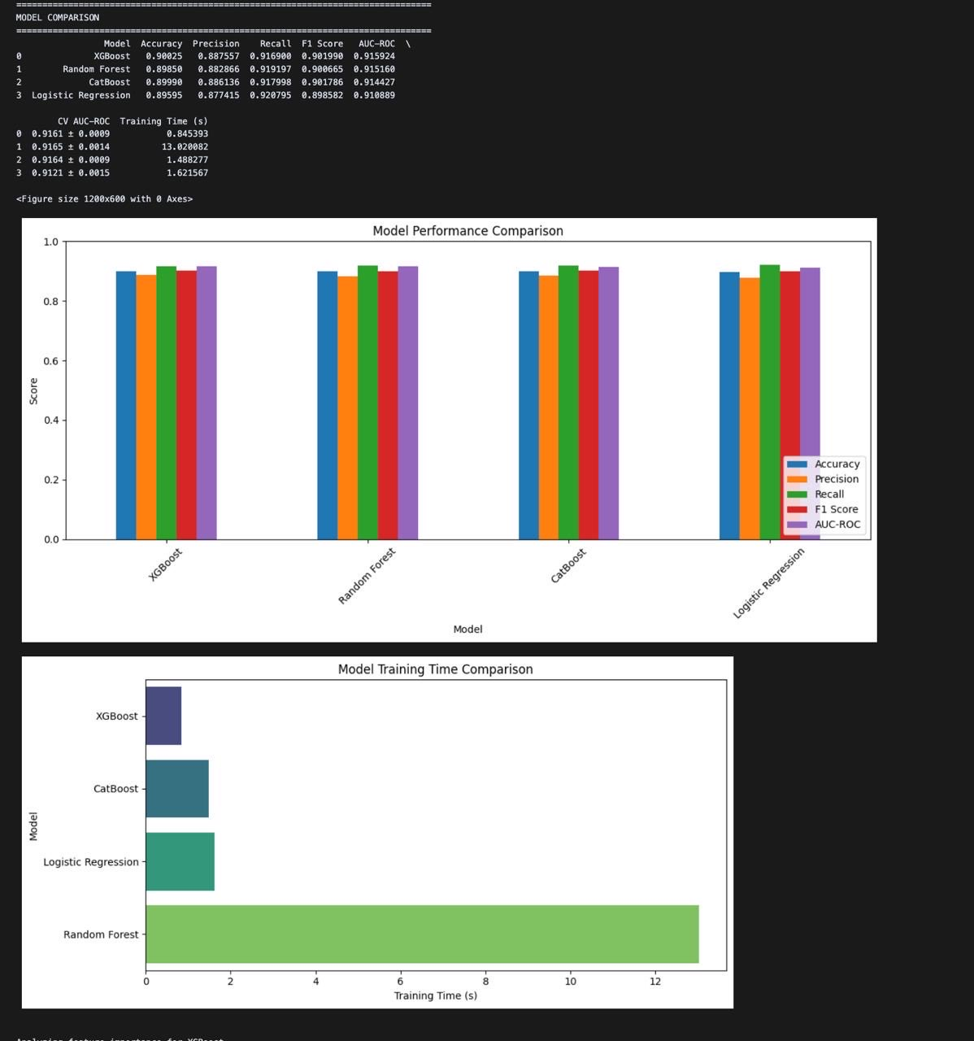
Model Evaluation and Comparison
Model | Accuracy | F1 score | AUC - ROC
XGBoost | 0.90 | 0.90 | 0.916
Random Forest | 0.9 | 0.9 | 0.915
CatBoost | 0.90 | 0.90 | 0.914
Logistic Regression | 0.90 | 0.89 | 0.911

Slide 9
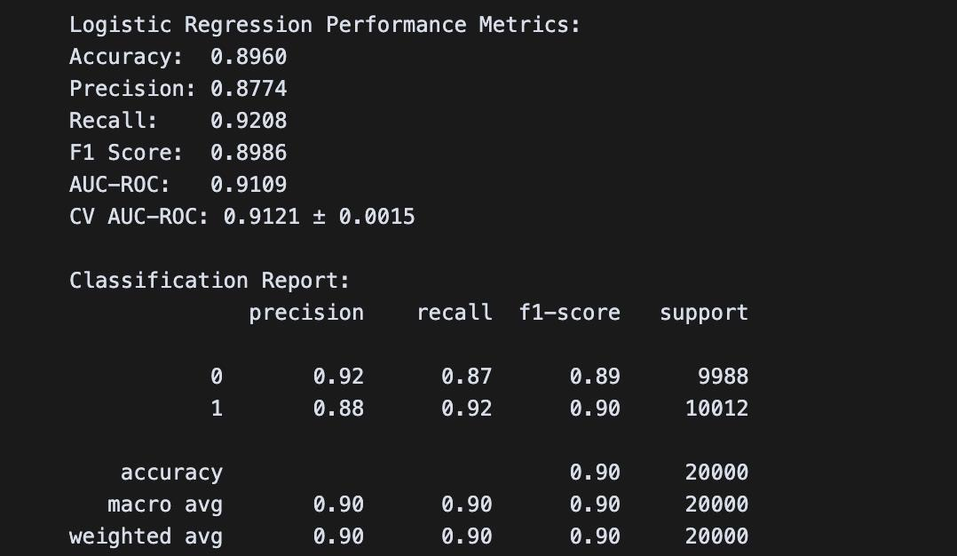
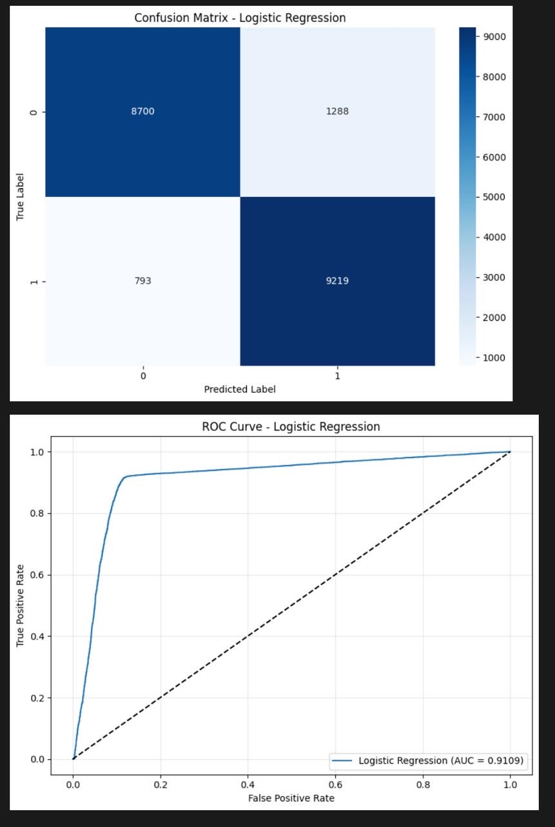
Confusion Matrices and ROC LogReg

Slide 10
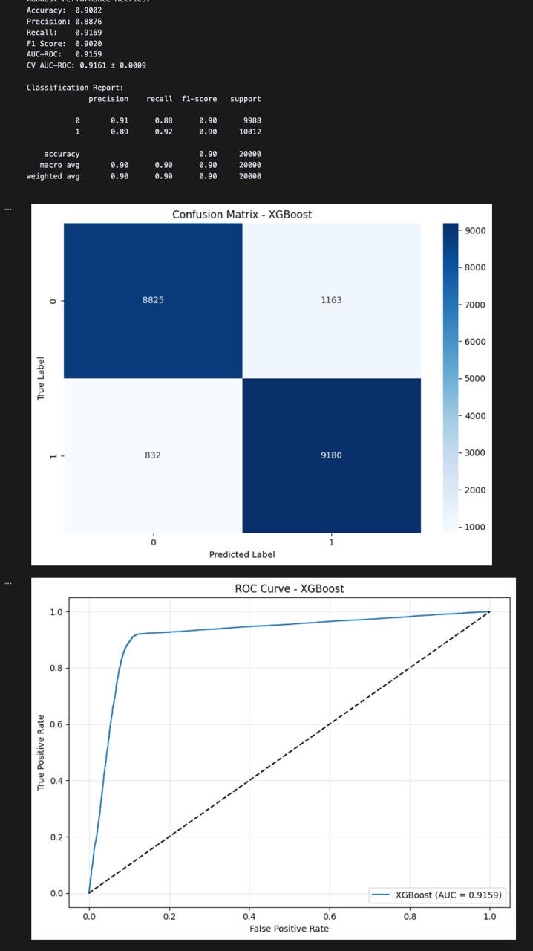
Confusion Matrices and ROC XGB
Notes:
XGBoost gave us the best overall results — with 90% accuracy and the highest AUC-ROC.
Random Forest and CatBoost performed closely behind, while Logistic Regression held up as a strong baseline.
We evaluated models using AUC, F1 score, and confusion matrices — with XGBoost consistently showing the best trade-off between precision and recall.

Slide 11
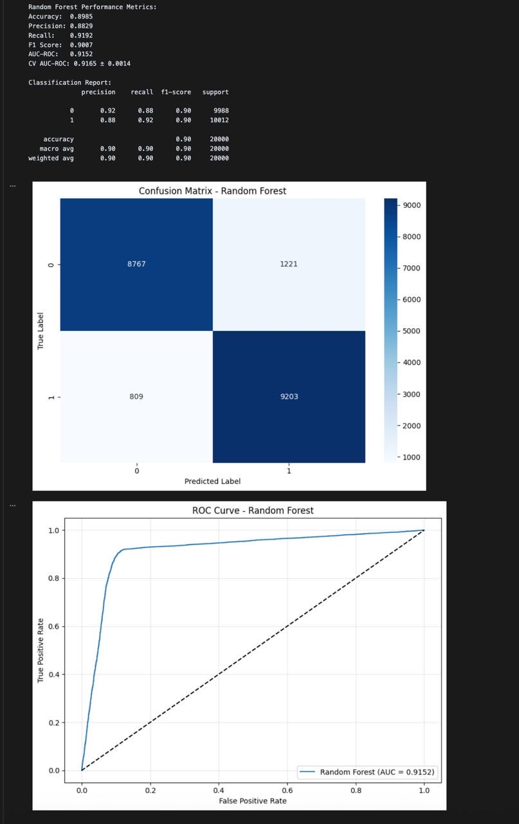
Random Forest

Slide 12
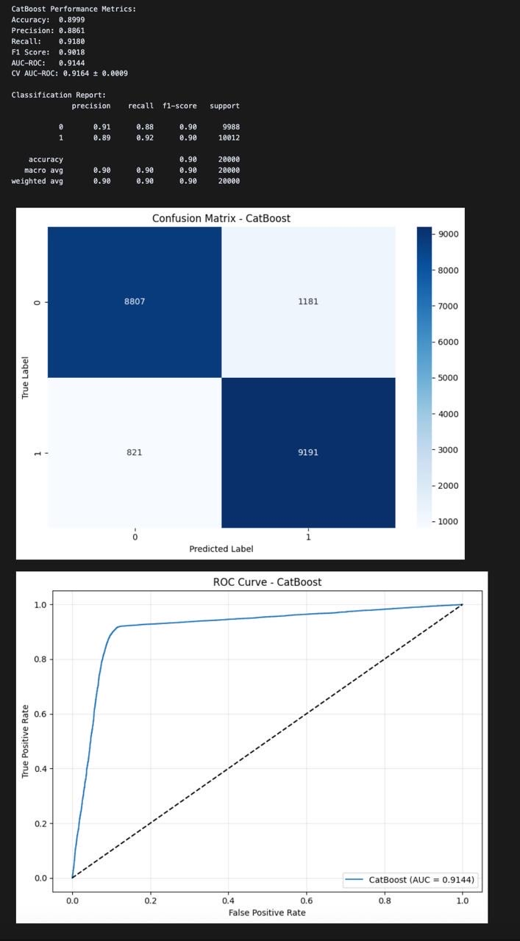
CatBoost

Slide 13
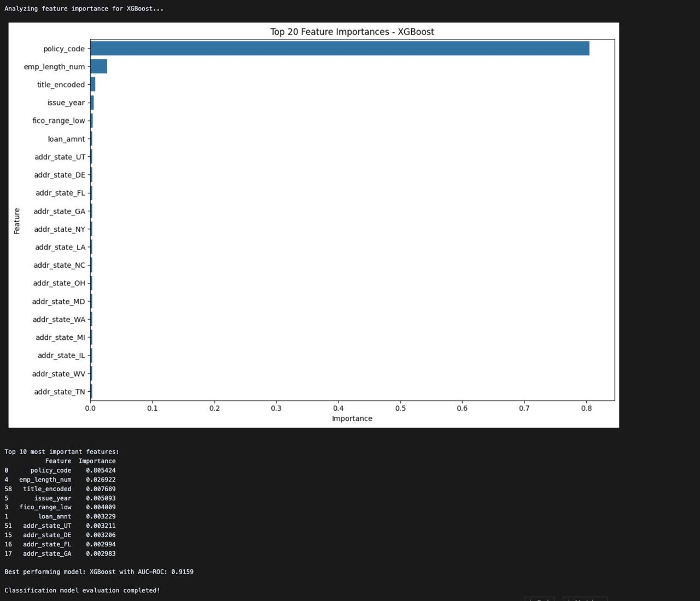
Feature Importance

Slide 14
Model Limitations
Challenges Faced:
Feature Correlation: Loan amount & DTI (r = 0.62)
Policy Code Bias: Dominated model, possible internal bias
Geographic Sparsity: Low data density in some states
Concept Drift: Financial behavior evolves; retraining is essential
Notes:
While the models perform well, we identified key challenges like multicollinearity, policy code dominance, and changing borrower behavior over time. These will guide future improvements.

Slide 15
Real World Case Studies
Case Study 1 – The Policy Edge
7 years employment, $12,000 loan, FICO 705
Prediction: 92% chance of repayment
Outcome: Repaid
Insight: Strong policy_code offset moderate DTI risk
Case Study 2 – The Geographic Factor
3 years employment, $22,000 loan, FICO 675, State: Florida
Prediction: 32% higher risk vs. same profile in Utah
Outcome: Defaulted after 9 months
Insight: State-level data captured regional economic signals
Case Study 3 – Employment Length Significance
<1 year employment, $15,000 loan, FICO 720
Prediction: • Logistic Regression: High risk • Tree Models: Medium-low risk
Outcome: Repaid
Insight: Tree models captured nuanced patterns missed by linear models
Notes:
These three examples show how model decisions align with real-world outcomes — and how non-obvious features like policy codes or geography can drive predictions.

Slide 16
Future Directions
What’s Next:
Ensemble Methods: Combine model strengths
Feature Interactions: Deeper analysis of combined signals
Temporal Modeling: Track behavior over time
Explainability: Use SHAP for deeper interpretability

Slide 17
Conclusion and Takeaway
Key Insights:
ML models achieved 90%+ accuracy
Internal policies outweigh credit scores
Geography affects default risk
XGBoost balances performance & efficiency
Employment history is more predictive than assumed
Impact:
Can improve approval rates by up to 14%
Maintain or reduce default rates
Significant financial gain for lenders

Slide 18
Thank you!

