Slide 1

DIGITAL NEPAL INITIATIVE
Smart Queue
Management System
(SQMS)
NOW SERVING
A-042
Counter 3 · Room 2
CROWD ADVISORY
Modernizing Citizen Service Delivery & Counter Operations at DAO Kathmandu
Moderate · est. wait ~12 min
PRESENTED BY
Bikash Dhakal
HCE080CSIT13
Manjil Chhetri
HCE080CSIT13
Deepak Singh
[HCE080CSIT13
Illustrative token card
Notes:
1

Slide 2




CONTEXT
The Problem & Our Vision
OUR SOLUTION
Crowded waiting halls
No live transparency
One synchronized ecosystem that eliminates queues and streamlines service delivery.
Citizens queue physically for hours.
No public view of who is being served.
Citizen Public Portal
Unclear checklists
Manual load balancing
real-time sync
Operator Workstation Terminal
Citizens arrive missing documents.
Staff shift work between desks by hand.
SQMS · DAO Kathmandu
2
Notes:
2

Slide 3






ARCHITECTURE
A Two-Tier Digital Ecosystem
TIER 1
TIER 2
Citizen Public Portal
Administrative & Operator Terminal
Mobile-first web app for real-time tracking, AI assistance and document checklists.
Secure counter workstation for token calling, verification, transfer and analytics.
  Live queue & crowd advisory
  24/7 AI citizen assistant
  Interactive document checklists
  Token calling & recall
  Verification & window transfer
  Queue monitor & analytics
INTEGRATION HIGHLIGHTS
Bilingual
English / Nepali support
Offline-resilient
Local sync keeps counters running
Accessible
Built for accessibility compliance
SQMS · DAO Kathmandu
3
Notes:
3

Slide 4

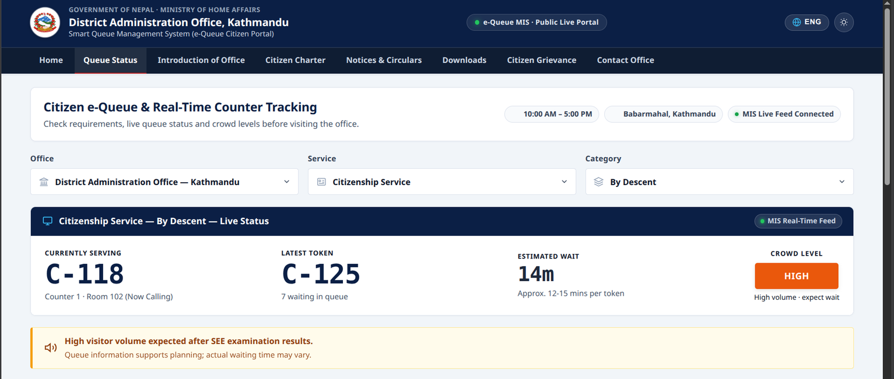



CITIZEN PORTAL · 04
Live Queue Tracking & Announcements
Live token display
Token now serving vs. latest issued, in real time.
Crowd advisory gauge
Low, Moderate, High and Very High levels.
Wait-time & room guidance
Average wait estimate with room direction indicators.
Department selector
Citizenship Services vs. National ID (NID).
✓
Outcome: citizens pick when to arrive, easing lobby crowding.
SQMS · DAO Kathmandu
4
Notes:
4

Slide 5
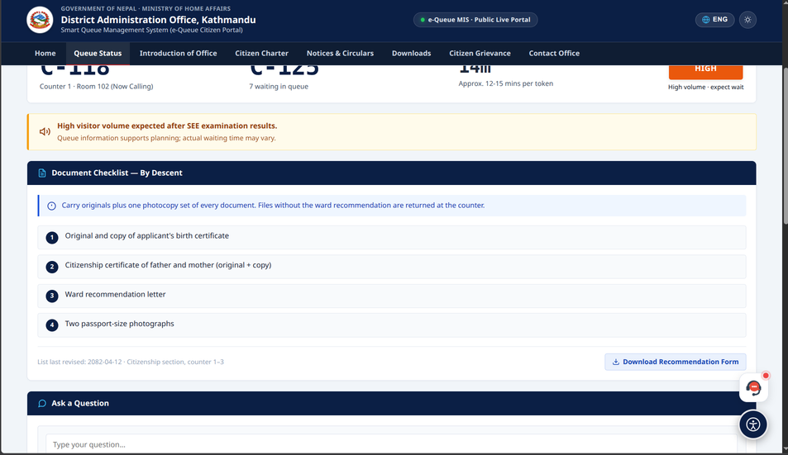




CITIZEN PORTAL · 05
Interactive Checklist & Accessibility
Dynamic document checklist
Descent, naturalized and marriage-based citizenship.
Accessibility toolbar
Screen reader, high contrast, dyslexic font, text scaling, pause motion.
English / Nepali switcher
One-click language change across the portal.
✓
Outcome: citizens arrive prepared and every citizen can use it.
SQMS · DAO Kathmandu
5
Notes:
5

Slide 6
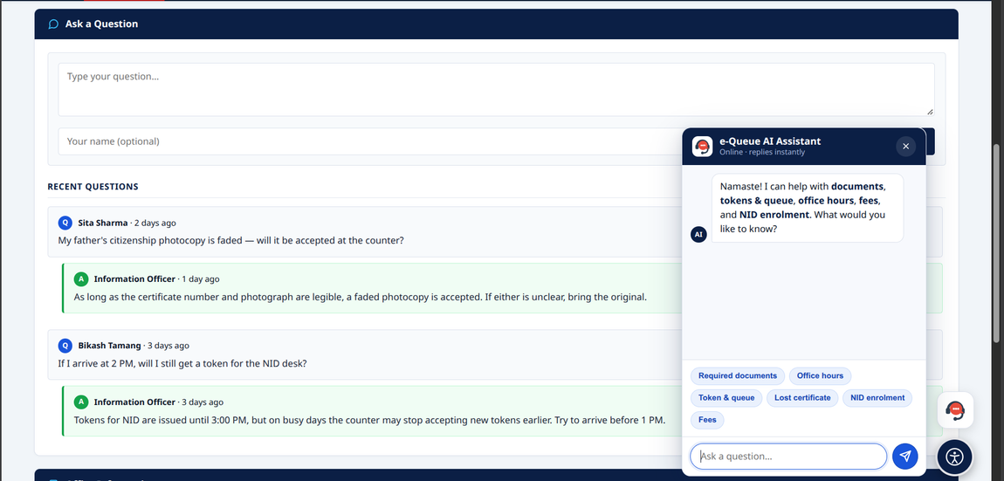



CITIZEN PORTAL · 06
24/7 AI Citizen Assistant & Inquiries
Rule-based + AI knowledge base
Answers on DAO services and circulars, any time.
Quick suggestion chips
Instant answers: fees, hours, documents, lost certificates.
Public inquiries wall
Citizen questions with administrative reply escalation.
✓
Outcome: routine questions are answered before the counter.
SQMS · DAO Kathmandu
6
Notes:
6

Slide 7
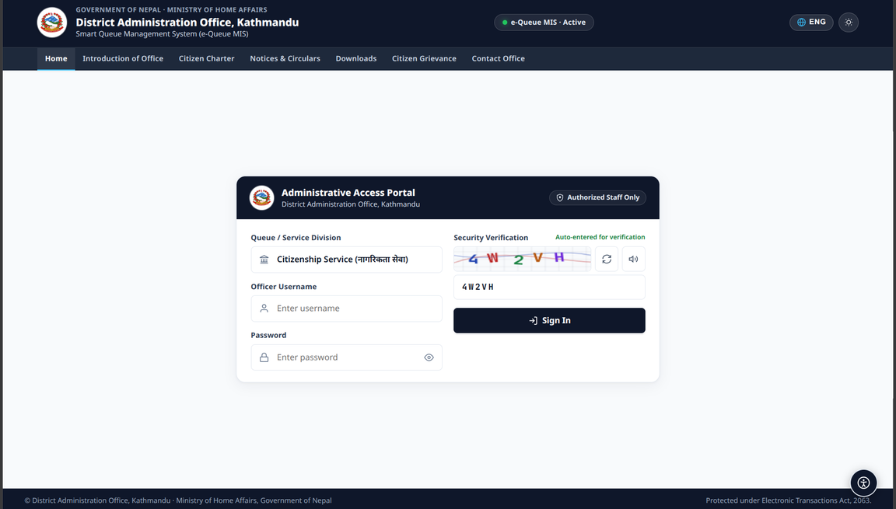



ADMIN PORTAL · 07
Secure Login & Department Partitioning
Role-based departments
Citizenship Division and NID Division kept separate.
Captcha-protected sign-in
Modern government sign-in viewport.
Isolated counter routing
No cross-department data clutter for operators.
✓
Outcome: operators see only their own division’s queue.
SQMS · DAO Kathmandu
7
Notes:
7

Slide 8
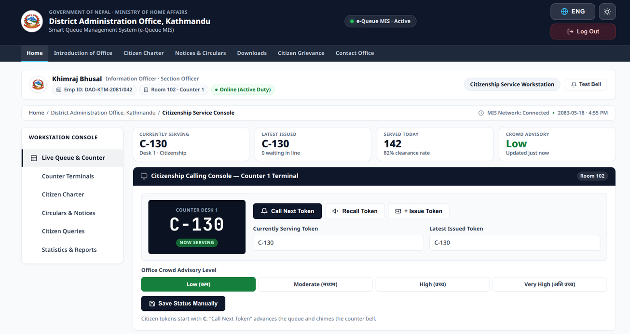



ADMIN PORTAL · 08
Operator Counter Terminal & Workstation
Counter operator console
Call Next, Recall, Mark Completed, Skip / No-Show.
Priority & window transfer
Prioritize citizens; transfer tokens between desks.
Live serving-token banner
Callout synced in real time with the public portal.
✓
Outcome: one consistent workflow, live status shared everywhere.
SQMS · DAO Kathmandu
8
Notes:
8

Slide 9
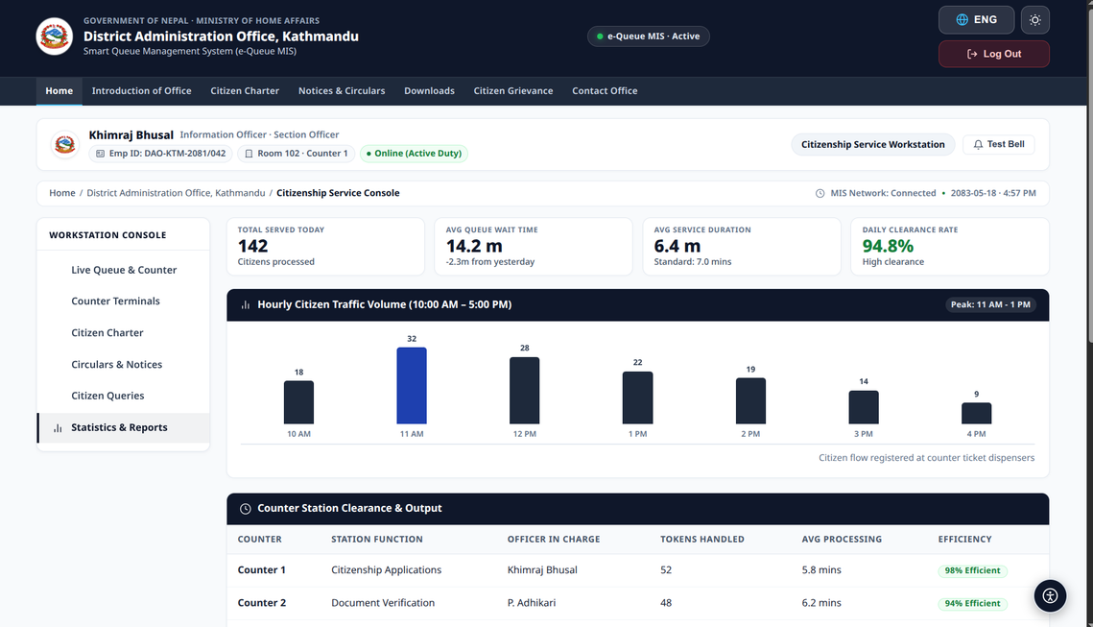



ADMIN PORTAL · 09
Real-time Queue Monitor & Analytics
Department queue monitoring
Waiting, in-service, completed and abandoned tokens.
Live counter status board
Status across Counters 1 through 5 at a glance.
Benchmarks & daily volume
Service speed benchmarks and daily volume counters.
✓
Outcome: supervisors rebalance counters from live data.
SQMS · DAO Kathmandu
9
Notes:
9

Slide 10



IMPACT & ROADMAP
Operational Impact & What’s Next
40%
85%
100%
reduction in on-premise waiting lobby congestion
drop in document-rejection rates via pre-visit checklists
transparency through a public digital audit trail
NEXT STEPS
Nagarik App integration
Tokens and live status inside the mobile app.
Automated SMS pinging
Alert citizens as their turn approaches.
Multi-district scaling
Replicate beyond DAO Kathmandu.
Notes:
10

Slide 11



CONCLUSION
Conclusion & Discussion
Better citizen experience
Live tracking, AI assistance and checklists cut waiting and confusion.
Thank you
Smarter counter operations
Operator console, transfers and live monitoring balance the workload.
Questions & Discussion
Ready to scale
Nagarik App, SMS alerts and multi-district rollout come next.
Notes:
11

