Slide 1
Maturing & Extending The EZSMT System
Nicholas Wilson
University of Nebraska at Omaha
Project Committee:
Dr. Yuliya Lierler
Dr. Abhishek Parakh
Dr. Jorge Fandinno Garcia

Slide 2
Introduction
Graduate Student
Computer Science
Family
Aviture

Slide 3
Outline
Background
Related Work
Project
Proposal
Contributions
System Comparison
Benchmarks
Challenges
Limitations
Conclusions

Slide 4
Background
Background

Slide 5
Answer Set Programming (ASP)
Background
Concepts
Program
In grounded form, set of boolean rules and atoms
Answer set
set of atoms that, when true, satisfy the program
{switch}.
{power}.
light :- switch, power.
:- light, not power.
Answer Set 1: {}
Answer Set 2: switch
Answer Set 3: power
Answer Set 4: switch, power, light

Slide 6
Answer Set Programming (ASP)
Background
Why ASP?
High-level; Declarative; Concise; Simple
Components
Grounder
Gringo
Solver
x(1..3).
y(1..2).
z(A,B) :- x(A), y(B).
x(1). x(2). x(3). y(1). y(2).
z(1,1). z(1,2). z(2,1). z(2,2). z(3,1). z(3,2).

Slide 7
Constraint Answer Set Programming (CASP)
Background
ASP + Non-Boolean constraints
Extended answer set: answer set + variable assignments that satisfy all constraints
{switch}.
{power}.
light :- switch, power.
:- light, not power.
:- light, 2 < hour, hour < 5
hour >= 0.
hour < 24.
An Extended Answer Set:
switch, power, light
Hour=10
Notes:
Constraint variable – clarify non-Boolean variable

Slide 8
Integrational or Translational Approach
Background
Integrational
Integrate constraint solver into existing answer set solver
Translational
Translate answer set program into a format that can be completely solved in a different solving framework
(Lierler, 2003)

Slide 9
Boolean Satisfiability Problem (SAT)
Background
Find assignment to Boolean variables that satisfies a boolean formula
Formula: (X ∧ Y ∧ Z) V !Z
Model 1: X, Y, Z
Model 2: X, Y, !Z
Model 3: !X, !Y, !Z
...

Slide 10
Satisfiability Modulo Theories (SMT)
Background
Generalization of SAT
Non-Boolean theories
Determine satisfiability of constraints within a theory w.r.t. a logic

Slide 11
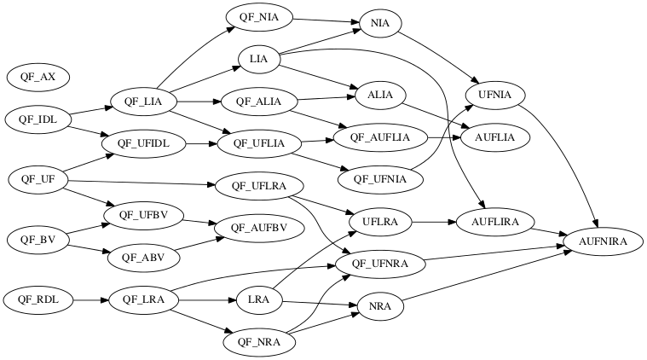
SMT-LIB
Background
SMT-LIB Logics
QF_LIA:
- Quantifier Free
- Linear
- Integer Arithmetic
QF_IDL:
- Quantifier Free
- Integer Difference Logic
http://smtlib.cs.uiowa.edu/logics.shtml

Slide 12
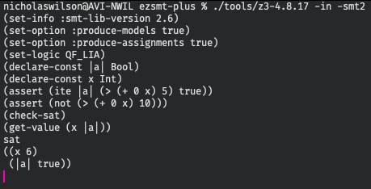
SMT-LIB
Background
SMT-LIB language
Low-level
(set-info :smt-lib-version 2.6)
(set-option :produce-models true)
(set-option :produce-assignments true)
(set-logic QF_LIA)
(declare-const |a| Bool)
(declare-const x Int)
(assert (ite |a| (> (+ 0 x) 5) true))
(assert (not (> (+ 0 x) 10)))
(check-sat)
(get-value (x |a|))

Slide 13
Review
Background
Answer Set Programming (ASP)
Constraint Answer Set Programming (CASP)
Integrational or Translational Approach
Boolean Satisfiability Problem (SAT)
Satisfiability Modulo Theories (SMT)
SMT-LIB

Slide 14
Related Work
Related Work

Slide 15
CModels
Related Work
2006, UT Austin
Answer Set Solver
Key Component: Completion construction
Translational approach
Backend: SAT Solver
https://www.cs.utexas.edu/users/tag/cmodels/
Notes:
What year?
Mention authors

Slide 16
EZCSP
Related Work
Constraint Answer Set solver
2009 (last updated 2021)
Kodac
Integrational approach
Clasp (ASP), BProlog (CP)
EZ language
http://www.mbal.tk/ezcsp/index.html

Slide 17
The EZ Language
Related Work
cspdomain(fd).
d(1..2).
cspvar(v(X),10,20) :- d(X).
required(v(1) >= v(2)).
required(sum([v/1],>=,39)).
cspvar(s,20,40).
required(sum([v/1],==,s)).
http://www.mbal.tk/ezcsp/index.html
Notes:
Populate with dumbed down example that matches an implemented logic
Take gringo 5 example and rewrite as EZ

Slide 18
EZSMT (1.0)
Related Work
2016, UNO
Constraint Answer Set Solver
Translational approach
Completion Engine: CModels
Backend: SMT Solver
EZ language

Slide 19
CModels(Diff)
Related Work
2018, UNO
Key Components
Completion construction
Level ranking construction
Backend: SMT Solver
Level ranking requires integer difference constraints

Slide 20
EZSMT+ (2.0)
Related Work
2018, UNO
CModels(Diff)
Basic answer set enumeration

Slide 21
Project
Project

Slide 22
“The main purpose of this project is to make EZSMT more valuable and accessible to the SMT and ASP communities and thereby encourage collaboration in the CASP field.”
Project

Slide 23
EZSMT 3.0
Project

Slide 24
Project Proposal
Project
Mature
Prototype → Stable System
Test coverage
Developer Experience
Lower maintenance cost
Extend
New input language
Answer set enumeration
ASP Minimization statements
Arbitrary SMT logics

Slide 25
Maturing EZSMT
Maturing EZSMT

Slide 26
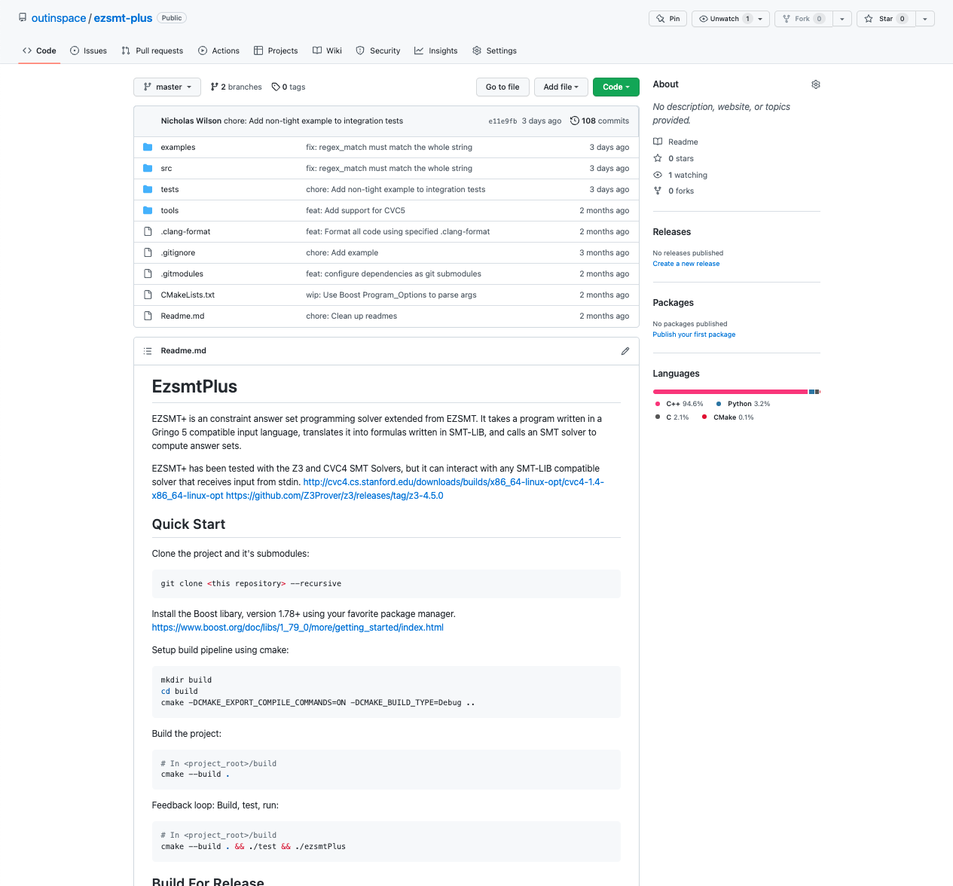
Code Repository
Maturing EZSMT
Version Control: Git, public GitHub repo
Code Formatting

Slide 27
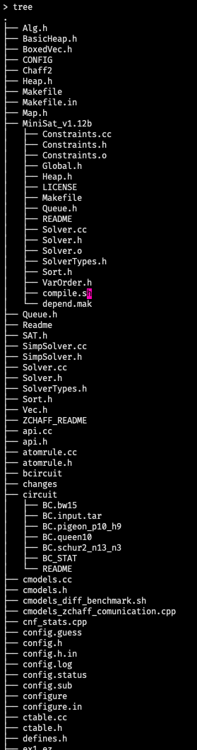
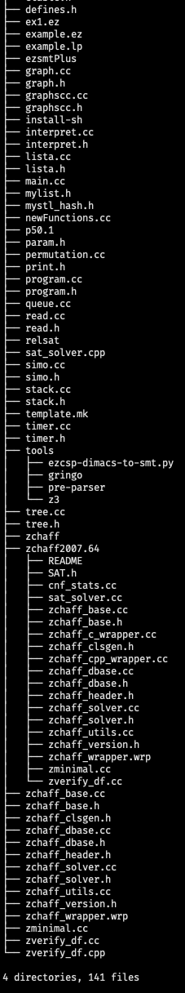
Code Repository
Maturing EZSMT
File Restructure

Slide 28
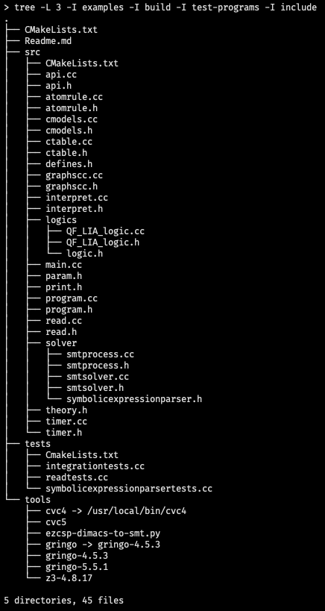
Code Repository
Maturing EZSMT
File Restructure

Slide 29
Build System
Maturing EZSMT
Cross-Platform Build System: Cmake
Dependencies

Slide 30
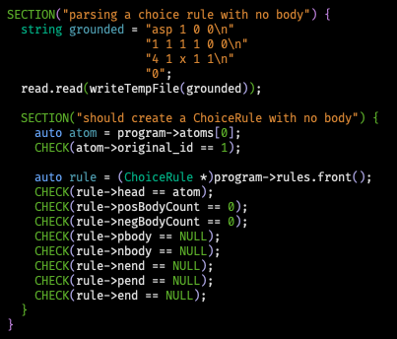
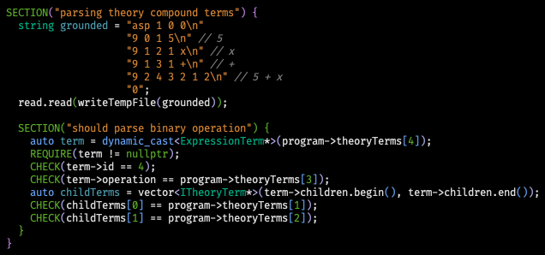
Test Coverage
Maturing EZSMT
Unit Tests

Slide 31
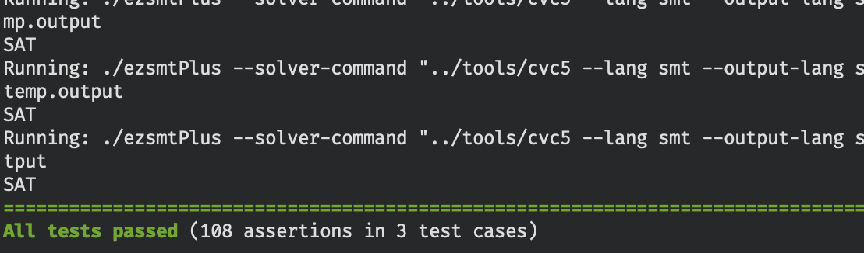
Test Coverage
Maturing EZSMT
Integration Tests
non-tight.lp | non-tight.expected
a:-c. b:-c. c:-a,b. c:-d. {d}. :-d,c. | {}

Slide 32
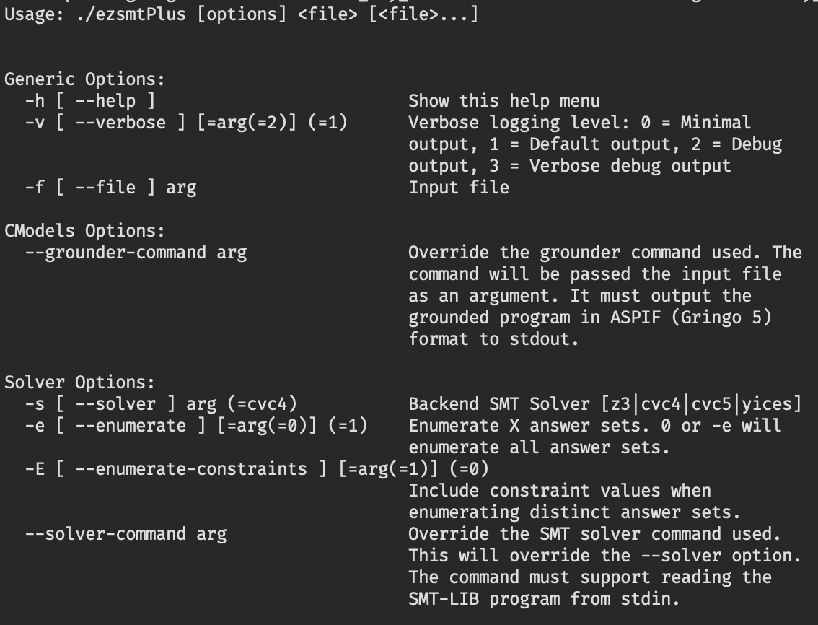
CLI Arguments Library
Maturing EZSMT
Less code to maintain
Automatically generated help menu
Grounder command argument
Solver command argument

Slide 33
Logging Library
Maturing EZSMT
User-configurable logging levels
0: Minimal output (for piping to another program)
1: Default output
2: User-friendly debug messages
3: Maintainer debug messages

Slide 34
Extending EZSMT
Project

Slide 35
Answer Set Enumeration
Extending EZSMT
EZSMT → File → SMT solver → EZSMT
Reload and re-solve entire program
EZSMT ⬄ SMT solver
Two-way pipes (Boost Process lib)
Holds program in memory
Efficient
Supported solvers: Z3, CVC4, CVC5, Yices

Slide 36
Answer Set Enumeration
Extending EZSMT
Input Pipe | Output Pipe
... (declare-const |a| Bool) (declare-const x Int) (assert (ite |a| (> x 5) true)) (assert (not (> x 10))) (check-sat) (get-value (x |a|)) | => ((x 6) (|a| true))
(assert (not (and (= x 6) (|a| true)))) (check-sat) (get-value (x |a|)) | => ((x 7) (|a| true))

Slide 37
ASP Minimization Statements
Extending EZSMT
Uses two-way pipes
Added support for minimization statements (single priority)
traveling-salesperson.lp | EZSMT Output
% Generate { cycle(X,Y) : edge(X,Y) } = 1 :- node(X). { cycle(X,Y) : edge(X,Y) } = 1 :- node(Y). % Define reached(Y) :- cycle(1,Y). reached(Y) :- cycle(X,Y), reached(X). % Test :- node(Y), not reached(Y). % Display #show cycle/2. % Optimize #minimize { C,X,Y : cycle(X,Y), cost(X,Y,C) }. | SAT cycle(1,4) cycle(4,2) cycle(3,1) cycle(2,6) cycle(6,5) cycle(5,3) 13 cycle(1,2) cycle(4,1) cycle(3,4) cycle(2,6) cycle(6,5) cycle(5,3) 12 cycle(1,2) cycle(4,1) cycle(3,4) cycle(2,5) cycle(6,3) cycle(5,6) 11
https://potassco.org/clingo/run/

Slide 38
New Input Language
Extending EZSMT
Gringo 4 → Gringo 5
Outputs ASPIF

Slide 39
Extending EZSMT
Input Logic Program | Gringo 4 Output | Gringo 5 Output (ASPIF)
% instance eagle(eddy). penguin(tux). % encoding fly(X) :- bird(X), not -fly(X). -fly(X) :- penguin(X). bird(X) :- penguin(X). bird(X) :- eagle(X). | 1 2 0 0 1 3 0 0 1 4 0 0 1 5 0 0 1 6 0 0 1 7 0 0 0 4 bird(tux) 5 bird(eddy) 6 -fly(tux) 7 fly(eddy) 3 penguin(tux) 2 eagle(eddy) 0 B+ 0 B- 1 0 1 | asp 1 0 0 1 0 1 1 0 0 1 0 1 2 0 0 1 0 1 3 0 0 1 0 1 4 0 0 1 0 1 5 0 0 1 0 1 6 0 0 4 10 bird(eddy) 0 4 9 bird(tux) 0 4 9 -fly(tux) 0 4 9 fly(eddy) 0 4 12 penguin(tux) 0 4 11 eagle(eddy) 0 0
https://potassco.org/clingo/run/

Slide 40
New Input Language
Extending EZSMT
Theory syntax
More flexible than EZ language
Support new SMT logics without changing EZSMT Reader

Slide 41
New Input Language
Extending EZSMT
Gringo parses logic program
Gringo grounds ASP atoms
ignoring content of theory atoms
Gringo outputs encoded abstract syntax tree (AST)
EZSMT Reader reconstructs AST

Slide 42
Extending EZSMT
Input Logic Program | Gringo 5 Output | EZSMT Reconstruction
% Theory definition #theory qf_lia { linear_term { + : 5, unary; - : 5, unary; * : 4, binary, left; + : 3, binary, left; - : 3, binary, left }; dom_term { + : 5, unary; - : 5, unary; .. : 1, binary, left }; &dom/0 : dom_term, {=}, linear_term, any; &sum/0 : linear_term, {<=,=,>=,<,>,!=}, linear_term, any }. % Program definition {a}. :- &sum {x + 20} > (1 + (3 + y)) + 5. | asp 1 0 0 1 0 0 0 1 1 1 1 1 2 0 0 9 1 0 3 sum 9 1 10 1 x 9 0 11 20 9 1 1 1 + 9 2 12 1 2 10 11 9 4 0 1 12 0 9 1 9 1 > 9 0 2 1 9 0 3 3 9 1 4 1 y 9 2 5 1 2 3 4 9 2 6 1 2 2 5 9 0 7 5 9 2 8 1 2 6 7 9 6 1 0 1 0 9 8 4 1 a 1 2 0 | T=Term, E=AtomElement :- A1 {A2}. T0 = “sum” T10 = “x” T11 = 20 T1 = “+” T12 = T1 T10 T11 E0 = [T12] : [] T9 = “>” T2 = 1 T3 = 3 T4 = “y” T5 = T1 T3 T4 T6 = T1 T2 T5 T7 = 5 T8 = T1 T6 T7 A1 = T0 {E0} T9 T8 A2 = “a”
https://www.cs.uni-potsdam.de/~torsten/Potassco/Slides/tsolving.pdf

Slide 43
Extending EZSMT
EZSMT Reconstruction
T=Term, E=AtomElement :- A1 {A2}. T0 = “sum” T10 = “x” T11 = 20 T1 = “+” T12 = T1 T10 T11 E0 = [T12] : [] T9 = “>” T2 = 1 T3 = 3 T4 = “y” T5 = T1 T3 T4 T6 = T1 T2 T5 T7 = 5 T8 = T1 T6 T7 A1 = T0 {E0} T9 T8 A2 = “a”
:- A1
:- T0 {E0} T9 T8
:- “sum” {E0} T9 T8
:- “sum” {[T12] : []} T9 T8
:- “sum” {(T1 T10 T11)} T9 T8
:- “sum” {(“+” T10 T11)} T9 T8
:- “sum” {(“+” “x” 20)} T9 T8
:- “sum” {“x” “+” 20} T9 T8
:- “sum” {“x” “+” 20} “>” T8
:- “sum” {“x” “+” 20} “>” (T1 T6 T7)
:- “sum” {“x” “+” 20} “>” (“+” T6 T7)
:- “sum” {“x” “+” 20} “>” (“+” (T1 T2 T5) T7)
:- “sum” {“x” “+” 20} “>” (“+” (“+” 1 T5) T7)
:- “sum” {“x” “+” 20} “>” (“+” (“+” 1 (T1 T3 T4)) T7)
:- “sum” {“x” “+” 20} “>” (“+” (“+” 1 (“+” 3 “y”)) T7)
:- “sum” {“x” “+” 20} “>” (“+” (“+” 1 (3 “+” “y”)) T7)
:- “sum” {“x” “+” 20} “>” (“+” (“+” 1 (3 “+” “y”)) 5)
:- “sum” {“x” “+” 20} “>” (“+” (1 “+” (3 “+” “y”)) 5)
:- “sum” {“x” “+” 20} “>” ((1 “+” (3 “+” “y”)) “+” 5)
:- &sum {x + 20} > (1 + (3 + y)) + 5

Slide 44
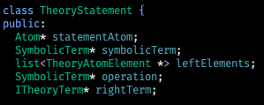





Extending EZSMT
EZSMT Reconstruction
T=Term, E=AtomElement :- A1 {A2}. T0 = “sum” T10 = “x” T11 = 20 T1 = “+” T12 = T1 T10 T11 E0 = [T12] : [] T9 = “>” T2 = 1 T3 = 3 T4 = “y” T5 = T1 T3 T4 T6 = T1 T2 T5 T7 = 5 T8 = T1 T6 T7 A1 = T0 {E0} T9 T8 A2 = “a”

Slide 45
Arbitrary SMT Logics
Extending EZSMT
Requirements
New logics shouldn’t increase system complexity
Adding a new logic shouldn’t require deep understanding of the system
Components
Gringo theory syntax
EZSMT Reader AST Construction
Logic interface

Slide 46
Arbitrary SMT Logics
Extending EZSMT
Example: Supporting a new logic
Program.ez | Program.lp
cspdomain(fd). d(1..2). cspvar(v(X),10,20) :- d(X). required(v(1) >= v(2)). required(sum([v/1],>=,39)). cspvar(s,20,40). required(sum([v/1],==,s)). | d(1..2). &dom {10..20} = v(X) :- d(X). &sum {v(1)} >= v(2). &sum {v(X) : d(X)} >= 39. &dom {20..40} = s. &sum {v(X) : d(X)} = s.
http://www.mbal.tk/ezcsp/index.html

Slide 47
1. Create Theory Grammar
Extending EZSMT
Program.lp
#theory qf_lia { linear_term { + : 5, unary; - : 5, unary; * : 4, binary, left; + : 3, binary, left; - : 3, binary, left }; dom_term { + : 5, unary; - : 5, unary; .. : 1, binary, left }; &dom/0 : dom_term, {=}, linear_term, any; &sum/0 : linear_term, {<=,=,>=,<,>,!=}, linear_term, any }. d(1..2). &dom {10..20} = v(X) :- d(X). &sum {v(1)} >= v(2). &sum {v(X) : d(X)} >= 39. &dom {20..40} = s. &sum {v(X) : d(X)} = s.

Slide 48
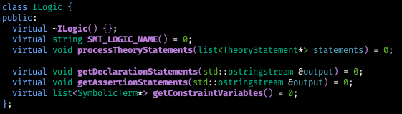
2. Write EZSMT logic implementation
Extending EZSMT

Slide 49
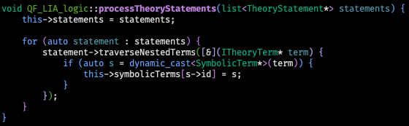
2. Write EZSMT logic implementation
Extending EZSMT
Logic Interface
Reader
(Atoms, Rules, Theories)
Theory Statements
QF_LIA Logic
Another Logic
Another Logic

Slide 50

2. Write EZSMT logic implementation
Extending EZSMT
(declare-const |v(1)| Int)
Logic Interface
Reader
(Atoms, Rules, Theories)
QF_LIA Logic
Another Logic
…
SMT Declarations
Another Logic
SMT Solver Bridge

Slide 51
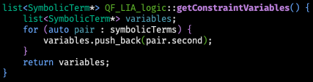
2. Write EZSMT logic implementation
Extending EZSMT
Logic Interface
Reader
(Atoms, Rules, Theories)
QF_LIA Logic
Another Logic
…
SMT Declarations,
Constraint Variables
Another Logic
SMT Solver Bridge

Slide 52
2. Write EZSMT logic implementation
Extending EZSMT
Logic Interface
Reader
(Atoms, Rules, Theories)
QF_LIA Logic
Another Logic
…
SMT Declarations,
Constraint Variables,
Assertions
Another Logic
SMT Solver Bridge

Slide 53
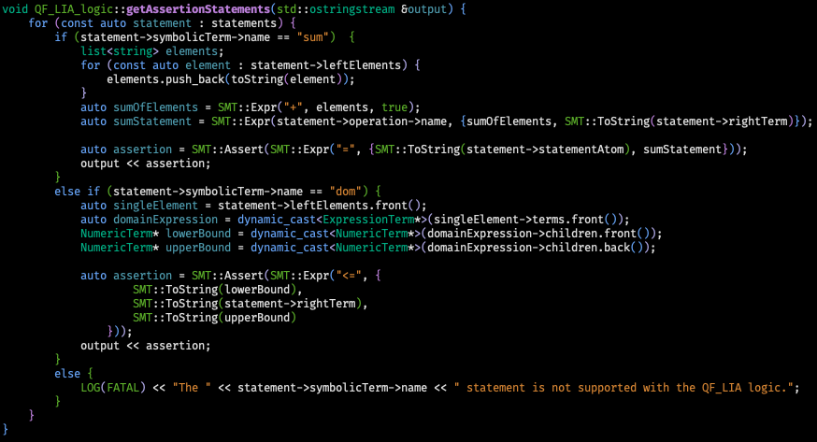
2. Write EZSMT logic implementation
Extending EZSMT
Example: &sum {v(X) : d(X)} = s.

Slide 54
2. Write EZSMT logic implementation
Extending EZSMT
Example: &sum {v(X) : d(X)} = s.
(+ |v(1)| |v(2)|)
(assert (= |EZSMTPLUS_THEORY(3)| (= (+ |v(1)| |v(2)|) s)))

Slide 55
2. Write EZSMT logic implementation
Extending EZSMT
Example: &sum {v(X) : d(X)} = s.
(+ |v(1)| |v(2)|)
(= (+ |v(1)| |v(2)|) s))
(assert (= |EZSMTPLUS_THEORY(3)| (= (+ |v(1)| |v(2)|) s)))

Slide 56
2. Write EZSMT logic implementation
Extending EZSMT
Example: &sum {v(X) : d(X)} = s.
(+ |v(1)| |v(2)|)
(= (+ |v(1)| |v(2)|) s))
(assert (= |EZSMT_THEORY(3)| (= (+ |v(1)| |v(2)|) s)))

Slide 57
2. Write EZSMT logic implementation
Extending EZSMT
Example: &sum {v(X) : d(X)} = s.
(+ |v(1)| |v(2)|)
(= (+ |v(1)| |v(2)|) s))
(assert (= |EZSMT_THEORY(3)| (= (+ |v(1)| |v(2)|) s)))

Slide 58
2. Write EZSMT logic implementation
Extending EZSMT
Program.lp | Generated SMT-LIB Program
#theory qf_lia { linear_term { + : 5, unary; - : 5, unary; * : 4, binary, left; + : 3, binary, left; - : 3, binary, left }; dom_term { + : 5, unary; - : 5, unary; .. : 1, binary, left }; &dom/0 : dom_term, {=}, linear_term, any; &sum/0 : linear_term, {<=,=,>=,<,>,!=}, linear_term, any }. d(1..2). &dom {10..20} = v(X) :- d(X). &sum {v(1)} >= v(2). &sum {v(X) : d(X)} >= 39. &dom {20..40} = s. &sum {v(X) : d(X)} = s. | (set-info :smt-lib-version 2.6) (set-option :produce-assignments true) (set-logic QF_LIA) (declare-const |1| Bool) (declare-const |2| Bool) (declare-const |EZSMT_THEORY(3)| Bool) (declare-const |EZSMT_THEORY(4)| Bool) (declare-const |EZSMT_THEORY(5)| Bool) (declare-const |EZSMT_THEORY(6)| Bool) (declare-const |EZSMT_THEORY(7)| Bool) (declare-const |EZSMT_THEORY(8)| Bool) (declare-const |d(1)| Bool) (declare-const |d(2)| Bool) (declare-const |11| Bool) (declare-const |12| Bool) (declare-const s Int) (declare-const |v(1)| Int) (declare-const |v(2)| Int) (assert (or |1|)) (assert (or |2|)) (assert (or |EZSMT_THEORY(3)|)) (assert (or |EZSMT_THEORY(4)|)) (assert (or |EZSMT_THEORY(5)|)) (assert (or |EZSMT_THEORY(6)|)) (assert (or |EZSMT_THEORY(7)|)) (assert (or |EZSMT_THEORY(8)|)) (assert (or |d(1)|)) (assert (or |d(2)|)) (assert (or |11|)) (assert (or (not |12|))) (assert (= |EZSMT_THEORY(3)| (= (+ |v(1)| |v(2)|) s))) (assert (<= 20 s 40)) (assert (= |EZSMT_THEORY(5)| (>= (+ |v(1)| |v(2)|) 39))) (assert (= |EZSMT_THEORY(6)| (>= |v(1)| |v(2)|))) (assert (<= 10 |v(1)| 20)) (assert (<= 10 |v(2)| 20))

Slide 59
3. Use the new EZSMT logic
Extending EZSMT
Program.ez | Program.lp
cspdomain(fd). d(1..2). cspvar(v(X),10,20) :- d(X). required(v(1) >= v(2)). required(sum([v/1],>=,39)). cspvar(s,20,40). required(sum([v/1],==,s)). | % import QF_LIA theory definition from file d(1..2). &dom {10..20} = v(X) :- d(X). &sum {v(1)} >= v(2). &sum {v(X) : d(X)} >= 39. &dom {20..40} = s. &sum {v(X) : d(X)} = s.
http://www.mbal.tk/ezcsp/index.html

Slide 60
3. Use the new EZSMT logic
Extending EZSMT
Program.ez | Program.lp
cspdomain(fd). d(1..2). cspvar(v(X),10,20) :- d(X). required(v(1) >= v(2)). required(sum([v/1],>=,39)). cspvar(s,20,40). required(sum([v/1],==,s)). | % import QF_LIA theory definition from file d(1..2). &dom {10..20} = v(X) :- d(X). &sum {v(1)} >= v(2). &sum {v(X) : d(X)} >= 39. &dom {20..40} = s. &sum {v(X) : d(X)} = s.
EZCSP Output | EZSMT Output
Answer: 1 Stable Model: cspdomain(fd) d(1) d(2) required(ezcsp__geq(v(1),v(2))) required(ezcsp__sum(list(v,1),ezcsp__geq,39)) cspvar(s,20,40) required(ezcsp__sum(list(v,1),ezcsp__eq,s)) cspvar(v(1),10,20) cspvar(v(2),10,20) s=39 v(1)=20 v(2)=19 Answer: 2 Stable Model: cspdomain(fd) d(1) d(2) required(ezcsp__geq(v(1),v(2))) required(ezcsp__sum(list(v,1),ezcsp__geq,39)) cspvar(s,20,40) required(ezcsp__sum(list(v,1),ezcsp__eq,s)) cspvar(v(1),10,20) cspvar(v(2),10,20) s=40 v(1)=20 v(2)=20 False | SAT d(1) d(2) v(1)=20 v(2)=19 s=39 d(1) d(2) v(1)=20 v(2)=20 s=40
http://www.mbal.tk/ezcsp/index.html

Slide 61
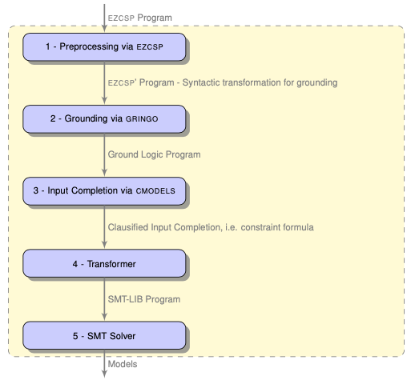
System Comparison
Extending EZSMT
EZSMT 1.0
(Susman, 2016)

Slide 62
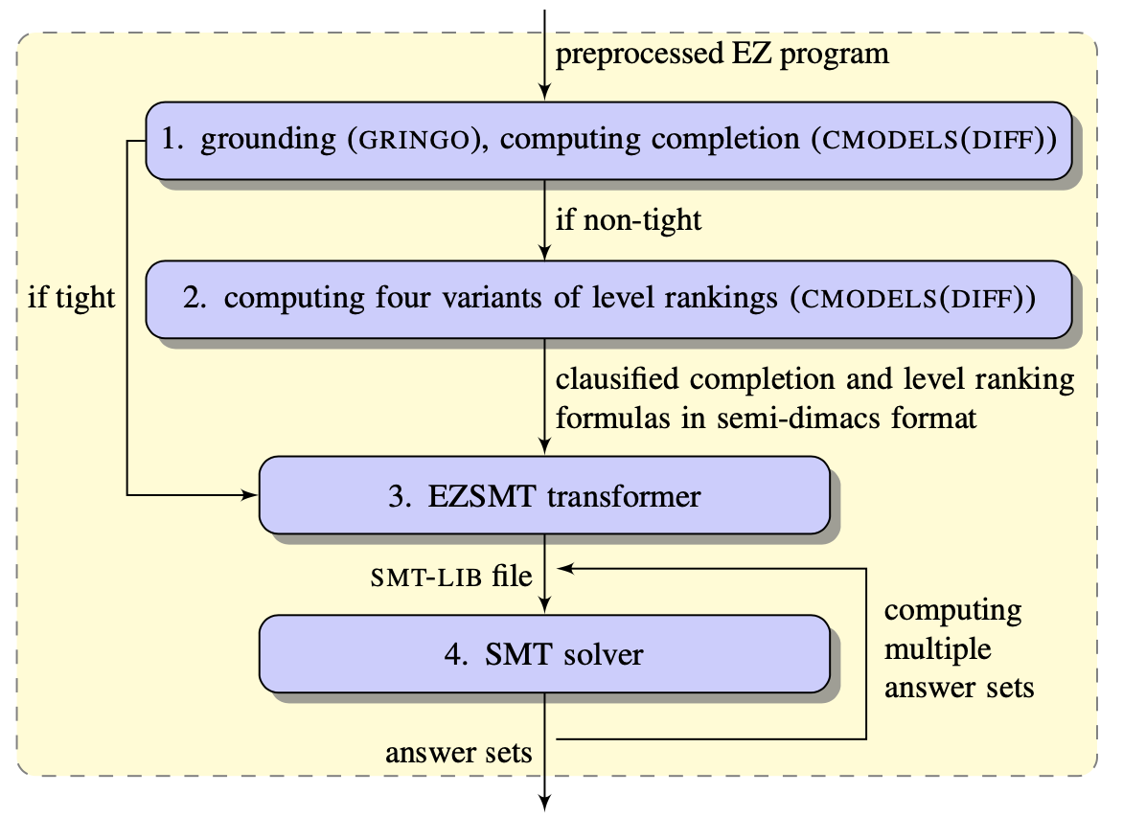
System Comparison
Extending EZSMT
EZSMT 2.0
(Shen, 2018)

Slide 63
System Comparison
Extending EZSMT
Logic Program
EZSMT 3.0
EZSMT 2.0

Slide 64
System Comparison
Extending EZSMT
Logic Program
EZSMT 3.0
EZSMT 2.0
Gringo (Grounding)
Grounded ASPIF Program
Reader
(Atoms, Rules, Theories)

Slide 65
System Comparison
Extending EZSMT
Logic Program
EZSMT 3.0
EZSMT 2.0
Gringo (Grounding)
Grounded ASPIF Program
Reader
(Atoms, Rules, Theories)
CModels(Diff)
(Completion, level ranking)
Clauses, Level Ranking Constraints

Slide 66
System Comparison
Extending EZSMT
Logic Program
EZSMT 3.0
EZSMT 2.0
Gringo (Grounding)
Grounded ASPIF Program
Logic Interface
Reader
(Atoms, Rules, Theories)
Theory AST
QF_LIA Logic
Another Logic
CModels(Diff)
(Completion, level ranking)
Constraints
Another Logic
Clauses, Level Ranking Constraints
SMT Solver Bridge

Slide 67
System Comparison
Extending EZSMT
Logic Program
EZSMT 3.0
EZSMT 2.0
Gringo (Grounding)
Grounded ASPIF Program
Logic Interface
Reader
(Atoms, Rules, Theories)
Theory AST
QF_LIA Logic
Another Logic
CModels(Diff)
(Completion, level ranking)
Constraints
Another Logic
Clauses, Level Ranking Constraints
SMT Solver Bridge
SMT Solver Process
SMT-LIB
Program
Inter-process pipes
Extended Answer Sets

Slide 68
System Comparison
Extending EZSMT
Logic Program
EZSMT 3.0
EZSMT 2.0
Gringo (Grounding)
Grounded ASPIF Program
Logic Interface
Reader
(Atoms, Rules, Theories)
Theory AST
QF_LIA Logic
Another Logic
CModels(Diff)
(Completion, level ranking)
Constraints
Another Logic
Clauses, Level Ranking Constraints
SMT Solver Bridge
SMT Solver Process
SMT-LIB
Program
Extended Answer Sets

Slide 69
Benchmarks
Benchmarks

Slide 70
Benchmarks
Benchmarks
What are we comparing?
Generated SMT-LIB program should be the same
Minor differences
Same underlying theory
EZSMT ⬄ SMT Solver communication
Should account for the majority of performance changes
Notes:
Enumeration
Compare with EZSMT, Clingcon, Clingo
Minimization statements
Compare with Clingcon, Clingo
Copy performance table from other publication with EZSMT. Put early in presentation as motivation.
This system should be relatively same performance as EZSMT prior
Motivation – EZSMT has good performance and now is extensible.
Double check hypothesis

Slide 71
N-Queens
Benchmarks
Hypothesis
Similar performance when computing 1 answer set
Big performance increases when computing all answer sets
EZSMT2 starts multiple processes
EZSMT3 streams incrementally to a single process
Notes:
Enumeration
Compare with EZSMT, Clingcon, Clingo
Minimization statements
Compare with Clingcon, Clingo
Copy performance table from other publication with EZSMT. Put early in presentation as motivation.
This system should be relatively same performance as EZSMT prior
Motivation – EZSMT has good performance and now is extensible.
Double check hypothesis

Slide 72
N-Queens: 1 Answer Set
Benchmarks
 | CVC4 |  |  | Z3
Instance | EZSMT 2 | EZSMT 3 | % Change | EZSMT 2 | EZSMT 3 | % Change
N-Queens 7 | .13s | .27s | 107.7% | .18s | .18s | 0%
N-Queens 8 | .14s | .34s | 142.9% | .10s | .21s | 110%
N-Queens 9 | .17s | .44s | 158.8% | .11s | .27s | 145.5%
Notes:
Enumeration
Compare with EZSMT, Clingcon, Clingo
Minimization statements
Compare with Clingcon, Clingo
Copy performance table from other publication with EZSMT. Put early in presentation as motivation.
This system should be relatively same performance as EZSMT prior
Motivation – EZSMT has good performance and now is extensible.
Double check hypothesis

Slide 73
N-Queens: All Answer Sets
Benchmarks
 | CVC4 |  |  | Z3
Instance | EZSMT 2 | EZSMT 3 | % Change | EZSMT 2 | EZSMT 3 | % Change
N-Queens 7 (40 answer sets) | 3.11s | .56s | -82% | 1.78s | .57s | -68%
N-Queens 8 (92 answer sets) | 10.74s | 1.27s | -88.2% | 5.75s | 1.08s | -81.2%
N-Queens 9 (352 answer sets) | 97.69s | 4.62s | -95.3% | 80.44s | 4.63s | -94.2%
Notes:
Enumeration
Compare with EZSMT, Clingcon, Clingo
Minimization statements
Compare with Clingcon, Clingo
Copy performance table from other publication with EZSMT. Put early in presentation as motivation.
This system should be relatively same performance as EZSMT prior
Motivation – EZSMT has good performance and now is extensible.
Double check hypothesis

Slide 74
Challenges
Challenges

Slide 75
Challenges
Challenges
Initial learning curve
C++, SMT-LIB, ASPIF
Technical debt
C++, Python
Build system
Tight coupling
Lack of tests
Limited time

Slide 76
Limitations
Limitations

Slide 77
Limitations
Limitations
Grounding explosion applies to CASP just as much as ASP
Theory must be defined or imported in the input file

Slide 78
Conclusions
Conclusions

Slide 79
Contributions
Conclusions
Mature, extendable infrastructure
Logic interface
Basic QF_LIA logic support
Improved system architecture
Improved answer set enumeration
Basic ASP minimization statement support
Gringo5 ASPIF input language
Notes:
Emphasize the infrastructure that has been created

Slide 80
Future Work
Conclusions
More test coverage
Detect logic from input file
Support multi-priority minimization statements
Additional SMT logic implementations
Non-boolean minimizations
Package for distribution
Performance enhancements
Documentation
Benchmarks

Slide 81
Acknowledgements
Conclusions
Project committee
Chair: Dr. Yuliya Lierler
Dr. Abhishek Parakh
Dr. Jorge Fandinno Garcia
Additional resources
Benjamin Susman
Da Shen

Slide 82
References & Further Reading
Conclusions
Banbara, M., Kaufmann, B., Ostrowski, M., Schaub, T. (2003). Clingocon: The Next Generation. Theory and Practice of Logic Programming.
Kaminski, R., Romero, J., Schaub, T., Wanko, P. (2003). How to build your own ASP-based system?!. Theory and Practice of Logic Programming.
Lierler, Y. (2003). Constraint Answer Set Programming: Integrational and Translational (or SMT-based) Approaches. Theory and Practice of Logic Programming.
Lierler, Y. (2010). SAT-based Answer Set Programming. PhD thesis, University of Texas at Austin.
Shen, D., Lierler, Y. (2018). SMT-based Answer Set Solver CMODELS-DIFF (System Description). University of Nebraska at Omaha.
Susman, B. (2016). The EZSMT Solver: Constraint Answer Set Solving meets SMT.

Slide 83
Questions?
Conclusions

