Slide 1
PERSONALIZED EDUCATION WITH AI TUTORS
The Rise Of AI Tutors

Slide 2

CORE IDEA:
Personalized education with AI tutors is that AI tutors are revolutionizing personalized learning by:
Using adaptive techniques to tailor education to individual student needs.
Leveraging machine learning and natural language processing to create a more engaging and effective learning experience.
Providing measurable benefits like improved student engagement and academic achievement.

Slide 3
TECHNICAL SPECIFICATION:
Machine Learning
Natural Language Processing (NLP)
Data Analytics
Educational Content

Slide 4
—Introduction
In the rapidly evolving landscape of education, personalized learning has emerged as a transformative approach that tailors educational experiences to individual student needs and preferences. Without AI tutors, students often face significant challenges such as
Lack of individualized attention and support.
Difficulty in identifying and addressing knowledge gaps.
Limited access to quality educational resources.
Motivational challenges and language barriers.
Difficulty in tracking progress effectively.

Slide 5


Traditional education struggles to accommodate various learning needs, leading to disparities in academic performance. Student often disengage due to lack of personalized instruction and interactive learning experiences.
Problem Statement:

Slide 6

Solution Overview:
Integrate AI tutors with BCI and VR technologies to deliver personalized, adaptive, and immersive learning experiences.
In this new way of learning, Artificial Intelligence (AI) is used to help students learn better.
Offer dynamic and adaptive learning experiences.
Provide personalized feedback and real-time support.
Identify and address individual knowledge gaps.
Enhance motivation through personalized encouragement.
Accommodate special needs with customized instruction.
Improve tracking of student progress for timely interventions.

Slide 7
How It Works:
Initial Assessment: Gather data on student strengths, weaknesses, and learning styles.
Curating Learning Path: Customize learning paths with appropriate materials.
Interactive Learning: Deliver multimedia lessons tailored to individual preferences.
Adaptive Learning: Adjust difficulty and provide feedback based on interactions.
Feedback and Reinforcement: Offer immediate feedback and positive reinforcement.
Continuous Improvement: Evolve based on interactions and student data analysis.

Slide 8
Flow chart
Start
|
V
1. Assessment
|
V
2. Personalization
|
V
3. Content Delivery
|
V
4. Feedback and Adaptation
|
V
5. Data Analysis
|
V
6. Progress Tracking
|
V
7. Intervention and Support
|
V
8. Continuous Improvement
|
V
End

Slide 9
Features
Initial Assessment : The focus should be on understanding the learner’s current knowledge, skills, preferences, and goals
A Voice Search: Users can utilize voice commands to search for topics and have them read aloud by the AI tutor.
Webcam Behavior Analysis: The AI tutor monitors student engagement through webcam analysis, detecting signs of boredom or disinterest. When boredom is detected, the system provides engaging activities such as puzzles, quiz to re-engage the student and maintain focus.
Interactive Learning: Interactive learning transforms the educational experience by making it more engaging and effective
Personal Study Plans: AI tutors generate personalized study plans based on individual learning styles, strengths, and weaknesses.
Speak Image, Mice: This feature enables users to verbally describe an image or topic without typing, enhancing accessibility for those with limited typing abilities.

Slide 10
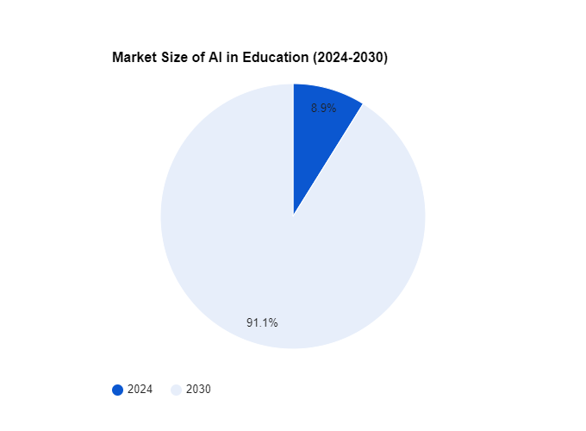
Target Market Size:
The AI in education market is estimated to be worth around $5.4 billion in 2024 and is projected to grow significantly, reaching $55.4 billion by 2030 at a CAGR (Compound Annual Growth Rate) of 47.2%. This indicates a rapidly expanding market for AI tutors, which are a sub-segment of the border AI in education market.

Slide 11
Software Requirements for Personalized Learning with AI Tutors:
Functional Requirements:
User Management: to manage different user roles (students, teachers, admins) with logins, profiles, and access controls.
Learning Content Management: AI tutors need a system to store and organize learning materials (text, video, audio, quizzes, etc.) with tagging for easy search, and can optionally connect to existing learning platforms.
AI Engine: adjusts difficulty, recommends materials, and creates custom practice problems

Slide 12
Delivery and Interaction: AI tutors offer students multiple ways to learn (text, audio, video) and interact (typing, voice - optional) with an intelligent interface that personalizes the experience.
Assessment and Feedback: AI tutors automatically grade work, provide personalized feedback, and track student progress through dashboards for both students and teachers.

Slide 13
Non-Functional Requirements:
Performance: The system should be responsive and deliver learning content with minimal lag. Efficient data processing and analysis by the AI engine.
Scalability: The System should be able to accommodate a growing number of users and data.
Security: Secure user authentication and data encryption to protect student privacy. Compliance with data privacy regulations (e.g., GDPR, FERPA).
Availability: The system should be highly available with minimal downtime.

Slide 14
Maintainability: The system should be easy to maintain and update with new features.
Usability: User-friendly interface for students, teachers, and administrators. Intuitive interaction with the AI tutor.
Reliability: The AI engine should deliver consistent and accurate learning recommendations.

Slide 15
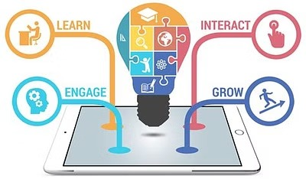
Benefits:
Personalization: Custom learning paths and real-time adjustments ensure that education is tailored to individual needs.
Engagement: Interactive and intuitive learning experiences keep students motivated and involved.
Accessibility: Broad access to resources and support for diverse learning needs make education more inclusive.
Efficiency: Continuous monitoring and adaptive learning help students progress more effectively.
Support: Enhanced feedback, parental and teacher involvement, and special accommodations ensure a supportive learning environment.
Scalability: High-quality, personalized education can be delivered to a large number of students cost-effectively.

Slide 16

Conclusion
In conclusion, personalized learning with AI tutors powered by NLP not only transforms the educational landscape by addressing key challenges but also paves the way for a more inclusive, efficient, and engaging learning experience. As technology continues to evolve, the potential for AI in education will only grow, offering even more sophisticated tools and methods to support learners worldwide. This innovative approach promises to equip students with the knowledge and skills they need to succeed in an ever-changing world.

Slide 17
THANK YOU!

