Slide 1
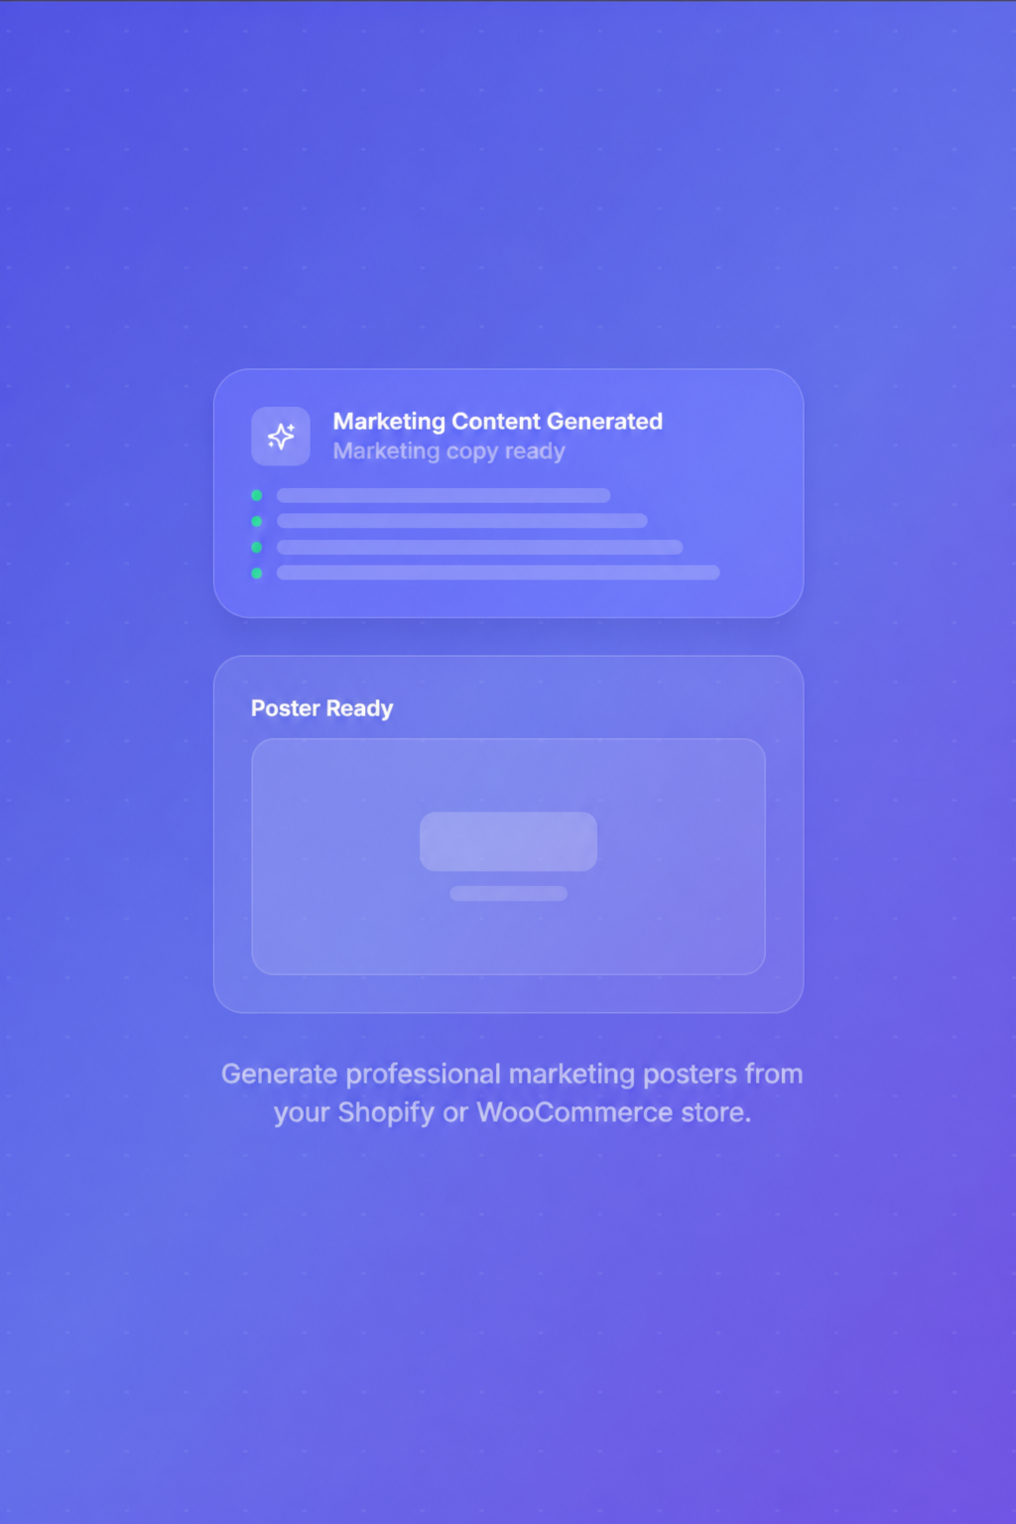
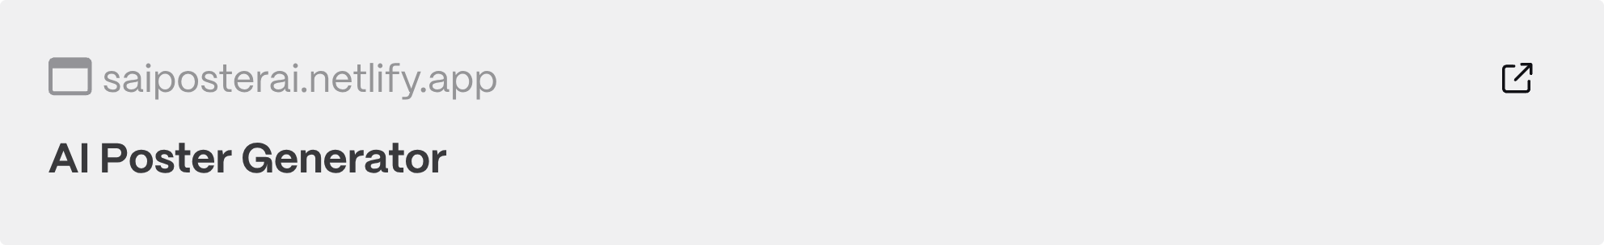
AI Poster Generator
An software platform that transforms e-commerce products into professional marketing posters — automatically.
🚀 Marketing Content Generation
🛍️ Store Integration
📤 One-Click Export

Slide 2
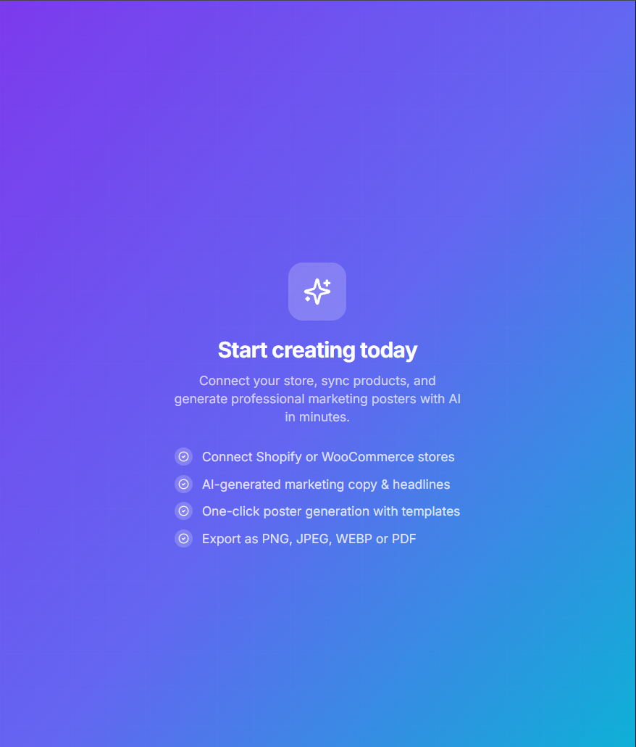

PRESENTATION
AGENDA
PROBLEM STATEMENT
SOLUTION
SYSTEM ARCHITECTURE
TECHNOLOGY STACK
STORE INTEGRATION
POSTER PIPELINE
CORE FEATURES

Slide 3
PROBLEM STATEMENT
The Challenge of Manual Poster Creation
⏱ Time-Consuming
🎨 No Design Resources
Every new product requires creating posters from scratch.
Hiring designers for every campaign is expensive.
🔁 Repetitive Editing
🚀 Slow Campaigns
Templates still require manual editing for every product.
Large catalogs delay marketing campaigns and product launches.
Manual poster creation doesn't scale with growing product catalogs.

Slide 4
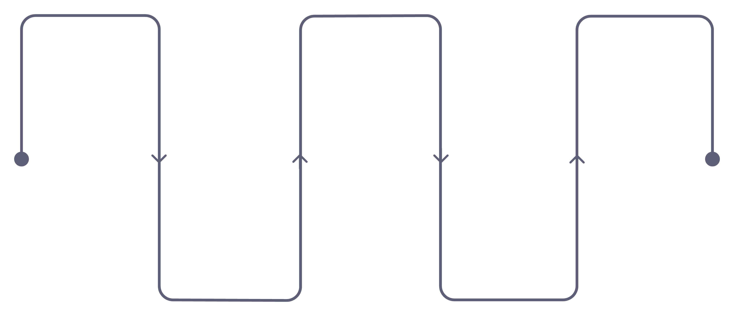
SOLUTION
From Store to Poster in Minutes
Connect Store
Generate
Marketing Content
Export
Authorize your e-commerce account
Download generated posters
Create titles and descriptions
Sync Products
Create Poster
Import product data on demand
Auto-layout images and text
A user-driven workflow — synchronize products, generate marketing content, create posters, and export downloads.

Slide 5
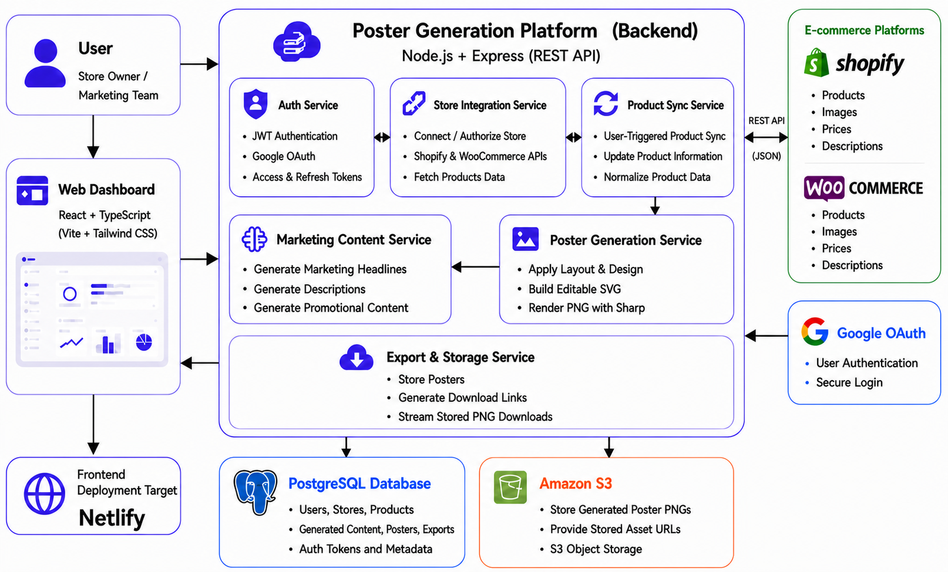
SYSTEM ARCHITECTURE
Architecture Overview

Slide 6
TECHNOLOGY STACK
Modern, Production-Ready Stack
Frontend
Backend
React · TypeScript · Vite · Tailwind CSS · React Query
Node.js · Express · TypeScript · REST API
Database
Storage & Deployment
PostgreSQL · Prisma ORM
Amazon S3 · Netlify/Render targets

Slide 7

STORE INTEGRATION
Seamless E-Commerce Sync
Verify Store
Manual Synchronization
Confirm credentials and connection
User-triggered catalog updates
Synchronize Products
Import catalog and match fields
After connecting a store, the user triggers product synchronization to import and update the catalog.

Slide 8







POSTER PIPELINE
End-to-End Poster Generation
Transforms synchronized product data into high-quality marketing posters through an automated rendering pipeline.
Product Sync
Marketing Content
Product data is synchronized from Shopify or WooCommerce
Template & Design Composition
A local marketing engine generates titles and promotional copy
TypeScript templates are converted into editable SVG layouts
SVG Layout
Sharp/libvips rasterizes the SVG into a high-quality PNG
The PNG is stored in Amazon S3
Sharp PNG Rendering
The export API streams the stored poster to the user
Amazon S3
Export & Download

Slide 9
CORE FEATURES
Core Platform Features
Auth & Access
Product Management
Poster Generation
Google OAuth, email login, password recovery
Store connection and user-triggered product synchronization
Marketing content, SVG composition, and Sharp PNG rendering
Editor & Export
Notifications
Inline editing, favorites, and stored PNG downloads
Status indicators from stores, posters, and exports

Slide 10
THANK YOU
AI Poster Generator
Marketing Poster Generation Platform
👨‍💻 G. Dhaksinesh Sai

