Slide 1

PREDICTIVE ANALYTICS DIVERSITY, EQUITY AND INCLUSION (DEI) IN TECH

Slide 2

INTRODUCTION
PURPOSE
Analyze diversity, equity, and inclusion (DEI) within the workplace
To improve DEI in the workplace
BACKGROUND
Dataset - employee dataset of a company (including sensitive information related to DEI)
Objective
-> to measure the impact of the company's efforts in improving DEI
-> identify any disparities among different demographic groups.

Slide 3

ANALYSIS
MEAN SENTIMENT SCORES
DIVERSITY
D_Negative: 1.56
D_Neutral: 0.79
D_Positive: 2.66
EQUITY
E_Negative: 1.26
E_Neutral: 0.64
E_Positive: 3.09
INCLUSION
I_Negative: 1.36
I_Neutral: 0.67
I_Positive: 2.96

Slide 4
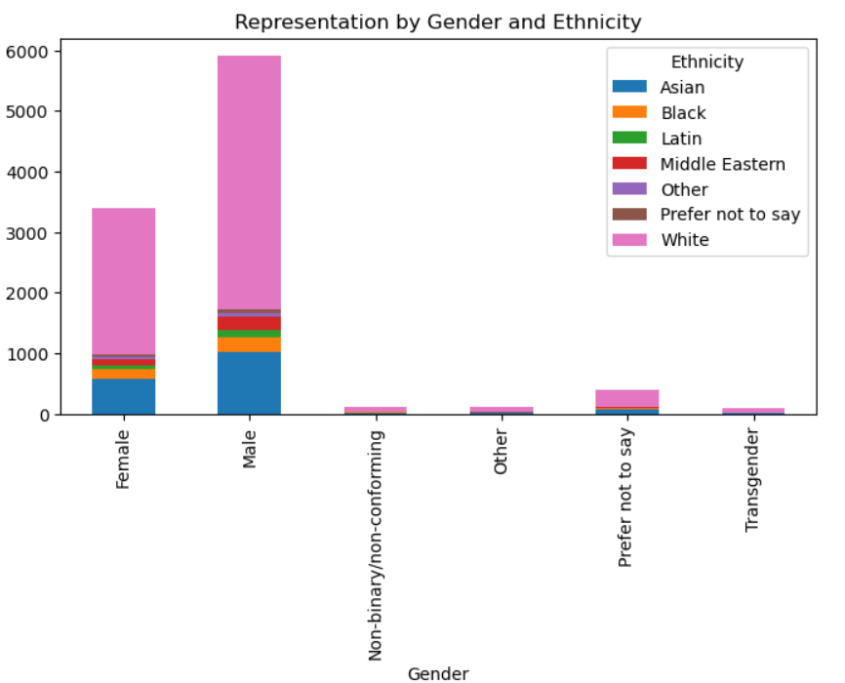
REPRESENTATION BY GENDER AND ETHNICITY

Slide 5
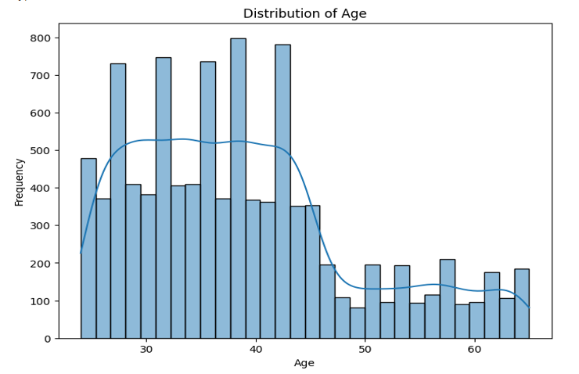
CAREER PROGRESSION BARRIERS ANALYSIS

Slide 6
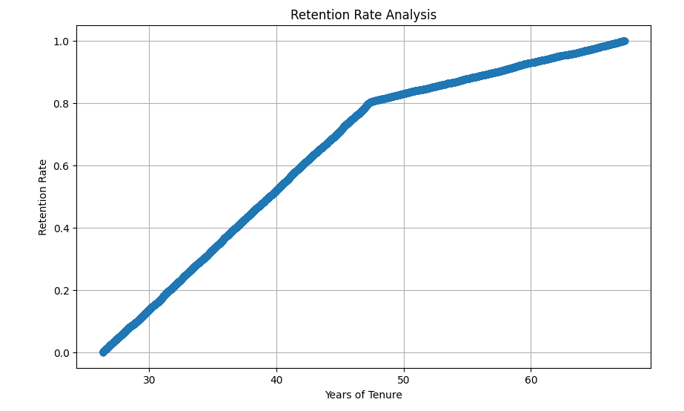
RETENTION RATE ANALYSIS

Slide 7
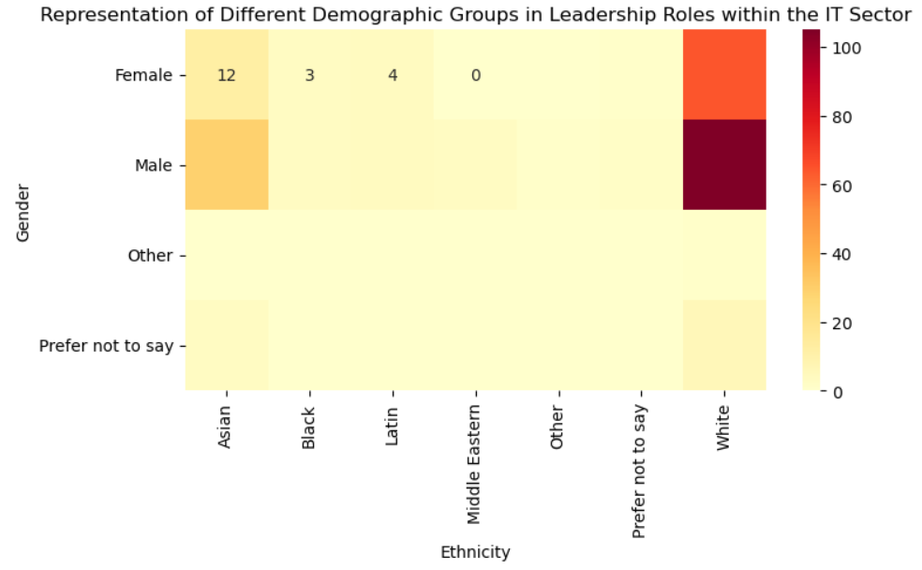
REPRESENTATION OF DIFFERENT DEMOGRAPHIC GROUPS IN LEADERSHIP ROLES

Slide 8

KEY FINDINGS
Gender Disparity - Males > Females
Ethnic Representation - White and Asian > Black,Latin,Middle Eastern and others
Underrepresentation of certain groups - Individuals who identify as "Other" or "Prefer not to say" have minimal representation in leadership positions

Slide 9

RECOMMENDATION
Implement Diversity Initiatives
Address Biases in Hiring and Promotion
Promote Inclusive Work Culture

Slide 10

CONCLUSION
Valuable insights into the current state of diversity, equity, and inclusion (DEI) within the organization.
Informs strategic decision-making processes.
Aims at fostering a more inclusive workplace culture.

