Slide 1

Codathon (Nov 4,5)
Rookie coders
Stella Mary’s College of Engineering

Slide 2
Learning Management System
Android app
This Application is made to assist College Students. We provide three roles as Student, Professor and Admin. Students will be added automatically by the Admin when creating class. Also, Admin can create a new subject and allocate a Professor. Admins also monitor students and professors by their activities. Professor take Classes, and share their notes, ask questions, post events, Assignments, Study materials and also can view student’s activities. Students can download notes, study materials and complete assignments as Quiz or File Submission. Students can Participate in events to get additional point with help to secure top places in leader board. Also, they can trace their activities and able to bookmark any post that published by professor to My Bookmarks for future reference.

Slide 3
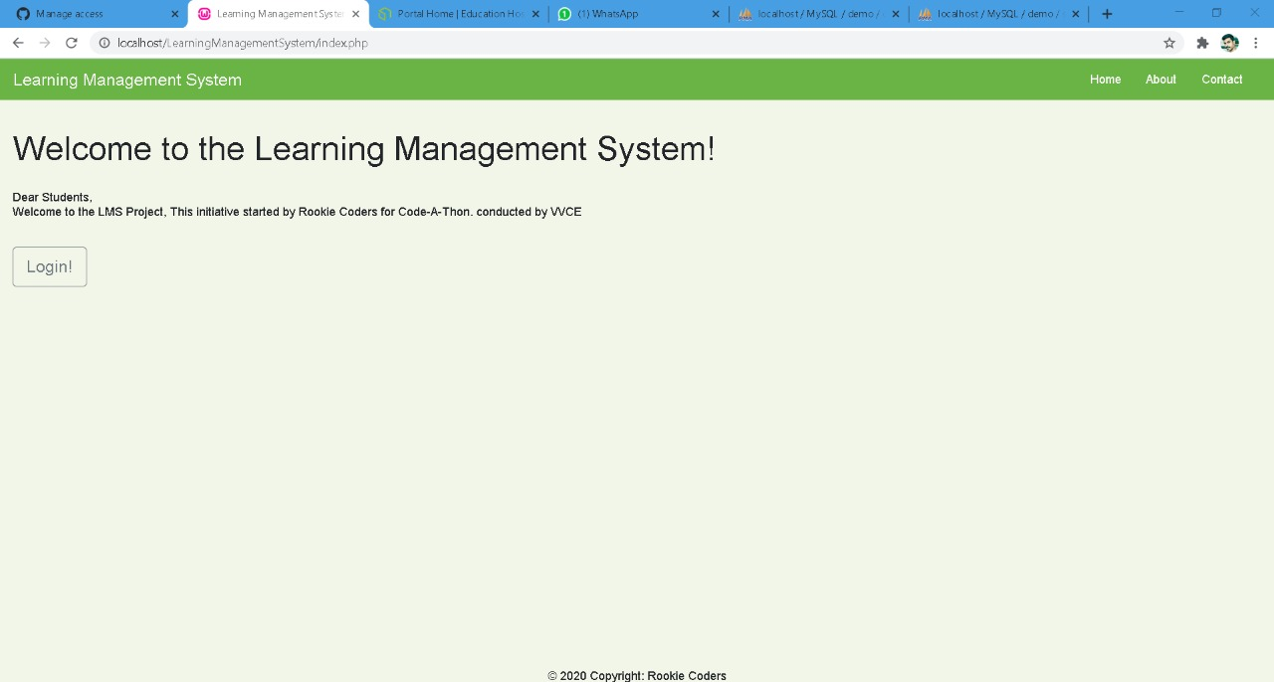
Home page

Slide 4
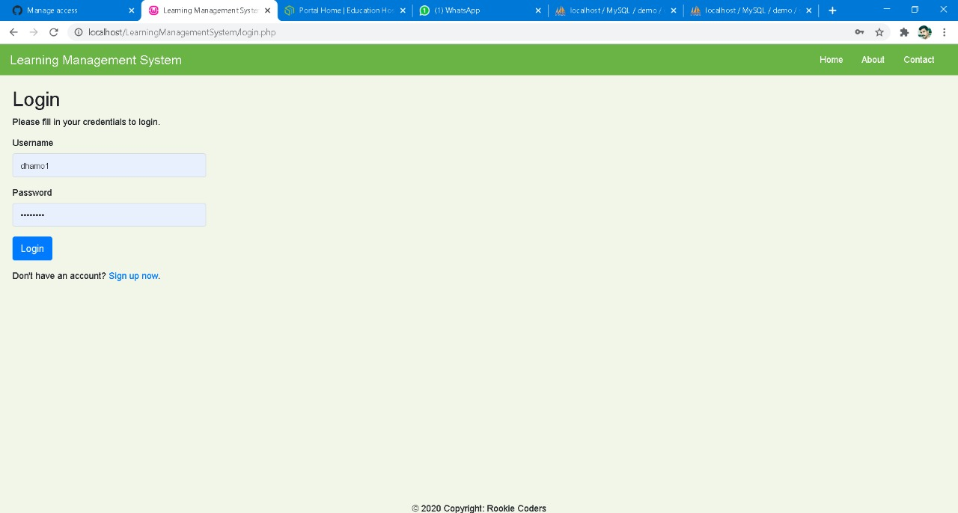
Login page

Slide 5
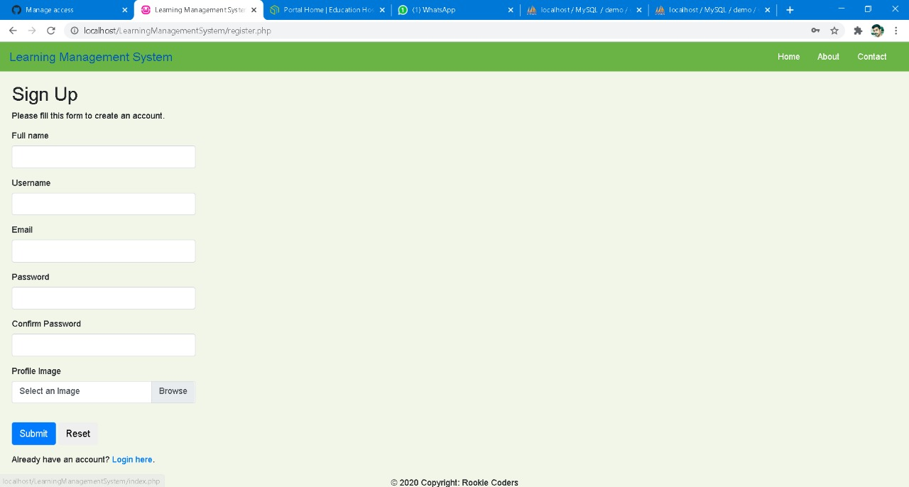
Register page

Slide 6
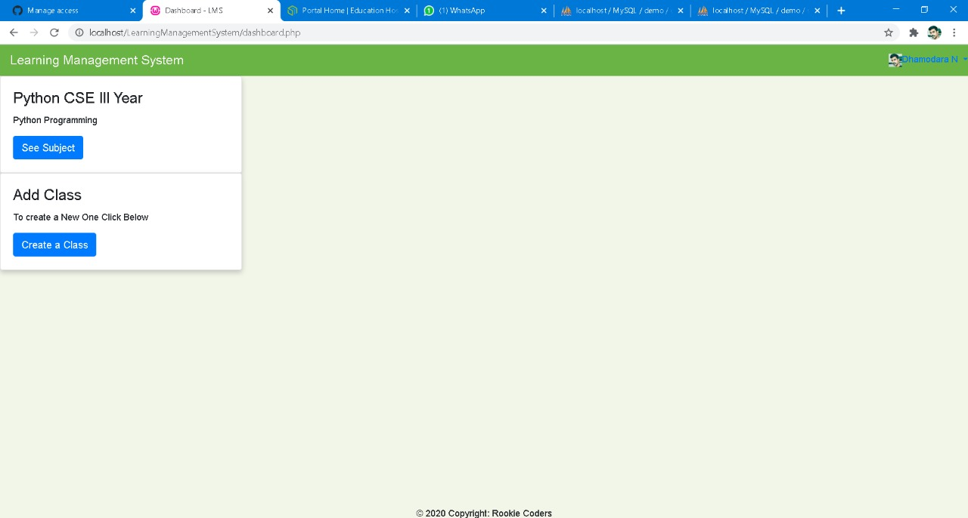
Classes

Slide 7
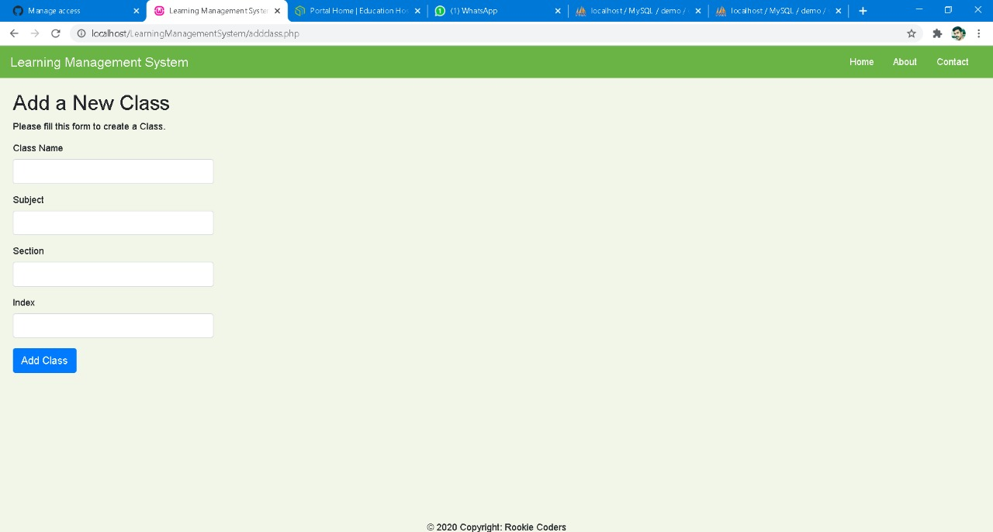
Add new class

Slide 8
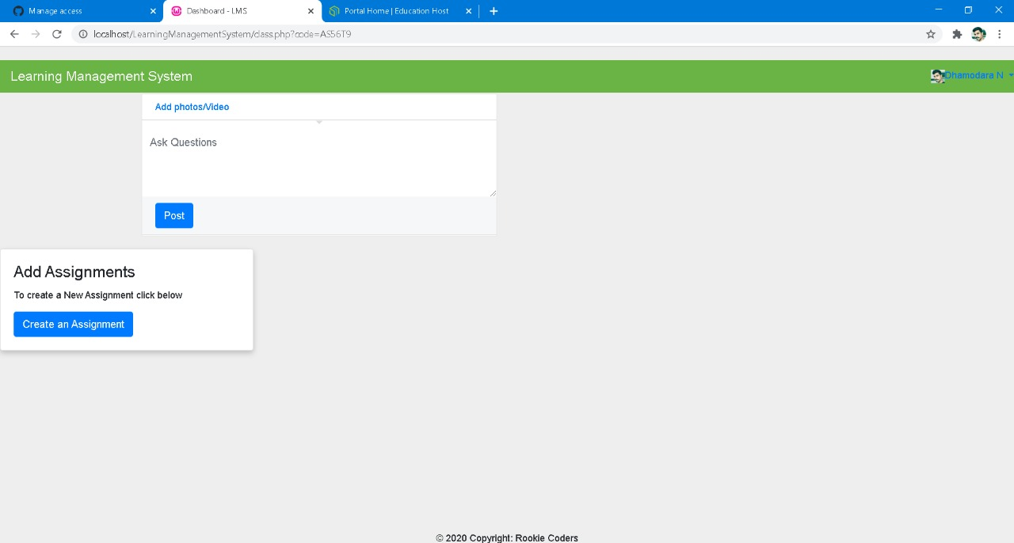
Upload syllabus

Slide 9
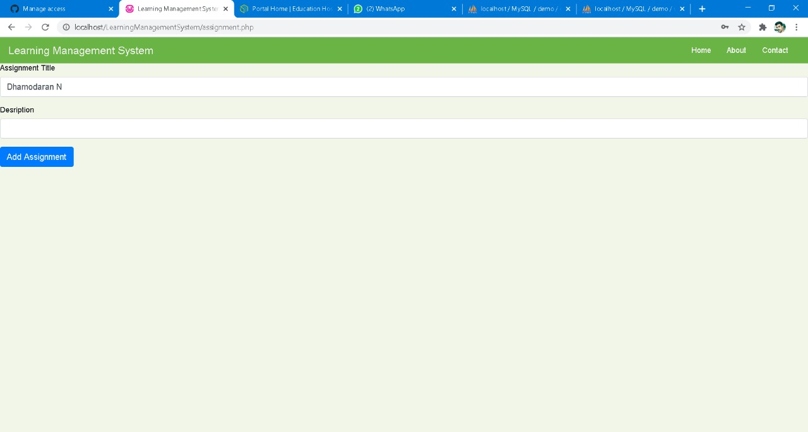
Assignment

Slide 10
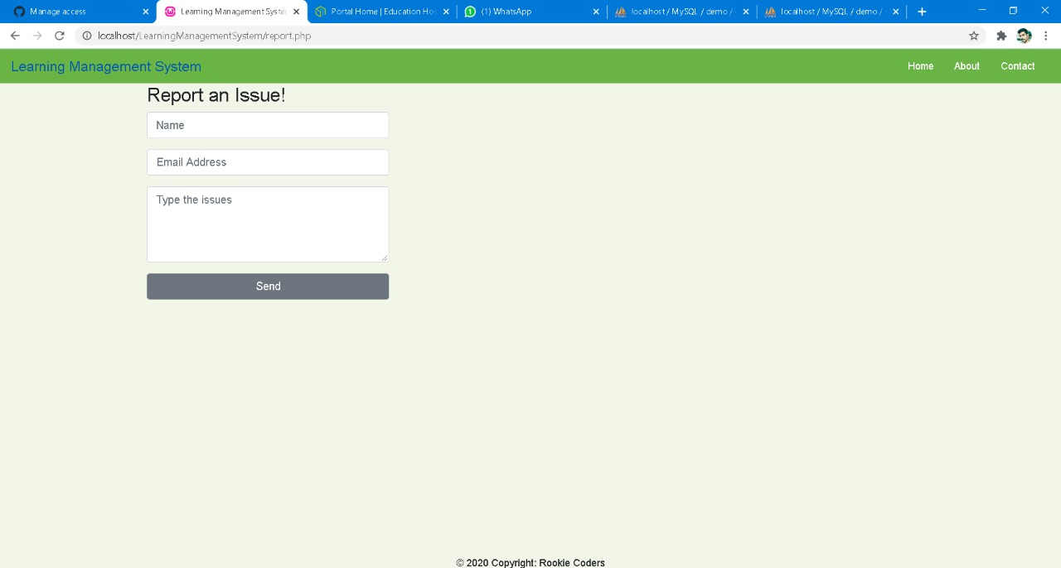
Bug Report

Slide 11
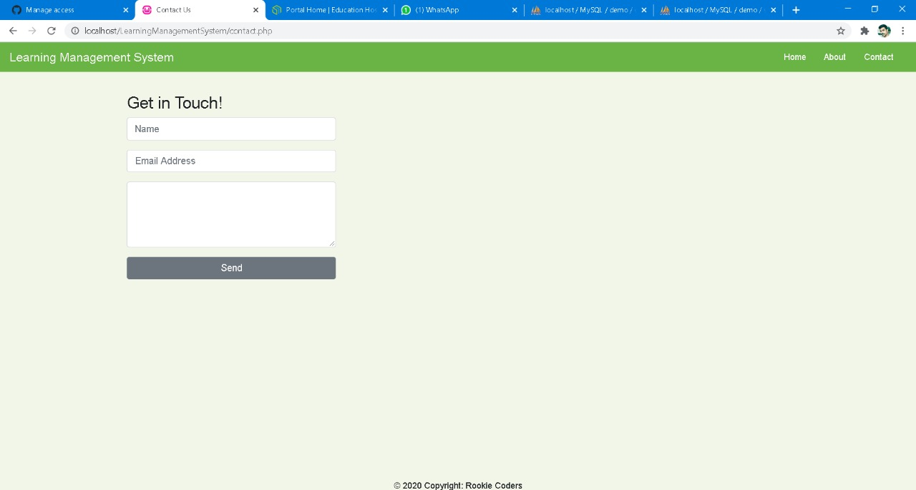
Contact us

Slide 12
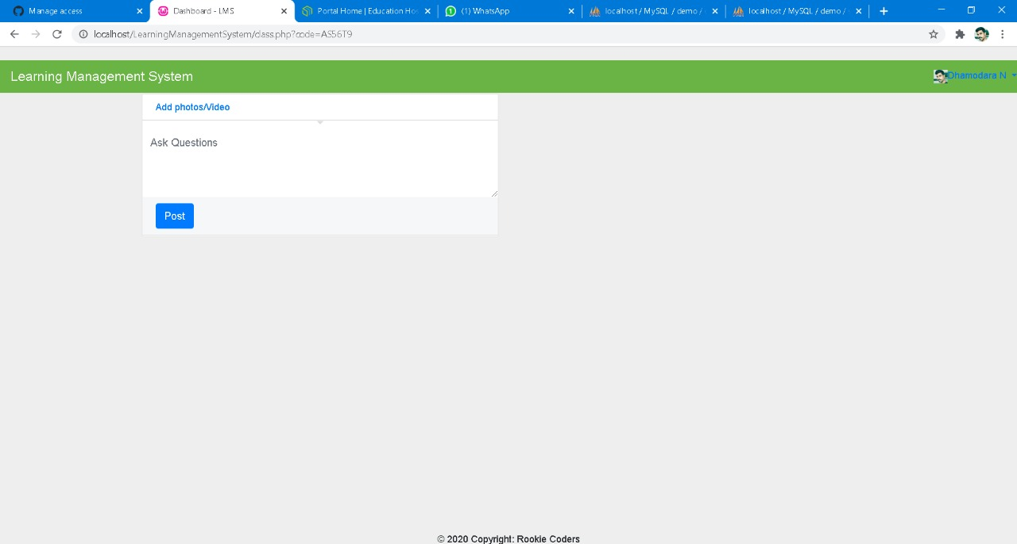
Posts

Slide 13
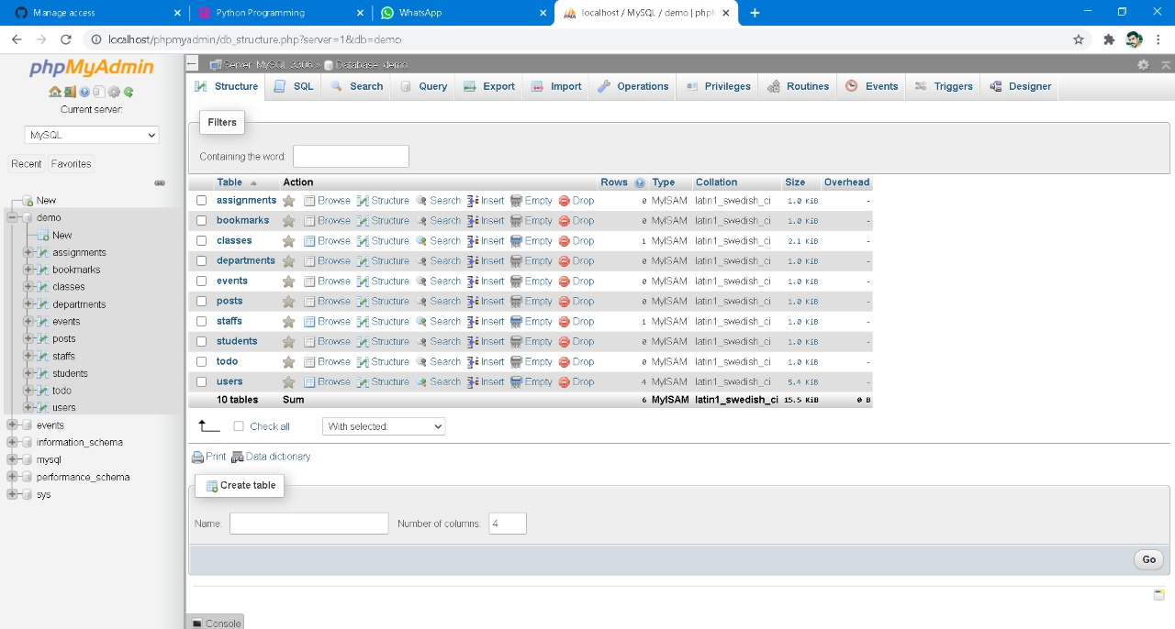
Data base

Slide 14
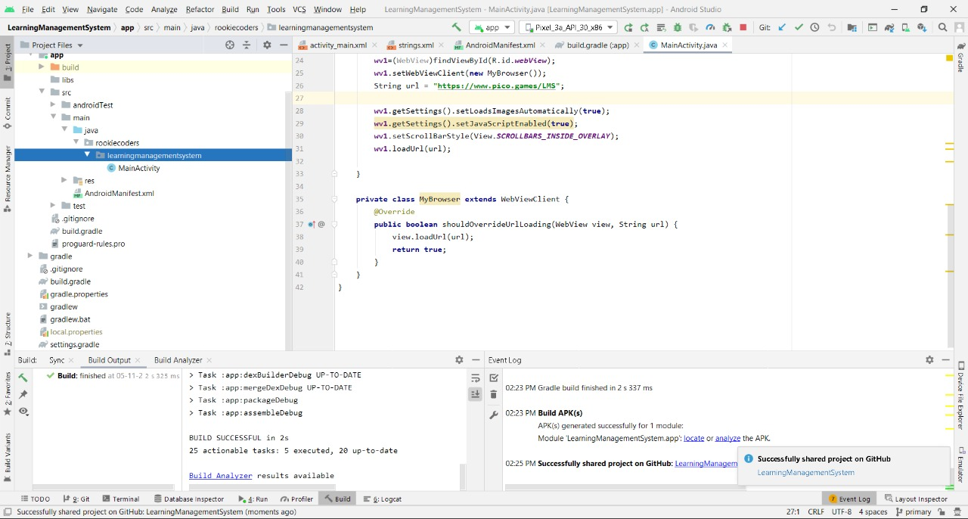
Android app

Slide 15
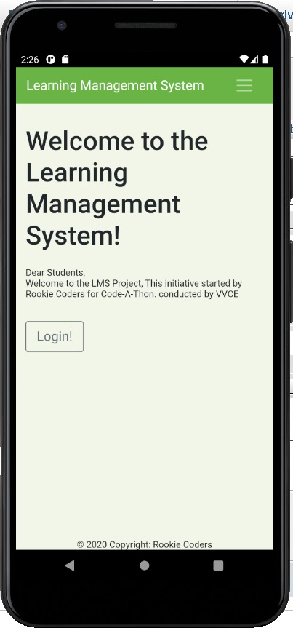
App in mobile

Slide 16
Thank you

