Slide 1
Cloud-based etl pipeline with rds,s3,AWS glue and sns integration
COACH : LEON YIGAL BENJAMIN
PROJECT MENTOR : BADRI PRASAD BALAKRISHNAN
TEAM MEMBERS- 1.PRAVEEN G 2.RAHUL V 3.DHAMOTHARAN A S 4.VISHWA R
5.LIKITHA CHINTAPALLI

Slide 2
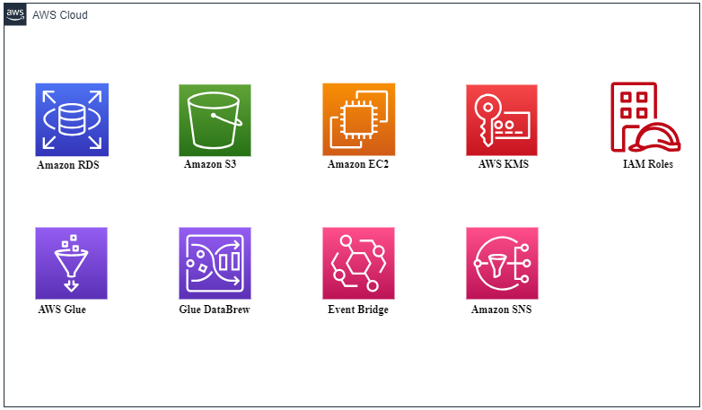
Services used

Slide 3
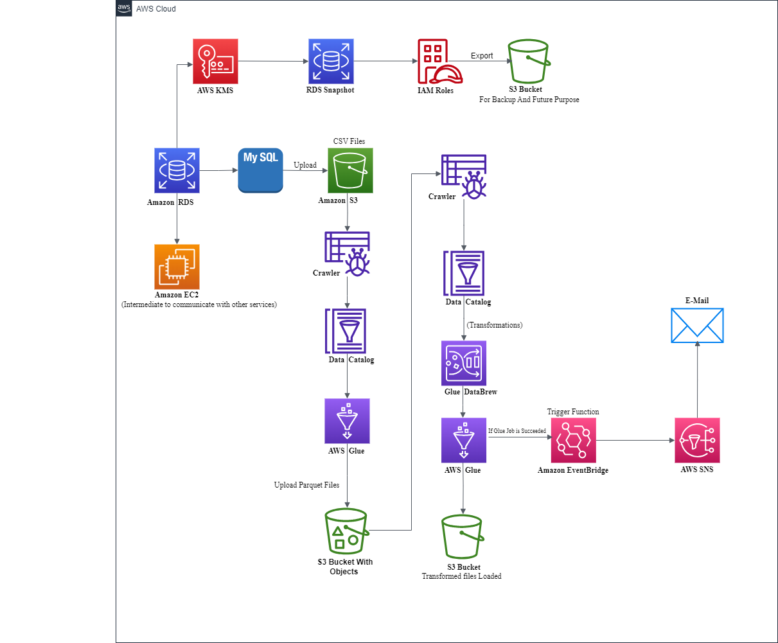
Architecture dIAGRAM

Slide 4
Implementation of Project overflow
RDS DATABASE CREATION
CONNECTING THE DATABASE IN MYSQL WORKBENCH USING ENDPOINT AND CREDENTIALS
SNAPSHOTS CREATION USING RDS
EXPORT THE SNAPSHOTS TO S3 IN PARQUET FORMAT
CHANGING THE DATAFORMAT USING DATABREW-SOURCE DATA CATALOG
CRAWL THE DATA FROM S3 AND STORED IN DATA CATAL
AWS GLUE DATA
CATALOG CREATION
UPLOADING THE CSV FILES TO S3 AND CHANGING THE FILE FORMAT OF CSV TO PARQUET USING AWS GLUE
UPDATING THE TRANSFORMED IN DATA CATALOG
TRANSFORMATION USING AWS GLUE -VISUALLY STORING IN S3
TRIGGERING GLUE WITH EVENTBRIDGE
CREATE AN SNS TOPIC TO SEND NOTIFICATION AFTER THE GLUE JOB HAS BEEN COMPLETED SUCCESSFULLY OR WHEN IT GETS FAILED

Slide 5
TRANSFORMATIONS
CHANGING THE FILE FORMAT and DATE FORMAT
CONCAT
SPLIT
DROP
JOIN
YY-MM-DD TO
DD-MM-YY
CSV TO PARQUET
CONCAT FIRST NAME AND LAST NAME AS "FULL NAME'
SPLIT THE ADDRESS INTO TWO COLOUMNS SUCH AS STREET NAME AND STREET NO
DROP FIRST NAME,LAST NAME AND ADDRESS COLOUMNS
PERFORM DIFFERENT JOIN OPERATIONS ON TABLES

Slide 6
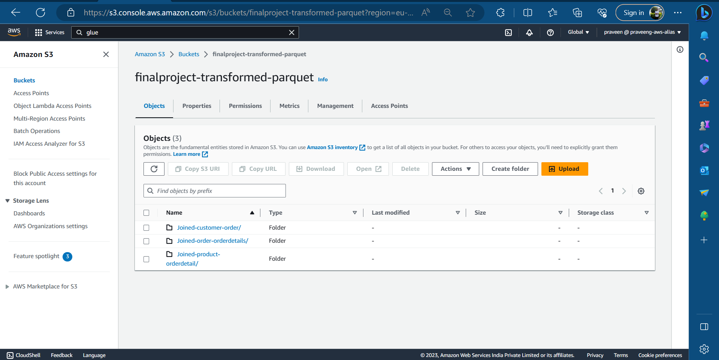
output

Slide 7

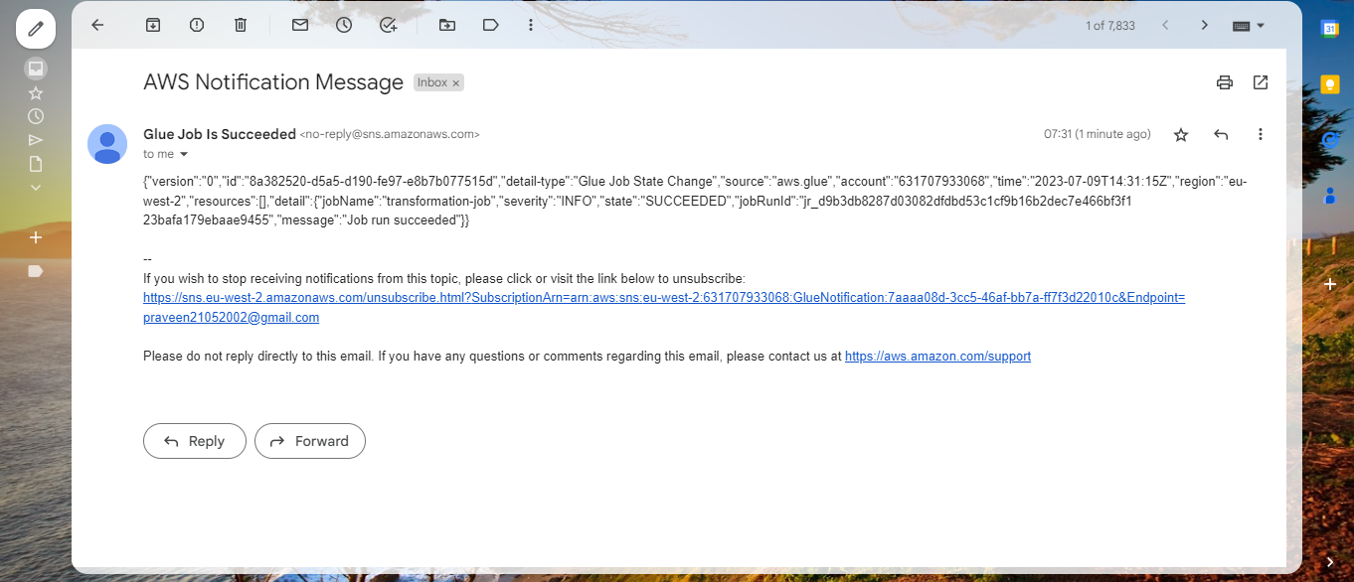

Slide 8
Conclusion
This project showcases the successful implementation of an Extract, Transform, and Load (ETL) process in the AWS cloud.
It leverages a range of AWS services including Amazon RDS, S3, AWS Glue, Databrew, and Eventbridge to achieve efficient data extraction, transformation, and loading capabilities.
By establishing a connection with MySQL and exporting a snapshot of the RDS database to an S3 bucket, data backup and security are ensured.
The integration of EventBridge and Simple Notification Service (SNS) allows for timely email notifications upon job completion, ensuring stakeholders are informed
5. Overall, this ETL project in the AWS cloud harnesses the scalability, reliability, and flexibility of AWS services, enabling organizations to efficiently manage and process their data.

Slide 9
THANK YOU

