Slide 1
Pirai infotech Code challenge
Dhanraj M
studentdevlpr@gmail.com
Nandha Engineering College

Slide 2
Objective
Problem Statement & Assignment:
Create a HTML web page
Give input details using input field
Display the details entered below in a table format
Tools / Frameworks to be used
Front-end – HTML, CSS or jQuery
Write a selenium script to automate the testing of your web application.

Slide 3
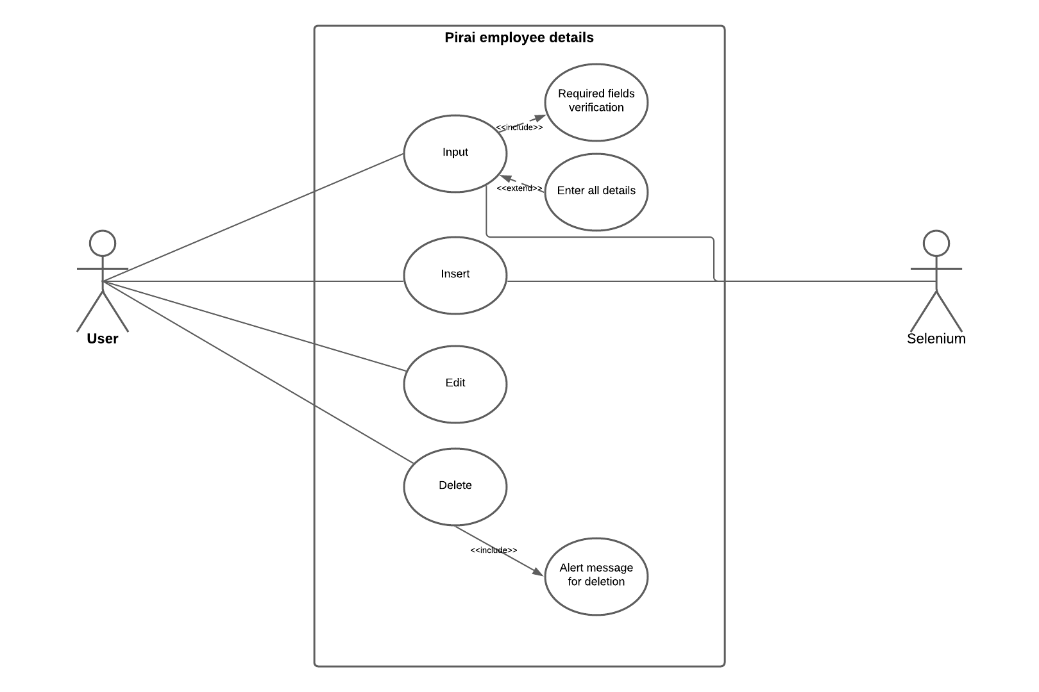
USE CASE DIAGRAM

Slide 4
USE CASE EXPLANATION
When the user submit the form all the datas are stored in a temporary variable.
That variable values are displayed in the table.
User can edit or delete based on their need.
The selenium script which is used here automates the testing process.

Slide 5
DEVELOPMENT TOOLS
Text Editor - Visual Studio Code
Front End
HTML, CSS, JS
Testing - Selenium
Software - Eclipse ( or ) VScode

Slide 6
MODULE EXPLANATION
Input
User needs to give input in the appropriate text boxes in the form provided.
The input should satisfy the necessary type and mandatory check.
Finally it can be submitted.
Output
Given input is listed in the form of table.
Table data can be Edit / Delete using appropriate buttons

Slide 7
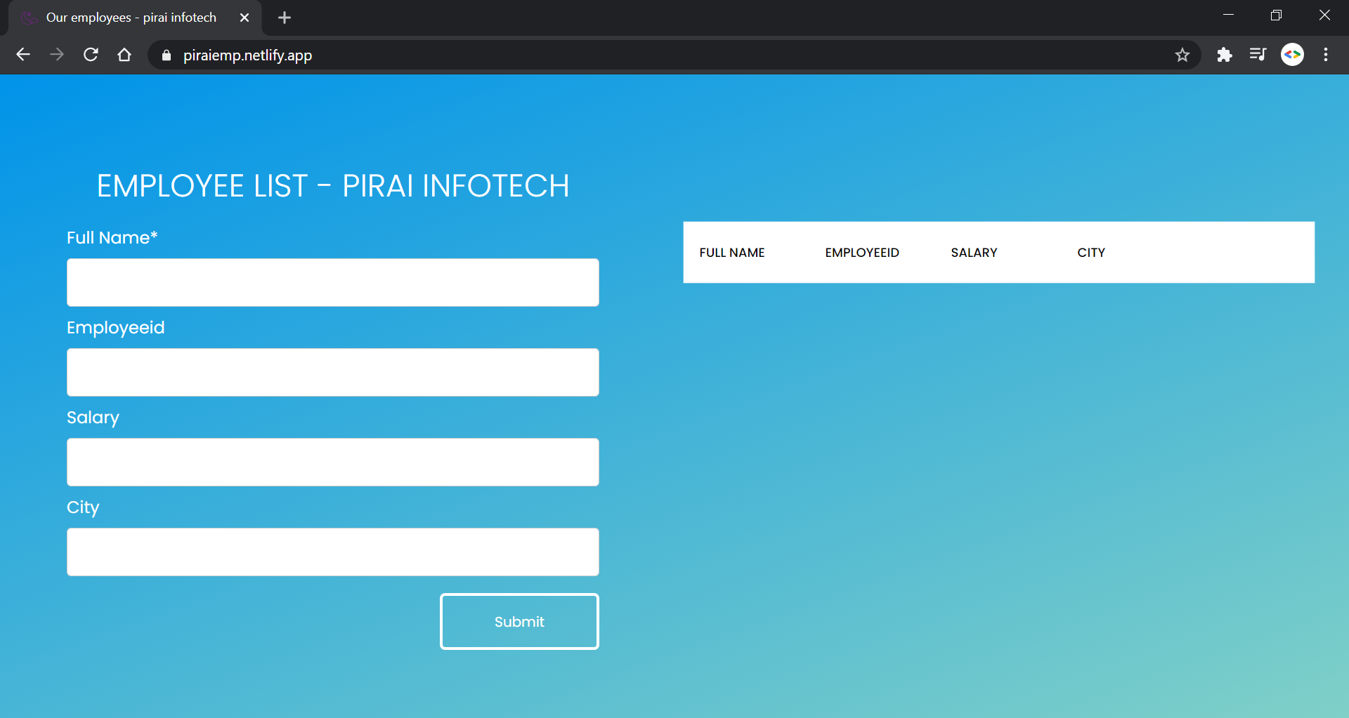
SCREENSHOT - without records

Slide 8
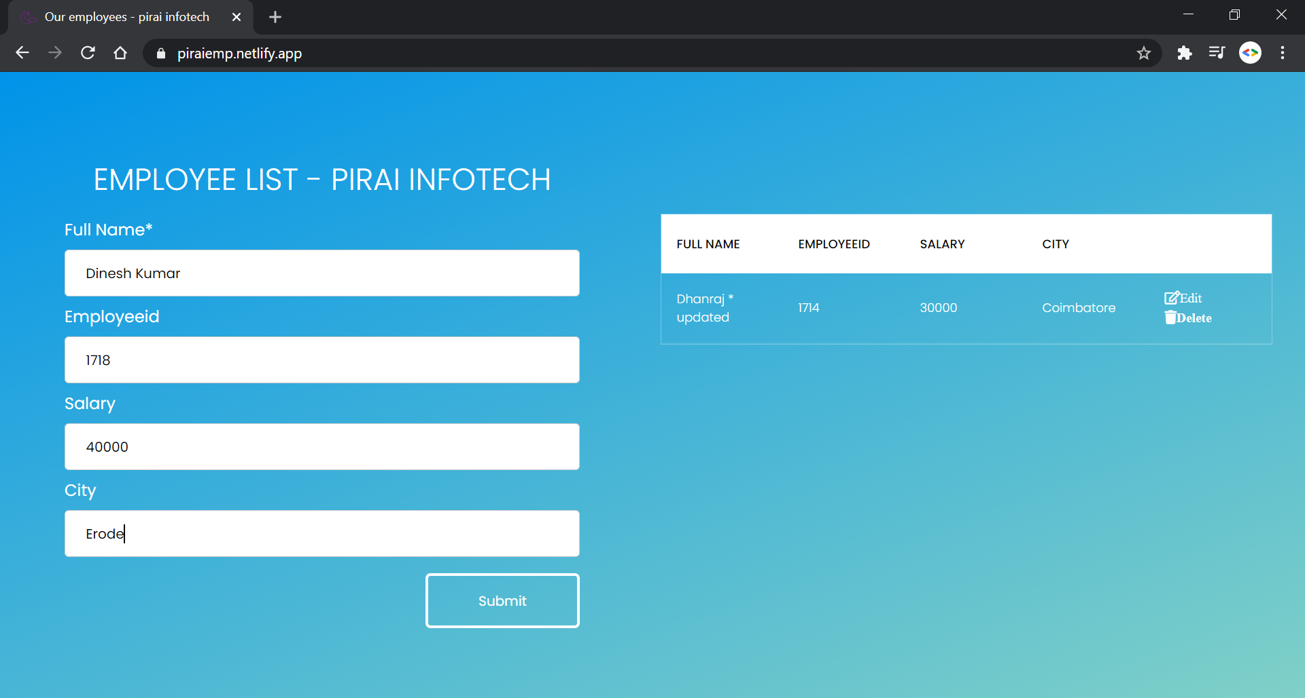
SCREENSHOT - with records

Slide 9
FUTURE ENHANCEMENT
In the next version it can be updated from HTML and CSS to MERN stack.
In future data is stored in MongoDB or MySQL database.
CONCLUSION
This project helped me to find out more about HTML, CSS, JavaScript and Selenium. It fulfilled all the objectives provided for code challenge by pirai infotech.

Slide 10
THANK YOU

