Slide 1
SALARY AND COMPENSATION ANALYSIS THROUGH EXCEL DATA MODELING
STUDENT NAME:J.DHANALAKSHMI
REGISTER NO:312200832
DEPARTMENT:BCOM GENERAL(3RD YEAR)
COLLEGE: PACHAIYAPPAS COLLEGE FOR WOMEN'S KANCHIPURAM

Slide 2
PROJECT TITLE:
SALARY AND COMPENSATION ANALYSIS THROUGH EXCEL DATA MODELING

Slide 3


INTRODUCTION:
Excel aids in conducting employee compensation analysis to ensure that compensation practices are fair and equitable across an organization. Compensation analysis within Excel provides data-driven insights into salary benchmarks, pay equity, and remuneration packages, thereby supporting transparency and fairness.
3/21/2024 Annual Review

Slide 4

PROBLEM STATEMENT:
Pay transparency: Employees want to know how their wages are calculated and why they change. While employers aren't required to disclose employee wages, it's important that employees know how their base rate is calculated. Global compensation management: Aligning global compensation and benefits with local market conditions and expectations can be challenging. This involves considering factors like cost of living, inflation, exchange rates, tax laws, and more.

Slide 5

PROJECT OVERVIEW:
A salary and compensation analysis is a process that involves evaluating an organization's compensation practices to ensure they are fair, competitive, and aligned with company goals. The analysis compares an organization's compensation to industry standards and internal benchmarks, and can include salaries, bonuses, and other benefits
.

Slide 6

GOAL?
Attract and retain top talent A data-driven approach to compensation can help attract and retain the best employees. Maintain pay equity Regular pay equity analyses can help identify and address pay gaps. Motivate employees A compensation analysis can help ensure that employees are compensated fairly and in a way that reflects their skills and experience.

Slide 7

FACTORS:
Attract and retain top talent A data-driven approach to compensation can help attract and retain the best employees. Maintain pay equity Regular pay equity analyses can help identify and address pay gaps. Motivate employees A compensation analysis can help ensure that employees are compensated fairly and in a way that reflects their skills and experience.

Slide 8
Data for salary and compensation analysis can include:
Salary survey data This data can be used to learn what other organizations pay for specific positions or job categories. You can find salary survey data from traditional surveying companies, membership associations, and free resources. Employment data This data can be used to understand factors from both the employee and employer side.

Slide 9

Here are some strategies for salary and compensation analysis:
Research the market: Keep an eye on market data to ensure that compensation remains competitive. Conduct a pay equity analysis: Analyze whether employees are being paid fairly. Track compensation metrics: Monitor compensation metrics regularly.
3/21/2024 Annual Review
9

Slide 10
Here are some things to consider when modeling compensation:
Compensation model types There are several types of compensation models, including location-agnostic, localized, and performance-based. Compensation analysis steps Steps for performing compensation analysis include defining job roles, gathering data, benchmarking jobs, and assessing internal equity. Compensation model pillars The Pay Model of Compensation states that a compensation system should be based on four pillars: internal consistency, competitive performance, and employee contribution. Compensation structure A compensation structure, also known as a salary or wage structure, considers factors like length of employment, merit, and industry minimums and maximums.
10

Slide 11
Advantages:
Attracting and retaining talent Compensation analysis can help companies attract and retain top talent by ensuring that their pay scales are competitive and in line with industry standards. Promoting pay equity Compensation analysis can help identify any factors that may contribute to wage gaps or pay inequities, and make data-supported decisions to promote pay equity
11

Slide 12
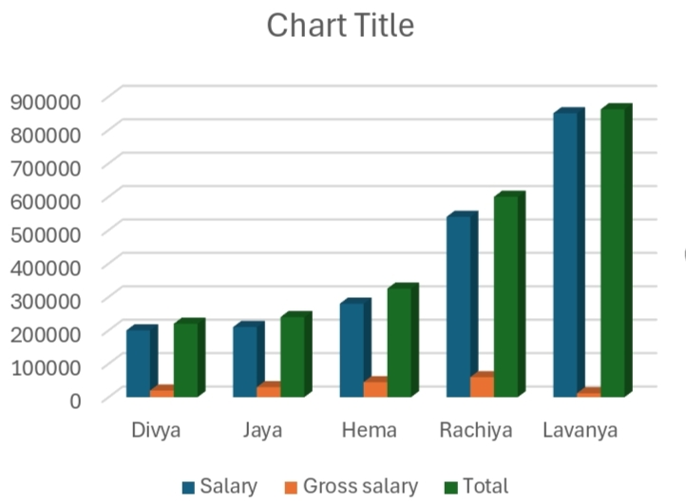
RESULTS:
12

Slide 13
Conclusion:
Conclusively, conducting a well-designed salary survey using online survey software is critical to your company's staff recruiting and retention strategy. When examined and the results implemented, a pay survey tool delivers your employees a fair salary and benefits package.

