Slide 1

AOOP
Under the guidance of
(Ms. Figlu Mohanty)

Slide 2
Advanced Object Oriented Programming
AUTOMATED BIRTHDAY WISH SYSTEM
By
B. Akshaya (2110030345)
U. Yesashwini (2110030412)
P. Subhatish (2110030426)
K. Dhana Sree (2110030444)
Under the guidance of
Mrs.Figlu Mohanty

Slide 3
PROBLEM STATEMENT AND DOMAIN
People sometimes forget to wish their friends, and family on their birthdays.
It is also difficult to remember every birthday.
So, we are developing an application that will help you never forget the birthday of your friends or family
We include reminders and also messages to be sent prior itself and send messages on your behalf via SMS.
It comes under Software Domain.

Slide 4
DATA SET COLLECTION
User login details
Birthday details
Name
Date
Phone number

Slide 5
TOOLS SETUP
GUI INTERFACE
Front-end designing
STAR UML
For Class diagrams to summarize details of a system and the users within that system.
ECLIPSE IDE
Write Code for the application

Slide 6
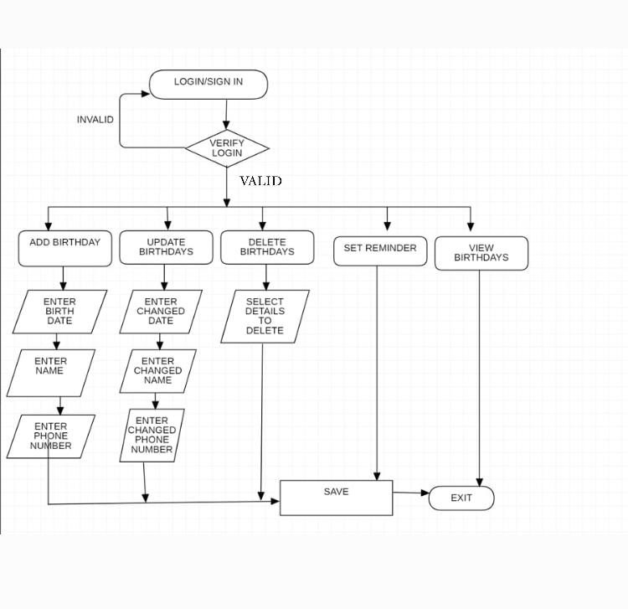
IMPLEMENTATION FLOW CHART

Slide 7
WORK PROGRESS
Created a Login page using GUI interface.
Front end design is completed.
Successfully connected database.
Used files as well to store data.

Slide 8
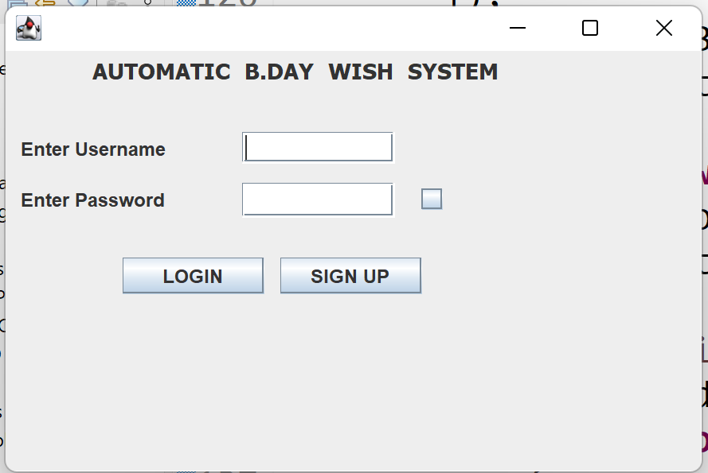
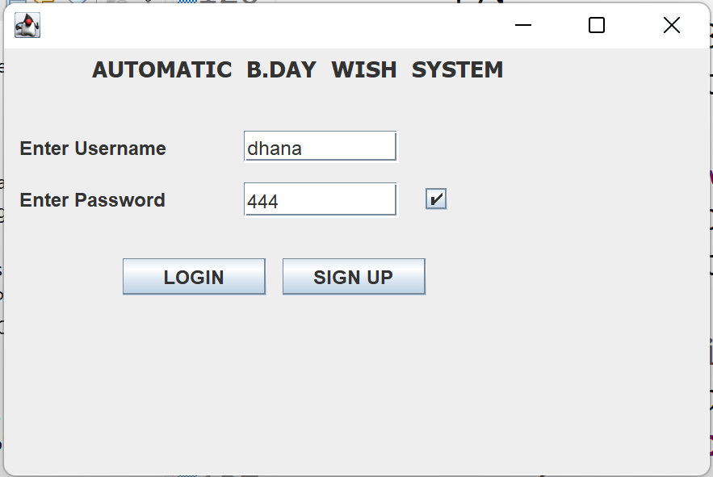
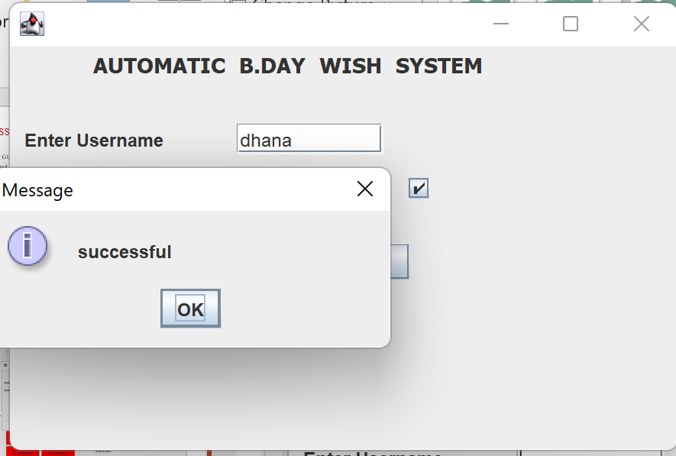
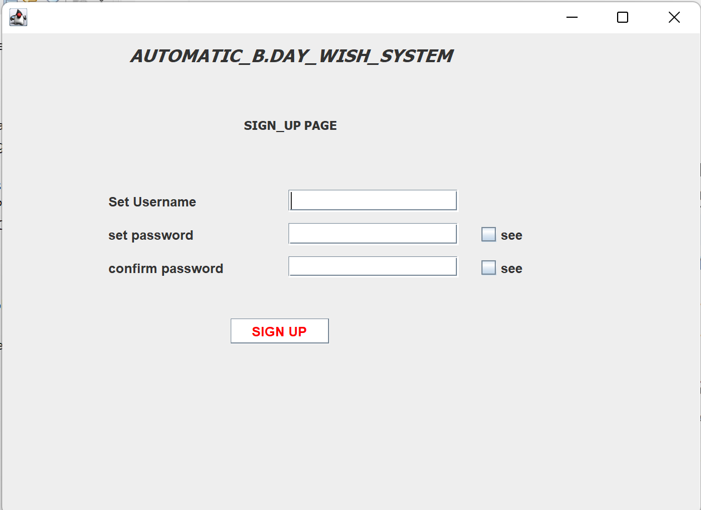
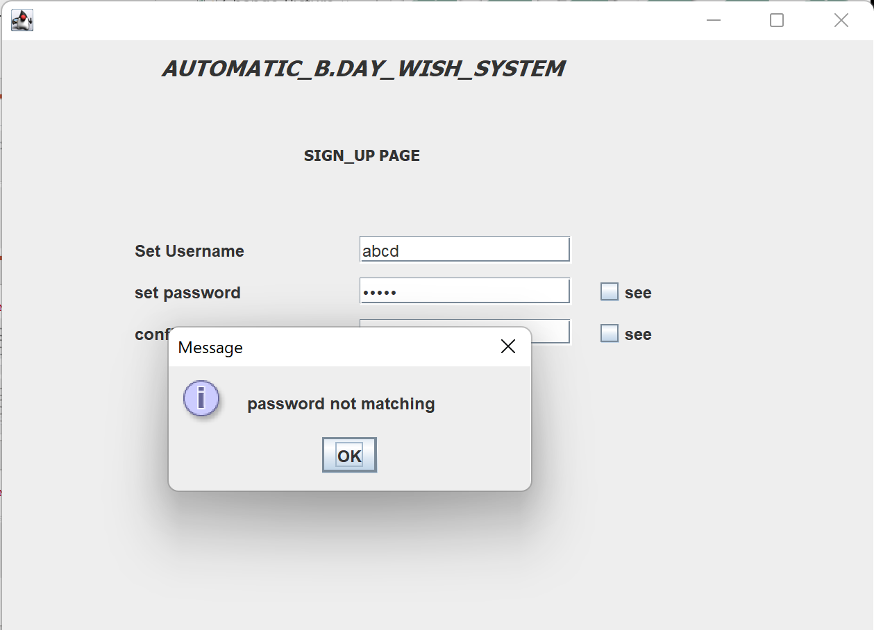
IMPLEMENTATION

Slide 9
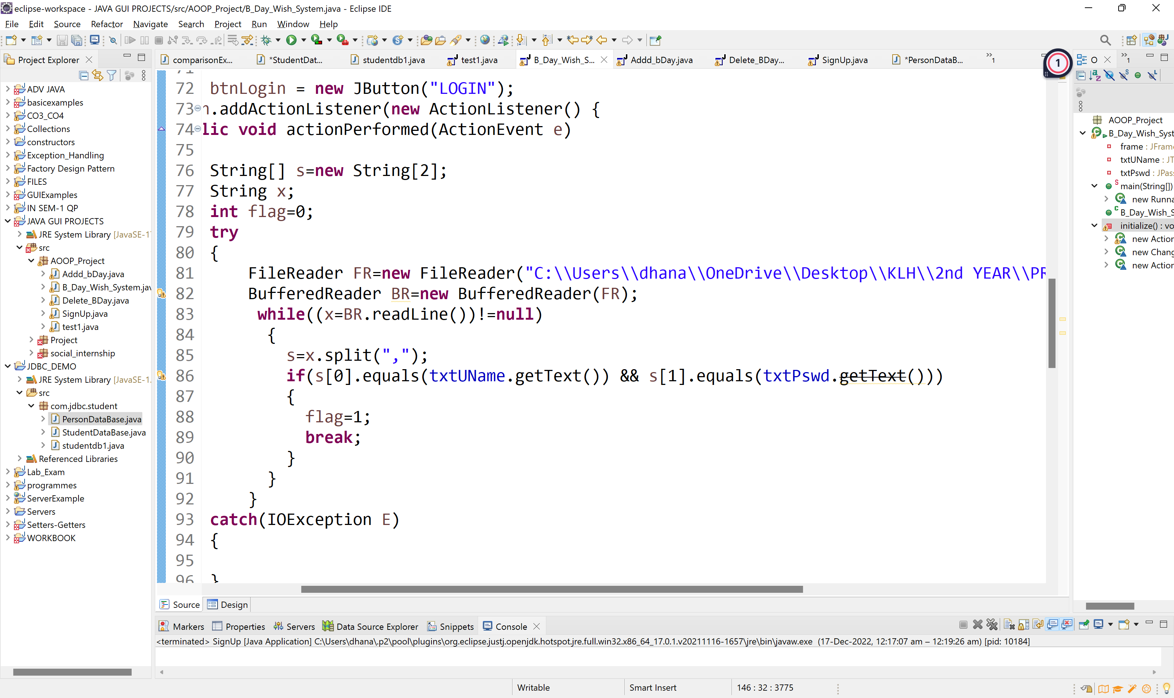
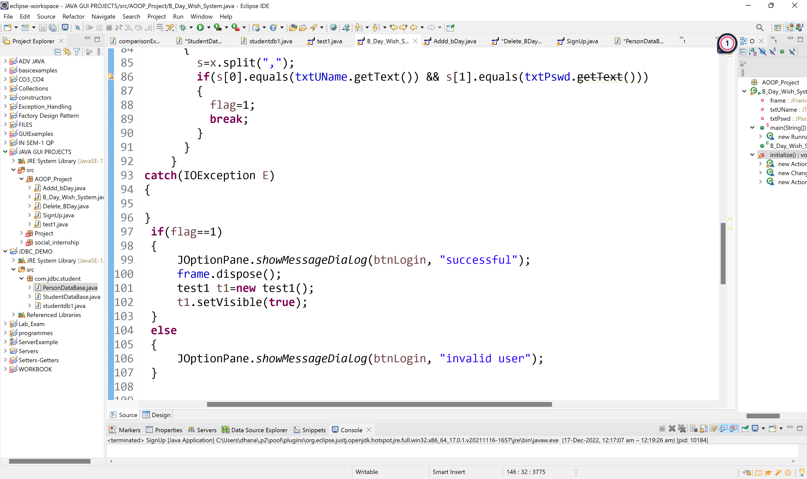
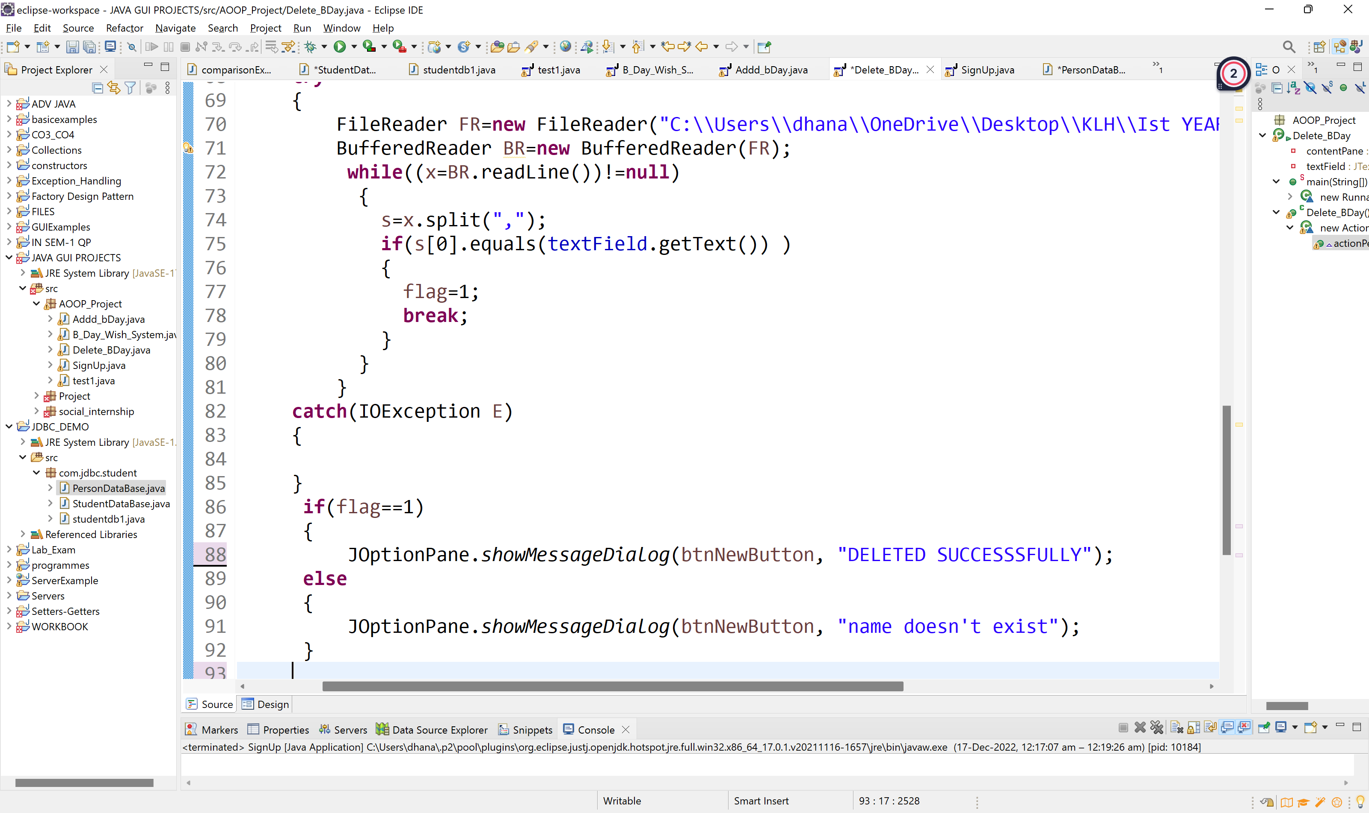
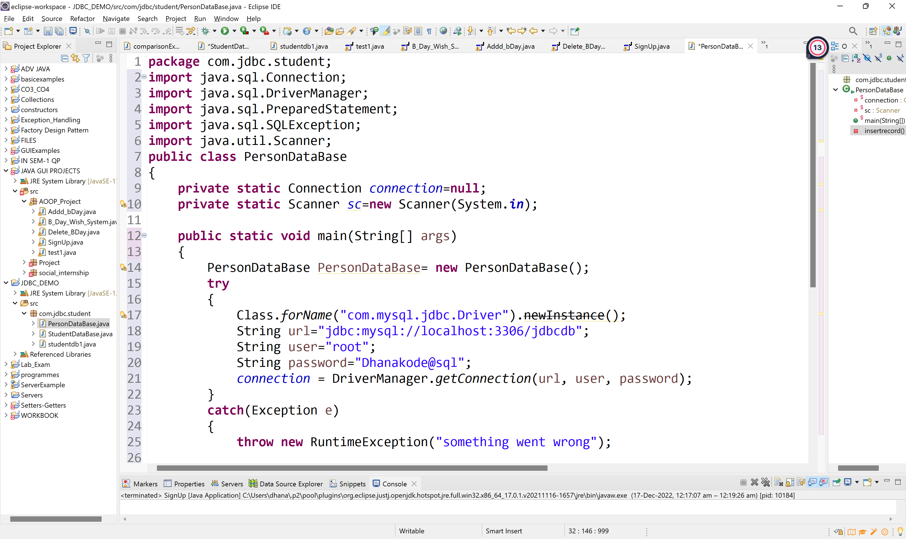
CODE
JDBC CONNECTION

Slide 10
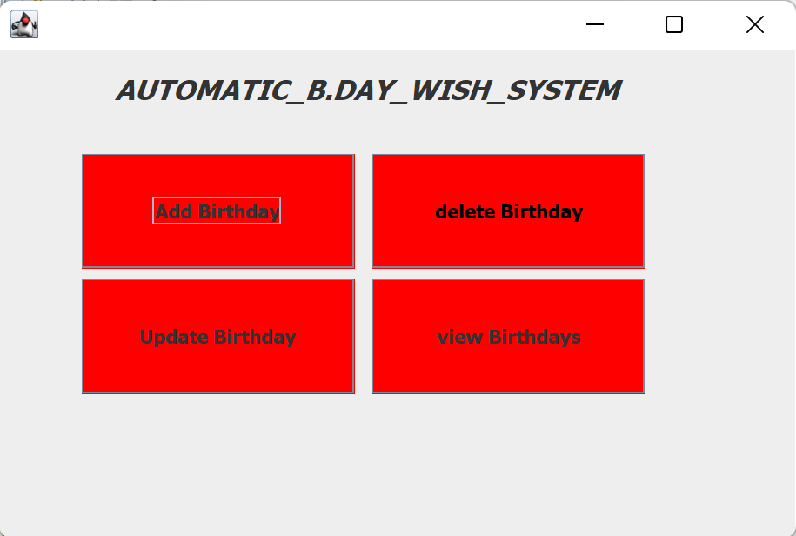
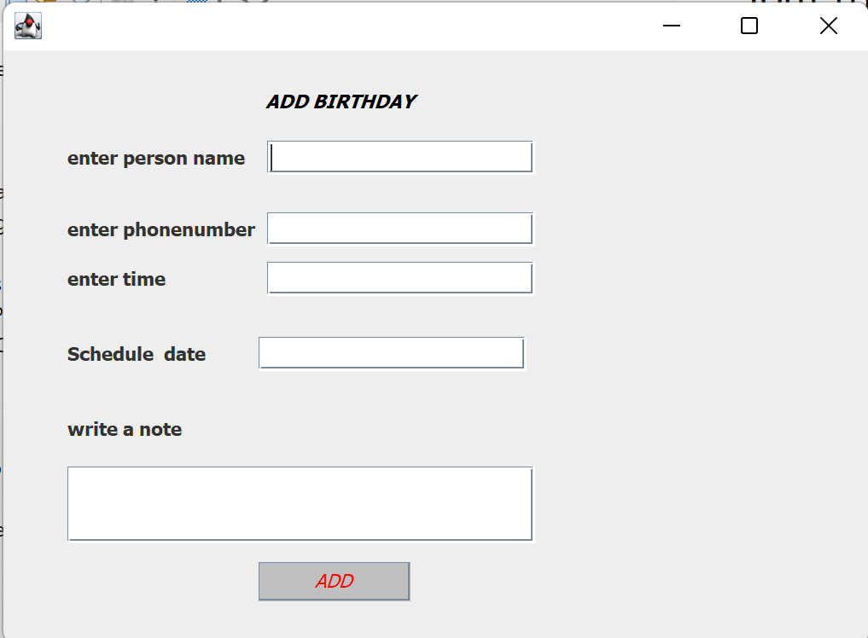
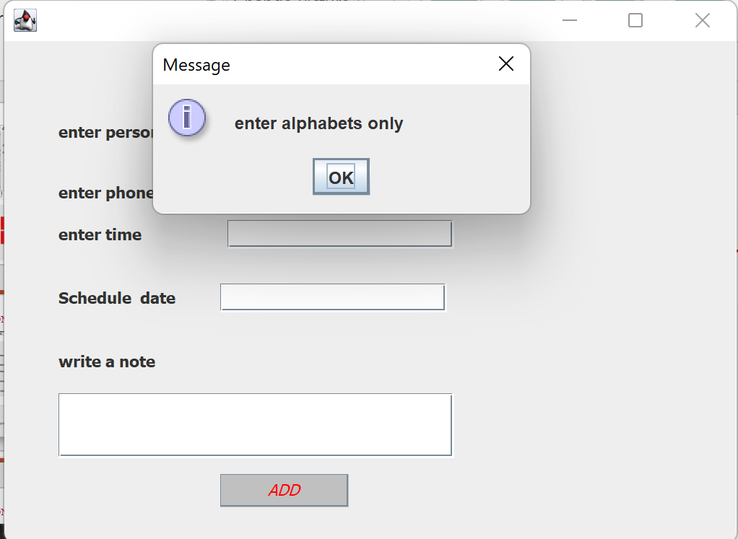
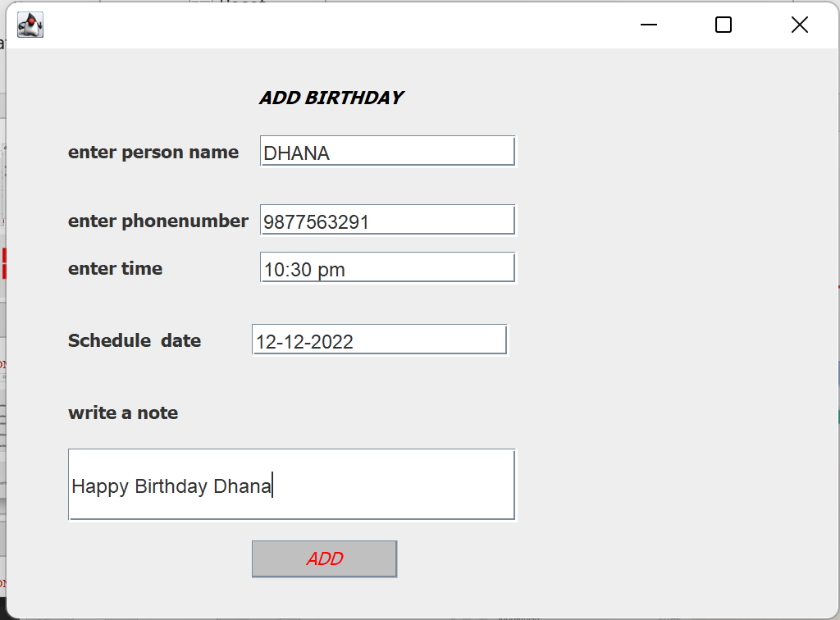
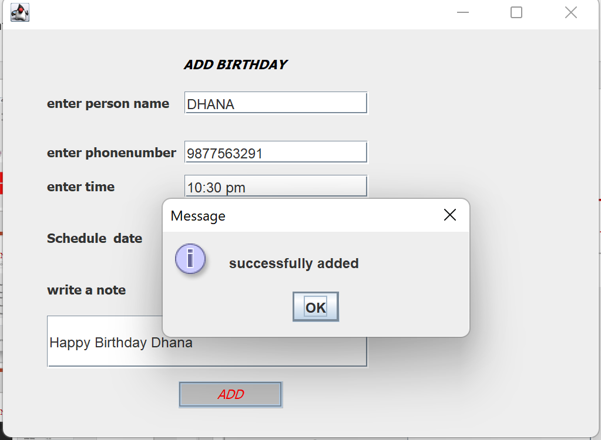
IMPLEMENTATION

Slide 11
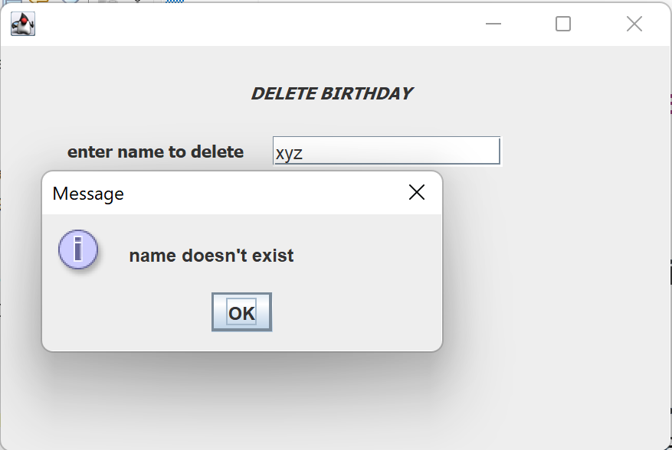
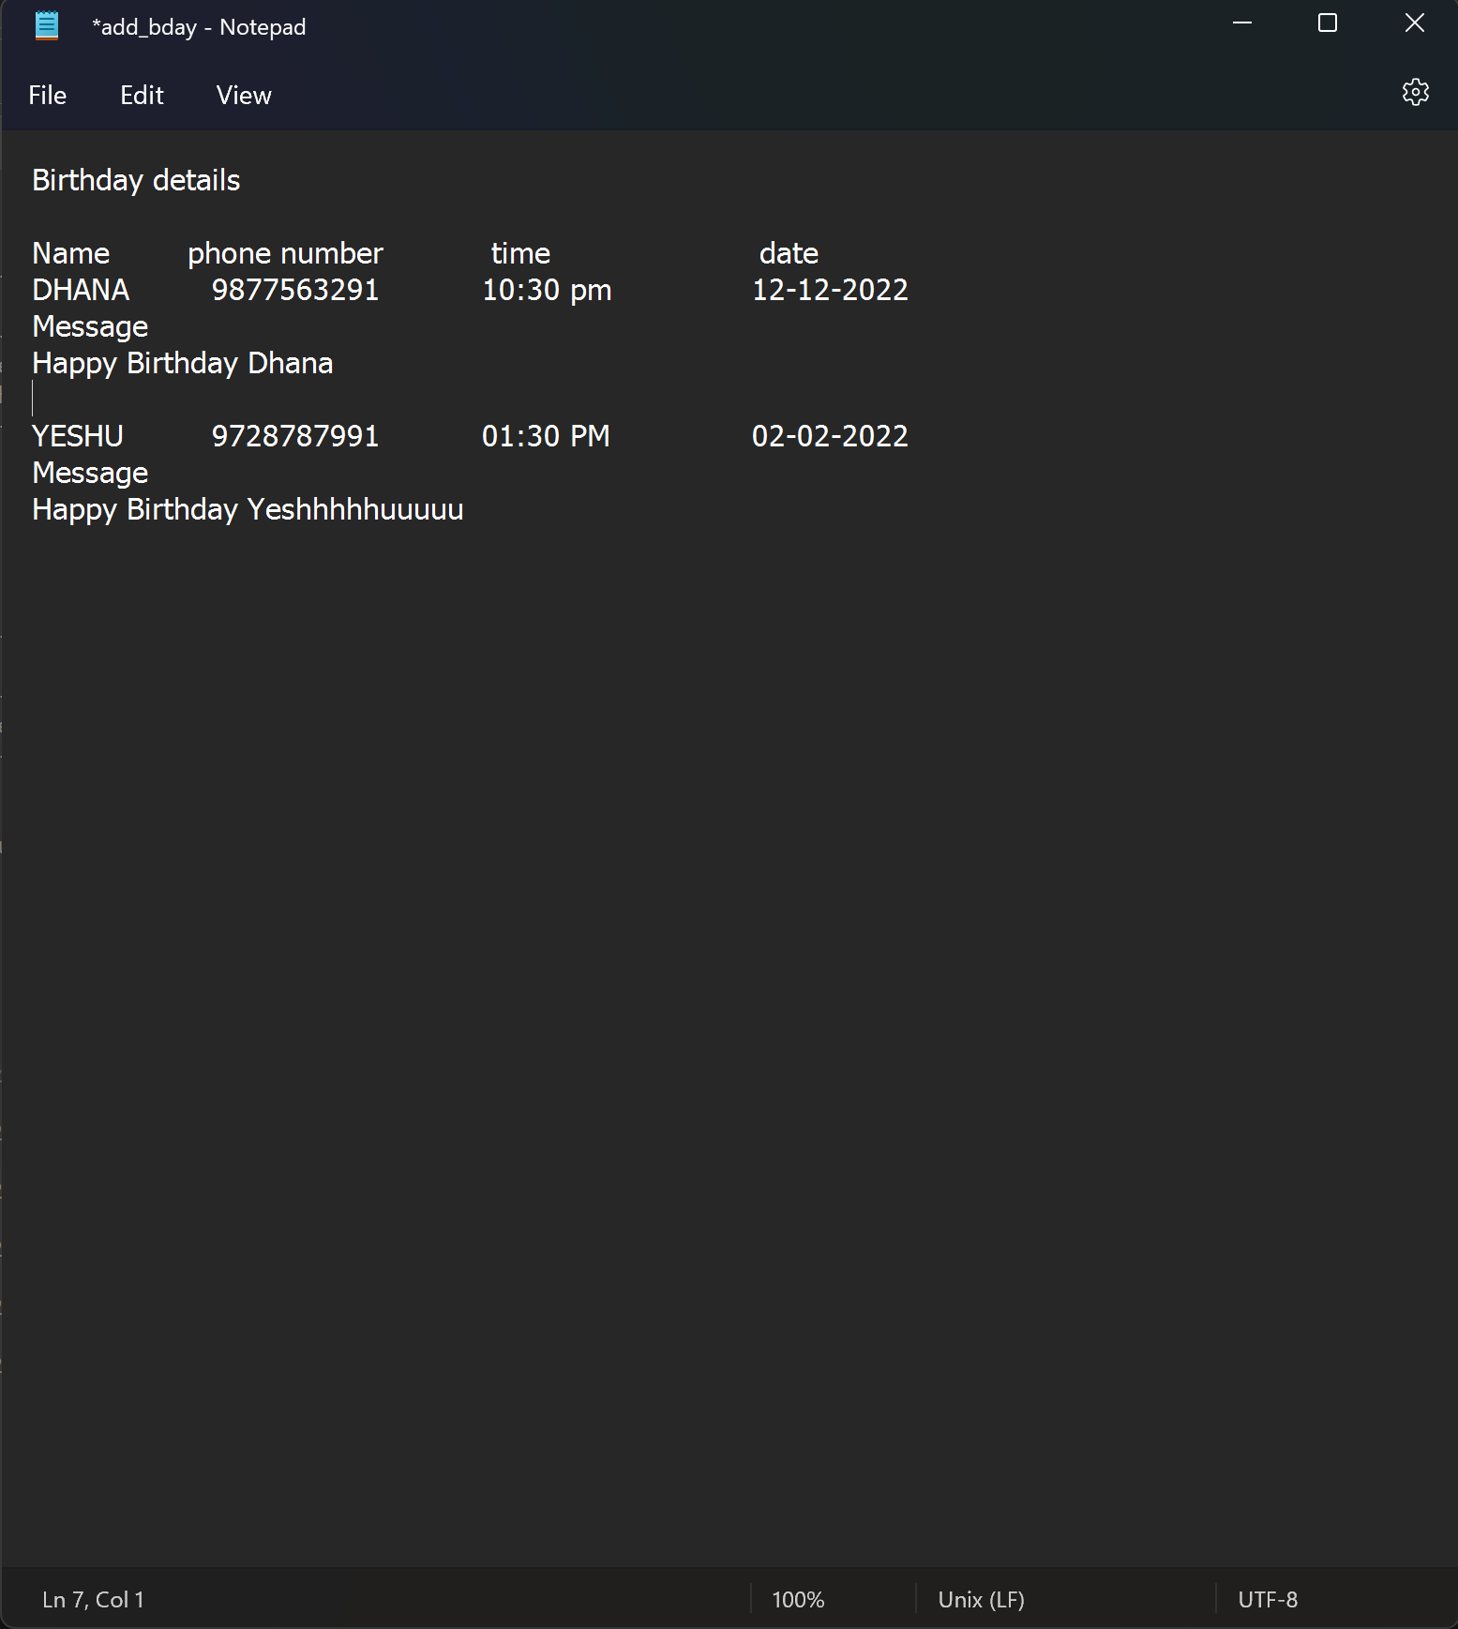
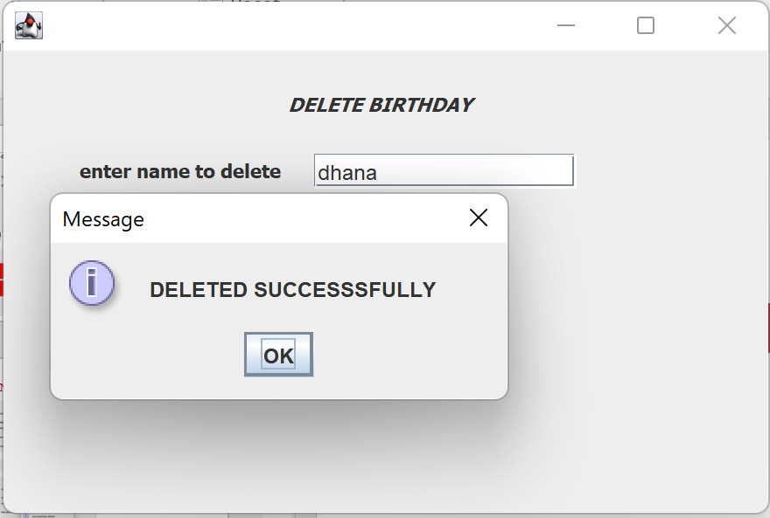
IMPLEMENTATION
Data in Files

Slide 12
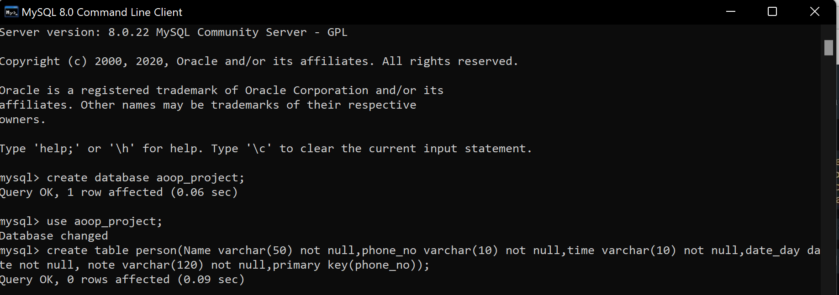
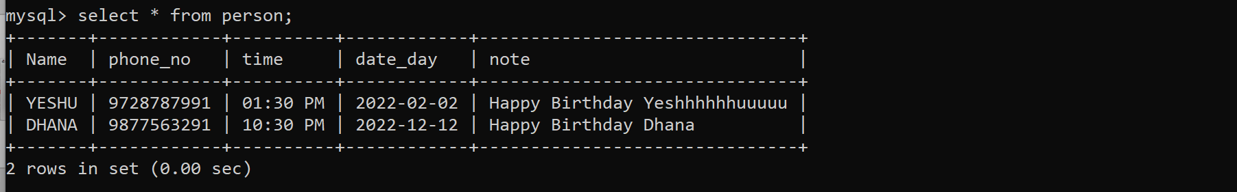
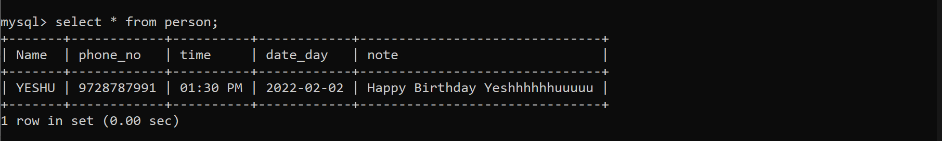
IMPLEMENTATION
DATABASE CONNECTION
After deletion

Slide 13
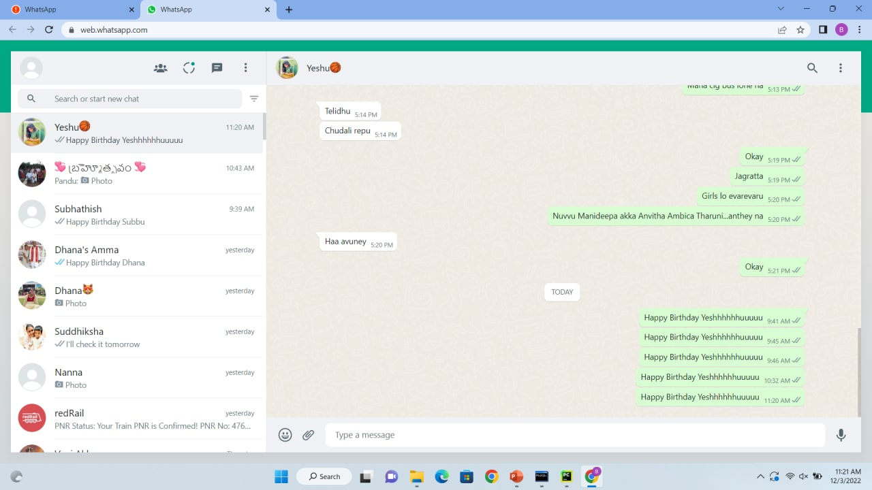
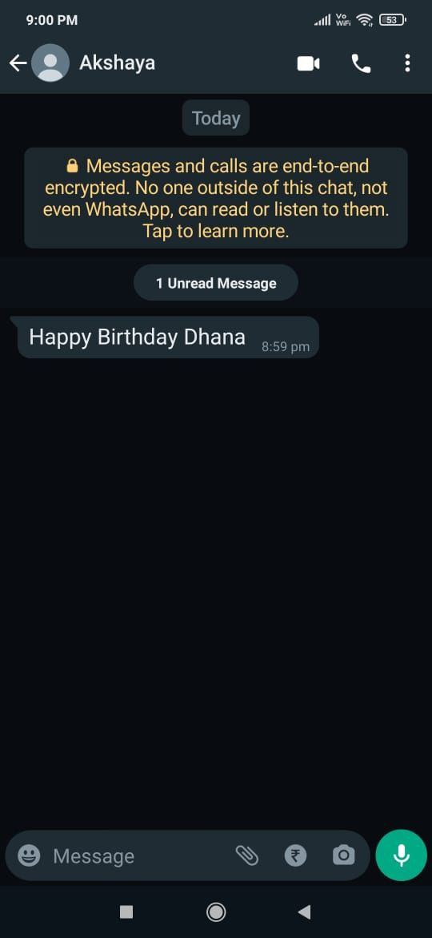
IMPLEMENTATION

Slide 14
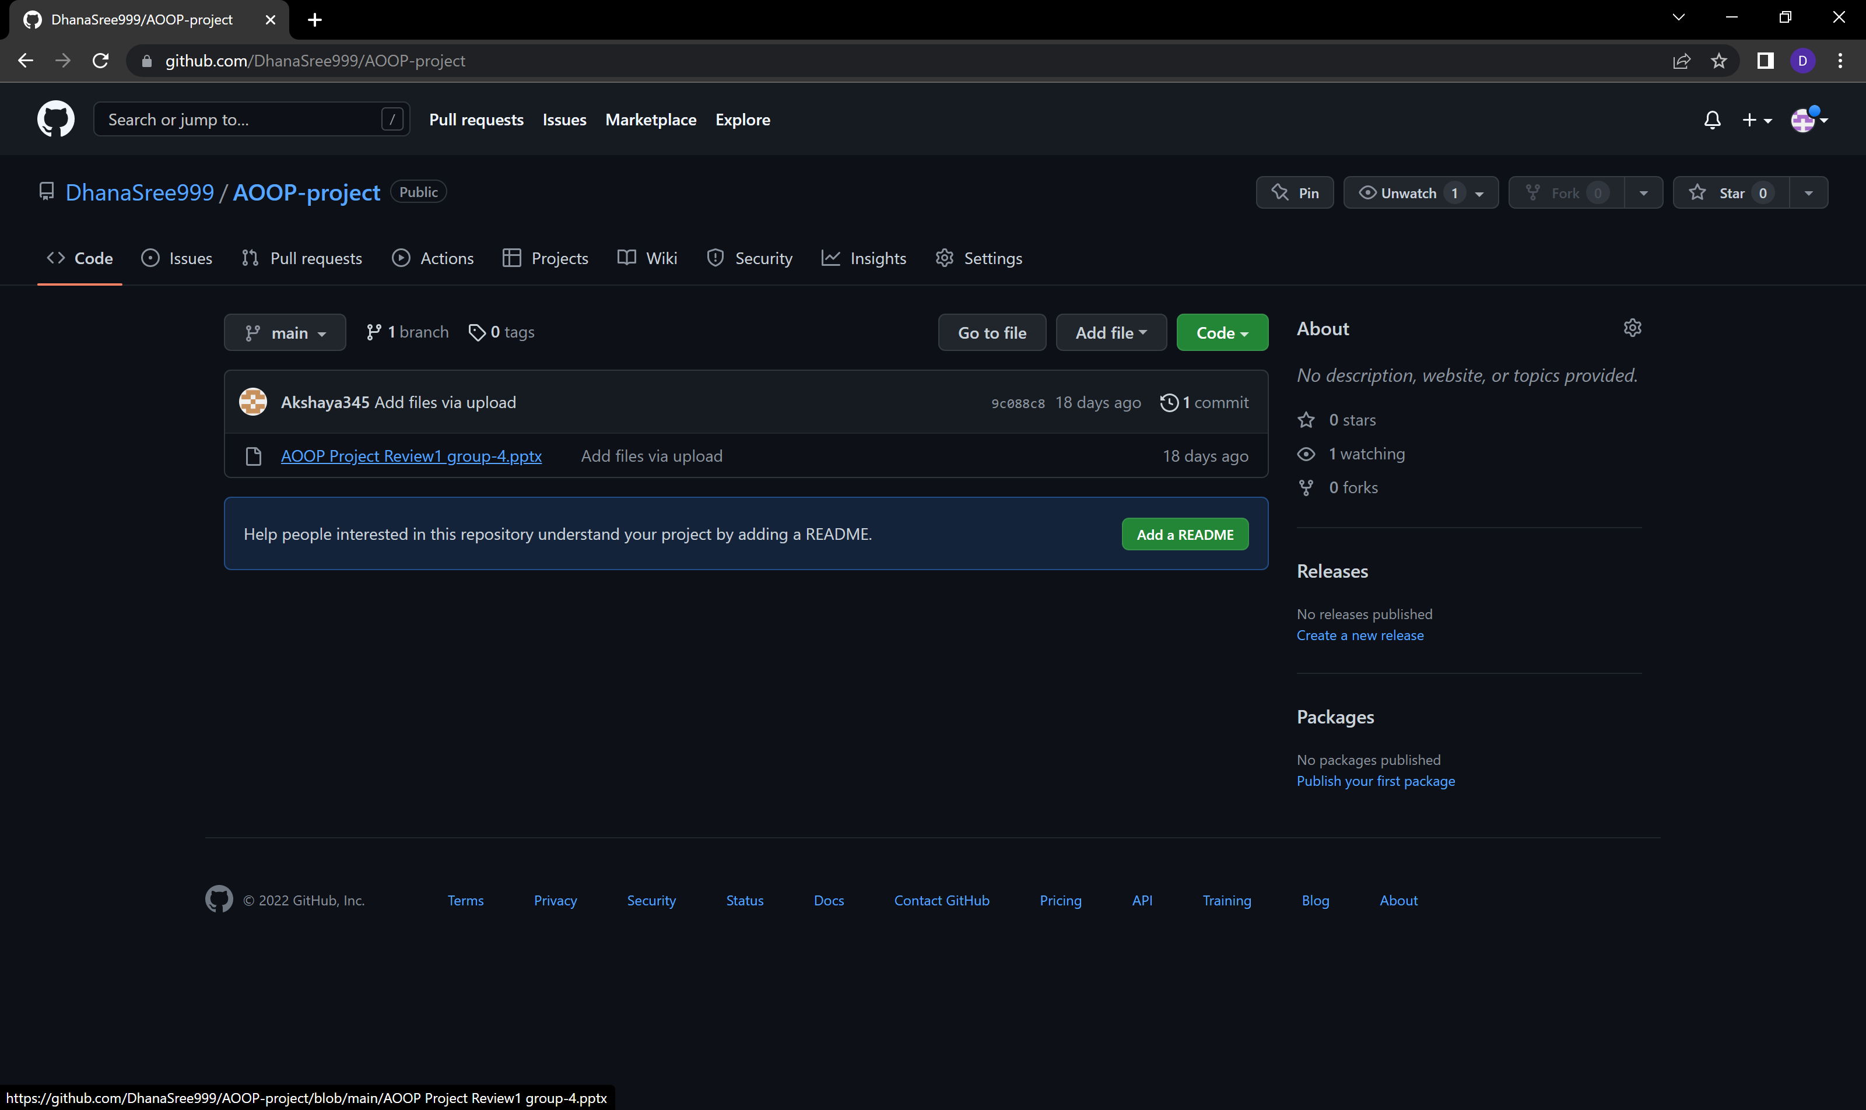
GITHUB COMMITS
https://github.com/DhanaSree999/AOOP-project

Slide 15
GITHUB LINKS
https://github.com/DhanaSree999/AOOP-project
https://github.com/Akshaya345/AOOP
https://github.com/subhathish
https://github.com/yesashwini412

Slide 16


