Slide 1
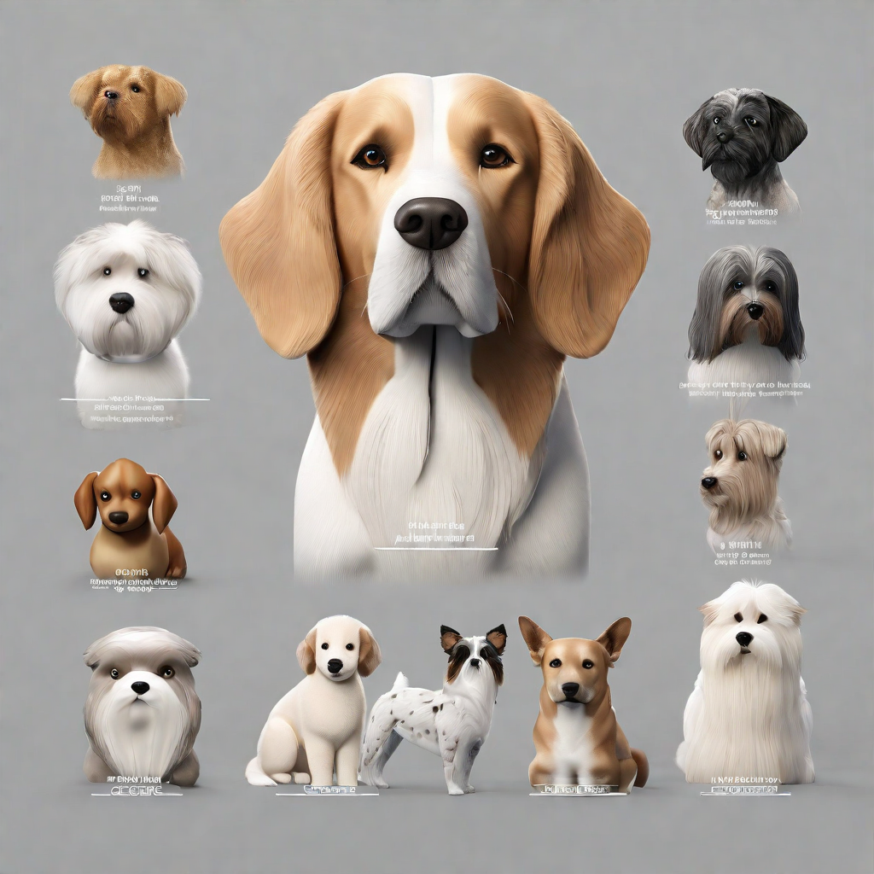
breedbot
DOG BREED IDENTIFICATION
By
Farhaan Ali(2110030291)
Venakata Suhas(2110030295)
U. Yesashwini (2110030412)
K. Dhana Sree (2110030444)
Under the guidance of
Dr. Rajib Debnath

Slide 2
contents
Problem statement
Description
Statistics
Novelty
Project feasibility
Orientation with social needs
Timeline
Contribution
Future directions
Key findings
Conclusion
references

Slide 3
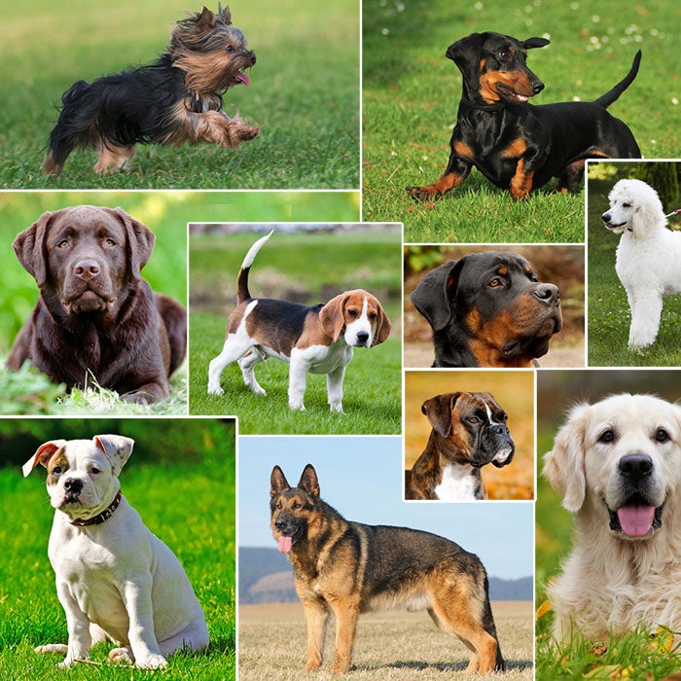
PROBLEM STATEMENT
Inaccurate breed identification leads to mismatches in adopters' expectations.
Increased returns or surrenders negatively impact both dogs and the adoption process.
A needed solution is a precise, user-friendly dog breed classification system.
An automatic dog breed classifier serves as a standalone tool, assisting experts in expediting the classification process.
The goal is to promote successful, informed adoptions through accurate information about available dog breeds.

Slide 4
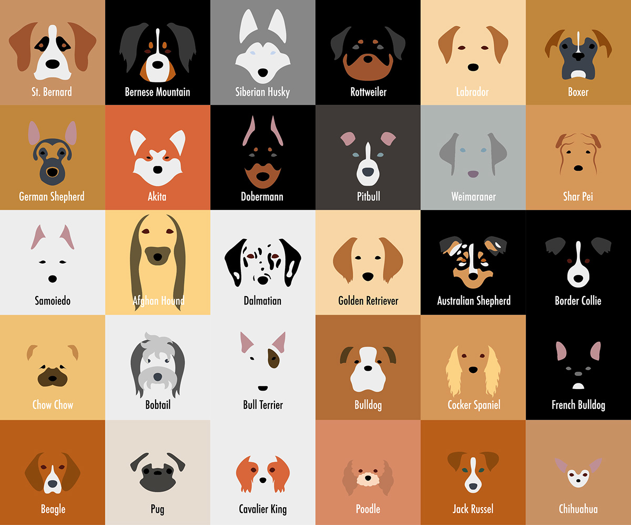
DESCRIPTION
Dogs are the most popular pets with over 154 breeds, some having similar face configurations.
Specific care and treatment are necessary based on dog breeds.
The project aims to develop a deep learning-based system that accurately predicts dog breeds from images.
This aims to address challenges in breed identification, especially in pet adoption.
Utilizes advanced techniques like convolutional neural networks (CNNs) for automated feature extraction.
Enables precise breed predictions to ensure appropriate care and cure.

Slide 5
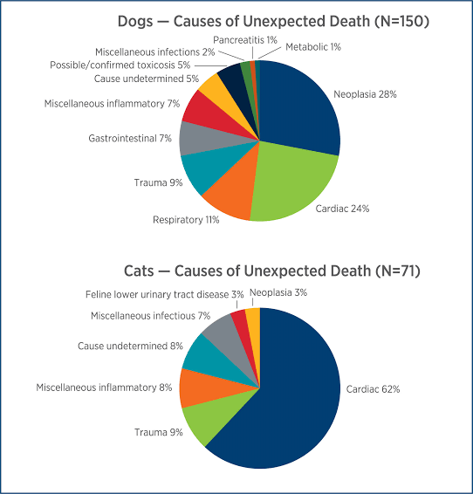
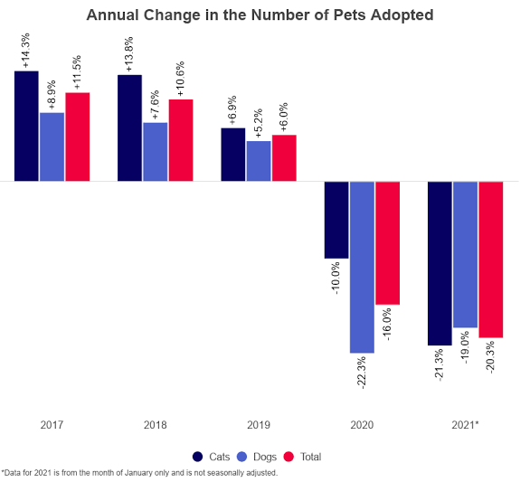
STATISTICS

Slide 6
NOVELTY
The novelty of the “Dog Breed Identification" project is rooted in its innovative amalgamation of computer vision and machine learning to tackle a specific and practical challenge.
One key aspect contributing to its uniqueness is the project's multifaceted application.
By offering a tool for precise and automated dog breed identification, it caters to the varied needs of dog owners, veterinarians, animal shelters, and regulatory authorities.

Slide 7
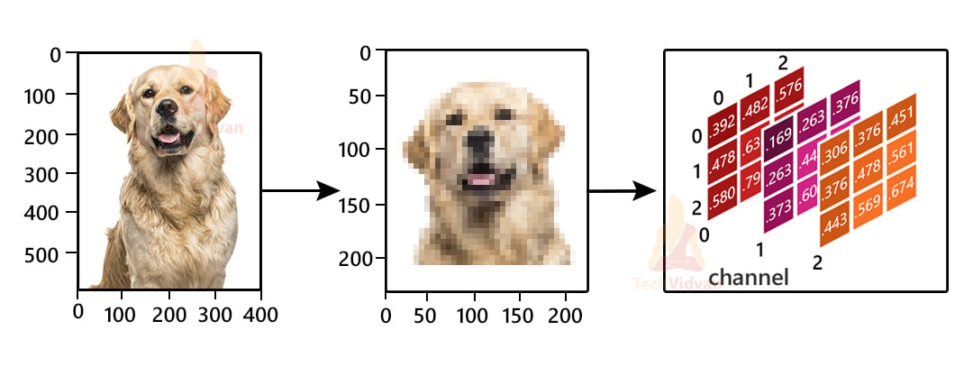


PROJECT FEASIBILITY
Data availability:
Assess the availability of a diverse and welllabeled dataset of dog images with annotated breeds.
Algorithm complexity:
Evaluate the complexity of the computer vision algorithms and machine learning models needed for accurate breed identification.
Hardware and software requirements:
Determine the computing resources and software tools necessary for implementing the project.

Slide 8
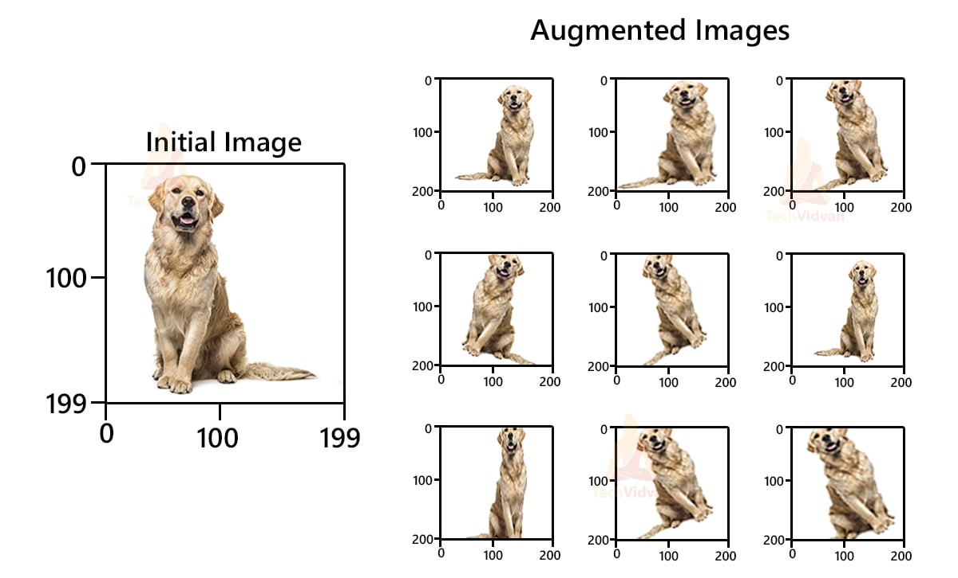
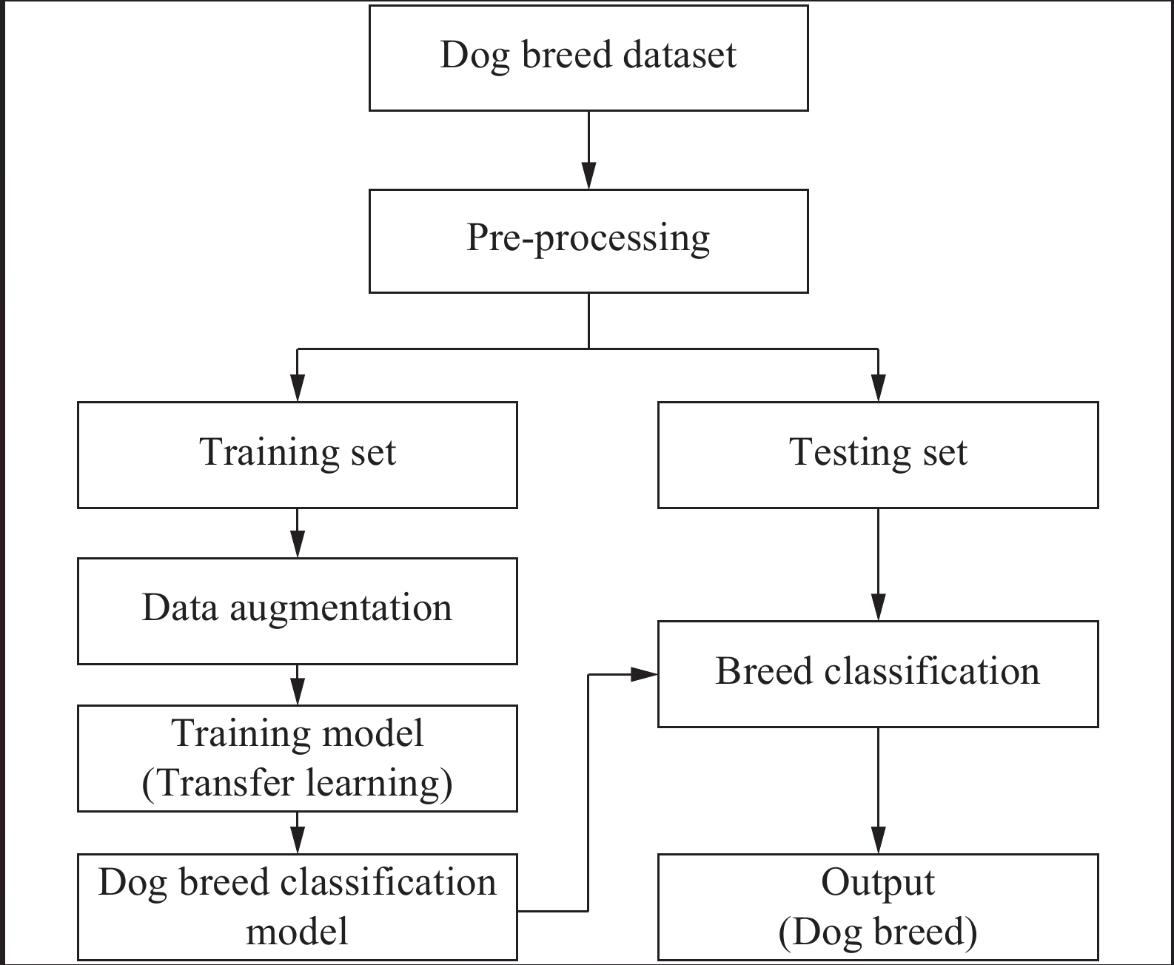
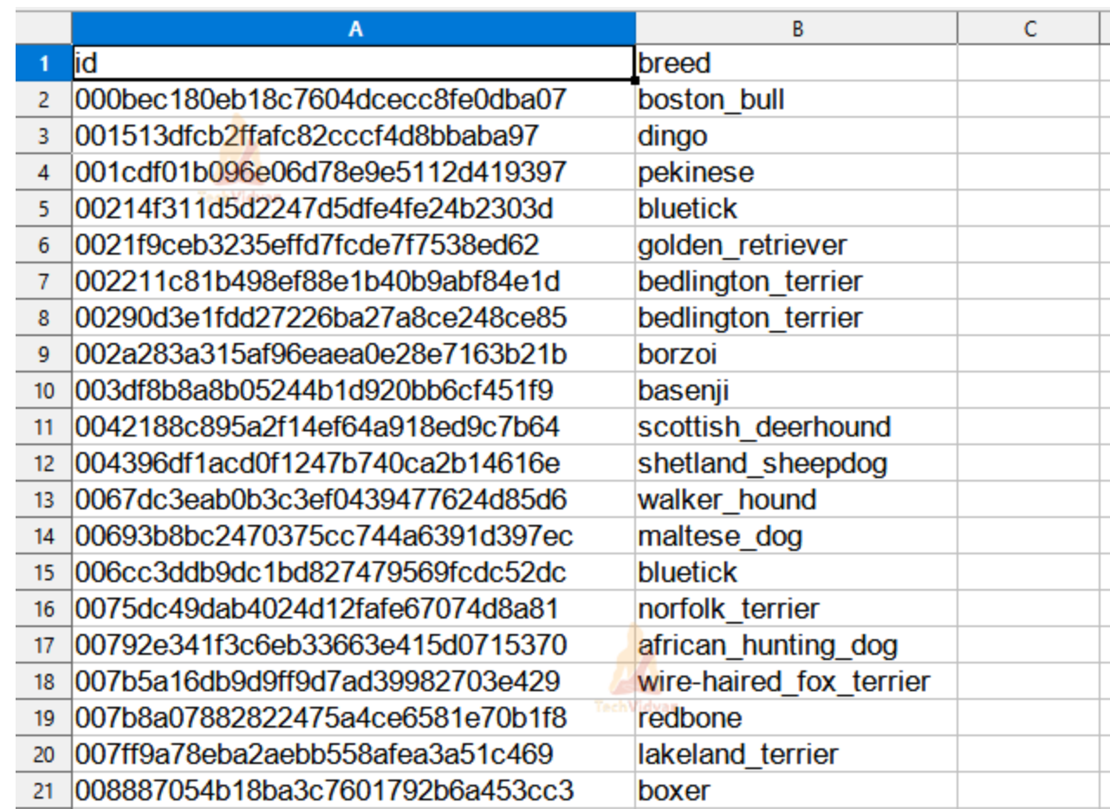

Slide 9
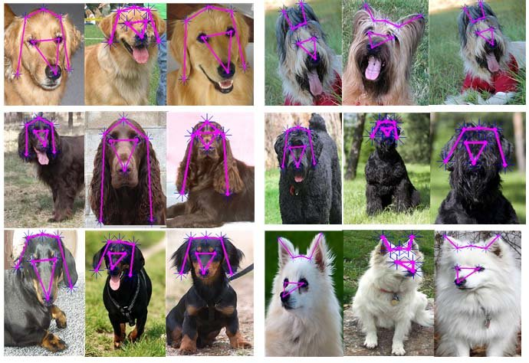
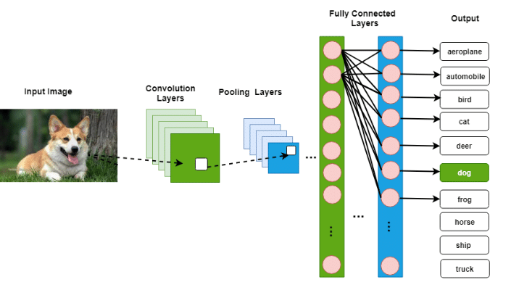

Slide 10

ORIENTATION WITH SOCIAL NEEDS
Pet Services Customization:
Tailor training, grooming, and dietary plans based on breed-specific needs.
Veterinary Diagnostics:
Assist veterinarians in identifying breed-specific health issues and provide targeted treatments.
Lost Pet Recovery:
Reunite lost dogs with owners by accurately identifying breeds through images or video footage.
Behavioral Analysis:
Understand breed-specific behaviors for effective training and behavior modification.

Slide 11
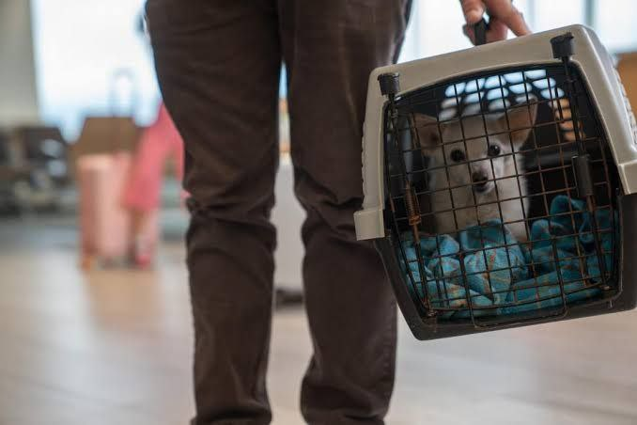
Adoption Matching:
Facilitate better matches between potential owners and dogs based on lifestyle and breed traits.
Public Policy Planning:
Support municipalities in understanding local dog populations for urban planning and public safety policies.
BreedSpecific Products:
Develop and market products tailored to specific breed needs, including toys, accessories, and healthcare items.
Education and Awareness:
Create educational resources to increase awareness about various breeds' characteristics, promoting responsible pet ownership.

Slide 12
Key findings
FUTURE DIRECTIONS
CONTRIBUTIONS
Through the use of deep learning techniques, we plan to develop a dog breed identification system that achieves high accuracy in classifying dog images.
Future improvements can be made to enhance the performance and efficiency of the dog breed identification.
This includes exploring advanced deep learning architectures, increasing the size and diversity of the training dataset, and incorporating additional contextual information such as dog behavior and physical traits.
Our study contributes to the field of computer vision by demonstrating the effectiveness of deep learning in accurately identifying dog breeds from images.

Slide 13
CONCLUSION
The project represents a groundbreaking initiative that seamlessly integrates computer vision and machine learning to provide a versatile solution.
The project's success will be measured by contributing to informed and successful pet adoptions, reducing returns or surrenders to shelters, and promoting responsible pet ownership practices.
Its innovative approach not only addresses the specific challenge of automated dog breed identification but also caters to the diverse needs of dog owners, veterinarians, shelters, and regulatory authorities.
The platform's success lies in its potential to positively impact the lives of dogs and their human companions.
This project stands at the forefront of technological advancements, promising valuable contributions to the field of animal care and management.

Slide 14
REFERENCES
https://slideplayer.com/slide/8370604/
https://www.miresearch.net/article/doi/10.1007/s1163302012610

Slide 15


ANY
QUESTI N

