Slide 1
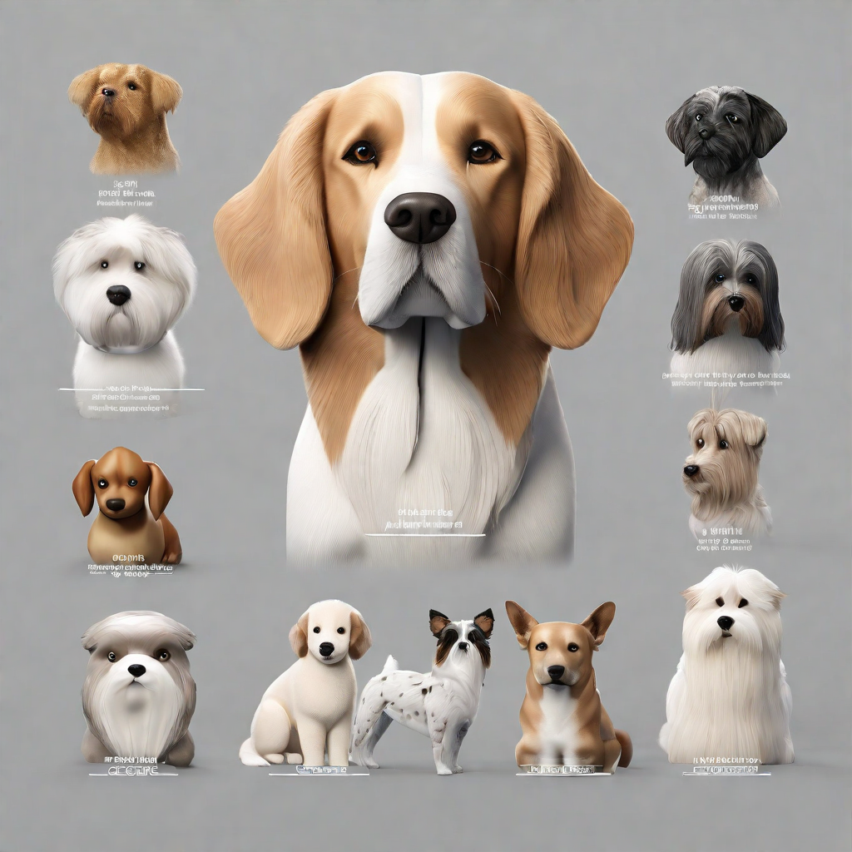
breedbot
DOG BREED IDENTIFICATION
By
Farhaan Ali(2110030291)
Venakata Suhas(2110030295)
U. Yesashwini (2110030412)
K. Dhana Sree (2110030444)
Under the guidance of
Dr. Rajib Debnath

Slide 2
contents
PROBLEM STATEMENT
FEW METHODOLOGIES
BEST ACCURACIES
RESEARCH PAPER ANALYSIS
GAPS IN EXISTING WORKS
Key findings
Future directions
Conclusion
references

Slide 3
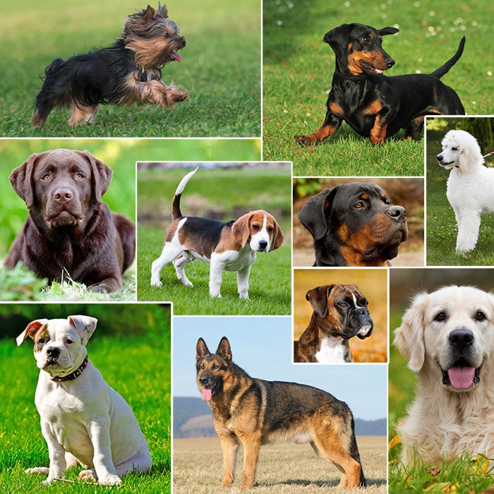
1.PROBLEM STATEMENT
Inaccurate breed identification leads to mismatches in adopters' expectations.
Increased returns or surrenders negatively impact both dogs and the adoption process.
A needed solution is a precise, user-friendly dog breed classification system.
An automatic dog breed classifier serves as a standalone tool, assisting experts in expediting the classification process.
The goal is to promote successful, informed adoptions through accurate information about available dog breeds.

Slide 4
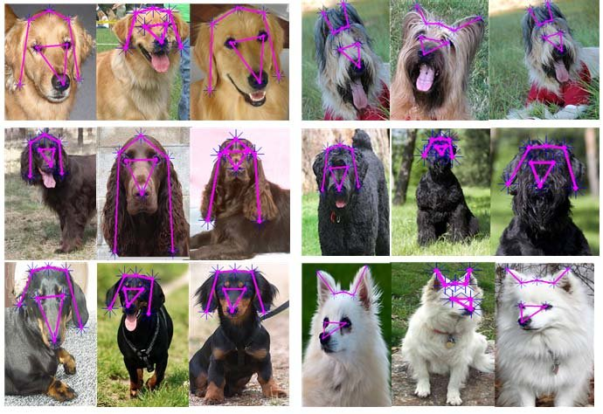
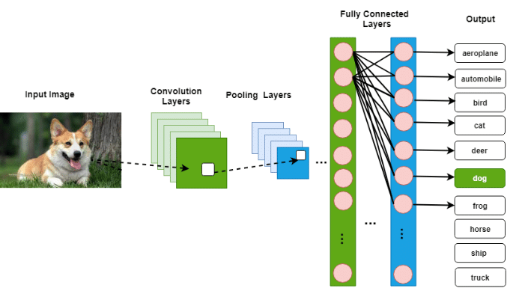

Slide 5
2.Few methodologies
Multi-scale Convolutional Neural Networks (CNNs):
Captures features at different resolutions for better representation.
Handles both local and global information effectively.
Might require more computational resources and careful architecture design.
Self-supervised Learning with Contrastive Loss:
Learns meaningful representations without labeled data.
Leverages semantic similarities between images.
Requires careful tuning of hyperparameters and depends on unlabeled data quality.
Attention Mechanism with Convolutional Neural Networks:
Focuses on relevant parts of the input image.
Captures spatial dependencies between image regions.
Increases model complexity and requires careful design.

Slide 6
2.Few methodologies
Transfer learning with multiple pre-trained models and ensemble voting:
Utilizes knowledge from large-scale datasets for improved performance.
Reduces overfitting and improves classification accuracy through ensemble voting.
Demands additional computational resources and optimal ensemble strategy selection.
Fine-tuning of alexnet, vgg19, and mobilenet v2 convolutional neural networks:
Adapts pre-trained models to specific dog breed characteristics.
Efficient training with smaller datasets.
Requires careful hyperparameter selection and regularization to prevent overfitting.

Slide 7
3.Best Accuracy analysis

Slide 8
4.Research Papers Analysis
Title: Deep learning models for dog breed identification through transfer learning
Authors: Kumar, S., & Pandey S. K.
Journal name and publisher: Multimedia tools and applications (springer)
Methodology adopted: Fine-tuning of alexnet, VGG19, and mobilenet V2 convolutional neural networks
Accuracy: Around 95% accuracy (specific performance varies) on stanford dogs dataset
Advantages: A relatively simple approach for practitioners to apply
Disadvantages: Less potential to exceed the base accuracy of the pre-trained model

Slide 9
4.Research Papers Analysis
Title: Accurate and real-time dog breed classification based on deep transfer learning.
Authors: Habiba, m., Ramadan, R., Elgedawy, I.
Journal name and publisher: International Journal of Computational Intelligence Systems (atlantis press)
Methodology adopted: Transfer learning with efficient net for feature extraction and a custom multi-label image classifier.
Accuracy: 94% accuracy on custom mixed breed dataset
Advantages: Leverages pre-trained feature learning with a dataset specialized for mixed-breed classification
Disadvantages: Can introduce significant overfitting risks to custom head classifier if the dataset isn't large enough

Slide 10
5.GAPS IN EXISTING WORKS
1. Mixed-breed classification:
Current models focus on purebreds, ignoring the complexities of mixed breeds.
2. Limited dataset diversity:
Some studies use narrow datasets, neglecting variation in breeds, age, and environments.
3. Continuous learning mechanisms:
Existing models are static, missing opportunities for ongoing improvement.
4. Real-world application challenges:
Models often struggle with real-world conditions like lighting and image quality.
5. Limited attention to breed-specific traits:
Some models overlook breed-specific characteristics, leading to errors.

Slide 11
6.Key findings
7.FUTURE DIRECTIONS
8.CONTRIBUTIONS
Through the use of deep learning techniques, we plan to develop a dog breed identification system that achieves high accuracy in classifying dog images.
Future improvements can be made to enhance the performance and efficiency of the dog breed identification.
This includes exploring advanced deep learning architectures, increasing the size and diversity of the training dataset, and incorporating additional contextual information such as dog behavior and physical traits.
Our study contributes to the field of computer vision by demonstrating the effectiveness of deep learning in accurately identifying dog breeds from images.

Slide 12
9.CONCLUSION
The project represents a groundbreaking initiative that seamlessly integrates computer vision and machine learning to provide a versatile solution.
The project's success will be measured by contributing to informed and successful pet adoptions, reducing returns or surrenders to shelters, and promoting responsible pet ownership practices.
Its innovative approach not only addresses the specific challenge of automated dog breed identification but also caters to the diverse needs of dog owners, veterinarians, shelters, and regulatory authorities.
The platform's success lies in its potential to positively impact the lives of dogs and their human companions.
This project stands at the forefront of technological advancements, promising valuable contributions to the field of animal care and management.

Slide 13
REFERENCES
https://docs.google.com/spreadsheets/d/1Bd5W8VBbiVCEo5sqY9c_KJFFXcEbpTwts4A2ssrcLgo/edit#gid=0
https://www.alibabacloud.com/blog/from-r-cnn-to-faster-r-cnn-%E2%80%93-the-evolution-of-object-detection-technology_593829
http://vision.stanford.edu/aditya86/ImageNetDogs/main.html

Slide 14


ANY
QUESTI N

