Slide 1
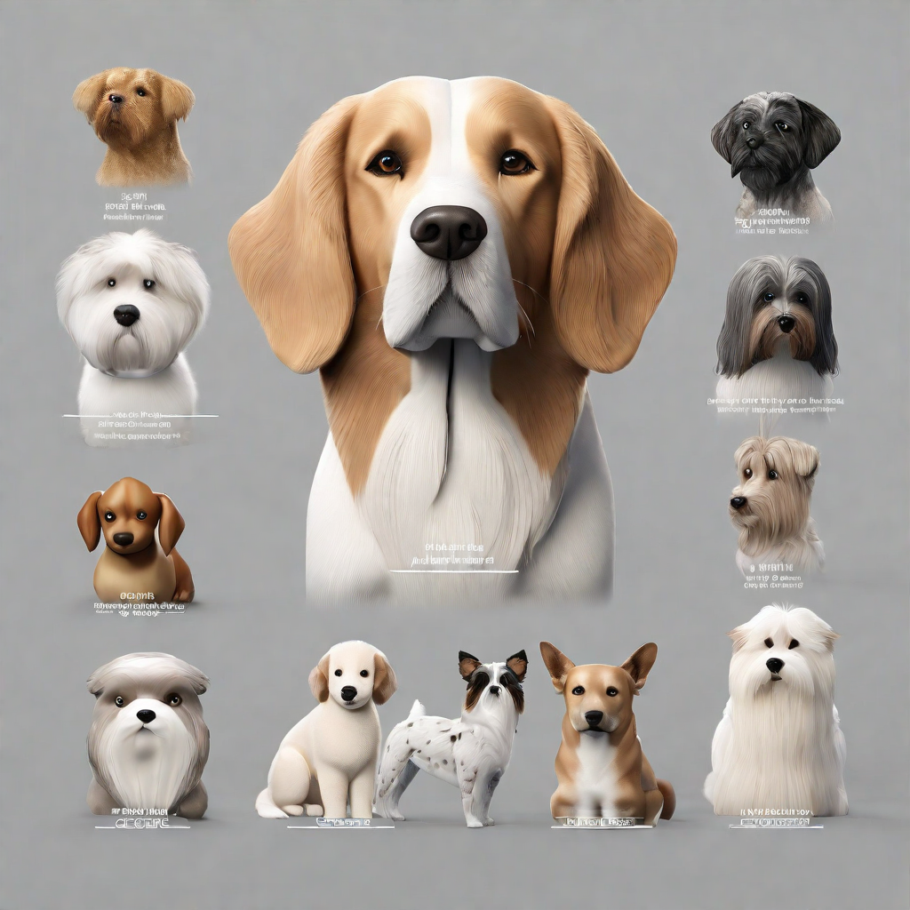
breedbot
DOG BREED IDENTIFICATION
By
Farhaan Ali(2110030291)
Venakata Suhas(2110030295)
U. Yesashwini (2110030412)
K. Dhana Sree (2110030444)
Under the guidance of
Dr. Rajib Debnath

Slide 2
contents
PROBLEM STATEMENT
FEW METHODOLOGIES
BEST ACCURACIES
RESEARCH PAPER ANALYSIS
GAPS IN EXISTING WORKS
Key findings
Future directions
Conclusion
references

Slide 3
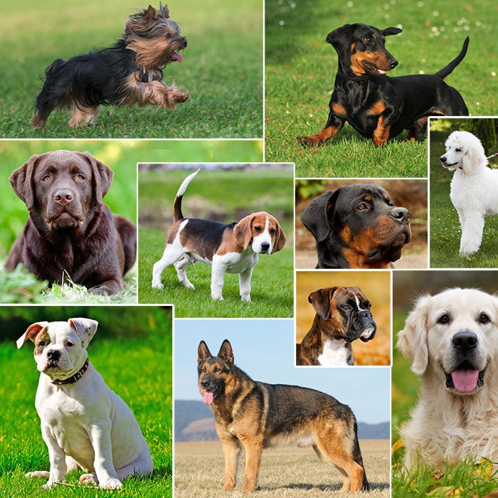
PROBLEM STATEMENT
Inaccurate breed identification leads to mismatches in adopters' expectations.
Increased returns or surrenders negatively impact both dogs and the adoption process.
A needed solution is a precise, user-friendly dog breed classification system.
An automatic dog breed classifier serves as a standalone tool, assisting experts in expediting the classification process.
The goal is to promote successful, informed adoptions through accurate information about available dog breeds.

Slide 4
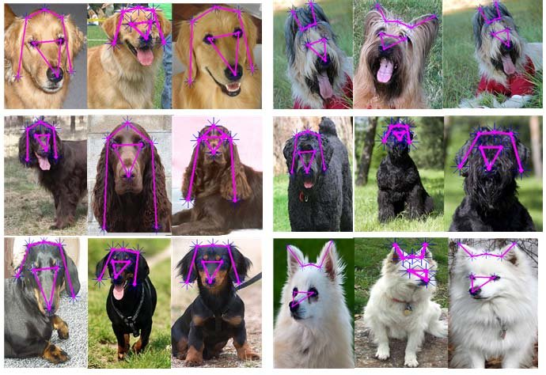
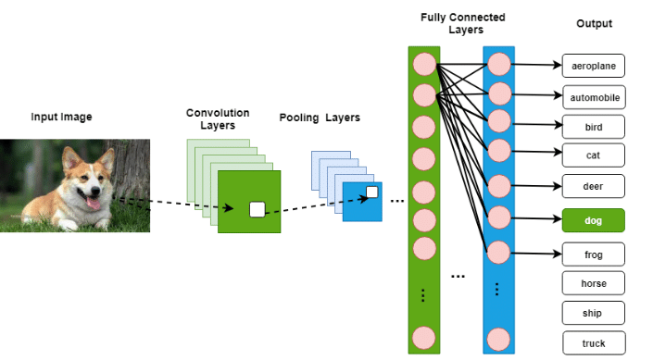

Slide 5
Novelty of Developed Methodology
Utilizes resnet50 architecture for dog breed classification.
Benefits from transfer learning with resnet50 pre-trained on imagenet.
Captures intricate features crucial for accurate classification.
Accessible to a wide range of users through intuitive interfaces or mobile applications

Slide 6
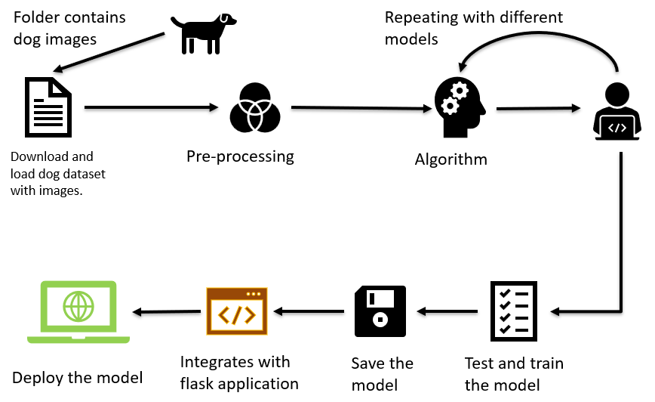
Adaptability of Methodology
Demonstrates flexibility through transfer learning.
Repurposes knowledge learned from imagenet.
Allows fine-tuning and freezing of layers based on dataset size.
Optimizes computational resources while maintaining performance.

Slide 7
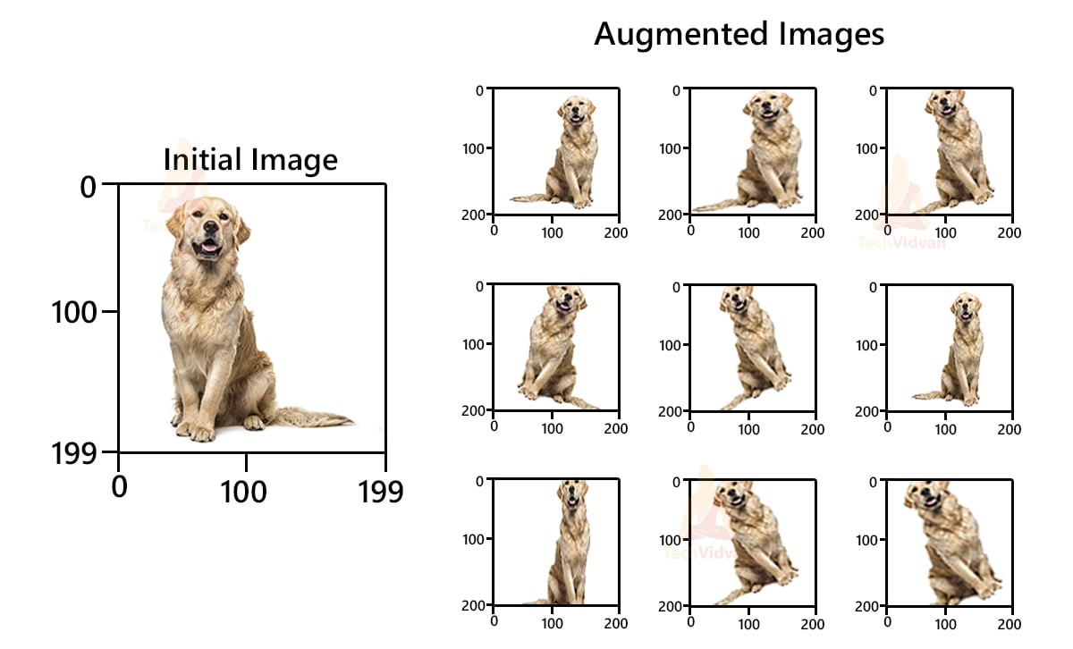
Methodology evaluation
Rigorous training, testing, and validation procedures.
Utilizes data augmentation to enhance generalization.
Assesses performance using accuracy, precision, recall, and f1 score.
Monitors performance over multiple epochs for robustness.

Slide 8
Dissemination and accessibility
Ensure widespread access to tools and resources for accurate dog breed classification.
Disseminate knowledge through workshops, online platforms, and user-friendly applications.
Focus on inclusivity by overcoming barriers like language and cost.
Empower individuals with the necessary tools and information.
Promote responsible pet ownership and breed preservation efforts.
Foster a thriving community of dog enthusiasts and professionals.
Contribute to the well-being and diversity of canine populations.

Slide 9
Accuracy of results
Achieved an accuracy of approximately 80% in dog breed classification using the resnet50 architecture.
Rigorous evaluation and validation procedures ensure the reliability and robustness of the results.
Continuous monitoring and improvement of model performance contribute to achieving high accuracy levels over time.

Slide 10
Technical competence
Demonstrates proficiency in deep learning and computer vision techniques.
Utilizes advanced methodologies such as transfer learning with pre-trained models.
Implements state-of-the-art architectures like resnet50, showcasing expertise in modern neural network architectures.

Slide 11
Innovative and sustainable features
Integrates transfer learning, enabling adaptation of knowledge from existing datasets like imagenet.
Leverages resnet50 architecture for efficient feature extraction and classification.
Incorporates sustainable practices through open science principles, encouraging collaboration and knowledge sharing.

Slide 12
Utility to society
Provides a valuable tool for dog breed classification, benefiting dog breeders, veterinarians, and pet owners.
Enhances efficiency in tasks such as breed identification, pet adoption, and animal welfare.
Facilitates research in areas like canine genetics, behavior analysis, and healthcare, contributing to advancements in veterinary science and pet care.

Slide 13
Best Accuracy analysis

Slide 14
GAPS IN EXISTING WORKS
1. Mixed-breed classification:
Current models focus on purebreds, ignoring the complexities of mixed breeds.
2. Limited dataset diversity:
Some studies use narrow datasets, neglecting variation in breeds, age, and environments.
3. Continuous learning mechanisms:
Existing models are static, missing opportunities for ongoing improvement.
4. Real-world application challenges:
Models often struggle with real-world conditions like lighting and image quality.
5. Limited attention to breed-specific traits:
Some models overlook breed-specific characteristics, leading to errors.

Slide 15
Key findings
FUTURE DIRECTIONS
CONTRIBUTIONS
Through the use of deep learning techniques, we plan to develop a dog breed identification system that achieves high accuracy in classifying dog images.
Future improvements can be made to enhance the performance and efficiency of the dog breed identification.
This includes exploring advanced deep learning architectures, increasing the size and diversity of the training dataset, and incorporating additional contextual information such as dog behavior and physical traits.
Our study contributes to the field of computer vision by demonstrating the effectiveness of deep learning in accurately identifying dog breeds from images.

Slide 16
CONCLUSION
The project represents a groundbreaking initiative that seamlessly integrates computer vision and machine learning to provide a versatile solution.
The project's success will be measured by contributing to informed and successful pet adoptions, reducing returns or surrenders to shelters, and promoting responsible pet ownership practices.
Its innovative approach not only addresses the specific challenge of automated dog breed identification but also caters to the diverse needs of dog owners, veterinarians, shelters, and regulatory authorities.
The platform's success lies in its potential to positively impact the lives of dogs and their human companions.
This project stands at the forefront of technological advancements, promising valuable contributions to the field of animal care and management.

Slide 17
REFERENCES
https://docs.google.com/spreadsheets/d/1Bd5W8VBbiVCEo5sqY9c_KJFFXcEbpTwts4A2ssrcLgo/edit#gid=0
https://www.alibabacloud.com/blog/from-r-cnn-to-faster-r-cnn-%E2%80%93-the-evolution-of-object-detection-technology_593829
http://vision.stanford.edu/aditya86/ImageNetDogs/main.html

Slide 18


ANY
QUESTI N

