Slide 1
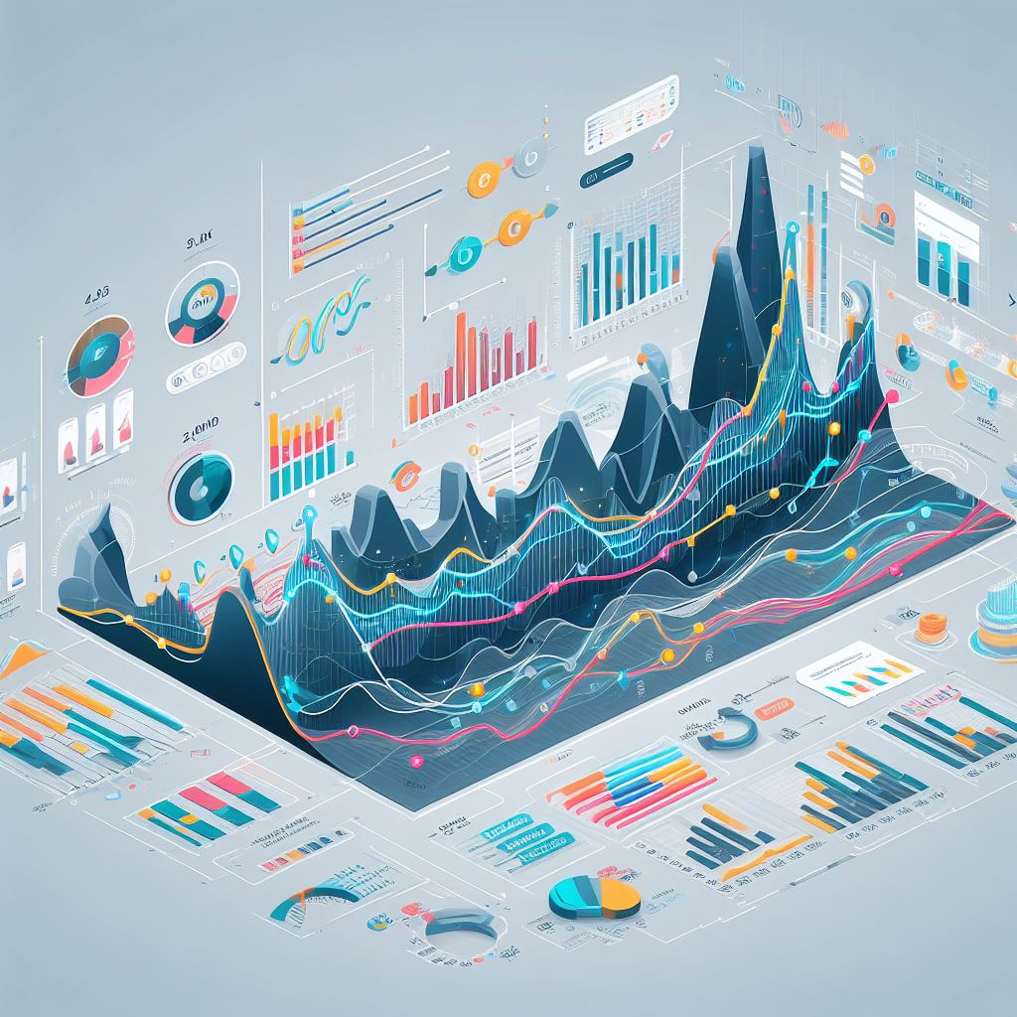
ISE 535 - Python Programming for Industrial & Systems Engineers
Project 2
Team 26
Dhana Surya Perumalsamy
Geethan Karthikeyan

Slide 2

Bokeh - Interactive Data Visualization in Python
Reference & Documentation: https://docs.bokeh.org/en/latest/

Slide 3
Motivation
Python library for generating web-based interactive visualizations and plots
Purpose
Simplifies the creation of web-friendly interactive visualizations in Python
Emphasizes usability and elegance for data exploration and presentation
Benefits
Relevance to ISE
User-friendly
Cross-platform compatibility for web-based interactive plots
Seamless integration with Python libraries like Pandas and NumPy
High interactivity without requiring extensive web development knowledge
Supports large datasets

Slide 4
Relevance to ISE
Visualizing Complex Data - Helps ISE professionals make sense of complex data by creating interactive, easy-to-understand visualizations
Process Optimization - Aids in optimizing manufacturing and industrial processes by visualizing performance metrics, identifying bottlenecks, and improving efficiency
Real-time Monitoring - Enables real-time monitoring of systems, allowing engineers to track operations and make immediate decisions based on live data
Simulation Visualization - Helps in visually representing and analyzing simulation results, validating models, and understanding system behaviors
Collaboration and Reporting - Facilitates clear communication of findings within ISE teams and help create compelling reports for stakeholders
Integration with Python - Being a Python library, Bokeh easily integrates with other ISE-related Python tools, streamlining data analysis and visualization workflows

Slide 5
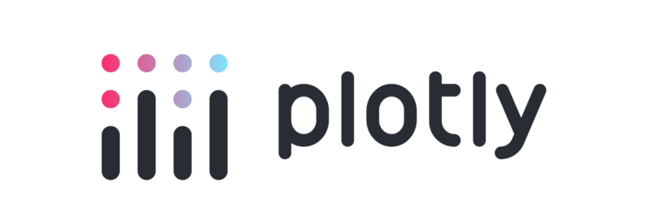


Existing Alternatives
Matplotlib - Comprehensive 2D plotting library for generating static, interactive, and publication-quality plots in Python
Plotly - Interactive and web-based library allowing the creation of rich, interactive visualizations with support for various programming languages including Python, R, and JavaScript
Seaborn - Built on top of Matplotlib, Seaborn provides a high-level interface for creating attractive statistical graphics through simplification and enhancement of Matplotlib's capabilities
ggplot - A Python implementation of the grammar of graphics in R, allowing users to create statistical visualizations

Slide 6
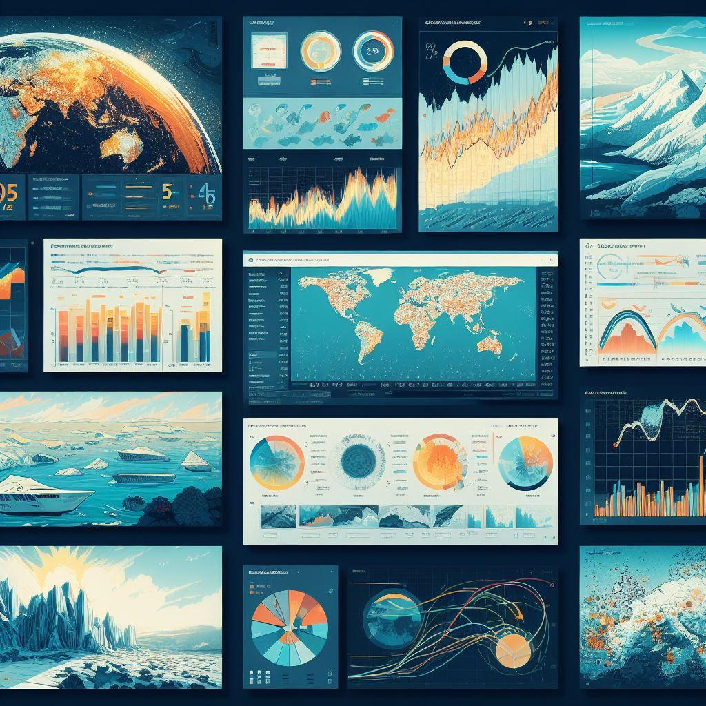
Advantages over Existing Alternatives
Native interactivity - Offers inherent interactivity without the need for additional plugins or tools, compared to limited interactivity in Matplotlib and Seaborn
Web-based interactive plots - Specializes in creating plots for web browsers, ensuring seamless integration into web-based applications
Flexibility in customization - Extensive options for customizing plots, allowing for precise control over visual elements and interactions which is lacking with respect to Plotly
Bokeh server capabilities - Allows building server-based applications for real-time data streaming and updates

Slide 7
Differences / Issues over Alternatives
Plotly vs. Bokeh - Although both provide web-based interactive plots, Plotly could present a more challenging learning curve for customization when compared to Bokeh's more user-friendly approach. Additionally, Plotly imposes licensing restrictions, whereas Bokeh is an open-source platform.
Seaborn vs. Bokeh - Seaborn excels in statistical plotting but lacks the inherent interactivity and flexibility that Bokeh offers for creating dynamic visualizations
Matplotlib vs. Bokeh - Matplotlib, being a foundational library, might require additional extensions or plugins to achieve the level of interactivity that Bokeh provides by default
ggplot vs. Bokeh - Bokeh excels in creating interactive and web-ready visualizations, making it a preferred choice over ggplot for projects that require dynamic and engaging data exploration on the web.

Slide 8
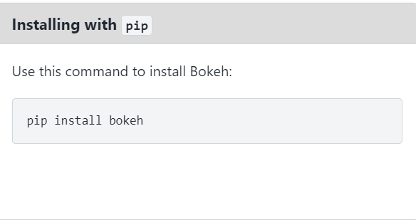
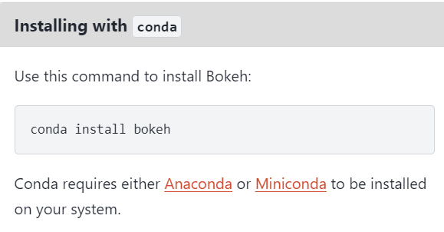
Installation Details & Basic Syntax
Install Bokeh with either conda or pip
After installation, you can verify the installation by opening Python in your CLI or terminal and typing - < import bokeh >
Syntax Examples
Creating plots - from bokeh.plotting import figure, show
Creating Multiple Figures or Layouts - from bokeh.layouts import gridplot, layout
Adding Interactivity (e.g., Hover Tools) - from bokeh.models import HoverTool

Slide 9
Expected Inputs & Outputs
Inputs
Pandas DataFrames
NumPy arrays
Python lists or dictionaries
Outputs
Interactive plots - Generates web-based interactive visualizations that can be viewed in web browsers
Web-based display - The generated plots are interactive and can be displayed on various platforms
Customization and Configuration - Allows for extensive customization of plots including but not limited to
Adjusting plot aesthetics
Adding titles, legends, and other visual elements to enhance interpretability

Slide 10
Illustrative Example

