Slide 1
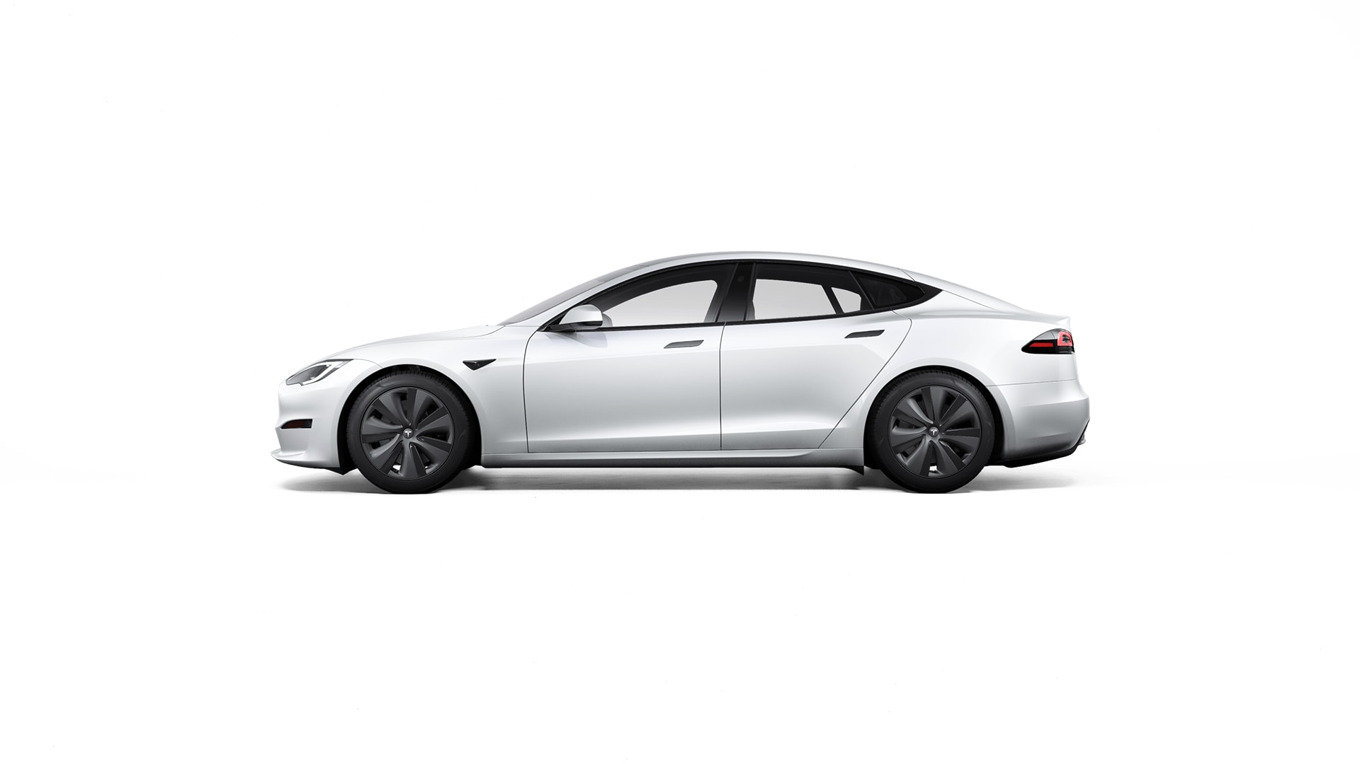


Model S

Slide 2
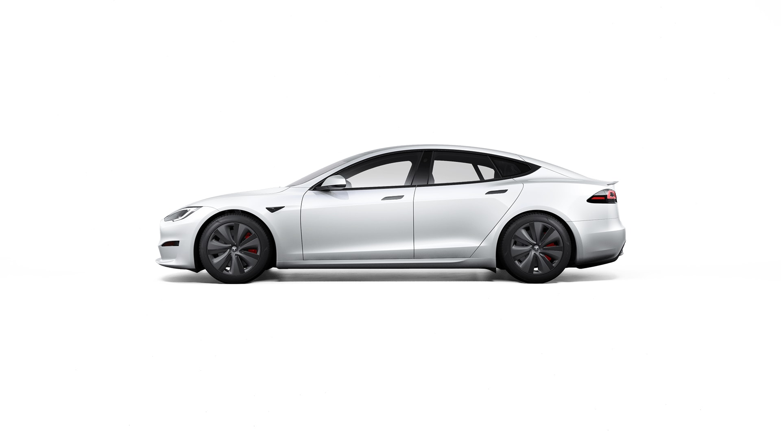
Model S Plaid

Slide 3
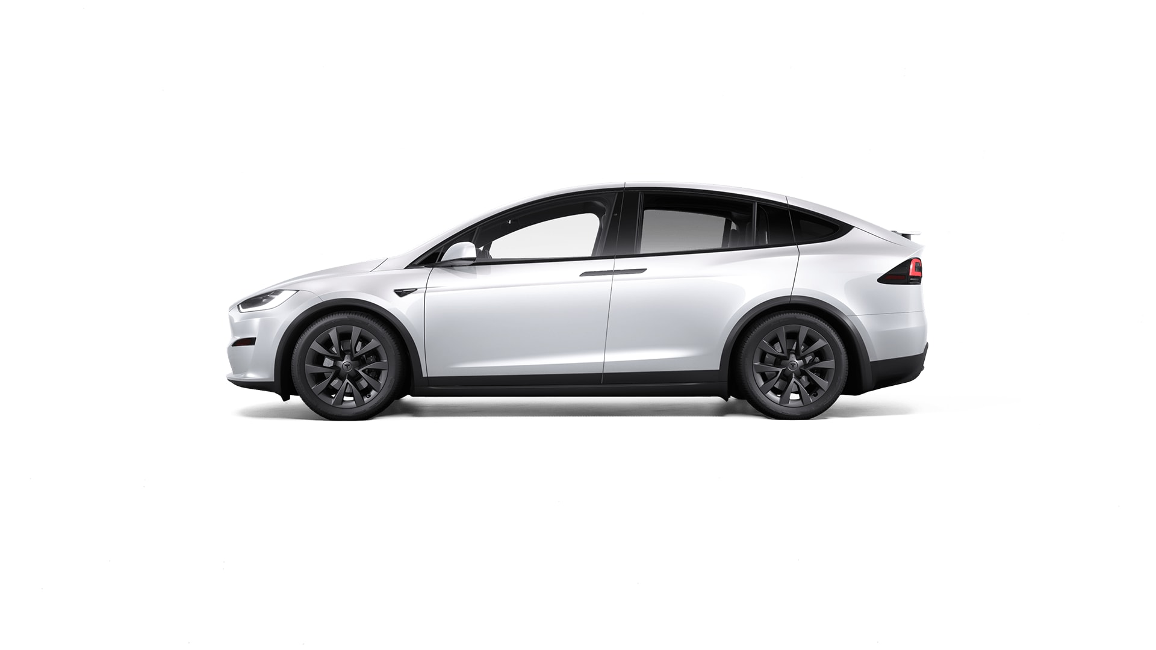
Model X

Slide 4
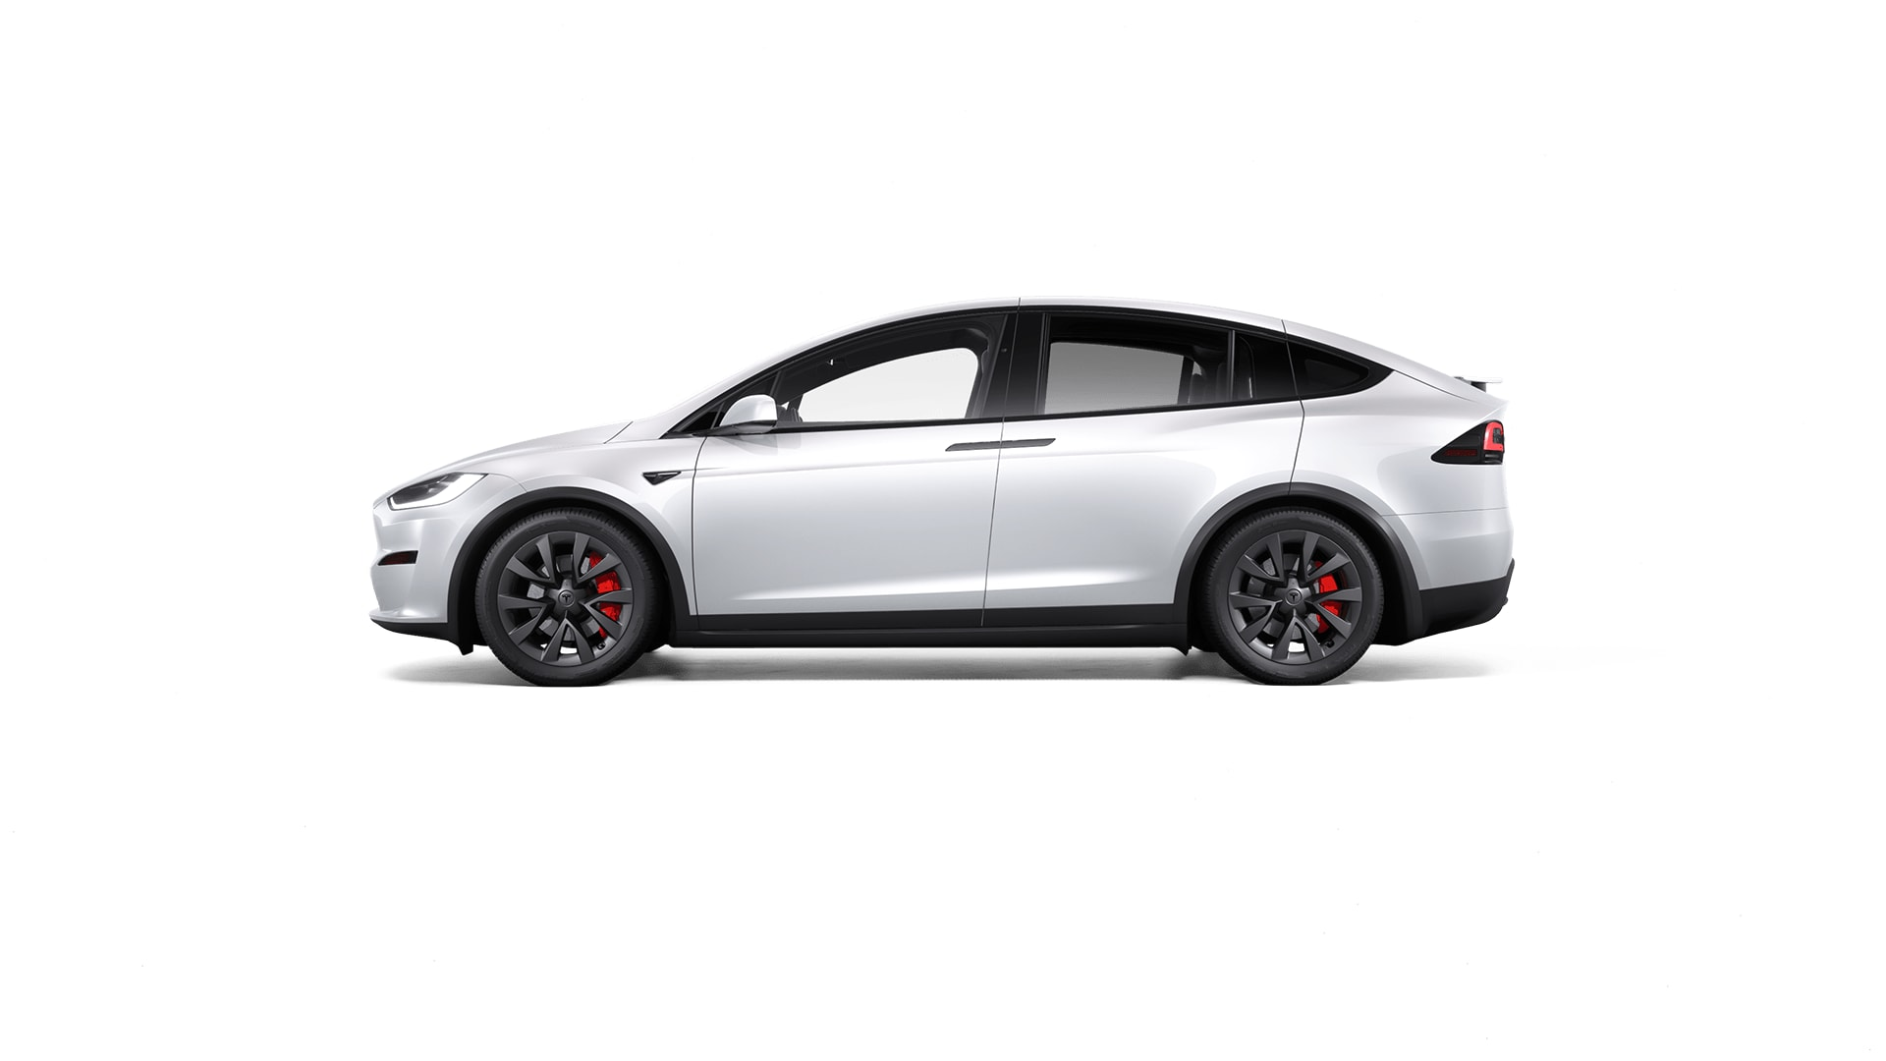
Model X Plaid

Slide 5
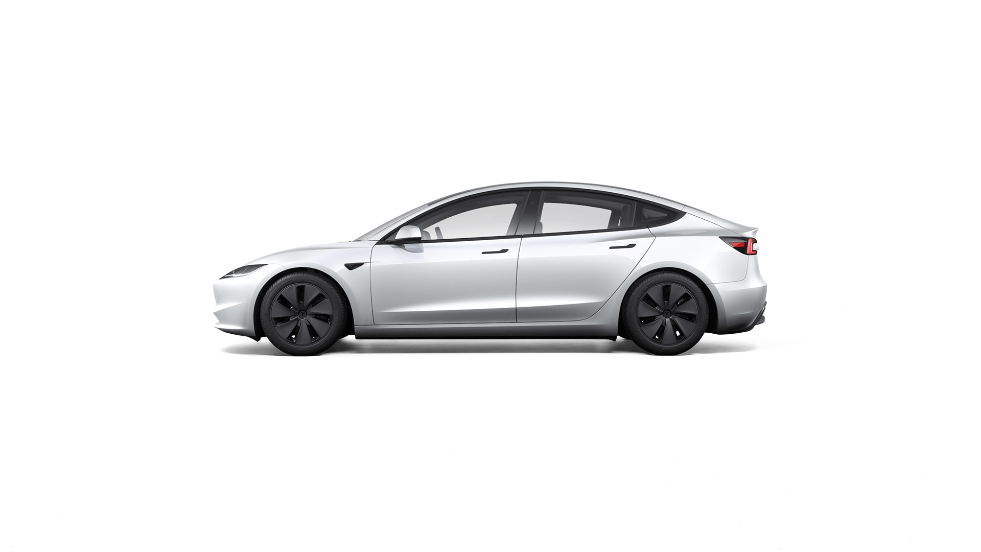
Model 3 Long Range

Slide 6
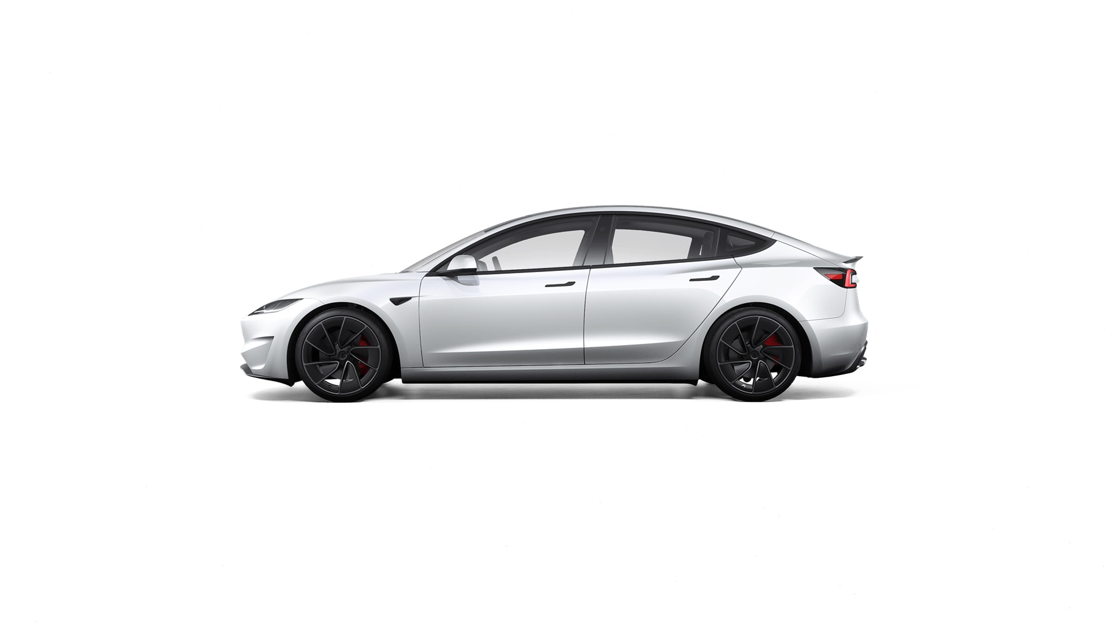
Model 3 Performance

Slide 7
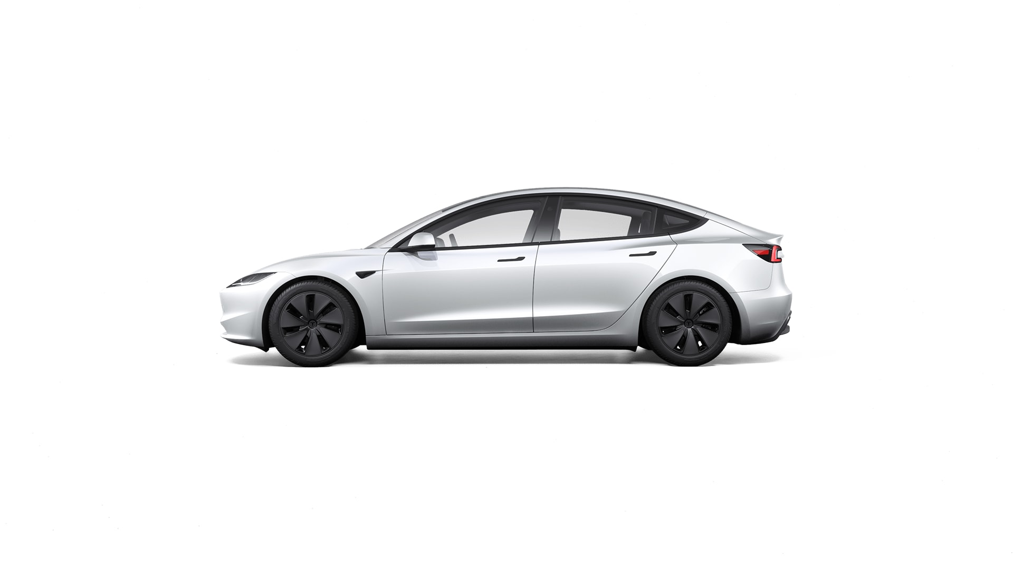
Model 3 Long Range RWD

Slide 8
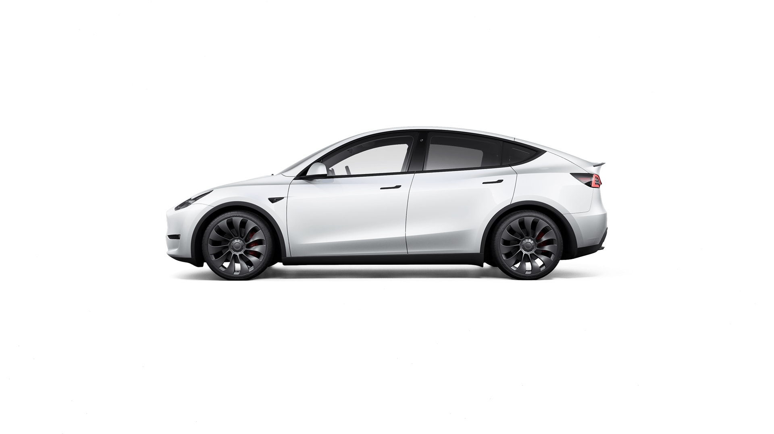
Model Y RWD

Slide 9
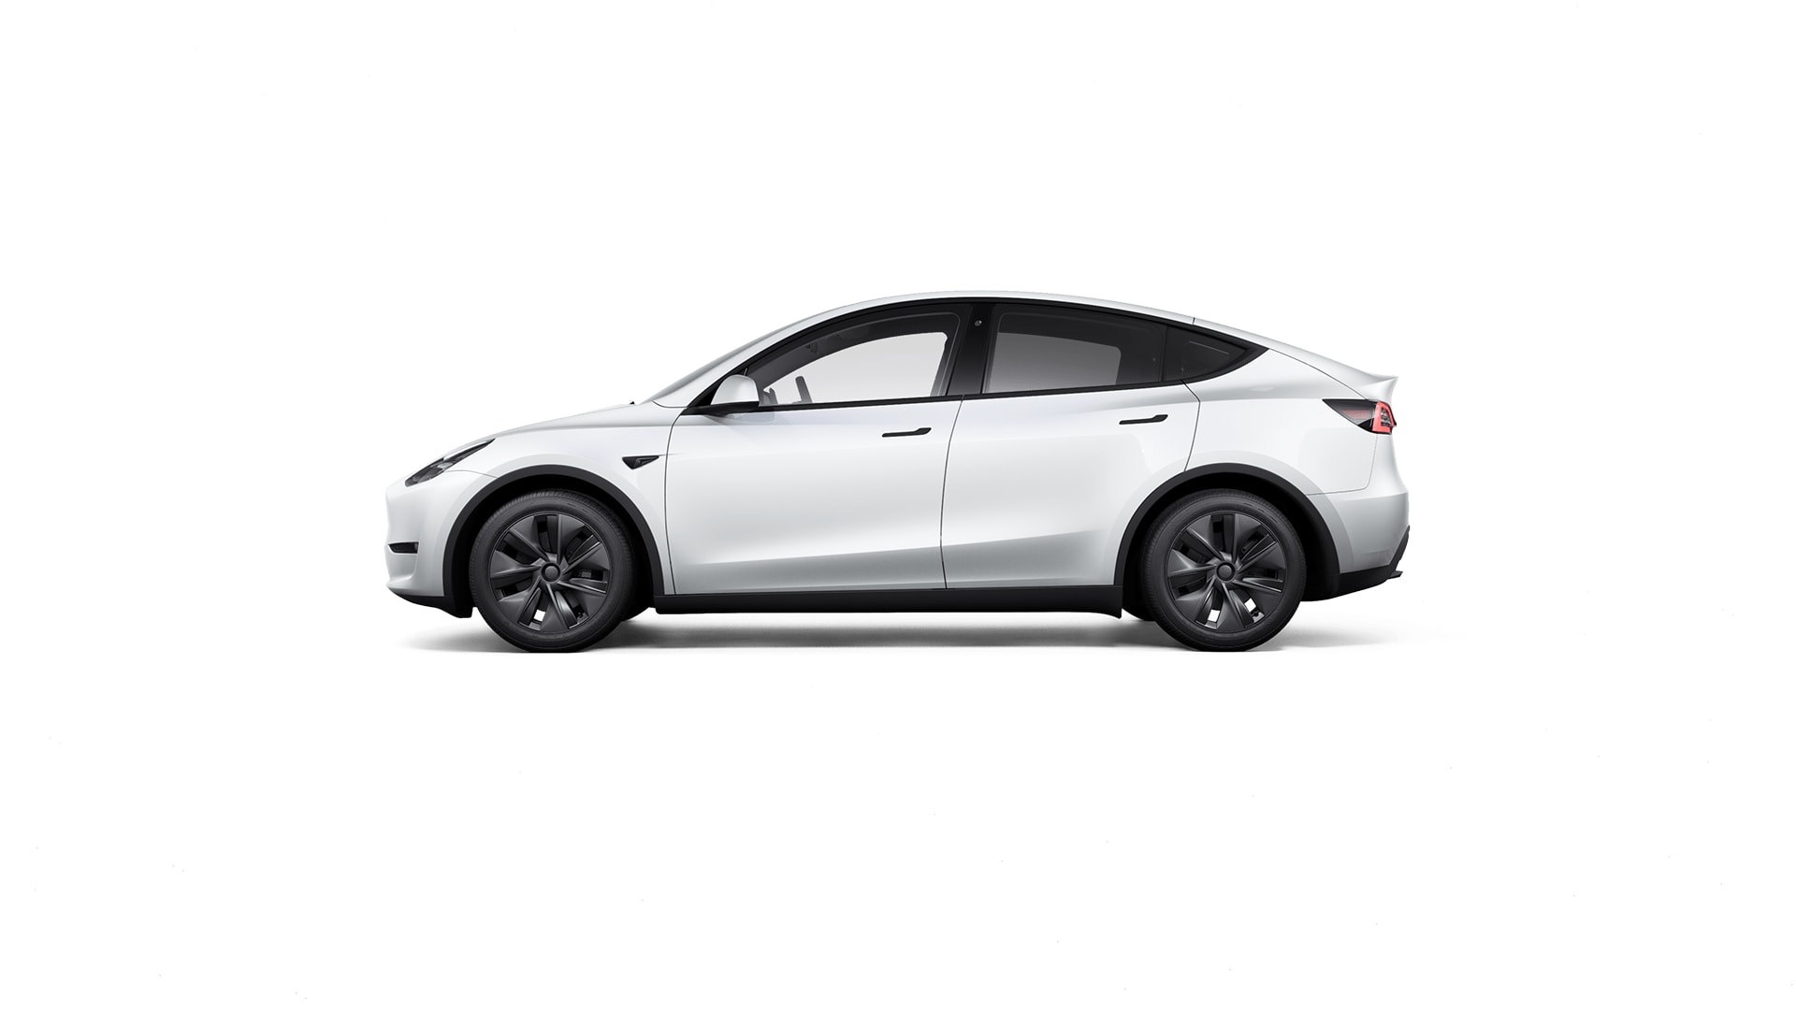
Model Y Long Range

Slide 10

Model Y Performance

