Slide 1
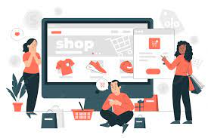
Ecommerce website Using Php and Mysql

Slide 2
Contents
What is ecommerce?
Ecommerce Website
Software/Hardware used
Languages used
Modules
Objective
Features
Future Enhancement

Slide 3
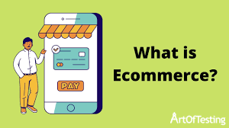

Slide 4
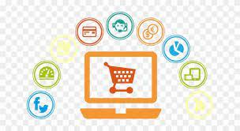
Ecommerce website
Ecommerce website is a tool to sell/buy goods and services
An ecommerce website is your digital
storefront on the internet it facilitates the transaction between a buyer and seller

Slide 5


Software requirement
Hardware requirement
Dual Core(Processor).
256 MB Ram
512 KB Cache Memory
Hard disk 10 GB
Microsoft Compatible 101 or more Key Board

Slide 6





Languages used

Slide 7


Modules
When admin login, he saw the customer’s database, means how many users are authenticated to this website and how many users are transact everyday, and newly items are inserting into products.
User entered into with his username and password, when he entered into this, he saw what items are available today, this facility is available for this site. Chosen different items from website get those through door delivery.

Slide 8
Modules
Product :
This module contains product name, and related image, and cost of its. Like toys, books, furniture, gold items, etc.. Whatever customer wants from the shopping cart.

Slide 9
Objective
The Shopping cart is mainly useful for who haven’t time to go to shopping, those are just entered into this website and bought what ever they want.
Even it is night or morning they entered into this site, and chosen different items like fruits, books, toys etc..
‘Customer is our god’ mainly this website is based on this formula. Customer is happily shopping at his rest place

Slide 10



Features

Slide 11
Future enhancement
This application avoids the manual work and the problems concern with it. It is an easy way to obtain the information regarding the various products information that are present in the Super markets.
Well I and my team members have worked hard in order to present an improved website better than the existing one’s regarding the information about the various activities. Still ,we found out that the project can be done in a better way. Primarily, when we request information about a particular product it just shows the company, product id, product name and no. of quantities available. So, after getting the information we can get access to the product company website just by a click on the product name .

Slide 12
conclusion
The package was designed in such a way that future modifications can be done easily. The following conclusions can be deduced from the development of the project.
Automation of the entire system improves the efficiency
It provides a friendly graphical user interface which proves to be better when compared to the existing system.
It gives appropriate access to the authorized users depending on their permissions.
It effectively overcomes the delay in communications.
Updating of information becomes so easier.
System security, data security and reliability are the striking features.
The System has adequate scope for modification in future if it is necessary

Slide 13

Thankyou

