Slide 1


K.RAMAKRISHNAN COLLEGE OF TECHNOLOGY (AUTONOMOUS), TRICHY
ONLINE AUCTION SYSTEM
PRESENTED BY
2303811710421025-DHANAKIRAN.G
GUIDED BY
Ms.UMA MAHESHWARI

Slide 2
PRESENTATION OVERVIEW
ABSTRACT
PROJECT INTRODUCTION
PROPOSED ARCHITECTURE
PROPOSED EXPLANATION AND ADVANTAGES
MODULES
EXPLANATION OF MODULE
DATABASE CONCEPTS
OUTPUT SCREENSHOTS

Slide 3
PROJECT ABSTRACT
1. Purpose : Develop a platform for buying and selling goods through competitive bidding.
2. Features : Includes user registration, product listing, bidding process, and secure payment integration.
3. Outcome : Provides a transparent, efficient, and user-friendly online marketplace.

Slide 4
PROJECT INTRODUCTION
An Online Auction System is a digital platform where buyers bid on products listed by sellers. It ensures transparent, competitive bidding, secure transactions, and a convenient marketplace for both parties.

Slide 5
PROPOSED ARCHITECTURE
USER LOGIN
USER MANAGEMENT
ADMIN PANEL
SYSTEM OVERSIGHT
User Dashboard
AUCTION MANAGER
LIST MANAGEMENT
User’s Bid
Product Categories
GENERATE REPORTS
Auction Starts
Product Page
REPORTING & ANALYTICS
BIDDING MODULE
Winning Report analysis
Bidding Portal
PAYMENT MODULE
NOTIFICATION SYSTEM
If invalid account entered

Slide 6
PROPOSED EXPLANATION ADVANTAGES
PROPOSED EXPLANATION:
The Online Auction System facilitates a streamlined process for buying and selling goods through competitive bidding. It allows sellers to list items easily, while buyers can place bids in real-time, ensuring a transparent and efficient marketplace.
ADVANTAGES:
Wider Reach: Connects buyers and sellers globally.
Transparency: Real-time bidding ensures fair pricing.
Convenience: Accessible 24/7 from any location.
Cost-Effective: Reduces overhead costs for sellers.
Secure Transactions: Ensures safe payments and data protection.

Slide 7
MODULE
1. User Management
2. Product management
3. Bidding and Auction
4. Reporting and analysis

Slide 8
MODULE EXPLANATION
1 . User Management: Handles user registration, login, profile management, and authentication.The User Management Module is responsible for handling all operations related to users of the Online Auction System. It facilitates user registration, authentication, profile management, and access control.
2.Product Management :The Product Management Module handles all operations related to the listing, updating, and displaying of auction items (products) on the platform. It enables registered users (sellers) to add products for auction, including details such as product name, description, base price, auction start/end time, and images. The module ensures that products are properly categorized, visible to potential bidders, and managed efficiently throughout their lifecycle in the auction system.

Slide 9
3.Bidding and Auction Module:The Bidding Module manages the process by which users place bids on auctioned products. It ensures that bids are submitted securely, follow auction rules, and are recorded in real-time. The module compares new bids with the current highest bid, updates the product's bid history, and displays the highest bidder and latest bid amount. It also restricts bidding to the auction’s active time window.
4.Reporting and analysis:The Reporting and Analysis Module provides the administrator with tools to monitor, evaluate, and analyze system activity, user behavior, and auction performance. This module generates summarized and detailed reports on various metrics such as the number of users, auctions conducted, most bid-on products, highest-selling items, and revenue generated. It helps the admin track system usage patterns, detect anomalies, and make informed decisions to improve the platform.

Slide 10
DATABASE CONCEPTS
1. Entity-Relationship Model (ER Model):
The system is designed using entities like Users, Auctions, Bids, and Transactions.
2. Normalization:
Ensuring 1NF, 2NF, and 3NF to avoid redundancy.Instead of storing seller details in the Auctions table, a foreign key (FK) to the Users table is used.
3. ACID Properties (Atomicity, Consistency, Isolation, Durability):
Atomicity: A bid should either be placed completely or not at all.
Consistency: Ensures no duplicate auction records.
Isolation: Prevents conflicts when multiple users place bids at the same time.
Durability: Data is permanently stored after a successful bid or transaction.
4. Transactions & Concurrency Control:
SQL Transactions ensure that multiple queries execute as a unit.Locking Mechanisms (e.g., Row-level locking) prevent two users from winning the same auction.

Slide 11
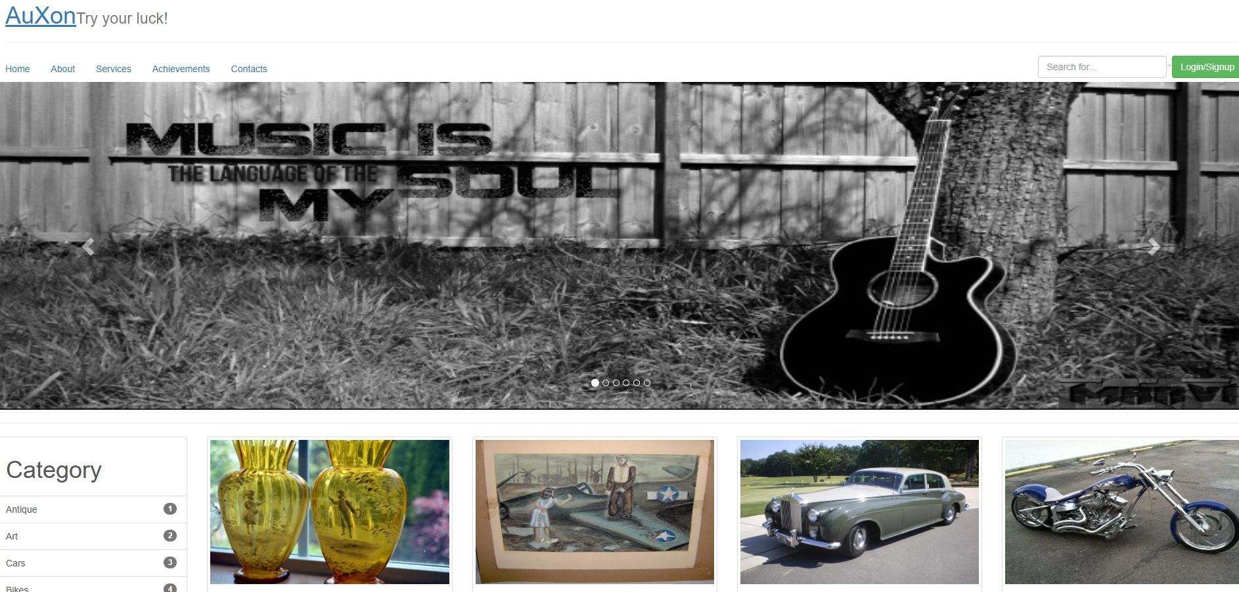
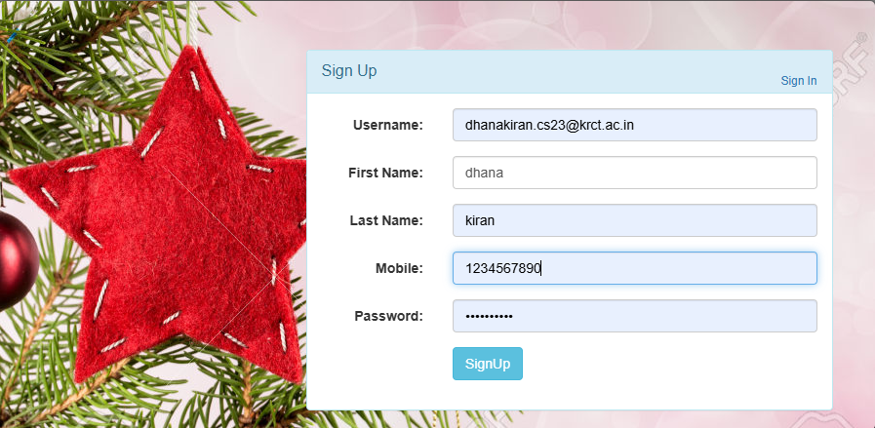
OUTPUT SCREENSHOTS

Slide 12
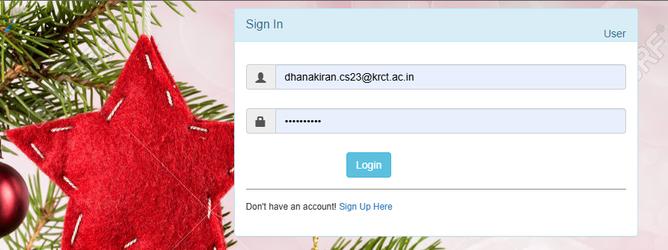
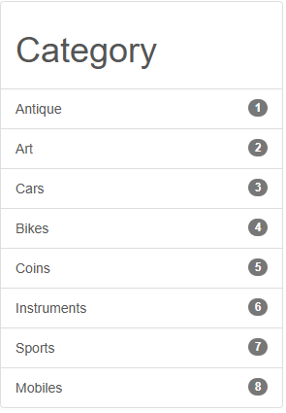
OUTPUT SCREENSHOTS

Slide 13
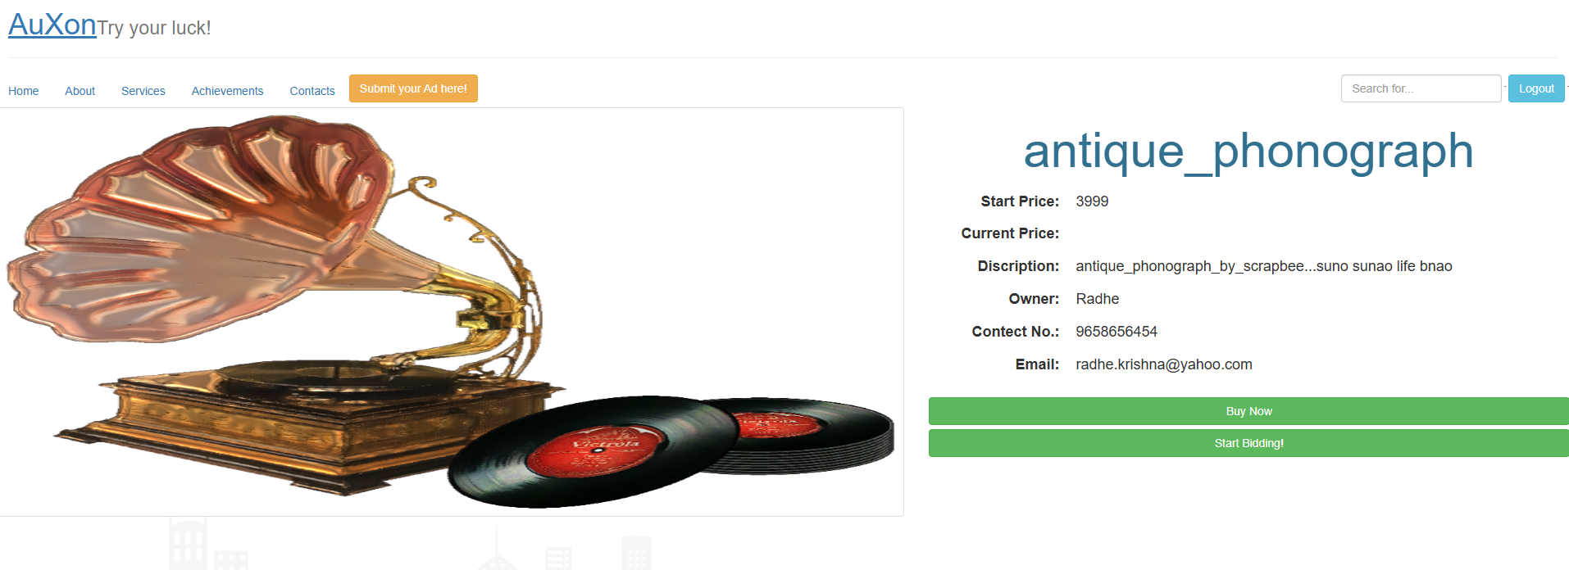
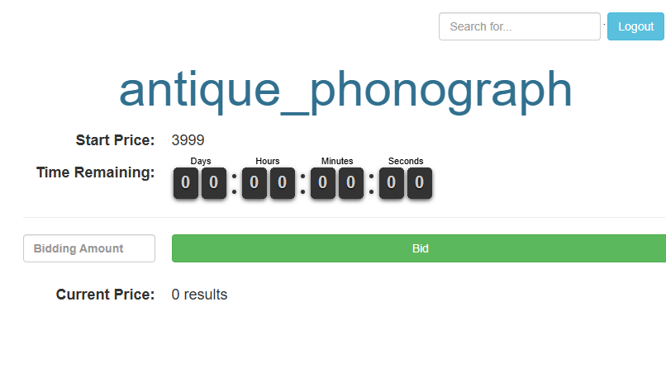
OUTPUT SCREENSHOTS

Slide 14
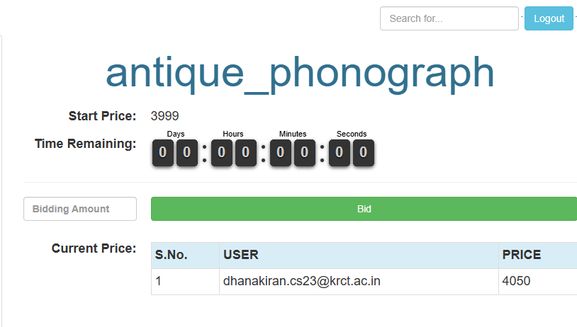
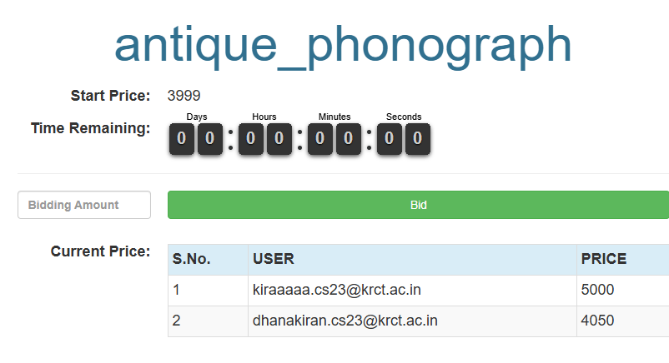
OUTPUT SCREENSHOTS

Slide 15
THANK YOU

