Slide 1
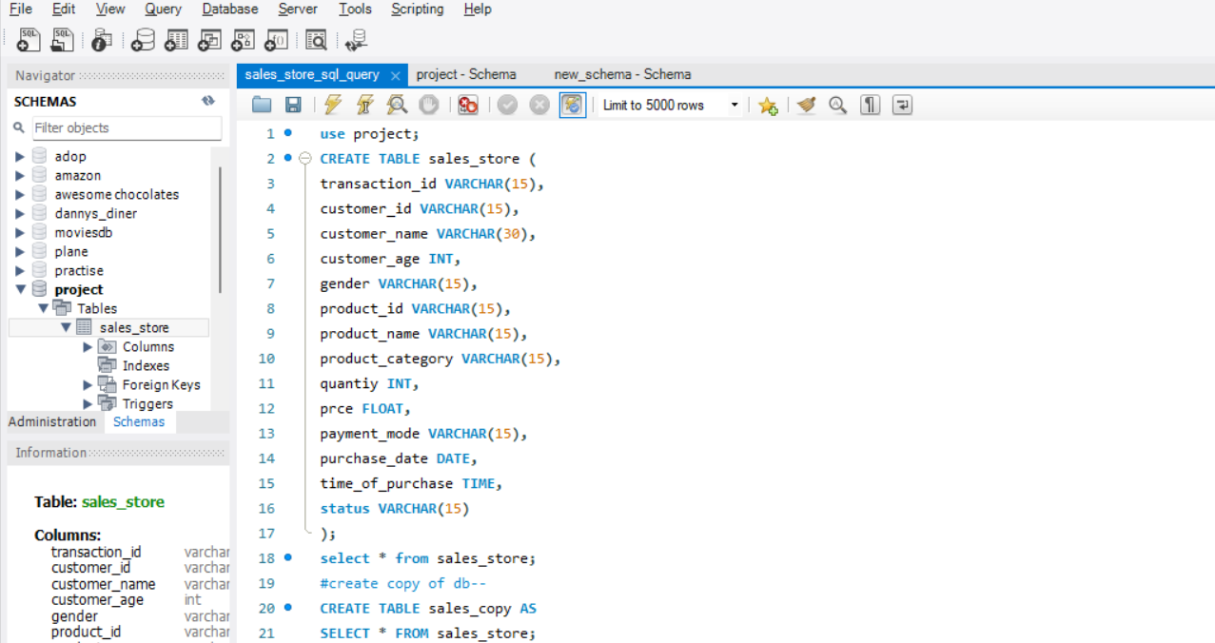
SALES_STORE_ANALYSIS SCHEMA CREATION AND DATA IMPORT FORDIABETES DATASET.

Slide 2
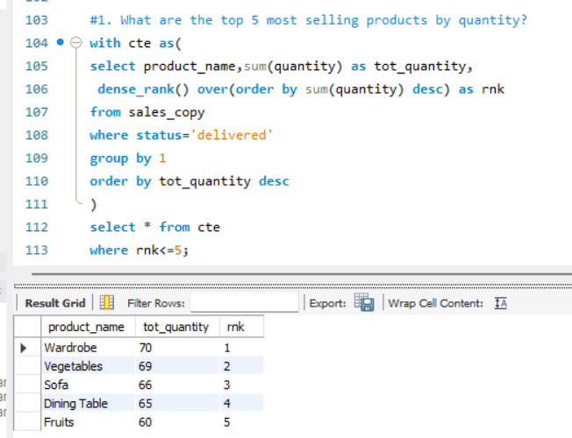
1. What are the top 5 most selling products by quantity?

Slide 3
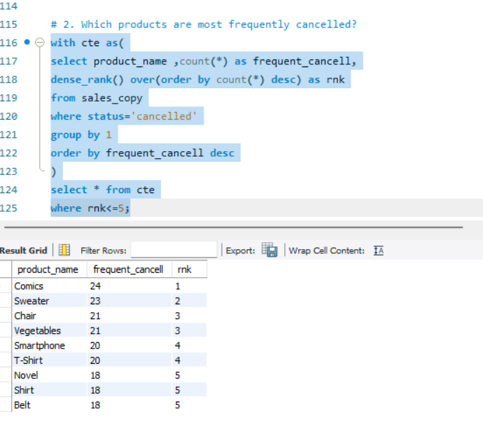
2. Which products are most frequently cancelled?

Slide 4
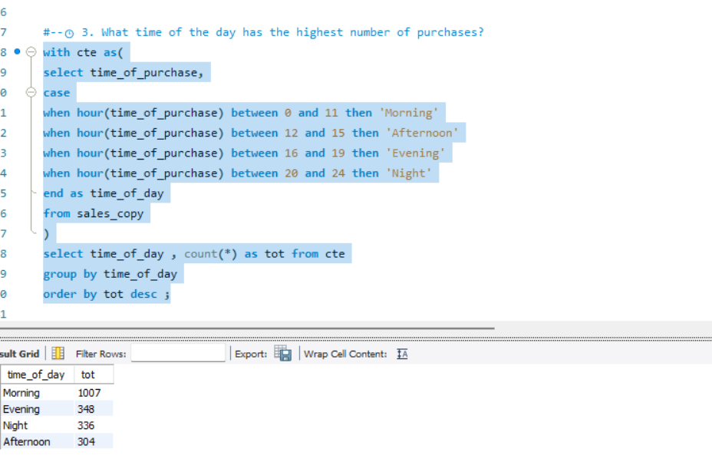
3. What time of the day has the highest number of purchases?

Slide 5
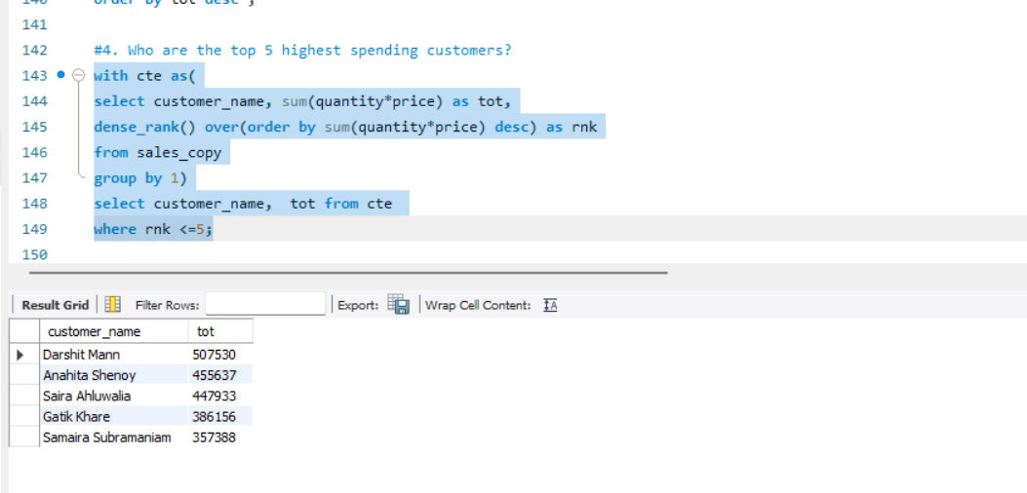
4. Who are the top 5 highest spending customers?

Slide 6
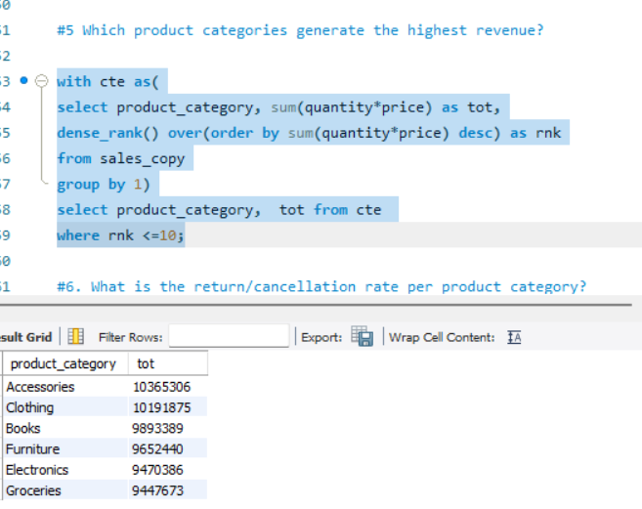
5 .Which product categories generate the highest revenue?

Slide 7
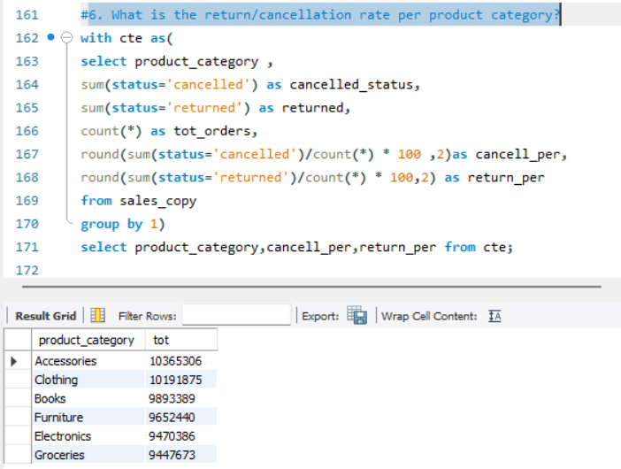
6. What is the return/cancellation rate per product category?

Slide 8
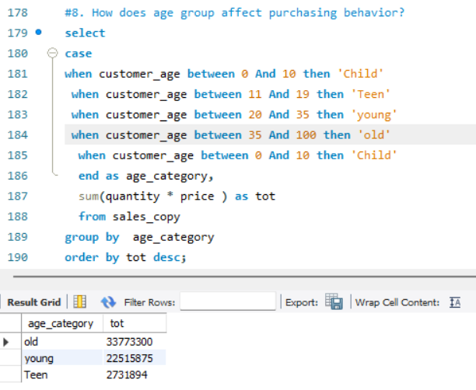
7. What is the most preferred payment mode?

Slide 9
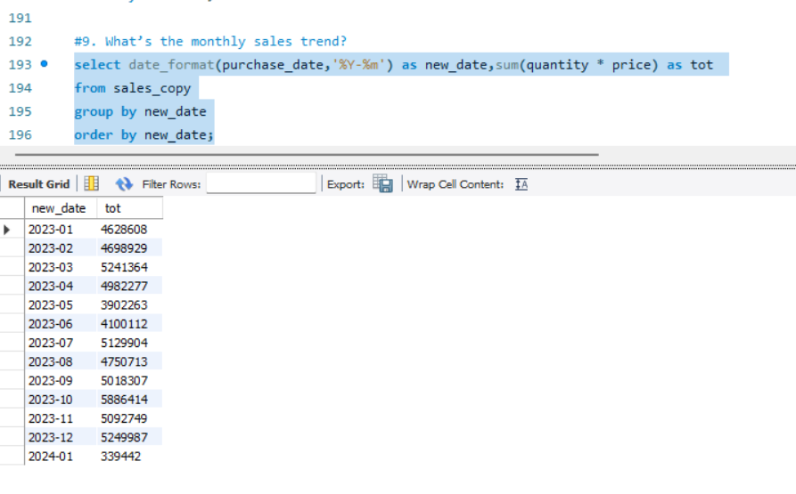
9. What’s the monthly sales trend?

Slide 10
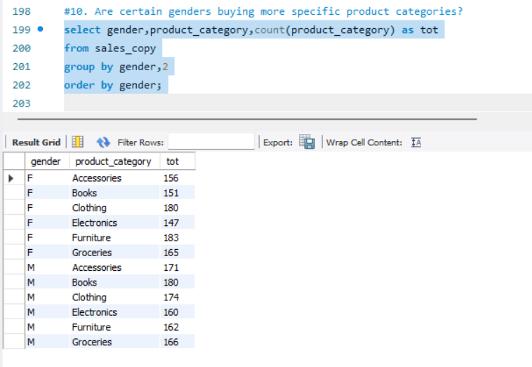
10. Are certain genders buying more specific product categories?

