Slide 1
A Spectral-Spatial Multicriteria Active Learning Technique for Hyperspectral Image Classification

Slide 2
ABSTRACT
Hyper-spectral image classification with limited labelled samples is a challenging task and still an open research issue.
This technique is mainly used for satellite images.
A novel technique is presented to address such an issue by exploiting dimensionality reduction, spectral-spatial feature Extraction, and classification with active learning.
It Analysis and Monitoring of Land data for the process Industries.

Slide 3
ABSTRACT (CONT…)
Here we are divide a two patterns
Feature Extraction
Classification
Feature Extraction
Extract features from the various cluster images.
Generate Morphological profile for the extracted components.
Classification
Test features, Target values and Training set are classify using SVM classification.

Slide 4
Objectives
Data Analysis and Monitoring of Land for the process Industries
Classify the image into regions based on colour values or texture.
Evaluate by common performance measures.
Active learning shows to be effective for strategic selection of training samples to support classification of hyper spectral imagery.

Slide 5
Introduction
Domain Introduction:
Digital image processing is the use of computer algorithms to create, process, communicate, and display digital images. Digital image processing algorithms can be used to:
Convert signals from an image sensor into digital images
Improve clarity, and remove noise and other artifacts
Extract the size, scale, or number of objects in a scene
Prepare images for display or printing
Compress images for communication across a network

Slide 6
Process Introduction
Synthetic Aperture Radar is a technique for computing high-resolution radar returns that exceed the traditional resolution limits imposed by the physical size, or aperture, of an antenna.
SAR exploits antenna motion to synthesize a large “virtual’ aperture, as if the physical antenna were larger than it actually is. The SAR technique is used to form a high-resolution backscatter image of a distant area using an airborne radar platform.
This model shows the following concepts.
Processing of realistic, synthesized SAR data.
Implementation of important signal processing operations, including matched filtering
Combining DSP system toolbox blocks and MATLAB code in a system context.

Slide 7
Existing System
For classification we have been used the Support Vector Machine and Relevance Vector Machine.
A singularity-based criterion is also used to identify informative pixels by taking spatial information into account when selecting samples.
The spatial features generated via 3D-RDWT not only provide sufficient views for multiview AL, but are also less sensitive to additive noise.
Class values contains the most unlabeled pixels.

Slide 8
Disadvantages
Large number of bands
Classification requires a large number of training samples.
The numbers of available labelled samples are scarce and very costly to collect.
It provides most uncertain pixels.

Slide 9
Proposed System
Here we are divide a two patterns
Spectral Spatial Feature Extraction
Classification
Spectral Spatial Feature Extraction
Extract features from the various cluster images.
Generate Morphological profile for the extracted components.
Classification
Test features, Target values and Training set are classify using SVM classification.

Slide 10
Advantages
Detailed classification of forest areas.
Analysis of inland water and coastal zones.
Analysis of natural risks.
Dimentiality reduction decreases the no of spectral channel with the help of feature selection.
It select only nonredundant informative features.

Slide 11
Modules
Read a File
Preprocessing
Segmentation
Clustering
Feature Extraction
Classification
Performance

Slide 12
1. Read a File
In our process we have to load a hyper-spectral dataset to process.
First, we group a hyperspectral images into dataset.
We can select the any of the image from the dataset. It can be possible by the use of uigetfile () function.
It has two parameters, these are type of file and message.
If we use ‘*.*’ for the type of file, we can select any type of file at runtime. If we use this type it displayed all type of files.

Slide 13
Read a File - Flow
Load a Dataset
Pick a file
No
Select a correct type
Yes
Go to Preprocessing

Slide 14
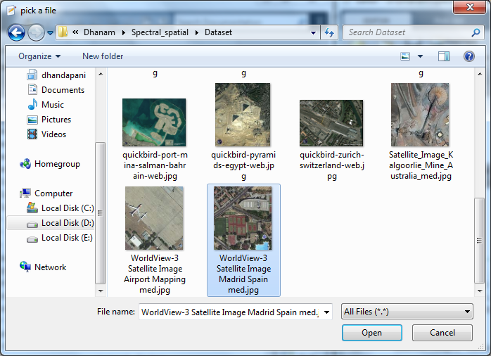
Read a File - Screenshot

Slide 15
2. Preprocessing
Pre-processing is a common name for operations with images at the lowest level of abstraction
The aim of pre-processing is an improvement of the image data that suppresses unwanted distortions or enhances some image features important for further processing.
The pre-processing is the size adjusting of the considered image, luminance normalization, statistical normalization, filtering noise with specified filter, conversion to certain class.

Slide 16
Preprocessing - Flow
Select a file
Preprocessing
Red Band
Green Band
Blue Band

Slide 17
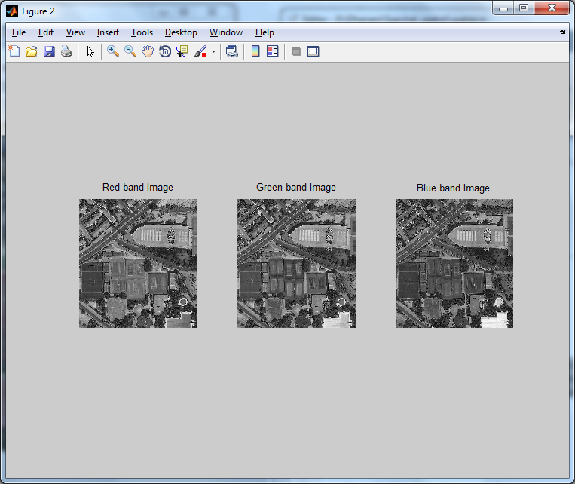
Preprocessing - Screenshot

Slide 18
3. Segmentation
Image segmentation is the process of dividing an image into multiple parts. This is typically used to identify objects or other relevant information in digital images.
For example, one way to find regions in an image is to look for abrupt discontinuities in pixel values, which typically indicate edges.
These edges can define regions. Other methods divide the image into regions based on colour values or texture.
Thresholding methods such as Otsu’s method
Colour-based Segmentation such as K-means clustering
Transform methods such as watershed segmentation
Texture methods such as texture filters

Slide 19
4. Clustering
Clustering can be considered the most important unsupervised learning problem. A cluster is therefore a collection of objects which are “similar” between them and are “dissimilar” to the objects belonging to other clusters.
Cluster analysis is an unsupervised learning method and an important task in exploratory data analysis.
Hierarchical clustering
k-Means clustering
Gaussian mixture models
Self-organizing maps:

Slide 20
Clustering - flow
Segmentation file
Clustering
Region-1
Cluster Index Image
Region-2
Region-3

Slide 21
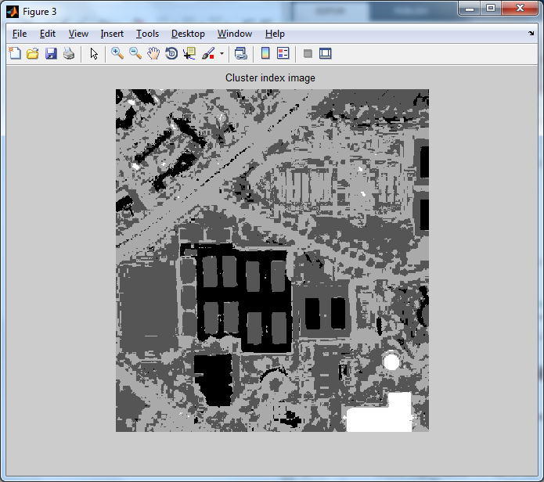
Clustering – Screenshot (Cluster index image)

Slide 22
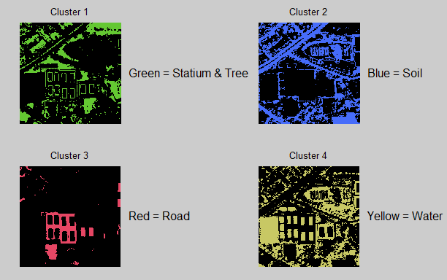
Cluster Index Image

Slide 23
5. Feature Extraction
Feature extraction a type of dimensionality reduction that efficiently represents interesting parts of an image as a compact feature vector.
This approach is useful when image sizes are large and a reduced feature representation is required to quickly complete tasks such as image matching and retrieval.
Feature extraction involves computing a descriptor, which is typically done on regions centered around detected features.
This representation permits comparison between neighbourhoods regardless of changes in scale or orientation.

Slide 24
Feature Extraction – Flow
Cluster Regions
Feature Extraction
Train Features
Test Feature

Slide 25
6. Classification
Digital Image classification is a grouping of similar features.
Classification of remotely sensed data is used to assign corresponding levels with respect to groups with homogeneous characteristics.
SVM Classification:
A Support Vector Machine (SVM) performs classification by finding the hyperplane that maximizes the margin between the two classes. The vectors (cases) that define the hyperplane are the support vectors.
SVM is a supervised machine learning algorithm which can be used for classification or regression problems. It uses a technique called the kernel trick to transform your data and then based on these transformations it finds an optimal boundary between the possible outputs.

Slide 26
7. Performance
Classification models in machine learning are evaluated for their performance by common performance measures.
This function calculates the following performance measures:
Accuracy
Sensitivity
Specificity
Precision
Recall
F-Measure
G-mean

Slide 27
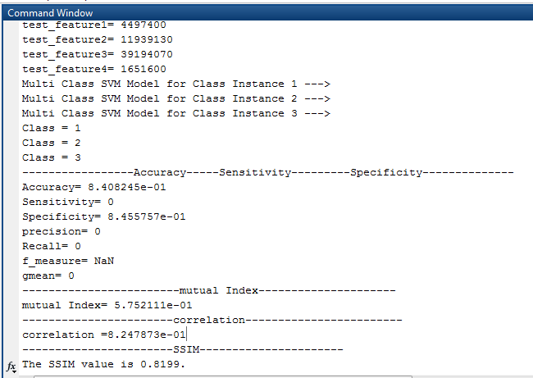
Performance - Screenshot

Slide 28
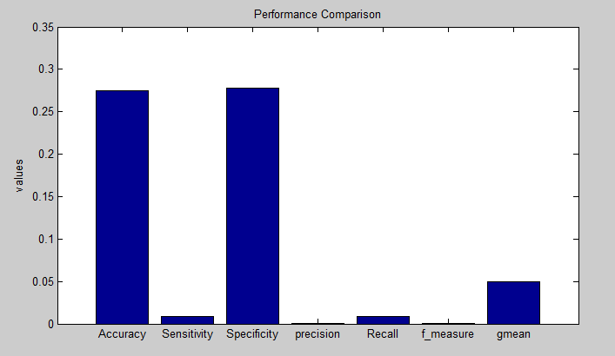
Bar Chart- Performance

Slide 29
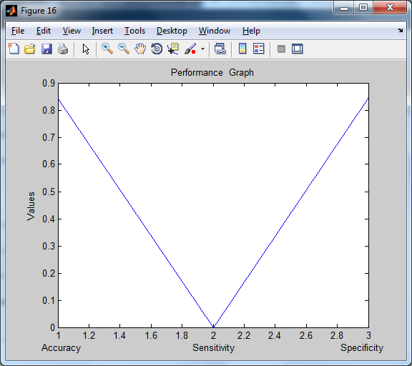
Line Chart - Performance

Slide 30
Block Diagram
Load Dataset
Preprocessing
Segmentation
Clustering
Performance
Classification
Feature Extraction

Slide 31
Architecture
Red
Load Dataset
Preprocessing
Green
Segmentation
Clustering
Blue
Accuracy
Feature Extraction
Correlation
Sensitivity
SSIM
Specificity
Performance
Classification
Precision
F Measure
Mutual Index
G Mean
Recall

Slide 32
FLOW DIAGRAM
Load a Dataset
Pick a file
No
Select a correct type of file
Form a chart
Yes
Measuring Performance
Preprocessing
Classification
Red Band
Green Band
Blue Band
Region-1
Feature Extraction
Segmentation
Clustering
Region-2
Region-3

Slide 33
Literature Survey

Slide 34
Title | Authors | Methodology | Merits | Demerits
Advances in hyper spectral image classification: Earth monitoring with statistical learning methods | G.Camps-Valls, D.Tuia, L.Bruzzone, and J.A.Benediktsson | The technological evolution of optical sensors over the last few decades has provided remote sensing analysts with rich spatial, spectral, and temporal information. In particular, the increase in spectral resolution of hyper spectral images (HSIs) and infrared sounders opens the doors to new application domains and poses new methodological challenges in data analysis. | Classification used to assigns pixels into objects. | Use signal processing and exploitation algorithms.

Slide 35
Title | authors | Methodology | Merits | Demerits
A batch-mode active learning technique based on multiple uncertainty for SVM classifier | S. Patra and L. Bruzzone | We present a novel batch-mode active learning technique for solving multiclass classification problems by using the support vector machine classifier with the one-against-all architecture. The uncertainty of each unlabelled sample is measured by defining a criterion which not only considers the smallest distance to the decision hyper planes but also takes into account the distances to other hyper planes if the sample is within the margin of their decision boundaries. | Minimum number of redundant data. | Balanced number of data only selected.

Slide 36
Title | Authors | Methodology | Merits | Demerits
Dimension reduction using spatial and spectral regularized local discriminant embedding for hyper spectral image classification | Y. Zhou, J. Peng, and C. Chen | Dimension reduction (DR) is a necessary and helpful preprocessing for hyperspectral image (HSI) classification. In this paper, we propose a spatial and spectral regularized local discriminant embedding (SSRLDE) method for DR of hyperspectral data. In SSRLDE, hyperspectral pixels are first smoothed by the multiscale spatial weighted mean filtering. Then, the local similarity information is described by integrating a spectral-domain regularized local preserving scatter matrix and a spatial-domain local pixel neighbourhood preserving scatter matrix. | More number of modified data scatters. | Less number of local spatial-spectral scatter.

Slide 37
Title | Authors | Methodology | Merits | Demerits
Dimensionality reduction of hyper spectral images with sparse discriminant embedding | H. Huang and M. Yang | Sparse manifold learning has drawn more and more attentions recently, and sparsity preserving projections (SPP) has been proposed, which inherits the advantages of sparse reconstruction. However, SPP only focuses on the sparse structure, ignoring the discriminant information of labeled samples. | Ignore discriminant information. | minimizing a local spatial-spectral scatter

Slide 38
Title | Authors | Methodology | Merits | Demerits
A novel semi supervised active-learning algorithm for hyper spectral image classification | Z.Wang, B. Du, L. Zhang, L. Zhang, and X. Jia | Less training samples are a challenging problem in hyperspectral image classification. Active learning and semisupervised learning are two promising techniques to address the problem. Active learning solves the problem by improving the quality of the training samples, while semisupervised learning solves the problem by increasing the quantity of the training samples. | It takes both semi-supervised and active learning. | Unlabelled samples cannot be assigned with labels.

Slide 39
Title | Authors | Methodology | Merits | Demerits
Definition of effective training sets for supervised classification of remote sensing images by a novel cost-sensitive active learning method | B. Demir, L. Minello, and L. Bruzzone | It proposes a novel cost-sensitive active learning (CSAL) method to the definition of reliable training sets for the classification of remote sensing images with support vector machines. Unlike standard active learning (AL) methods, the proposed CSAL method redefines AL by assuming that the labeling cost of samples during ground survey is not identical, but depends on both the samples accessibility and the traveling time to the considered locations. | It proposes reliable training sets. | Uncertain samples optimize the diversity and cost criteria.

Slide 40
System Requirements

Slide 41
Software Requirements
O/S : Windows 7.
Language : MATLAB.
Hardware Requirements
System : Intel Core
Hard Disk : 160 GB
Ram : 2GB

Slide 42
CONCLUSION
The preprocessing technique is used to split the three different bands of image.
Clustering technique used to find the similar patterns of samples.
And the classification technique predict the class value by using test features values.
Finally, we evaluate the performance using measuring performance parameters.

Slide 43
FEATURE ENHANCEMENTS
For clustering, we use k-means clustering algorithm.
k-means clustering aims to partition n observations into k clusters.
Instead of k-means we can use Hierarchical clustering.
Hierarchical clustering groups data over a variety of scales by creating a cluster tree.
This allows you to decide the level or scale of clustering that is most appropriate for your application.

Slide 44
References
G. Camps-Valls, D. Tuia, L. Bruzzone, and J. A. Benediktsson, “Advances in hyperspectral image classification: Earth monitoring with statistical learning methods,” IEEE Signal Process. Mag., vol. 31, no. 1, pp. 45–54, Jan. 2014.
G. Hughes, “On the mean accuracy of statistical pattern recognizers,” IEEE Trans. Inform. Theory, vol. 14, no. 1, pp. 55–63, Jan. 1968.
S. B. Serpico and L. Bruzzone, “A new search algorithm for feature selection in hyperspectral remote sensing images,” IEEE Trans.Geosci.Remote Sens., vol. 39, no. 7, pp. 1360–1367, Jul. 2001.
C.-I. Chang and S. Wang, “Constrained band selection for hyperspectral imagery,” IEEE Trans. Geosci. Remote Sens., vol. 44, no. 6, pp. 1575– 1585, Jun. 2006.

Slide 45
W. Li, S. Prasad, J. Fowler, and L. Bruce, “Locality-preserving dimensionality reduction and classification for hyperspectral image nalysis,” IEEE Trans. Geosci. Remote Sens., vol. 50, no. 4, pp. 1185–1198, Apr.2012.
Y. Zhou, J. Peng, and C. Chen, “Dimension reduction using spatial and spectral regularized local discriminant embedding for hyperspectral image classification,” IEEE Trans.Geosci. Remote Sens., vol. 53, no. 2, pp. 1082– 1095, Feb. 2015.
H. Huang and M. Yang, “Dimensionality reduction of hyperspectral images with sparse discriminant embedding,” IEEE Trans. Geosci. Emote Sens., vol. 53, no. 9, pp. 5160–5169, Sep. 2015.
S. Patra, P. Modi, and L. Bruzzone, “Hyperspectral band selection based on rough set,” IEEE Trans. Geosci. Remote Sens., vol. 53, no. 10, pp. 5495–5503, Oct. 2015.

Slide 46
Z. Wang, N. M. Nasrabadi, and T. S. Huang, “Semisupervised hyperspectral classification using task-driven dictionary learning with laplacian regularization,” IEEE Trans. Geosci. Remote Sens., vol. 53, no. 3, pp. 1161–1173, Mar. 2015.
S. Patra and L. Bruzzone, “A novel SOM-SVM-based active learning technique for remote sensing image classification,” IEEE Trans. Geosci. Remote Sens., vol. 52, no. 11, pp. 6899–6910, Nov. 2014.
B. Demir, L. Minello, and L. Bruzzone, “Definition of effective training sets for supervised classification of remote sensing images by a novel cost-sensitive active learning method,” IEEE Trans. Geosci. Remote Sens., vol. 52, no. 2, pp. 1272–1284, Feb. 2014.
Z.Wang, B. Du, L. Zhang, L. Zhang, and X. Jia, “A novel semisupervised active-learning algorithm for hyperspectral image classification,” IEEE Trans. Geosci. Remote Sens., vol. 55, no. 6, pp. 3071–3083, Jun. 2017.

Slide 47
Thank You…

