Slide 1
Manifold Embedding and SemanticSegmentation for Intraoperative Guidance With Hyperspectral Brain Imaging

Slide 2
ABSTRACT
Hyper-spectral imaging is a non-contact, non-ionizing and minimally-invasive sensing technique.
A novel dimensionality reduction scheme and a new processing pipeline are introduced to obtain a detailed tumour classiﬁcation map for intra-operative margin deﬁnition during brain surgery.
It has been performed to demonstrate the potential clinical value of the system.
We propose a novel manifold embedding framework where the output generated from a hyperspectral image is semantically segmented into a tumour map.
The main goal of delineating the exact boundaries of the brain tumours, allowing a complete resection of the malignant cells while saving as much healthy brain tissue as possible.

Slide 3
OBJECTIVES
To obtain a detailed tumour classiﬁcation map for intra-operative margin deﬁnition during brain surgery.
Delineating the exact boundaries of the brain tumours.
To improve diagnosis and treatment planning, as well as follow-up of individual patients.

Slide 4
INTRODUCTION
DOMAIN INTRODUCTION
Digital image processing is the use of computer algorithms to create, process, communicate, and display digital images. Digital image processing algorithms can be used to:
Convert signals from an image sensor into digital images
Improve clarity, and remove noise and other artifacts
Extract the size, scale, or number of objects in a scene
Prepare images for display or printing
Compress images for communication across a network

Slide 5
PROCESS INTRODUCTION
Dimensionality reduction
Dimensionality reduction or dimension reduction is the process of reducing the number of random variables under consideration by obtaining a set of principal variables. It can be divided into feature selection and feature extraction.
Feature selection
Feature extraction:

Slide 6
EXISTING SYSTEM
The Existing approaches to dimensionality reduction based on manifold embedding can be time consuming and may not guarantee a consistent result, thus hindering ﬁnal tissue classiﬁcation.
To brain tumour visualisation are commonly based on the use of Computed Tomography (CT) or MRI.
Usually represent local intensity differences, intensity distributions, texture and spatial regularity of tissue labels.

Slide 7
DISADVANTAGES
The main weaknesses of the traditional approach are two fold.
It is invasive with many potential side effects and complications.
Diagnostic information is not available in real-time and requires off-line histopathology sample preparation and analysis.
It can be time consuming and may not guarantee a consistent result

Slide 8
PROPOSED SYSTEM
The main goal of delineating the exact boundaries of the brain tumours, allowing a complete resection of the malignant cells while saving as much healthy brain tissue as possible.
It can also be used to improve diagnosis and treatment planning, as well as follow-up of individual patients.
A process divided into two steps:
Dimensionality reduction
It is based on an extension of the T-distributed stochastic neighbour approach
Semantic segmentation
It is applied to the embedded results by using a Semantic Text on Forest for tissue classiﬁcation.

Slide 9
ADVANTAGES
Hyper spectral imaging is a non-contact, non-ionizing and minimally invasive sensing technique.
It helps in understanding the cancer progression.
This techniques can improve surgical accuracy, providing additional information that can also reduce the probability of erroneous resectioning of healthy tissue.
It can be seen that the high quality and accuracy of the obtained tumour maps can be achieved by using a suitable embedding approach.

Slide 10
MODULES
Read the file
Preprocessing
Manifold Embedding
Semantic Segmentation
Validation

Slide 11
1. READ A FILE
In our process we have to load a hyper-spectral dataset to process.
First, we group a hyper spectral images into dataset.
We can select the any of the image from the dataset. It can be possible by the use of uigetfile () function.
It has two parameters, these are type of file and message.
If we use ‘*.*’ for the type of file, we can select any type of file at runtime. If we use this type it displayed all type of files.

Slide 12
READ A FILE - FLOW
Load a Dataset
Pick a file
No
Select a correct type
Yes
Go to Preprocessing

Slide 13
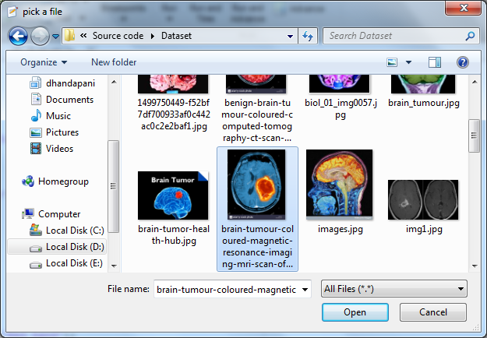
READ A FILE

Slide 14
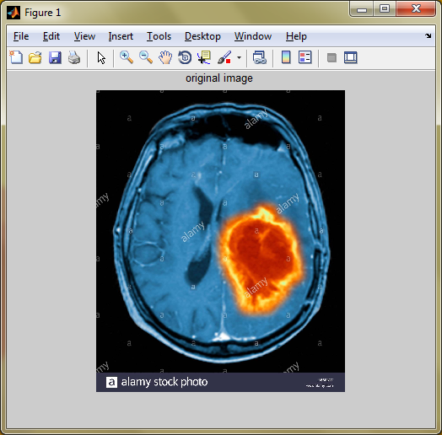
ORIGINAL IMAGE

Slide 15
PREPROCESSING
Pre-processing is a common name for operations with images at the lowest level of abstraction
The aim of pre-processing is an improvement of the image data that suppresses unwanted distortions or enhances some image features important for further processing.
The pre-processing is the size adjusting of the considered image, luminance normalization, statistical normalization, filtering noise with specified filter, conversion to certain class.
Using preprocessing technique we can get a 3 bands of images.
This image we apply 3 techniques
Image Calibration
Noise Removal
Data Normalization

Slide 16
PREPROCESSING - FLOW
Hyper spectral Image
Red Band
Calibration
Preprocessing
Green Band
Group
Noise Removal
Blue Band
Data Normalization

Slide 17
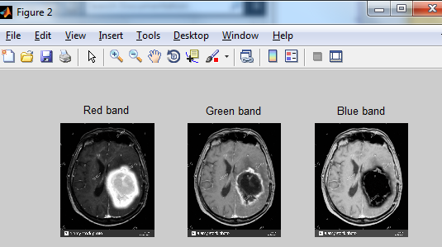
PREPROCESSED IMAGE

Slide 18
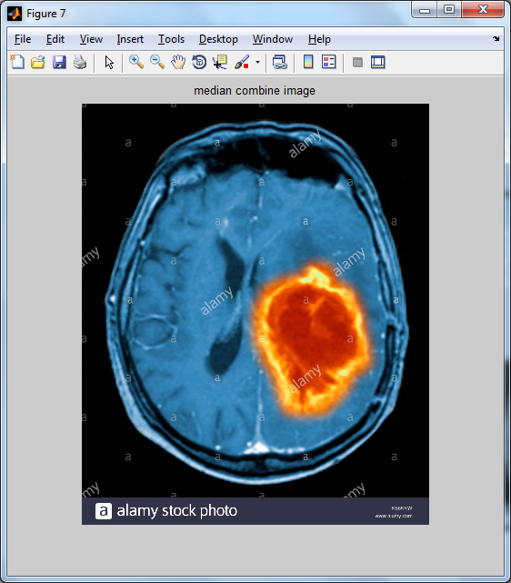
MEDIAN COMBINE IMAGE

Slide 19
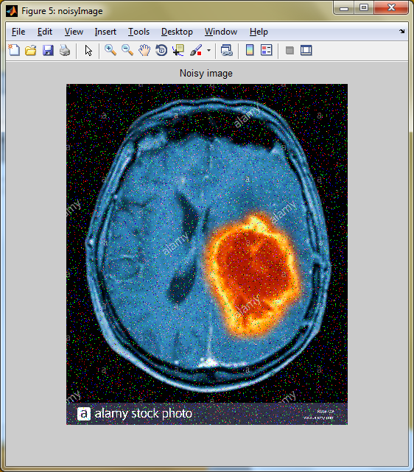
NOISY IMAGE

Slide 20
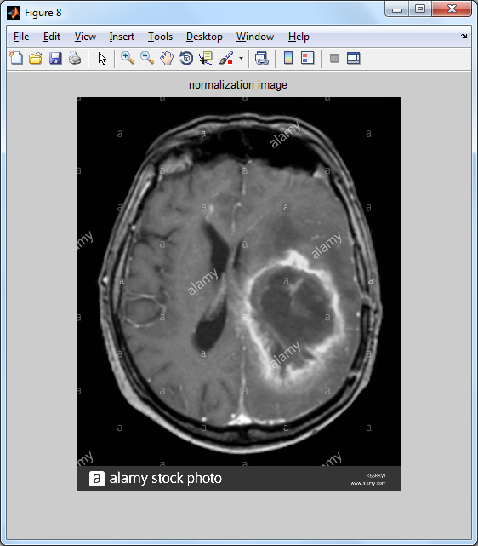
NORMALIZED IMAGE

Slide 21
MANIFOLD EMBEDDING
Manifold learning and nonlinear dimensionality reduction (NLDR).
Many of these non-linear dimensionality reduction methods are related to the linear methods.
Non-linear methods can be broadly classified into two groups:
Mapping (either from the high-dimensional space to the low-dimensional embedding)
Visualisation.
In the context of machine learning, mapping methods may be viewed as a preliminary feature extraction step, after which pattern recognition algorithms are applied.

Slide 22
MANIFOLD EMBEDDING - FLOW
Data Normalization
imadjust()
Contrast Adjust
imhist()
Histogram Equalization

Slide 23
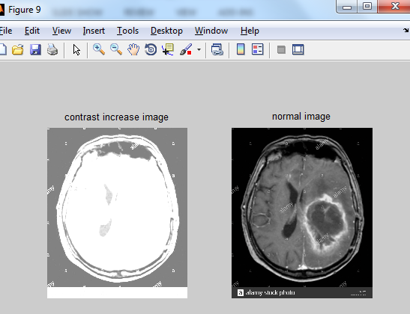
CONTRAST ADJUST IMAGE

Slide 24
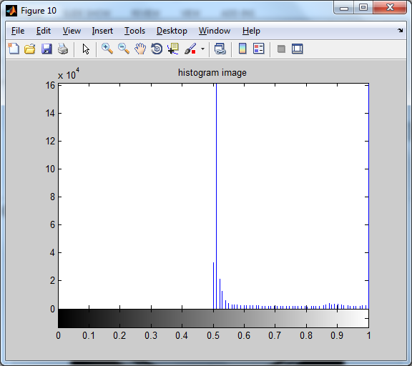
HISTOGRAM EQUALIZATION

Slide 25
SEGMENTATION
Image segmentation is the process of partitioning a digital image into multiple segments.
Image segmentation is typically used to locate objects and boundaries in images.
It is the process of assigning a label to every pixel in an image such that pixels with the same label share certain characteristics.
Each of the pixels in a region are similar with respect to some characteristic or computed property, such as colour, intensity, or texture. Adjacent regions are significantly different with respect to the same characteristics.
Clustering Methods:
The K-means algorithm is an iterative technique that is used to partition an image into K clusters.

Slide 26
SEGMENTATION - FLOW
Embedded Image
random_forest
Cluster Image

Slide 27
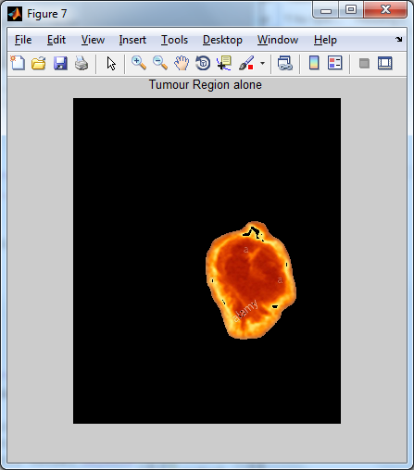
SEGMENTED REGION

Slide 28
VALIDATION
Classification models in machine learning are evaluated for their performance by common performance measures.
Mean-Class Accuracy:
Is obtained averaging the accuracies achieved in each of the classes. It is a more reliable measure than the overall accuracy when, as in this case, the sample distributions for the same classes are limited in number, causing an unbalanced dataset.
Sensitivity:
Is the proportion of actual positives which are correctly identiﬁed as positives by the classiﬁer.
Speciﬁcity:
Is the proportion of the actual negatives which the classiﬁer successfully identiﬁes as negative.

Slide 29
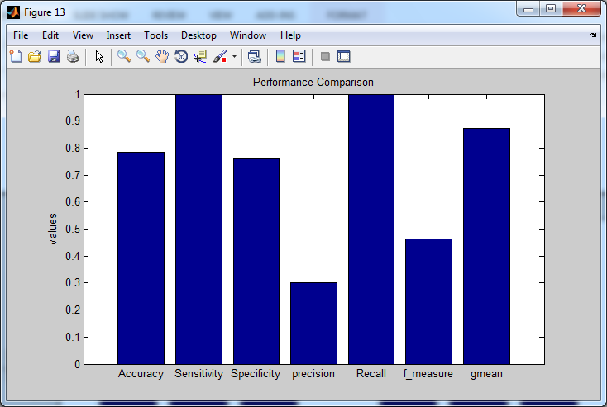
PERFORMANCE BAR CHART

Slide 30
DATA FLOW DIAGRAM
Load a Dataset
Image Calibration
Data Normalization
imread()
imadjust()
random-forest
Pick a file
Yes
Preprocessing
Manifold Embedding
Semantic Segmentation
Accuracy
imnoise()
No
Sensitivity
Noise Removal
Validation
Select a correct type of file
Specificity
Form a chart

Slide 31
SYSTEM ARCHITECTURE
Calibration
Read a file
Preprocessing
Noise Removal
Manifold Embedding
Data Normalization
Semantic Segmentation
Accuracy
Measuring Performance
Sensitivity
Specificity

Slide 32
SEQUENCE DIAGRAM
Read a file
Preprocessing
Manifold Embedding
Segmentation
Performance
Red, GreenBlue
imread()
imadjust()
imrotate(),
imnoise(),
norm()
random-forest
Accuracy
Sensitivity
Specificity

Slide 33
USE CASE DIAGRAM
Read a file
Preprocessing
Hyper spectral Image
Manifold Embedding
Dataset
Segmentation
Performance

Slide 34
BLOCK DIAGRAM
Load Dataset
Preprocessing
Manifold Embedding
Performance
Semantic Segmentation

Slide 35
LITERATURE SURVEY

Slide 36
Title | Authors | Methodology | Merits | Demerits
Level-set evolution with region competition: Automatic 3-D Segmentation of brain tumours | S. Ho, L. Bullitt, and G. Gerig | Develop a new method for automatic segmentation of anatomical structures from volumetric medical images. Driving application is tumor segmentation from 3-D MRIs, which is known to be a very challenging problem due to the variability of tumor geometry and intensity patterns. Level-set snakes offer significant advantages over conventional statistical classification and mathematical morphology, however snakes with constant propagation need careful initialization. | Statistical classification and mathematical morphology is applied. | Missing or fuzzy boundaries.

Slide 37
Title | Authors | Methodology | Merits | Demerits
Training data selection for cancer detection in multispectral Endoscopy images | C. V. Dinh, M. Loog, R. Leitner, O. Rajadell, and R. P. Duin | Multispectral endoscopy images provide potential for early stage cancer detection. It considers this relatively novel imaging technique and presents a supervised method for cancer detection using such multispectral data. The data under consideration include different types of cancer. Consequently, it is not always feasible to transfer the knowledge learnt from one data set to another data set. In our approach, we select suitable training data for a given test set based on a similarity measurement between data sets. | Test set are selected for training instead of using all available data sets. | Different cancer types may exhibit different spectral signatures

Slide 38
Title | Authors | Methodology | Merits | Demerits
Principal Component Analysis. | Jolliffe, Wiley, Hoboken | Explored various feature extraction methods for use in automated diagnosis of Attention-Deficit Hyperactivity Disorder (ADHD) from functional Magnetic Resonance Image (fMRI) data. Each participant's data consisted of a resting state fMRI scan as well as phenotypic data (age, gender, handedness, IQ, and site of scanning) from the ADHD-200 dataset. We used machine learning techniques to produce support vector machine (SVM) classifiers that attempted to differentiate between all ADHD patients vs. healthy controls and ADHD combined (ADHD-c) type vs. | High accuracy using advanced statistical methods. | Some substantial variance is not related to diagnosis.

Slide 39
Title | Authors | Methodology | Merits | Demerits
A new use of hyper spectral imaging for brain cancer detection in Real- time during neurosurgical operations | H. Fabelo et al | Hyper spectral images allow obtaining large amounts of information about the surface of the scene that is captured by the sensor. Using this information and a set of complex classification algorithms is possible to determine which material or substance is located in each pixel. The HELICoiD (Hyper spectral Imaging Cancer Detection) project is a European FET project that has the goal to develop a demonstrator capable to discriminate, with high precision, between normal and tumour tissues, operating in real-time, during neurosurgical operations. | Delimitation of the tumour boundaries will improve the results of the surgery. High accuracy between normal and tumour tissues. | Brain tumour resection, avoiding the excessive extraction.

Slide 40
Title | Authors | Methodology | Merits | Demerits
Segmentation of meningioma as and low grade gliomas in MRI | M. Kaus et al | Computer assisted surgical planning and image guided technology have become increasingly used in neurosurgery. We have developed a system based on ATmC (Adaptive Template moderated Classification) for the automated segmentation of 3D MRI brain data sets of patients with brain tumours (meningioma as and low grade gliomas) into the skin, the brain, the ventricles and the tumour. In a validation study of 13 patients with brain tumours, the segmentation results of the automated method are compared to manual segmentations carried out by 4 independent trained human observers. | More accuracy and Robustness. | More amount of time spend to prepare a data.

Slide 41
SYSTEM REQUIREMENTS

Slide 42
SOFTWARE REQUIREMENTS
O/S : Windows 7.
Language : MATLAB.
HARDWARE REQUIREMENTS
System : Intel Core
Hard Disk : 160 GB
Ram : 2GB

Slide 43
CONCLUSION
We have proposed a novel manifold embedding framework FR-t-SNE with which the output generated from a hyperspectral image can be used as input for a semantic segmentation classiﬁer of brain tissues.
It aims to determine the boundaries of tumours, saving healthy brain tissue and allowing a complete resection of the malignant cells.

Slide 44
FUTURE ENHANCEMENTS
In terms of the near-future
As medical image segmentation plays a very important role in the field of image guided surgeries.
By creating Three dimensional [3D] anatomical models from individual patients, training, planning, and computer guidance during surgery is improved.

Slide 45
REFERENCES

Slide 46
B.H.Menze et al., “The multimodal brain tumor image segmenta-tion benchmark (BRATS),” IEEETrans.Med.Imag., vol. 34, no. 10,pp. 1993–2024, Oct. 2015.
M.T.Eismann, Hyperspectral Remote Sensing. Bellingham, WA, USA:SPIE, 2012.
N. Ramanujam, “Fluorescence spectroscopy of neoplastic and non-neoplastic tissues,” Neoplasia, vol. 2, nos. 1–2, pp. 89–117, 2000.
H. Akbari et al., “Hyperspectral imaging and quantitative analysis for prostate cancer detection,” J. Biomed. Opt., vol. 17, no. 7,pp. 076005-1–076005-10, 2012.
H. Fabelo et al., “HELICoiD project: A new use of hyperspectralimaging for brain cancer detection in real-time during neurosurgicaloperations,” Proc. SPIE, vol. 9860, p. 986002, May 2016.
K. M. Pohl et al., “A unifying approach to registration, segmentation,and intensity correction,” in Medical Image Computing and Computer-Assisted Intervention–MICCAI. Palm Springs, CA, USA: Springer, 2005.

Slide 47
S. Kabwama et al., “Intra-operative hyperspectral imaging for braintumour detection and delineation: Current progress on the HELICoidproject,” Int. J. Surgery, vol. 36, no. 2, p. S140, 2016.
E. D. Angelini, O. Clatz, E. Mandonnet, E. Konukoglu, L. Capelle,and H. Duffau, “Glioma dynamics and computational models: A reviewof segmentation, registration, and in silico growth algorithms andtheir clinical applications,” Current Med. Imag. Rev., vol. 3, no. 4,pp. 262–276, 2007.
S. Bauer, R. Wiest, L.-P. Nolte, and M. Reyes, “A survey of MRI-based medical image analysis for brain tumour studies,” Phys. Med. Biol.,vol. 58, no. 13, p. R97, 2013.
M. Kaus et al., “Segmentation of meningiomas and low grade gliomasin MRI,” in Medical Image Computing and Computer-AssistedIntervention—MICCAI. Cambridge, U.K.: Springer, 1999, pp. 1–10.

Slide 48
E. Konukoglu et al., “Monitoring slowly evolving tumors,” in Proc.5th IEEE Int. Symp. Biomed. Imag., Nano Macro (ISBI), May 2008,pp. 812–815.
M. B. Cuadra, M. D. Craene, V. Duay, B. Macq, C. Pollo, andJ.-P. Thiran, “Dense deformation ﬁeld estimation for atlas-based segmen-tation of pathological MR brain images,”, 2006.
L. Weizman et al., “Automatic segmentation, internal classiﬁcation, andfollow-up of optic pathway gliomas in MRI,” Med. Image Anal., vol. 16,no. 1, pp. 177–188, 2012.
K. Van Leemput, F. Maes, D. Vandermeulen, and P. Suetens, “Automatedmodel-based bias ﬁeld correction of MR images of the brain,” IEEETrans. Med. Imag., vol. 18, no. 10, pp. 885–896, Oct. 1999.
M. R. Kaus, S. K. Warﬁeld, A. Nabavi, P. M. Black, F. A. Jolesz, andR. Kikinis, “Automated segmentation of MR images of brain tumors 1,”Radiology, vol. 218, no. 2, pp. 586–591, 2001.

Slide 49
F. O. Kaster, B. H. Menze, M.-A. Weber, and F. A. Hamprecht,“Comparative validation of graphical models for learning tumor segmen-tations from noisy manual annotations,”. Beijing,China: Springer, 2010, pp. 74–85.
B. Fischl et al., “Whole brain segmentation: Automated labeling ofneuroanatomical structures in the human brain,” Neuron, vol. 33, no. 3,pp. 341–355, 2002.
J. Ashburner and K. J. Friston, “Uniﬁed segmentation,” NeuroImage,vol. 26, no. 3, pp. 839–851, 2005.
C. V. Dinh, M. Loog, R. Leitner, O. Rajadell, and R. P. Duin,“Training data selection for cancer detection in multispectral endoscopyimages,” in Proc. 21st Int. Conf. Pattern Recognit. (ICPR), Nov. 2012
H. Akbari, K. Uto, Y. Kosugi, K. Kojima, and N. Tanaka, “Cancerdetection using infrared hyperspectral imaging,” Cancer Sci., vol. 102,no. 4, pp. 852–857, 2011.

Slide 50
D. Cobzas, N. Birkbeck, M. Schmidt, M. Jagersand, and A. Murtha,“3D variational brain tumor segmentation using a high dimensionalfeature set,” in Proc. IEEE 11th Int. Conf. Comput. Vis. (ICCV),Oct. 2007, pp. 1–8.
N. Amharref et al., “Discriminating healthy from tumor and necrosistissue in rat brain tissue samples by Raman spectral imaging,” Biochim.Biophys. Acta (BBA)-Biomembranes, vol. 1768, no. 10, pp. 2605–2615,2007.
A.Cerussi, N.Shah, D.Hsiang, A.Durkin, J.Butler, B.J.Tromberg,“In vivo absorption, scattering, and physiologic properties of 58 malig-nant breast tumours determined by broadband diffuse optical spectroscopy,” J. Biomed. Opt., vol. 11, no. 4, p. 044005, 2006.
Y.-F. Tsai, I.-J. Chiang, Y.-C. Lee, C.-C. Liao, and K.-L. Wang, “Auto-matic MRI meningioma segmentation using estimation maximization,”in Proc. 27th Annu. Int. Conf. Eng. Med. Biol. Soc. (IEEE-EMBS),Jan. 2005,

Slide 51
Thank You…

Slide 53
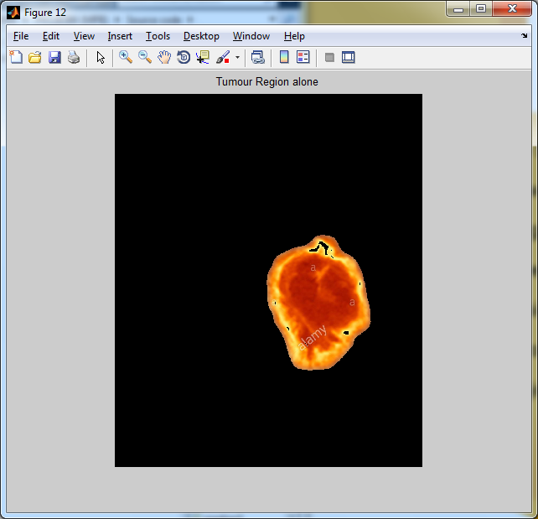

Slide 54
