Slide 1
Capstone project
PRESENTED BY
DHANALAKSHMI.K
DEPT OF BIOTECHNOLOGY
ARUNAI ENGINEERING COLLEGE

Slide 2
PROJECT TITLE
CARDIOVASCULAR RISK PREDICTION

Slide 3


AGENDA
PROJECT OVERVIEW
WHO ARE THE END USERS
YOUR SOLUTION AND ITS VALUE PROPOSITION
PROBLEM STATEMENT
THE WOW IN YOUR SOLUTION
MODELLING
RESULTS
3/21/2024 Annual Review

Slide 4

PROBLEM STATEMENT
The dataset is from an ongoing cardiovascular study on residents of the town of Framingham, Massachusetts. The classification goal is to predict whether the patient has a 10-year risk of future coronary heart disease (CHD). The dataset provides the patients’ information. It includes over 4,000 records and 15 attributes. Each attribute is a potential risk factor. There are both demographic, behavioral, and medical risk factors.

Slide 5

PROJECT OVERVIEW
The most widely reported measure of model discrimination for CVD risk prediction models is the C statistic. The C statistic is a function of both the sensitivity and specificity of the model across all of its values, and it represents the ability of the score to discriminate (future) cases from noncases.

Slide 6

WHO ARE THE END USERS?
There are two primary end users in cardiovascular risk prediction:
Healthcare Professionals: Physicians, nurses, and other healthcare providers use cardiovascular risk prediction tools to assess their patients' risk of developing cardiovascular disease (CVD). This information helps them make informed decisions about preventive measures, such as lifestyle modifications or medications.
Individuals: Individuals can also use cardiovascular risk prediction tools to estimate their own risk of CVD. This information can motivate them to make healthy lifestyle changes to reduce their risk. Some online calculators are available but it is important to consult with a healthcare professional for a personalized assessment and guidance.

Slide 7

YOUR SOLUTION AND ITS VALUE PROPOSITION
Let’s explore the value propositions of our cardiovascular risk prediction solutions:
Enhanced Risk Assessment:
Precision Preventive Approaches:
Patient Engagement and Empowerment:
Clinical Practice Integration:
Research and Innovation:
6.Our solution evolves with new findings, ensuring up-to-date risk assessment models.
7.Collaboration with researchers and healthcare professionals drives continuous improvement.

Slide 8

THE WOW IN YOUR SOLUTION
Here's the value proposition:
For Healthcare Professionals:
Improved Risk Communication Tools
AI-powered Decision Support:
For Individuals:
Accessible Risk Assessment Tool
Interactive Risk Reduction Guidance
Important Disclaimers
Long-term Risk Monitoring
3/21/2024 Annual Review

Slide 9
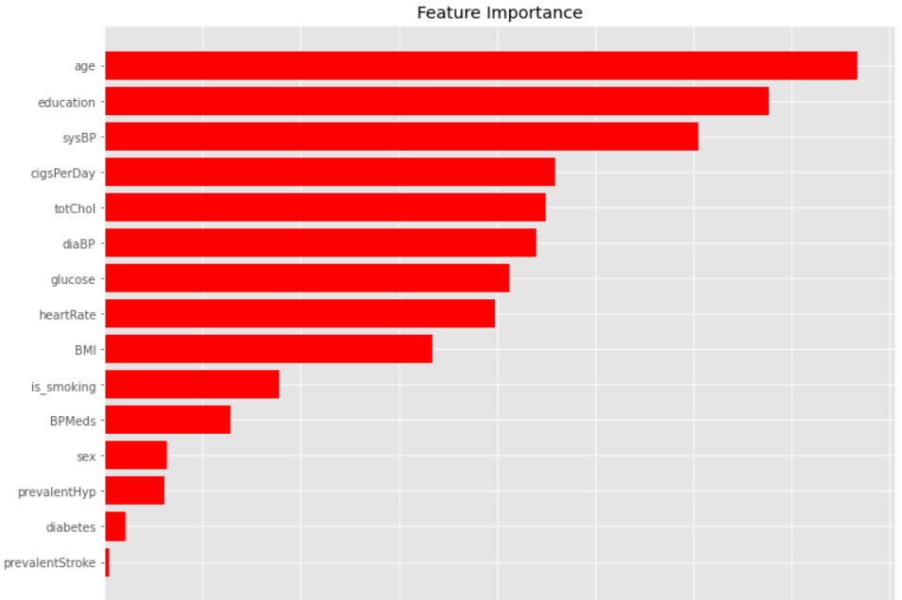
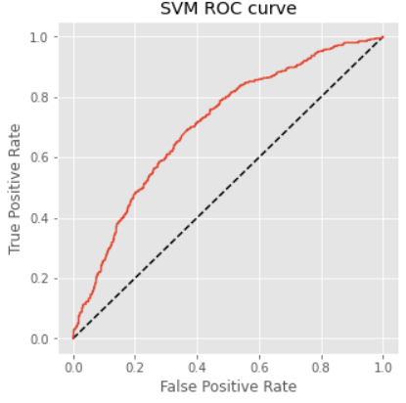
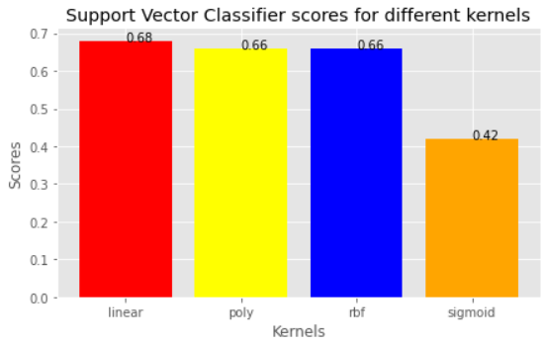
MODELLING

Slide 10
RESULTS
Let’s explore the results in cardiovascular risk prediction:
Machine Learning (ML) in Cardiovascular Risk Prediction:
Purpose: ML techniques enhance risk prediction models for cardiovascular diseases (CAD) and personalize preventive approaches.
Recent Findings:
Clinical Epidemiology and Risk Prediction:
Risk Assessment Factors:
In summary, ML-driven risk prediction models and clinical risk assessment tools contribute to better understanding and management of cardiovascular risk.

