Slide 1


HACKNOVA 2025
SAI VIDYA INSTITUTE OF TECHNOLOGY
Approved by AICTE, New Delhi, Affiliated to VTU, Recognized by Govt. of Karnataka, Accredited by NBA, New Delhi (CSE, ECE. ISE) NAAC "A" Grade
DEPARTMENT OF INFORMATION SCIENCE AND ENGINEERING
Problem Statement Title - Real Life Solutions for Waste Management (Software - Clean & Green)
Team Name - Visionaries

Slide 2
Problem statement
Urban areas face challenges like unsegregated waste, overflowing bins, inefficient collection, and low citizen participation.
Proposed Solution
A software platform and mobile app for smart waste segregation and tracking.
Uses AI image recognition to identify waste type (wet, dry, plastic, e-waste).
QR-coded smart bins linked to a cloud system for monitoring and data analytics
Reward-based system (Eco Points) to encourage responsible disposal
Dashboard for authorities to view bin status and plan efficient collection routes.

Slide 3
TECHNICAL APPROACH
Technologies Used:
Programming Languages: Python, JavaScript
Frameworks & Tools:
Frontend: Flutter / React (for user & admin apps)
Backend: Node.js with Firebase / MongoDB
AI/ML: TensorFlow or Teachable Machine (waste image recognition)
IoT Hardware (optional): Arduino / Raspberry Pi with sensors to detect bin fill levels
APIs: Google Maps API for bin location and navigation
Methodology & Implementation Process
Step 1: User uploads or scans waste image via app Step 2: AI model identifies waste type (wet, dry, plastic, e-waste) Step 3: App suggests correct bin and records disposal via QR code Step 4: Data stored in cloud → Dashboard updates in real-time Step 5: Authorities monitor bin status, optimize collection routes, and reward users

Slide 4
IMPACT AND BENEFITS
🌿 Environmental
Promotes waste segregation & recycling
Reduces landfill and pollution
Supports sustainable city goals
👥 Social
Raises awareness & citizen participation
Rewards eco-friendly behavior
Builds cleaner, responsible communities
🏛️ Operational / Government
Real-time monitoring & analytics
Optimized collection routes
Improved efficiency & transparency

Slide 5
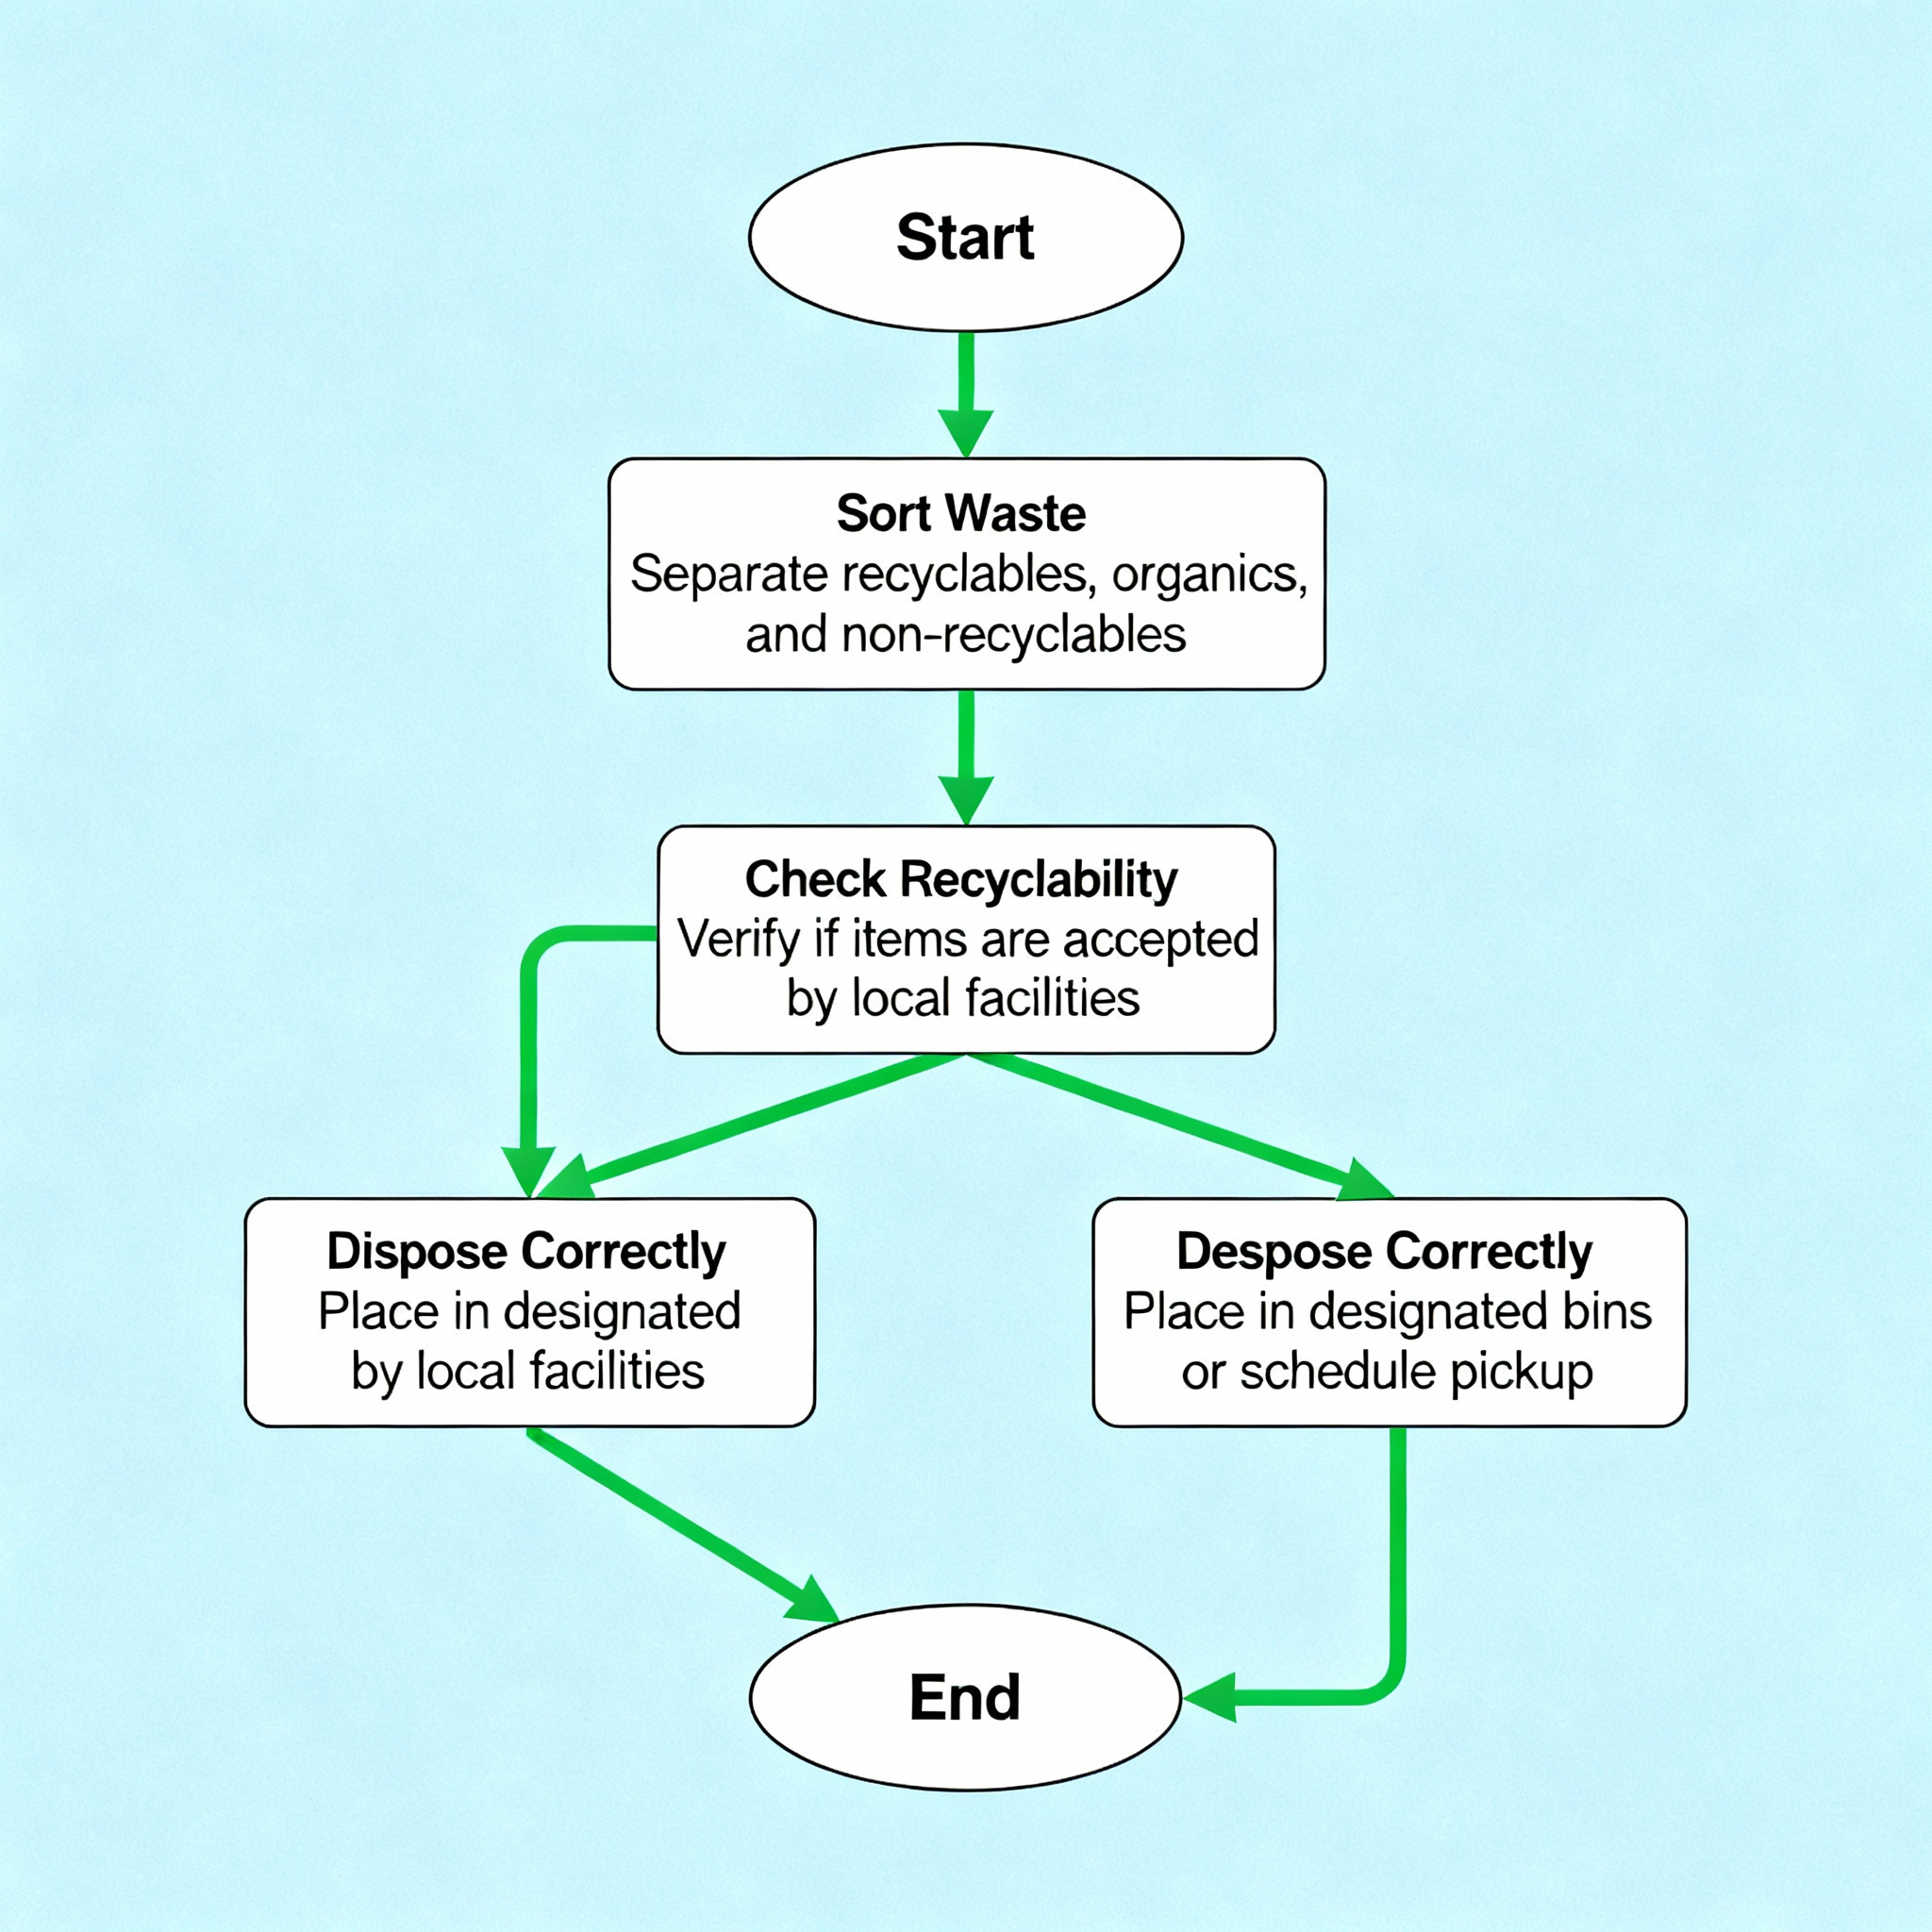
TECHNICAL APPROACH

Slide 6
THANK YOU.

