Slide 1
Analyzing Demographic and Regional Disparities in Tele Law Case Registrations for Inclusive Legal Access
CAPSTONE PROJECT
Presented By:
1. Dhanam Patel - KPGU - CSE

Slide 2
OUTLINE
Problem Statement (Should not include solution)
Proposed System/Solution
System Development Approach (Technology Used)
Algorithm & Deployment
Result (Output Image)
Conclusion
Future Scope
References

Slide 3
Problem Statement
Despite the expansion of the Tele-Law initiative across states and districts, there is limited understanding of demographic utilization patterns and regional disparities in legal aid access. The challenge is to analyze Tele-Law case registration data to uncover gender-wise, caste-wise, and geographic disparities in service utilization across CSCs. Uneven representation among marginalized groups (SC, ST, OBC) and low outreach in certain districts raise concerns about equity and effectiveness. Moreover, the varying number of CSCs per region complicates direct comparisons. This problem demands a data-driven approach to evaluate inclusivity and optimize service delivery.

Slide 4
Proposed Solution
Develop a data-driven approach that analyzes Tele-Law case registration data to uncover demographic and regional disparities. This approach will use a Linear Regression model to identify and quantify the relationships between variables, such as demographic data and case registrations. This analysis will provide a clear understanding of equity and effectiveness, helping to inform strategic decisions to optimize service delivery.
Key components:
Data Collection: Use the provided dataset on district-wise Tele-Law case registrations.
Preprocessing: Clean and normalize the dataset to prepare the data for modeling.
Model Training: Train a Linear Regression model to identify the impact of different demographic and regional factors on case registrations.
Evaluation: Validate the model's findings and evaluate the inclusivity of the program by presenting key insights and actionable recommendations.

Slide 5
System Approach
The "System Approach" section outlines the overall strategy and methodology for developing and implementing the power system fault detection and classification. Here's a suggested structure for this section:
System necessities:
IBM Cloud (required)
IBM Watson Studio for building and deploying the model
IBM Cloud Object Storage to manage the dataset

Slide 6
Algorithm & Deployment
Linear Regression: Use a linear regression model to analyze the relationship between demographic (e.g., male/female, SC/ST/OBC) and regional variables and the number of case registrations.
Case Registration Data: The primary input will be the Tele-Law case registration dataset, including columns for (States/UTs, Districts, No. of CSCs, Female, Male, General, OBC, SC, ST)
Supervised Learning: The model will use the provided data to quantify the impact of demographic and regional factors on case registrations. The goal is to identify which factors are most correlated with higher or lower service utilization.
Model Deployed on IBM Watson Studio: The analysis and the model will be deployed on IBM Watson Studio. The output will be a report and visualizations that highlight key disparities and provide actionable insights for improving outreach and service delivery.

Slide 7
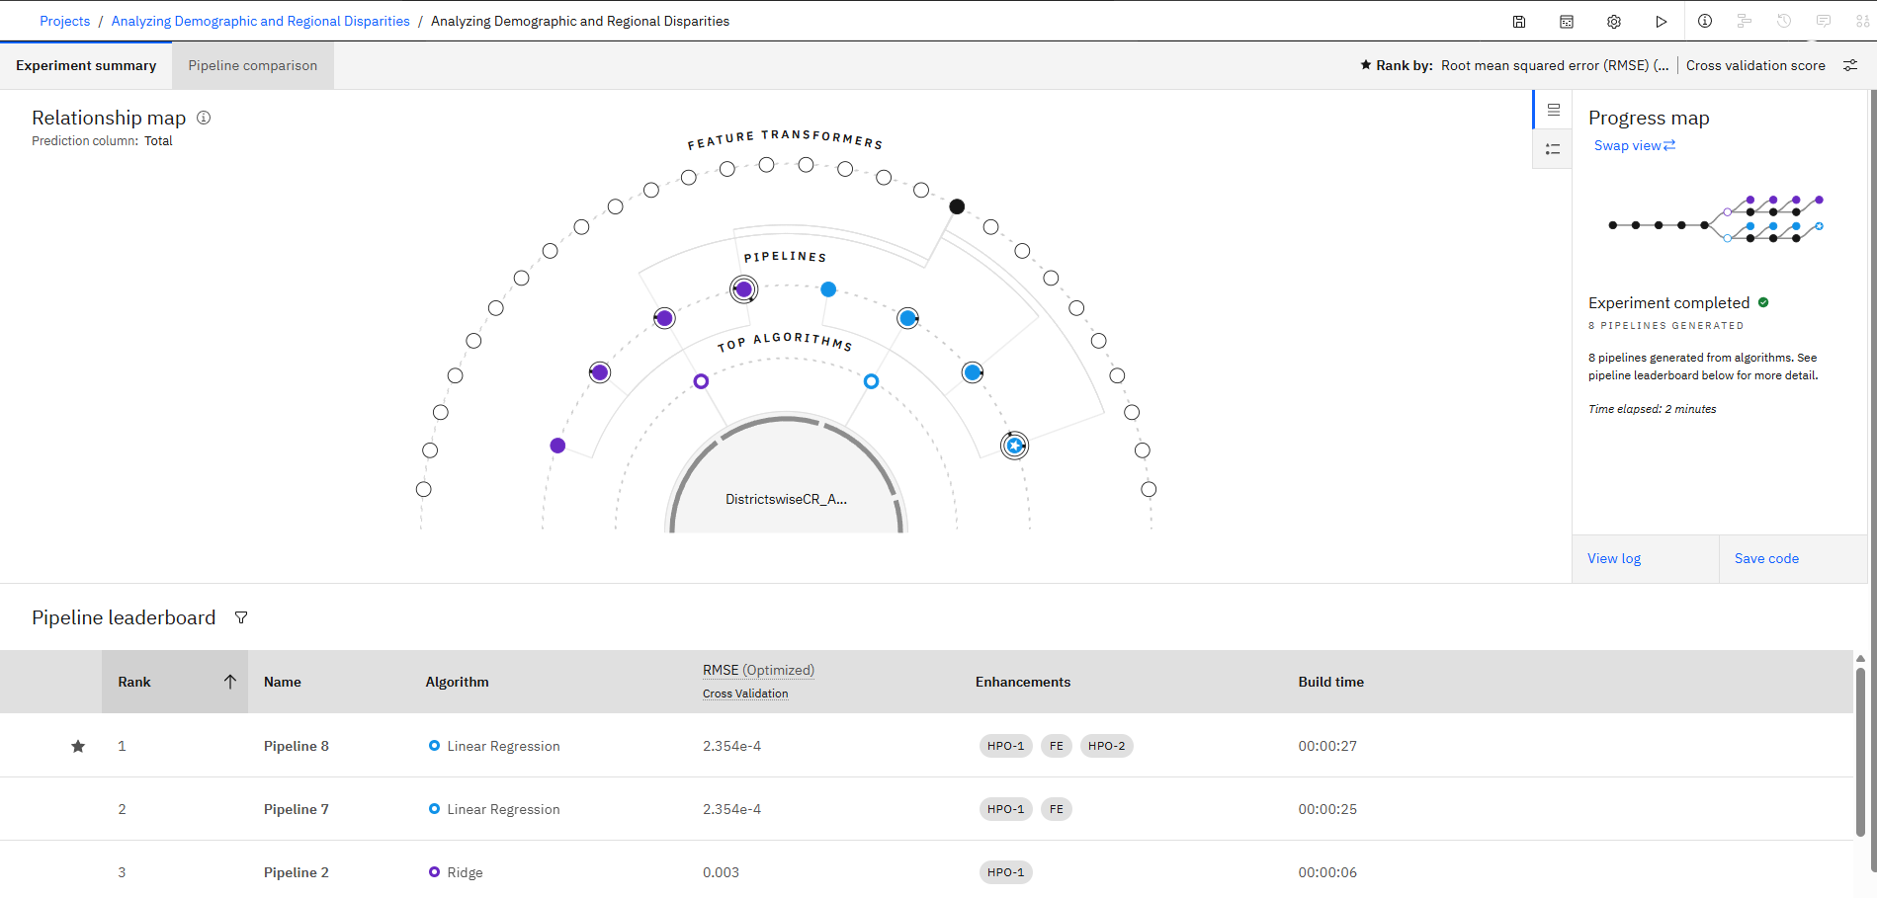
Result

Slide 8
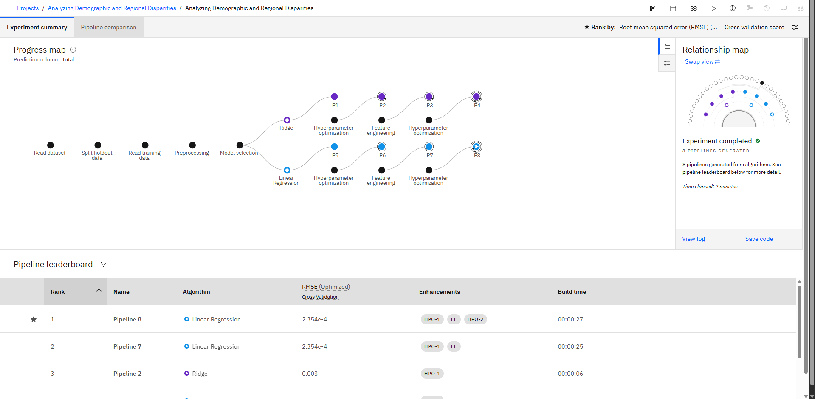
Result

Slide 9
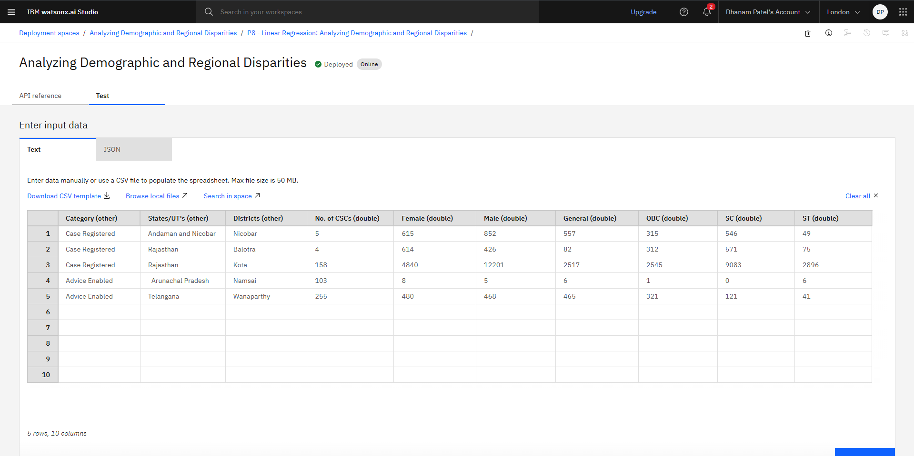
Result

Slide 10
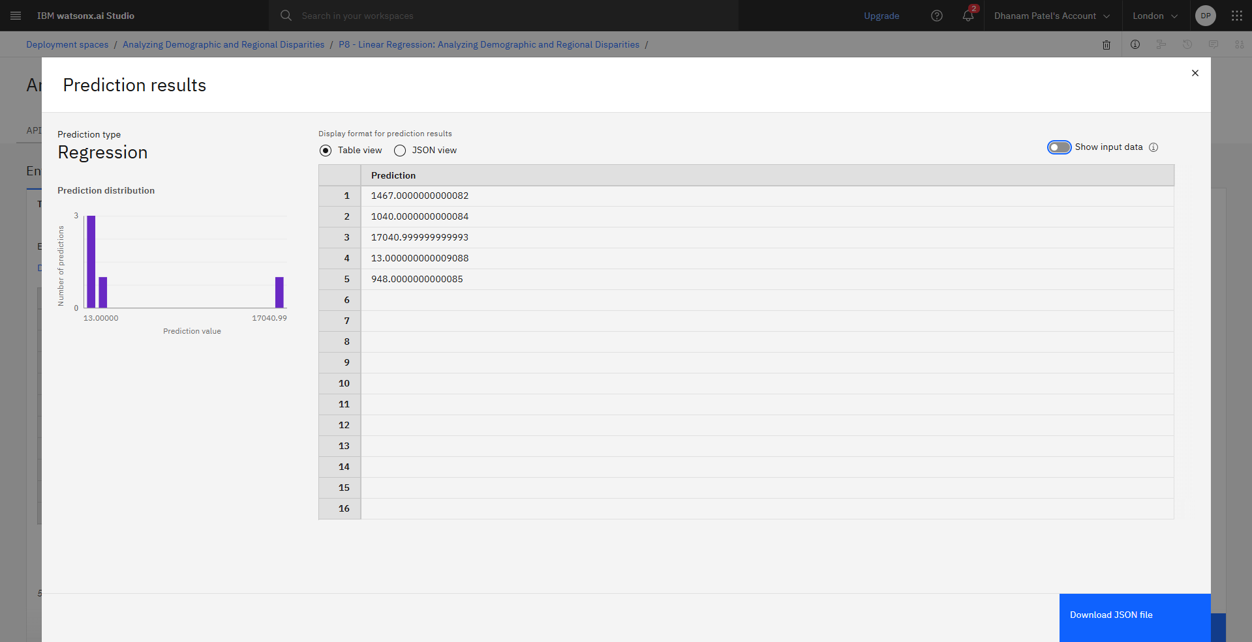
Result

Slide 11
Conclusion
In conclusion, this project successfully addressed the critical challenge of analyzing demographic and regional disparities in Tele-Law case registrations. By leveraging the power of IBM Cloud, we established a robust platform for data analysis. The project utilized IBM Watson Studio's AutoAI to accelerate the model development process, allowing us to rapidly select and train the most effective model, which was a Linear Regression model, to quantify the relationships between demographic factors and case registrations. This data-driven approach moved beyond anecdotal observations to provide a quantifiable understanding of service utilization patterns. The analysis revealed specific disparities related to gender, caste, and geographic location, highlighting areas where outreach efforts are falling short. The insights derived from this study, powered by the capabilities of IBM Cloud and AutoAI, serve as a foundational tool for policymakers, offering actionable recommendations to optimize resource allocation, improve outreach strategies, and ultimately ensure more equitable and inclusive access to legal aid for all citizens.

Slide 12
Future scope
Predictive Analysis: Develop a predictive model to forecast future Tele-Law case registrations and identify potential disparities before they emerge.
Geospatial Disparity Mapping: Utilize geospatial analysis to create a detailed map visualizing regions with the most significant demographic and regional disparities. This would help pinpoint specific locations requiring urgent intervention.
Correlation with Socio-economic Factors: Expand the analysis to include socio-economic data (e.g., literacy rates, income levels) to determine if these factors correlate with low Tele-Law case registrations among marginalized groups.
Impact Assessment of Interventions: After new outreach programs or resource allocations are implemented, use this analytical framework to measure their effectiveness in reducing the identified disparities.
Dynamic Dashboard for Stakeholders: Build a dynamic, real-time dashboard on IBM Cloud that allows policymakers and CSC managers to monitor key disparity metrics, enabling data-driven decision-making for ongoing optimization.

Slide 13
References
Data Source: Tele-Law Case Registrations Data from government websites.
Data Storage: The raw data is ingested and stored securely in IBM Cloud Object Storage as a data lake.
Platform: IBM Watson Studio is the integrated environment used for the entire project workflow.
Data Preparation: Jupyter Notebooks are used for data preprocessing, cleaning, and exploratory data analysis (EDA) to prepare the dataset for modeling.
Algorithm Selection: IBM AutoAI is leveraged to automate the process of preparing and training machine learning models.
Model Training: AutoAI automatically selects and trains a Linear Regression model to quantify the relationship between demographic/regional factors and case registrations.
Model Deployment: The trained model and analysis are deployed within IBM Watson Studio.
Data Visualization: The results are presented through visualization tools on IBM Cloud to create interactive dashboards and reports. The output provides a clear visual representation of gender-wise, caste-wise, and geographic disparities.
Actionable Insights: The final output is a set of actionable insights for stakeholders to optimize service delivery and enhance inclusivity.

Slide 14
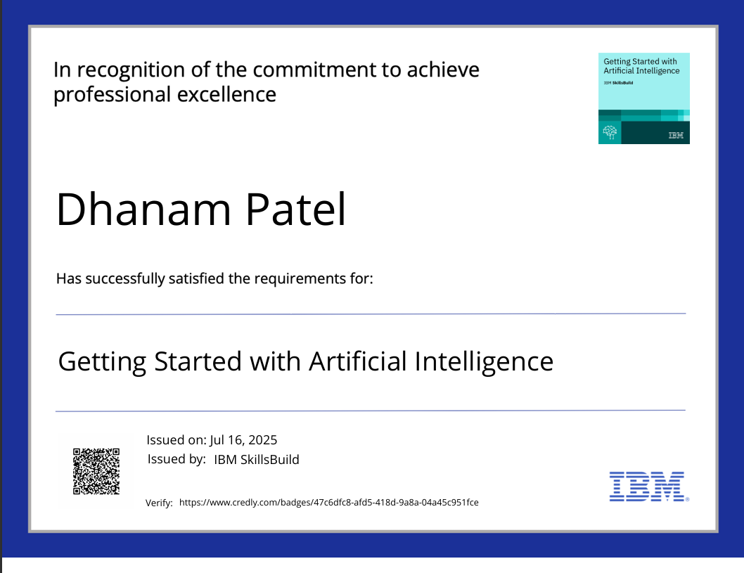
IBM Certifications

Slide 15

IBM Certifications

Slide 16

IBM Certifications

Slide 17
THANK YOU

