Slide 1
YUVA INTERNSHIP PROGRAMME · WEEK 4 CAPSTONE
Customer Churn Prediction
from a notebook to a service
Serialising a scikit-learn pipeline, serving it with FastAPI,
and measuring what it actually costs.
Peram Dhanam Srinivas
October 2026
Notes:
This is the final week of the internship: the deployment week. Over the last three weeks I built a churn model and compared algorithms. This week is about the gap between that model and something another team could actually call, version and trust. I will keep it to about ten minutes and leave time for questions.

Slide 2
THE STARTING POINT
A model in a notebook is not a product
No interface. Nobody can call it without opening the notebook.
No contract. Nothing validates what comes in; a typo becomes a silent imputation.
No version. Which coefficients are running in production?
No measured cost. 12 ms or 12 seconds? Nobody knows until someone asks.
No limits. Nothing records what the model must not be used for.
The deliverable
A FastAPI service, a serialised pipeline, a model card, 18 tests and a measured latency budget.
Peram Dhanam Srinivas · Week 4 Capstone · AI Project Deployment
Notes:
The framing I want to establish: the hard part of deployment is not the code. It is the five things a notebook does not have — an interface, a contract, a version, a measured cost and documented limits. Everything in this deck is one of those five.

Slide 3
SCOPE
What the brief asked for, and what exists
1
End-to-end project with FastAPI
train → serialise → serve → test
2
Serialisation with Pickle and Joblib
both written, compared, hashed
3
Documentation and presentation
report, model card, API reference, this deck
Peram Dhanam Srinivas · Week 4 Capstone · AI Project Deployment
Notes:
Three objectives, three deliverables. The important thing is that this is not a mock up: the service in this deck is the one in the repository, and every number was produced by running it.

Slide 4
WHAT IS DEPLOYED
The model: simple on purpose
Logistic Regression, C = 0.1, balanced weights
0.768
0.656
5.7 KiB
Selected by 5-fold CV ROC-AUC in Week 3 (0.806)
Not the strongest Random Forest scored 0.796 — inside one std. dev.
Chosen for an exact explanation for every prediction
One artifact imputer, scaler, encoder and classifier in one file
ROC-AUC
recall
artifact
held-out
two thirds of churners
5.7 KiB, 1 ms load
Peram Dhanam Srinivas · Week 4 Capstone · AI Project Deployment
Notes:
I could have deployed the Random Forest. I did not, and the reason is on the next slide but one: the linear model gives an exact decomposition of every prediction. The gap between them was inside the noise band, so explainability was free.

Slide 5
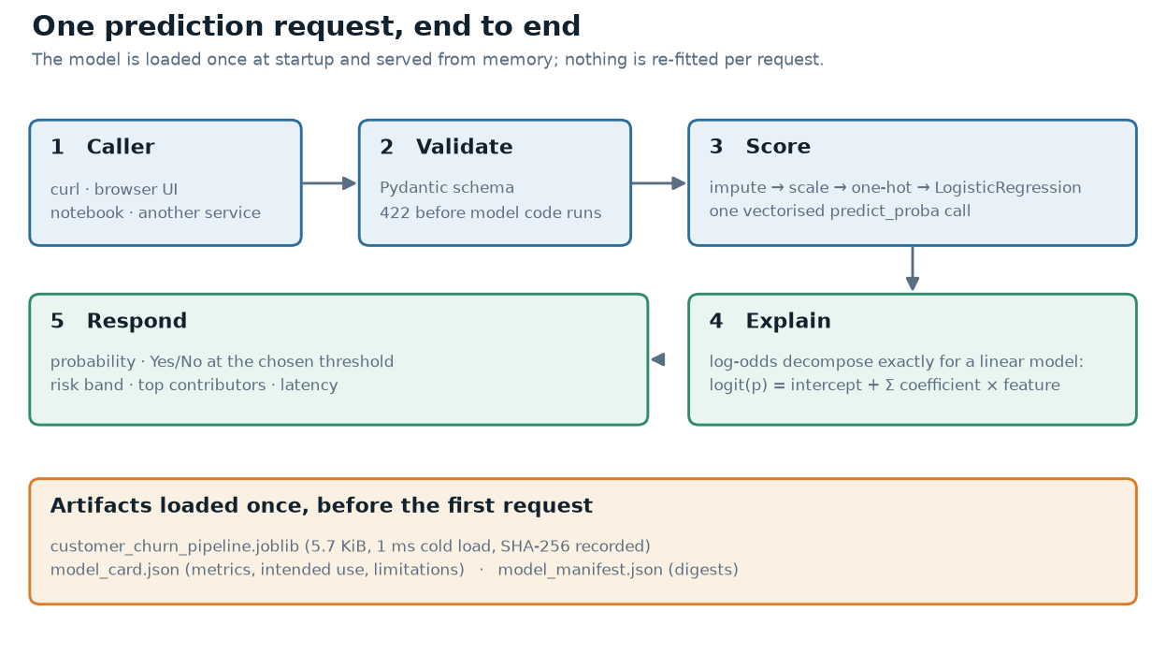
ARCHITECTURE
One request, end to end
Peram Dhanam Srinivas · Week 4 Capstone · AI Project Deployment
Notes:
Read it left to right. Validation happens before any model code runs, which is the single most valuable design decision in the whole service. The model is loaded once at startup — you can see the artifact box at the bottom. Nothing is re-fitted per request.

Slide 6
THE API
Six endpoints, each with one job
GET
/health
is the model actually loaded?
GET
/model
model card: metrics, intended use, limits
GET
/model/manifest
SHA-256 per artifact file
POST
/predict
one customer, with an explanation
POST
/predict/batch
up to 1,000, vectorised
GET
/docs
generated from the schemas
Health reports whether the model object exists — a container whose model failed to load should not answer 200.
Peram Dhanam Srinivas · Week 4 Capstone · AI Project Deployment
Notes:
The health endpoint is worth a sentence. The usual implementation returns 200 as long as the process is alive, which means a container with no model still passes its readiness probe. This one checks the model object.

Slide 7
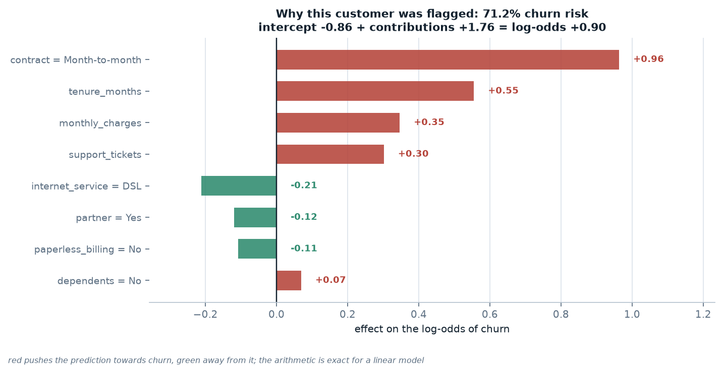
EXPLAINABILITY
Every prediction can be justified
• Exact, not approximated
• Adds to the log-odds
• The arithmetic checks out
Peram Dhanam Srinivas · Week 4 Capstone · AI Project Deployment
Notes:
This customer is at 71% risk. The contract type alone is worth +0.96 log-odds; DSL and having a partner pull the other way. If you add those numbers, apply the logistic function, you get exactly the probability the API returned. That is the difference between an explanation and a plausible-looking chart.

Slide 8
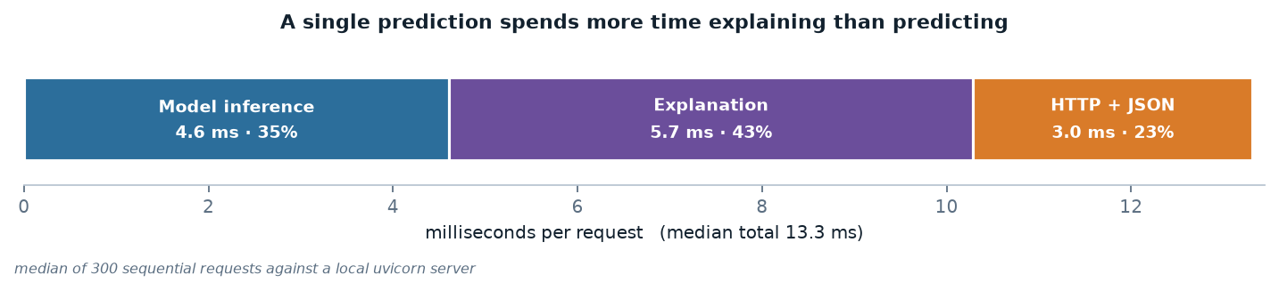
PERFORMANCE
Where 13.3 milliseconds actually goes
Model is 35%. Optimising it further would be invisible to the user.
Explanation is 43%. The largest cost — so it is optional, not mandatory.
HTTP is 23%. A floor that no model change can go below.
Peram Dhanam Srinivas · Week 4 Capstone · AI Project Deployment
Notes:
This chart changed how I thought about the project. I assumed the model was the expensive part. It is not: the explanation costs more than the prediction it explains. That is why the API has an explain_result flag.

Slide 9
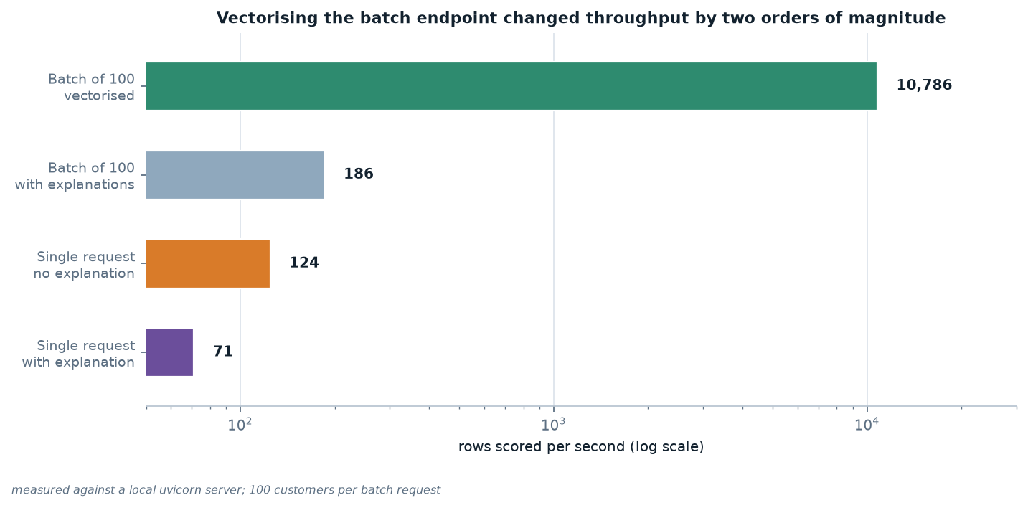
PERFORMANCE
A defect only a benchmark could find
92 rows/s first implementation, all 18 tests green
10,786 rows/s after vectorising one call
3 lines to remove a per-row pandas frame
Peram Dhanam Srinivas · Week 4 Capstone · AI Project Deployment
Notes:
This is the finding I am most pleased with, because it was invisible to every test. The batch endpoint looped over rows, so it was paying the fixed cost of a pandas frame and a transformer call a hundred times per request. All eighteen tests passed. The benchmark took it from 92 rows per second to nearly eleven thousand.

Slide 10
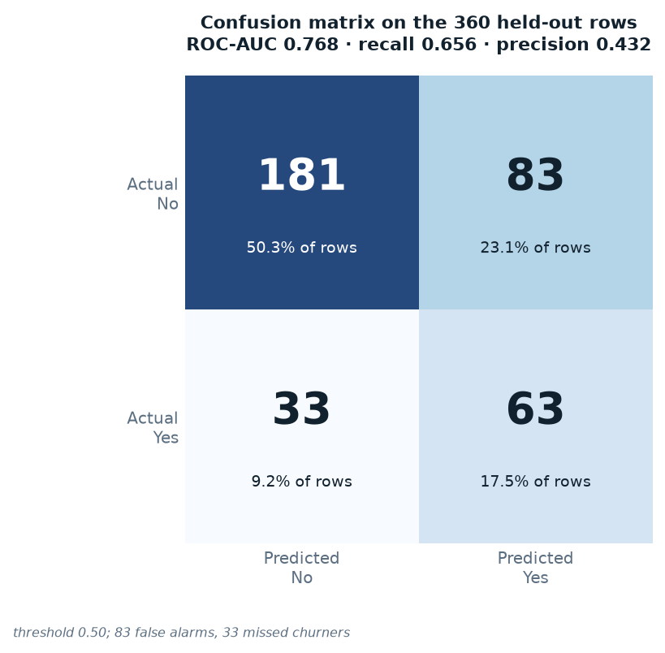
MODEL QUALITY
How good is it, really?
181 + 63 correct of 360 held-out rows
83 false alarms a wasted retention offer
33 missed churners a lost customer — far more expensive
0.768 ROC-AUC useful for ranking, not for automating
Peram Dhanam Srinivas · Week 4 Capstone · AI Project Deployment
Notes:
I want to be careful not to oversell this. Accuracy is 0.678, which is below the do-nothing baseline of 0.733. That is expected — balanced class weights trade accuracy for recall deliberately. The two errors are not symmetric: a false alarm costs one offer, a missed churner costs the whole customer.

Slide 11
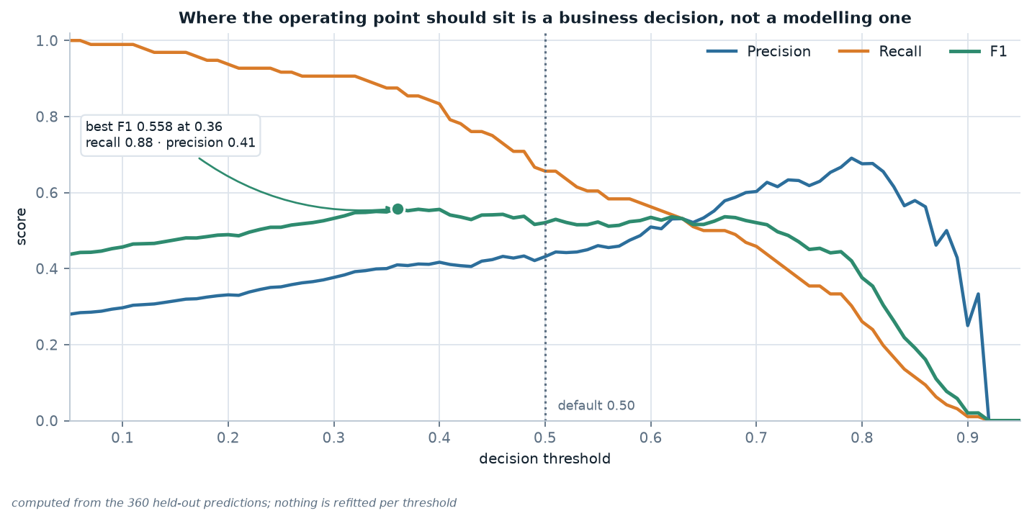
OPERATING POINT
The threshold is a business decision
0.50 default neutral, documented, echoed in every response
0.40 recall 0.82, precision 0.42
The API refuses to pick one silently for the caller
Peram Dhanam Srinivas · Week 4 Capstone · AI Project Deployment
Notes:
The model returns a probability. Turning it into a decision is a separate act, and the right threshold depends on what a missed churner costs relative to a wasted offer. That is not something I can know from the data, so the API exposes it as a parameter and returns it in the response for auditability.

Slide 12
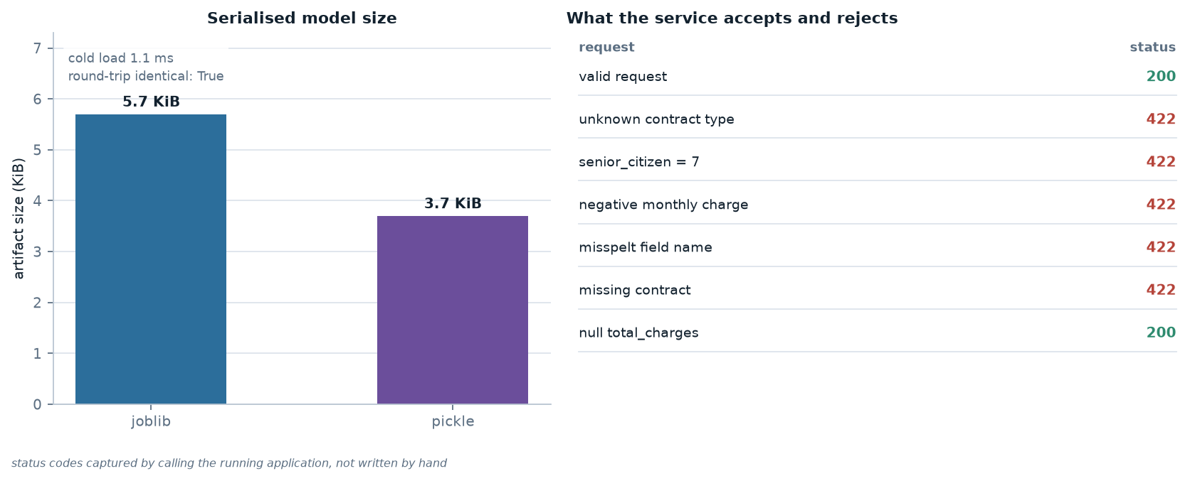
ROBUSTNESS
Failing at the edge, not in the model
• 7 validation tests
• 422 with a readable message
• null total_charges accepted
Peram Dhanam Srinivas · Week 4 Capstone · AI Project Deployment
Notes:
The most common production failure is not a bad prediction, it is a request in a shape the model never saw. Every 422 here is an exception that never reached scikit-learn. Note the last row: an omitted total_charges is accepted, because a new customer genuinely has none.

Slide 13
RESPONSIBLE USE
What this model must not be used for
Synthetic data. Every pattern is a property of the generator, not of real customers.
Not for consequential decisions. No credit, pricing, insurance or hiring.
No fairness audit. Error rates can differ by subgroup; that has not been measured.
No authentication. A local demonstration, not a public service.
It will drift. The model card records the training date for exactly this reason.
Peram Dhanam Srinivas · Week 4 Capstone · AI Project Deployment
Notes:
Deploying a model makes its limitations consequential, because people act on the output. The model card lists these, and I would rather say them out loud than have someone discover them later.

Slide 14
What I would do next
Monitoring. Log every prediction and compare the live distribution to training.
Fairness. Compute the confusion matrix per subgroup before any real use.
Auth and rate limiting. The two things between this and a public deployment.
Thank you — questions welcome.
Peram Dhanam Srinivas · github.com/Dhanam33/Yuva_intern/tree/main/week-4
Notes:
To close: the deployment works, it is measured, and it is honest about what it is. The three things I would add before real use are monitoring, a fairness audit, and authentication. Happy to take questions.

