Slide 1
YUVA INTERNSHIP • MACHINE LEARNING
Customer Churn
Prediction Capstone
Four-week learning journey: preprocess → compare models → evaluate clusters → deploy an API
Built with Python, NumPy, Pandas, scikit-learn, Joblib, and FastAPI
Synthetic teaching data only — not a real telecom dataset

Slide 2
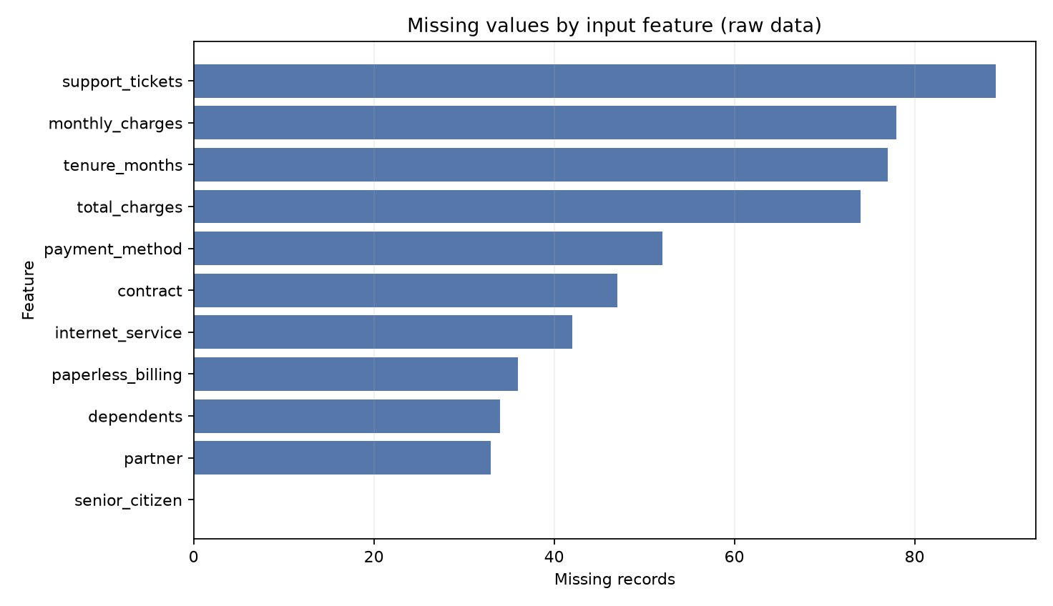
1 | Data quality and preprocessing
1,800
562
25
synthetic customer records
raw missing feature cells
encoded/scaled model inputs
• Audited data types, duplicate IDs, missingness, and churn-label balance.
• Median imputation + numeric missingness indicators; mode imputation for categories.
• StandardScaler for numeric values; one-hot encoding for categorical values.
• Mutual information ranks features; top-ten selection is exported.
2
YUVA INTERNSHIP • EDUCATIONAL SYNTHETIC-DATA PROJECT

Slide 3
2 | Supervised learning results
Model | Accuracy | Recall | F1 | ROC-AUC
Logistic Regression | 0.678 | 0.667 | 0.525 | 0.767
Random Forest | 0.697 | 0.604 | 0.516 | 0.746
Decision Tree | 0.672 | 0.604 | 0.496 | 0.713
K-Nearest Neighbors | 0.731 | 0.302 | 0.374 | 0.696
Linear Regression
Monthly charges prediction
MAE 7.61 • RMSE 9.68
R² 0.817
Key readout
Logistic Regression led ROC-AUC; KNN had the highest accuracy but lower churn recall. Metric choice affects the decision.
Classifiers: Logistic Regression • Decision Tree • Random Forest • K-Nearest Neighbors | 80/20 stratified test split
3
YUVA INTERNSHIP • EDUCATIONAL SYNTHETIC-DATA PROJECT

Slide 4
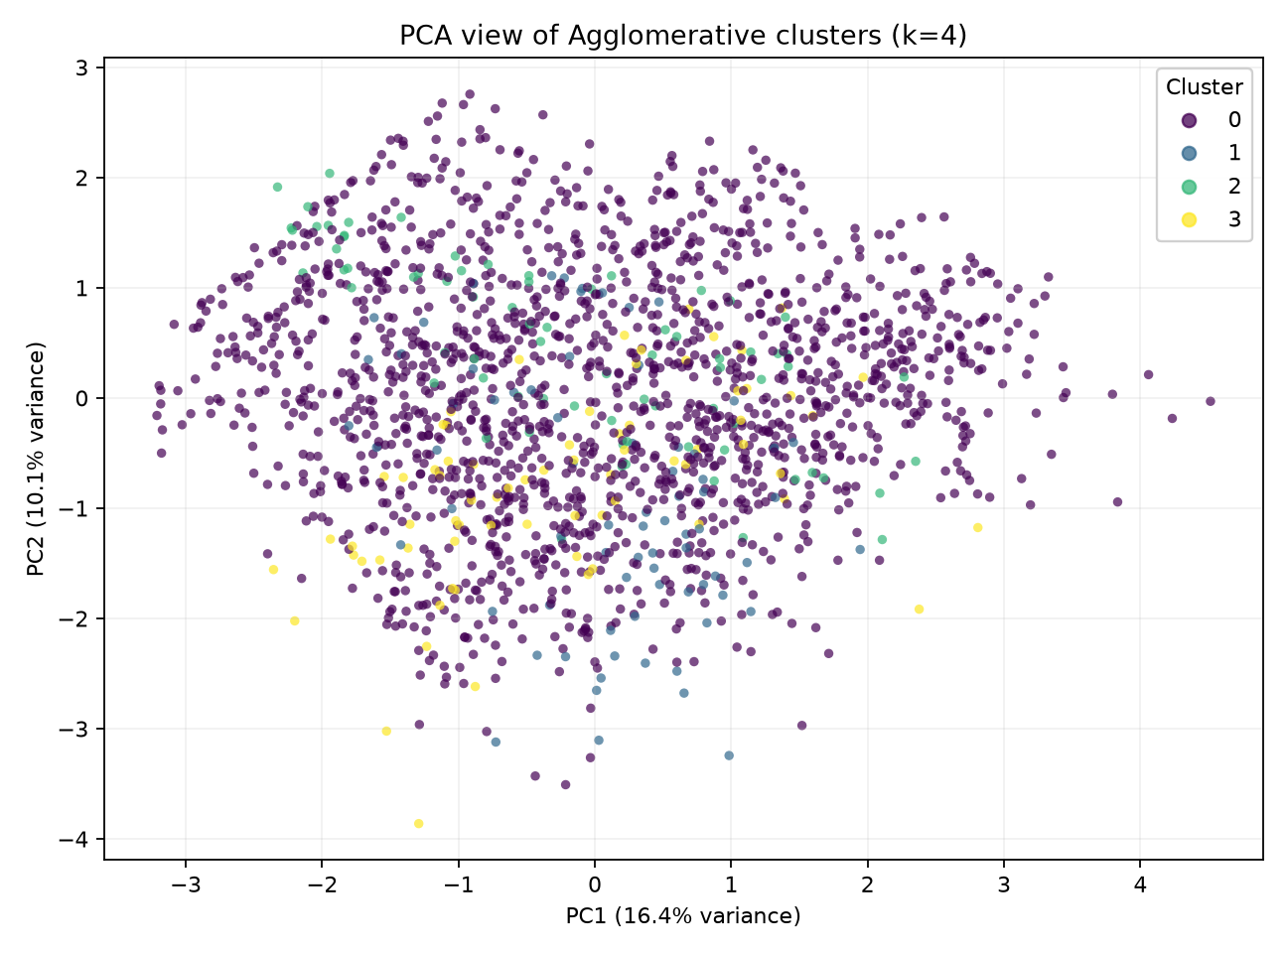
3 | Clustering and model evaluation
0.355
0.802 ± 0.022
0.766
best silhouette • Agglomerative k=4
5-fold CV ROC-AUC
held-out ROC-AUC
• K-Means and Agglomerative clustering tested k=2–6; churn was excluded from clustering.
• Tuned Logistic Regression C=0.1 using stratified 5-fold CV.
• Test precision 0.429 • recall 0.656 • F1 0.519.
• Four-cluster solution is highly imbalanced; silhouette is not proof of natural segments.
4
YUVA INTERNSHIP • EDUCATIONAL SYNTHETIC-DATA PROJECT

Slide 5
4 | Deployment architecture
Raw JSON
→
FastAPI validation
→
Joblib pipeline
→
Prediction
→
Label + probability
Local run
Built-in safeguards
uvicorn yuva_ml.api:app --app-dir src --host 0.0.0.0 --port 8000
GET /health • POST /predict • GET /docs
• Missing fields imputed; unseen categories tolerated.
• Batches limited to 100 rows; empty batches rejected.
• Preprocessing travels with the serialized estimator.
Local educational API only — no cloud hosting, authentication, or real-customer validation is claimed.
5
YUVA INTERNSHIP • EDUCATIONAL SYNTHETIC-DATA PROJECT

Slide 6
5 | Takeaways and next steps
• A reproducible preprocessing pipeline prevents common data-quality and leakage errors.
• Multiple metrics expose trade-offs that a single accuracy score can hide.
• Unsupervised clusters need balance, stability, and domain validation—not only a score.
• A saved end-to-end pipeline makes inference consistent between training and the API.
Next: validate on representative consented data, review costs and fairness, secure the API, and monitor drift.
6
YUVA INTERNSHIP • EDUCATIONAL SYNTHETIC-DATA PROJECT

