Slide 1
Student Database

Slide 2
STUDENT(snum: integer, sname: string, branch: string, levels: string, age: integer)
CLASS(cname: string, meetsat: string, room: string, fid: integer) ENROLLED(snum: integer, cname: string)
FACULTY(fid: integer, fname: string, deptid: integer)

Slide 3
SCHEMA DIAGRAM
Student | SNUM | SNAME | BRANCH | LEVEL | AGE
Class | CNAME | MEETSAT | ROOM | FID
Enrolled | SNUM | CNAME
Faculty | FID | FNAME | DEPTID

Slide 4
SCHEMA DIAGRAM
Student | SNUM | SNAME | BRANCH | LEVEL | AGE
Class | CNAME | MEETSAT | ROOM | FID
Enrolled | SNUM | CNAME
Faculty | FID | FNAME | DEPTID

Slide 5
SCHEMA DIAGRAM
Student | SNUM | SNAME | BRANCH | LEVEL | AGE
Class
CNAME
MEETSAT
ROOM
FID
Enrolled
SNUM
CNAME
Faculty | FID | FNAME | DEPTID

Slide 6
SCHEMA DIAGRAM
1
Student | SNUM | SNAME | BRANCH | LEVEL | AGE
Class
CNAME
MEETSAT
ROOM
FID
3
Enrolled
SNUM
CNAME
4
Faculty | FID | FNAME | DEPTID
2

Slide 7
Create tables commands
CREATE TABLE STUDENT
(snum integer, sname varchar(10), major varchar(10), levels varchar(2), age integer,
PRIMARY KEY(snum));

Slide 8
CREATE TABLE FACULTY
(fid integer,
Fname varchar(10), deptid integer, PRIMARY KEY(fid));

Slide 9
CREATE TABLE CLASS
(cname varchar(10), Meetsat varchar(10), room varchar(5),
fid integer,
PRIMARY KEY(cname),
FOREIGN KEY(fid) references FACULTY(fid));
•

Slide 10
CREATE TABLE ENROLLED
(snum integer, cname varchar(10),
PRIMARY KEY(snum, cname), FOREIGN KEY(snum) references STUDENT(snum),
FOREIGN KEY(cname) references
CLASS(cname));

Slide 11
SQL> SELECT *
SNUM SNAME
FROM STUDENT;
MAJOR LEVELS AGE
101 | Amit |  | CS | JR | 21
102 | Dilip | CS |  | SR | 22
103 | Samit | CS |  | SR | 27
104 | chandu | CS |  | JR | 20
105 | Ramu | CS |  | SR | 27

Slide 12
SQL> SELECT * FROM CNAME MEETSAT |  | CLASS; ROOM | FID
DBMS | 10 | r04 | 501
WEB | 10 | r02 | 502
DAA | 11 | r03 | 503
MM | 11 | r128 | 502
DIPMAT | 12 | r04 | 504
OS | 11 | r128 | 501
CIP | 10 | r02 | 501
LAB | 12 | r03 | 501

Slide 13
SQL>SELECT * FROM ENROLLED;
SNUM CNAME
101 |  | DBMS
101 |  | WEB
101 |  | DAA
101 |  | MM
101 |  | DIPMAT
101 |  | OS
101 |  | CIP
101 |  | LAB
102 |  | DBMS
102 |  | WEB
103 |  | DBMS
104 |  | DAA
105 |  | DIPMAT
103 |  | MM
105 |  | DBMS
104 |  | DBMS

Slide 14
SQL> SELECT
FID
* FROM FACULTY;
FNAME DEPTID
501 | Kuldeep | 401
502 | Akshata | 402
503 | Sanjeev | 401
504 | Math | 405
505 | Vidhya | 403
506 | Jog | 404
507 | Patil | 402

Slide 15
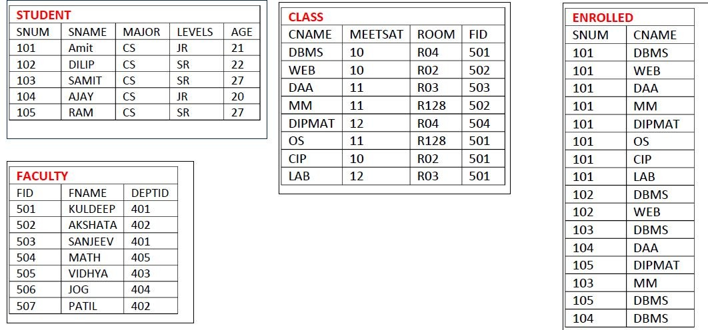

Slide 16
1)Find the names of all Juniors (level = JR) who are enrolled in a class taught by Prof. kuldeep

Slide 17
1)Find the names of all Juniors (level = JR) who are enrolled in a class taught by Prof. kuldeep
SELECT DISTINCT S.Sname
FROM STUDENT S, CLASS C, ENROLLED E, FACULTY F
WHERE S.snum = E.snum AND E.cname = C.cname AND C.fid = F.fid AND F.fname = 'kuldeep‘
AND S.levels = 'JR';

Slide 18
2)Find the names of all classes that either meet in room R128 or have five or more Students enrolled

Slide 20
2)Find the names of all classes that either meet in room R128 or have five or more Students enrolled
SELECT DISTINCT C.cname FROM CLASS C
WHERE C.room = 'r128'
OR C.cname IN (SELECT E.cname FROM ENROLLED E
GROUP BY E.cname HAVING COUNT (*) >= 5);

Slide 21
3)Find the names of faculty members who teach in every room in which some class is taught.

Slide 23
3)Find the names of faculty members who teach in every room in which some class is taught.
SELECT DISTINCT F.fname FROM FACULTY F
WHERE NOT EXISTS(( SELECT room FROM CLASS)
Minus
(SELECT C1.room FROM CLASS C1
WHERE C1.fid = F.fid ));

Slide 24
4) Write a SQL query to update the room number for DBMS course to S11.

Slide 26
4) Write a SQL query to update the room number for DBMS course to S11.
UPDATE CLASS SET ROOM =‘S11’
Where cname=‘DBMS’;

Slide 27
Summary of SQL
SELECT (attribute and function) FROM( TABLE LIST) WHERE(CONDITION)
GROUP BY(Grouping attribute) HAVING (group condition) ORDER by (attribute list)

Slide 28
OVERVIEW
What is DDL and DML?
Various Types of DDL and DML?
Various constraints on SQL?
Schema change statements in SQL?
Basic query structure in SQL?
Various Aggregate functions in SQL?
Data types in SQL?
Group by, having clause and order by clause?

Slide 29
What is DDL and DML?
The language which is used to alter table properties in called Data Definition language.
Create - create table
Alter - modify table values
Delete - to delete attributes from tables
Drop – to drop a table

Slide 30
DML
The language that is used to modify table contents are called as Data Manipulation Language.
Insert
Update
Delete

Slide 31
Various constraints in SQL?
Not Null - Indicates that a column cannot store NULL value
Unique - Ensures that each row for a column must have a unique value
Primary key – combination of Not null and unique
Foreign key -Ensure the referential integrity of the data in one table to match values in another table
Check - Ensures that the value in a column meets a specific condition
Default - Specifies a default value for a column

Slide 32
Schema change statements in SQL?
Drop
Alter
Alter to add new column
Alter to remove column
Alter to set new datatype to column
Alter to set default value to column

Slide 33
Basic query structure in SQL?
SELECT (attribute and function) FROM( TABLE LIST) WHERE(CONDITION)
GROUP BY(Grouping attribute) HAVING (group condition) ORDER by (attribute list)

Slide 34
Various Aggregate functions in SQL?
Max
Min
Avg
Count
Sum

Slide 35
Data types in SQL?
Integer
Decimal
Varchar(size)
Char(size)
Date
Timestamp
Number

Slide 36
Group by, having clause and order by clause?
Group by – to group items by column value
Having – to check condition meets
Order by – to display in ascending or decending

