Slide 1
QUEUE DATA STRUCTURE

Slide 2
Introduction
A queue is defined as a linear data structure that is open at both ends and the operations are performed in First In First Out (FIFO) order.
We define a queue to be a list in which all additions to the list are made at one end, and all deletions from the list are made at the other end.

Slide 3
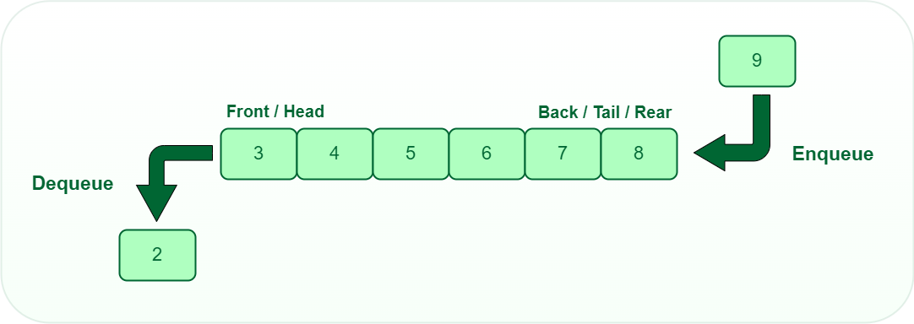

Slide 4
Characteristics of Queue:
Characteristics of Queue:
Queue can handle multiple data.
We can access both ends.
They are fast and flexible.

Slide 5
Representation of Queue
Like stacks, Queues can also be represented in an array: In this representation, the Queue is implemented using the array. Variables used in this case are
Queue: the name of the array storing queue elements.
Front: the index where the first element is stored in the array representing the queue.
Rear: the index where the last element is stored in an array representing the queue.

Slide 6
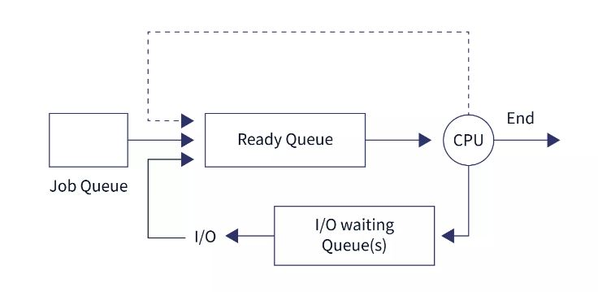
CPU Scheduling

Slide 7
Applications of Queue
CPU scheduling
Disk scheduling
Job scheduling algorithms
Queuing the messages in the mailbox
Queuing the SMS
Handling hardware or real-time systems interrupts.
Handling website traffic.
Routers and switches in networking.
Maintaining the playlist in media players.

Slide 8
CPU Scheduling

Slide 9
DISK Scheduling (I/O Scheduling )
Disk scheduling is done by operating systems to schedule I/O requests arriving for the disk.
Multiple I/O requests may arrive by different processes and only one I/O request can be served at a time by the disk controller. Thus other I/O requests need to wait in the waiting queue and need to be scheduled.
Hard drives are one of the slowest parts of the computer system and thus need to be accessed in an efficient manner.

Slide 10
Job scheduling
First-Come, First-Served (FCFS) Scheduling.
Shortest-Job-Next (SJN) Scheduling.
Priority Scheduling.
Shortest Remaining Time.
Round Robin(RR) Scheduling.
Multiple-Level Queues Scheduling.

