Slide 1
Quick Sort Algorithm
Problem Definition: Implement QuickSort Algorithm to sort a given set of elements and determine the time required to sort the elements. Plot the graph of Computing V/s Problem size.
CSE@GIT

Slide 2
Objectives of the Experiment:
To apply the divide and conquer strategy
Present the working of Quicksort
3. Learn to write Algorithm in standard form
4. Analyze the Algorithm & Estimate computing time

Slide 3
Quick Sort – Divide and Conquer
Divide: Partition (rearrange) the array A[left : right] into two (possibly empty) sub-arrays
A[left : q – 1] and A[q + 1:right] such that each
element of A[left : q – 1] is less than or equal to A[q], and
element of A[q + 1:right] is greater than or equal to A[q]
Conquer: Sort the two subarrays A[left : q – 1] and A[q + 1:right ] by recursive calls to quicksort.
Combine: Because the subarrays are already sorted, no work is needed to combine them: the entire array A[left : right] is now sorted.

Slide 4
Partitioning Array
a pivot, partition the elements of the array such that the resulting array consists of:
One sub-array that contains elements >= pivot
Another sub-array that contains elements < pivot
The sub-arrays are stored in the original data array.
Partitioning loops through, swapping elements below/above pivot.

Slide 5
Quicksort Example
5 3 1 9 8 2 4 7
2 3 1 4 5 8 9 7
1 2 3 4 5 7 8 9
1 2 3 4 5 7 8 9
1 2 3 4 5 7 8 9
1 2 3 4 5 7 8 9

Slide 6
P
5
3
1
9
8
2
4
7
I
J
Undo last swap
Swap I-th and J-th element
i < j ?? Continue
STOP

Slide 7
P
2
3
1
4
5
8
9
7
I
J
Undo last swap
Swap I-th and J-th element
Swap pivot and J-th element
STOP

Slide 8
P
1
2
3
4
5
8
9
7
I
J

Slide 9
P
1
2
3
4
5
8
9
7
I
J

Slide 10
P
1
2
3
4
5
8
9
7
I
J
J
I

Slide 11
P
1
2
3
4
5
7
8
9

Slide 12
Quick Sort Algorithm
quickSort(A, left,right)
//Sorts a subarray by quicksort
//Input: A subarray A[left..right] of A[0..n-1], defined by its left and right indices
//Output: Subarray A[left..right] sorted in nondecreasing order
if left < right
q = Partition (A, left ,right)
quickSort(A, left, q-1)
quickSort(A, q+1 ,right)
Note: To sort an entire array A, the initial call is
quickSort(A, 0, n-1)

Slide 13
Quick Sort Partition Pseudo code
Partitioning the array The key to the algorithm is the Partition procedure, which rearranges the sub-array A[left : right] in place around the partition element.
Partition(A, left, right)
//Partitons a subarray by using its first element as a pivot
//Input : A subarray a[left..right] of A[0..n-1], defined by its left // and right indices left and right(left<right)
//Output :A partition of A[left..right], with the split position returned as this //function’s value
pv = A[left] // Select Pivot as left most element
i = left, j = right+1 // Set left and right indices
do begin
do i=i+1 while ( A[i] < pv) // Search from left
do j=j-1 while ( A[j] > pv) // Search from right
exchange A[i] with A[j]
while(i<j)
exchange(A[i], A[j]) // Undo the extra exchange
exchange A[j] with A[left] // Exchange pivot with A[j]
return j // Return position of partition

Slide 14
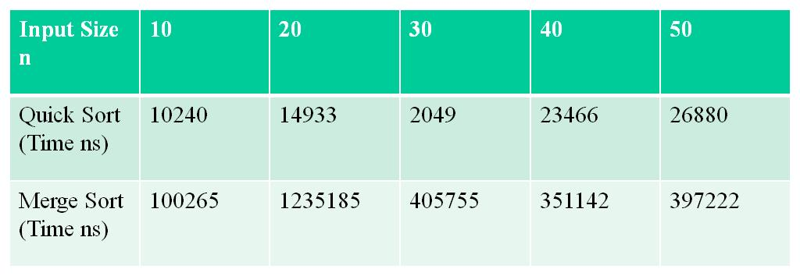
Computation Time for Different Size of Input
For smaller inputs quick sort perform better than the merge sort, due to the fact the merge sort is not in place unlike quick sort. We need more amount of space in case of merge sort.

Slide 15
Time and Space Complexity
Quick Sorts worst-case running time is : Θ(n²)
( This case occurs when list is almost sorted )
But its average-case running time is as good as merge sort's: Θ(n*logn)
( This case occurs when list contains random values )
The in-place version of quickSort has a space complexity of O(n) as compared to mergeSort which is O(2n)

Slide 16
Time and Space Complexity
N ²
→ BubleSort
T(N)
N*logN → QuickSort
N

Slide 17
Learning Outcome of the Experiment and Conclusion
At the end of the session, students should be able to :
Explain the working of Divide and Conquer Strategy [L2, CO 2, PO1]
Demonstrate the working of Quick sort algorithm on a given set of size n
[L3, CO 2, PO3]
Estimate the computing time using appropriate time functions.
[L3, CO 2, PO3]
4. Plot a graph of Computing time V/s Size of the input and draw conclusions
[L4, CO 2, PO4]

