Slide 1
Topics to be covered :
UNIT-1. INTRODUCTION TO FINITA AUTOMATA
Introduction to Finite Automata : Structural Representation, The Central Concept of Automata Theory - Alphabet, String & langauges. Deterministic Finite Automata(DFA), Non-Deterministic Finite Automata(NFA), and Equivalance of NFA and DFA , Finite Automata with Epsilon (Ԑ) Transitions.
Upon completion you will be able to
Explain the concepts of Auotomata Theory and its Applications.
Design DFA, NFA and Ԑ-NFA for Regular languages
Demonstrate the equivalence of DFA, NFA and Ԑ-NFAs.

Slide 2
Deterministic Finite Automata(DFA)
Structural /Schematic Representation and working of a Finite Automata.
Types of Automata
Deterministic and Non Deterministic
The cental concept of Automata theory
Formal Definition of Deterministic Finite Automata-DFA
Processing of a string by DFA
Extended Transition Function δ*
Languages of an DFA
Examples

Slide 3
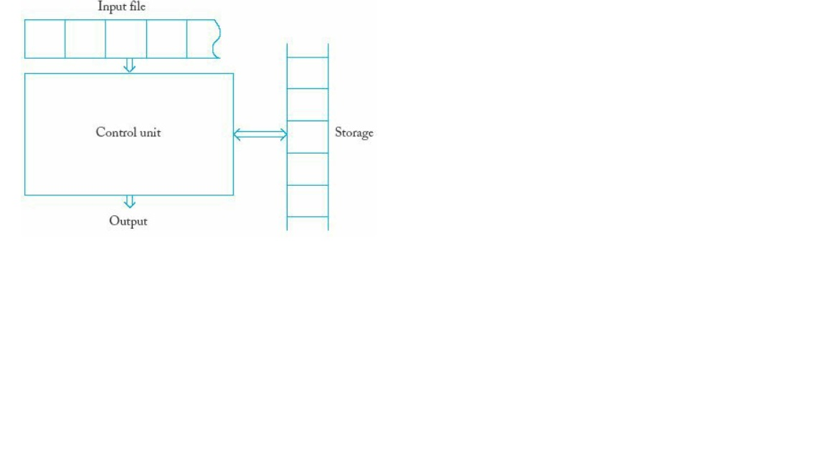
Structural/Schematic Representation and working of a Finite Automata.
Automata has the follwing essential features :
1. It has a mechanism for reading the input that is assumed to be string over a given alphabet and is strored in a input file or Input beffer which the automata can read one character at a time but cannot write. The input file is divided into ‘n’ number of cell, where each cell is cable of holding the single character. The input mecahnism can read the input file from left to right one character at a time. It can also detect the end of input.
2. The Automata can produce an Output of some form.
3. The Automata may have a temporary Storage device consisting of an unlimited number of cells, each Cell is capable of holding a single character from an alphabet. The Automata can read and change the contents of the storage cells

Slide 4
4. Finally Automata has a Control Unit, which can be in any one of a finite number of internal states, and can change state in some defined manner.
Working of Automata :
An Automata is assumed to operate in discrete manner of timeframe. At any given instance of time, the control unit is in some internal state and the input mechanism is scanning the perticular input symbol on the input file. The internal state of the control unit at next time step is determined by the transision function - δ.
The Transision function - δ gives the next state interms of the current state and current input symbol and the information currently in the temporary storage. During the transition from one state to next state the output may be produced or the information in the temporary staorage changed.
The term Configuaration will be used to refer to perticular state of the control unit, input file and temporary storage. The transition of the automata from configuration to another will be called as MOVE.
NOTE : This genaral model covers all the automatra like PDA, Turing Machine. The finite state control will be common to all specific cases, however the diffrence will arise from the way the output can be produced and the nature of the temporary storage. The power of differnt types of automata is governed by nature of Temporary storage.

Slide 5
Central concept of automata theory
Alphabets - ∑
An alphabet is a finite, non empty set of symbols. ∑- symbol is used denote the same.
Ex-1. ∑ = {0, 1}, the binary alphabet
Ex-2. ∑ ={a, b,.....z}, the set of all lower case letters
Strings
A string ( referred as word ) is finite sequence of symbols choosen from some alphabet.
Ex-1. if ∑ = {0, 1}, is the binary alphabet then 011011 is string
from binary alphabet
The Empty string is a string with zero occurance of symbols from the alphabet. This is denoted by ‘Ԑ’ which can be choosen from any alphabet-∑

Slide 6
- Power of an alphabet - ∑k - If ∑ is an alphabet, then power of an alphabet is set of strings of certain length from alphabet by an exponential notation. i.e We define ∑^{k} to be the set of strings of length k, each of whose symbol is in ∑.
Ex-1 if ∑ = {0,1}, then
1. ∑¹= {0,1} is the set of strings of length 1.
2. ∑²= {00,01,10,11} is the set of strings of length 2.
and so on.... Note that ∑⁰= Ԑ is string of length 0 no
matter what the alphabet -∑ is
3. The set of all strings of any length is conventionaly
denoted by ∑* = {Ԑ, 0,1,00,01,10,11, 000,010,........}.
This can also be denoted as follows
∑* = ∑⁰ Ụ ∑¹ Ụ ∑² Ụ ∑³ Ụ.............
4. ∑⁺ = ∑¹ Ụ ∑² Ụ ∑³ Ụ............. This excludes the
empty string - Ԑ
5. ∑* can also be written as - ∑* = ∑⁺ Ụ { Ԑ }

Slide 7
Concatenation of string - Let x and y be strings. Then xy denotes the concatenation of string x and y, that is string formed by making a copy of x and followed by copy of y.
Ex-1. Let x = 1101 and y = 0001.Then xy = 11010001
Languages
A set of strings all of which are choosen from ∑*, where ∑ is a perticluar alphabet is called a Language. If ∑ is an alphabet and L ⊆ ∑*, then L is a language over ∑.
Note that the language over ∑ need not include strings with all the symbols of ∑

Slide 8
Types of Automata
Depending on how the Transision function - δ is defined there are two types of Autromata.
1. Determinstic Finite Automata :
A deteministric automata is one in which each move is uniquely determinined by the current configuaration. i.e A finite automata is said to be deterministic iff, for any state ‘s’ and for any input symbol ‘a’ the Transision function - δ is uniquely defined. i.e next state can be easily determined

Slide 9
Types of Automata
2. Non Determinstic Finite Automata :
A non deteministric automata is one in which each move is not uniquely determinined by the current configuaration. i.e A finite automata is said to be non deterministic iff, for any state ‘s’ and for any input symbol ‘a’ the Transision function - δ is not uniquely defined. i.e next state cannot be easily determined.

Slide 10
DFA - Deterministic Finite Automata

Slide 11
Formal Definition
The Deterministic Automata (DFA) is defined as 5-tuple or quintuple indicating five components:
D = { Q, ∑, δ, q₀, F}
Where:
1.Q is a finite set of states.
2. ∑ is a finite set of input symbols.
3. δ is the transition function that takes a state
in Q and an input symbol in ∑ as arguments
and returns a state
δ : Q x ∑ → Q
4. q₀ is the start state that belongs to Q
5. F is a subset of Q, is the set of final (or accepting) states.

Slide 12
Processing of strings by DFA
Suppose w=a1,a2,….an is the string to be processed then DFA starts with start state q0 and a1 the first character and consults the transition function δ to find the next state that DFA stays after processing the input symbol a1.
This is continued for all the subsequent input characters from a2,a3,....an and current state to find next state by consulting transition function δ and finally DFA stays in a state q.
and if a state q is a final state then the input w is accepted, otherwise rejected.

Slide 13
Simpler Notations of DFA
There are two types of notations to represent DFA
Transition Diagram
Trantion Table
1. Transition Diagram : A transition diagram for DFA A ={ Q, ∑, δ, q0, F} is a directed graph and defined as follows :
a. For each state in Q there is node and nodes are denoted by Circle
b. For each state ‘q’ in Q and for each input symbol ‘a’ in ∑, let δ(q, a) = p then transition diagram must contain an arc or edge from state ‘q’ to state ‘p’ with labelled ‘a’.
c. there is an arrow into the start state q0 labelled START
d. Node corresponding to accepting states (Those are in F) are marked by double circle other states have a single circle

Slide 14
Simpler Notations of DFA
2. A transition table : A transition table for DFA A ={ Q, ∑, δ, q0, F} is a conventional tabular representation of transition function δ, where
Rows corresponds to the states in Q for the transition table.
Columns corresponds to the inputs from ∑.
The entry for the row corresponding to state ‘q’ and the column corresponding to input ‘a’ is the state ‘p’ from δ(q, a)

Slide 15
Extended Transition Function δ *
The extended transition function δ* for DFA is an extension of Transition function δ of DFA and is defined as follows
Basis : δ*(q,Є) = {q} that is without reading any input symbols
DFA is still in same state q.
Induction: Suppose w is of the form w=xa where a is the final
symbol of w and x is the rest of w.
Then δ*(q, w)= δ(δ*(q, x),a)
If δ*(q, x) =p then
δ*(q, w)= δ(δ*(q, x),a) = δ(p, a)

Slide 16
b
a
a
q₀
q₁
b
Use of Extended transition function δ* to validate the inputs
Example -1 - Computation of δ*(q0,bbaa) :
δ*(q0,€) = q0 → By Basis
By Induction :
δ*(q0,b) =δ(δ*(q0,€),b) = δ(q0, b) = q0
δ*(q0,bb) =δ(δ*(q0,b),b) =δ(q0,b) = q0
δ*(q0,bba) =δ(δ*(q0,bb),a) =δ(q0,a) = q1
δ*(q0,bbaa) =δ(δ*(q0,bba),a) =δ(q1,a) = q1
The string w = bbaa is valid as DFA remains in q1 and is a final state
Exercise problems

Slide 17
Example -2 - Computation of δ*(q0,abbab) :
δ*(q0,€) = q0 → By Basis
By Induction :
δ*(q0,a) =δ(δ*(q0,€),a) = δ(q0, a) = q1
δ*(q0,ab) =δ(δ*(q0,a),b) =δ(q1,b) = q0
δ*(q0,abb) =δ(δ*(q0,ab),b) =δ(q0,b) = q0
δ*(q0,abba) =δ(δ*(q0,abb),a) =δ(q0,a) = q1
δ*(q0,abbab) =δ(δ*(q0,abba),b) =δ(q1,b) = q0
The string w = abbab is invalid as DFA remains in q0 and is not a final state
Exercize problems : 1. Compute δ*(q0,aababb)
2. Compute δ*(q0,aaabaa)

Slide 18
Language of DFA
If A={Q,∑,δ, q0, F} is an NFA then
L(A) = {w | δ*(q0,w) = p Є F (i.e it is F) }
that is L(A) is the set of strings w in ∑ * such that δ*(q0,w) contains an accepting state
In other words - The language of a DFA (Q, Σ, δ, q₀, F) is the set of all strings over Σ that, starting from q₀ and following the transitions as the string is read left to right, will reach some accepting state.

Slide 19
Examples
Σ = {a, b}
q₀
Σ = {a, b}
a
b
b
a
a
a
q₁
q₃
b
q₀
q₁
b
b
a
a
b
b
q₂
q₄
a
0
1
0, 1
q₀
1
q₁
0
q₂
Σ = {0, 1}
What are the languages of these automata?

Slide 20
Examples on Design Of DFA
Design the DFA for the following languages on the Alphabet ∑={a, b}
1. Set of all strings that starts with prefix ‘ab’.
2. Set of all strings that contains exactly one ‘a’.
3a. Set of all strings that contains at least one ‘a’.
3b. Set of all strings having substring ‘aa’.
4 Set of all strings that contains not more than three a’s
5. Set of all strings of a’s and b’s ending with substring ‘abb’.

Slide 21
6. Set of all strings of a’s and b’s not ending with substring ‘abb’.
7. L={ w : |w| mod 3 = 0 }
8. L={ w : |w| mod 5 <> 0 }
9. L={ awa : wЄ {a, b}* }
10. L={ aw1aaw2a : w1,w2 Є {a, b}* }
11. L={ ab⁵wb⁴ : wЄ {a, b}* }
12. Set of all strings of a’s and b’s having three consecutive a’s.

Slide 22
13. Set of all strings of a’s and b’s ending with ‘ab’ or ‘ba’.
14. L= { w : n_{a}(w) =2, n_{b}(w)>=3, where w belongs to ∑ * and ∑ ={a,b} }
15. L= { w : |w|mod 3 >= |w| mod 2, where w belongs to ∑ * and ∑ ={a,b} } }
16. L= { w : n_{a}(w) mod =2, n_{b}(w) mod 2, where w belongs to ∑ * and ∑ ={a,b} } }

Slide 23
Non Deterministic Finite Automata(NFA)
Introduction and Why study NFA ?
Formal Definition
Processing of a string
Extended Transition Function δ*
Languages of an NFA
Design of NFA for some languages
Equivalence of Deterministic and Non Deterministic Finite Automata
Conversion of NFA to DFA using subset construction Scheme by Lazy evaluation
Algorithm
Examples

Slide 24
Introduction
Why NFA ?
In order to construct a DFA for some languages we have the following difficulties.
1. Construction is difficult.
2. DFA cannot guess about its inputs
3. At any point of time the DFA is in only one state and does not have the power to be in several states.
4. Not an efficient mechanism to describe some complicated languages concisely.
These difficulties can be overcome by using NFA

Slide 25
Formal Definition
The Non Deterministic Automata (NFA) is defined as 5-tuple or quintuple indicating five components:
A= { Q, ∑, δ, q₀, F}
Where:
1.Q is a finite set of states.
2. ∑ is a finite set of input symbols.
3. δ is the transition function that takes a state
in Q and an input symbol in ∑ as arguments
and returns a subset of Q i.e a set of states.
δ : Q x ∑ → 2^{Q}
4. q₀ is the start state that belongs to Q
5. F is a subset of Q, is the set of final (or accepting) states.

Slide 26
Processing of string by an NFA
Suppose w=a1,a2,….an is the string to be processed then NFA starts with start state q0 and a1 the first character and consults the transition function δ and takes all possible transitions and stays in multiple states.
This is continued for all the inputs for each state and finally the set of states in which NFA stays contains at least on final state then the input is accepted, otherwise rejected.

Slide 27
Extended Transition Function δ *
The extended transition function δ* for NFA is an extension of Transition function δ of NFA and is defined as follows
Basis : δ*(q,Є) = {q} that is without reading any input symbols
NFA is still in same state q.
Induction: Suppose w is of the form w=xa where a is the final
symbol of w and x is the rest of w.
Then δ*(q, w)= δ(δ*(q, x),a)
If δ*(q, x) ={p1, p2,……..pk} then
_{k}
δ*(q, w)= δ(δ*(q, x),a) = Ụ δ(pi, a) = {r1,r2….rm}
^{i=1}

Slide 28
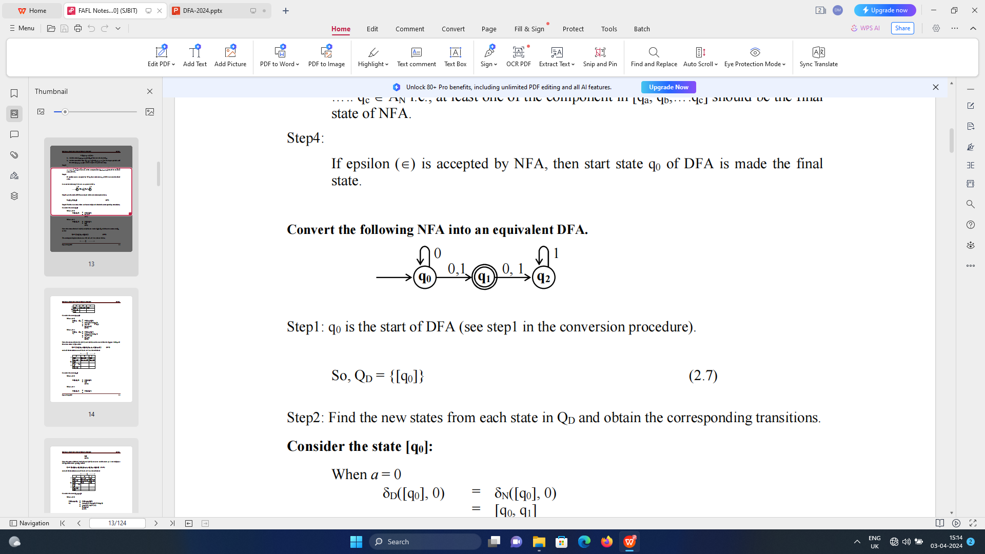
Use of Extended transition function δ* to validate the inputs :
Example -1 - Computation of δ*(q0,001) :
δ*(q0,€) = q0 → By Basis
δ*(q0,0) =δ(δ*(q0,€),0) = δ(q0,0)= {q0,q1} ← By induction
δ*(q0,00) = δ(δ*(q0,0),0) = δ({q0,q1},0)
= δ(q0,0) Ụ δ(q1,0)
= {q0,q1} Ụ {q2}
= {q0,q1,q2}
δ*(q0,001) = δ(δ*(q0,00),1) = δ({q0,q1,q2},1)
= δ(q0,1) Ụ δ(q1,1) Ụ δ(q2,1)
= {q0,q1} Ụ {q2} Ụ { q2}
= {q0,q1,q2}
The string w = 001 is valid as NFA remains in {q0,q1,q2} and contains q1, the final state

Slide 29
Example -2 - Computation of δ*(q0,111) :
δ*(q0,€) = q0 → By Basis
δ*(q0,1) =δ(δ*(q0,€),1) = δ(q0,1)= {q1} ← By induction
δ*(q0,11) = δ(δ*(q0,1),1) = δ({q1},1) = {q2}
δ*(q0,111) = δ(δ*(q0,11),1) = δ({q2},1) = {q2]
The string w = 111 is invalid as NFA remains in {q2} and does not contains q1, the final state.
Exercize problems : 1. Compute δ*(q0,0010111)
2. Compute δ*(q0,00010)

Slide 30
Languages of an NFA
If A={Q,∑,δ, q0, F} is an NFA then
L(A) = {w | δ*(q0,w) П F<> φ }
that is L(A) is the set of strings w in ∑ * such that δ*(q0,w) contains at least one accepting state

Slide 31
Problems on the design of NFA
Design the NFA’s to recognize the following sets of strings
a. abc, abd, and aacd {∑={a,b,c,d}}
b. 0101, 101 and 011 {∑={0,1}}
c. ab,bc and ca { ∑={a,b,c}}
d. Set of strings of a’s and b’s having prefix ‘a’
e. Set of strings of a’s and b’s having exactly one ‘a’
f. Set of strings a’s and b’s ending with substring ‘abb’
g. L= { w │wε abab^{n} or aba^{n} for n>=0}

Slide 32
Equivalence of Deterministic and Non Deterministic Finite Automata
There are many languages for which a NFA is easier to construct than DFA. It means that every language that can described by some NFA can also be described by DFA.
We have a subset construction scheme using which any NFA is Converted to an equivalent DFA

Slide 33
Conversion of NFA to DFA using Subset Construction Scheme
The Subset Construction Scheme is a basic version that starts with a given NFA
N=(Q_{N},∑,δ_{N}, q₀, F_{N}) and
DFA D=(Q_{D},∑,δ_{D}, {q₀}, F_{D}) is to be constructed in such way that L(D) = L(N).
In this method if there are n states for NFA - N then the number of states for DFA-D is consider to be 2^{N} number of states and δ_{D} is defined for the all 2^{N} tnumber of states.
The following steps needs to be followed

Slide 34
1. Initialize DFA state set QD to {q0} and is the start state of DFA D which is the set containing only the start state of NFA N.
2. While (δ_{D} for all DFA state in Q_{D} is not defined) Do
Begin
For each state ‘S’ in Q_{D} and for each ‘a’ in ∑ find next state by applying transition function δ_{N.}
i.e δ_{D}(S, a) = Ụ δ_{N}(p, a)
^{p in S}
END
3. FD is final states of DFA which contains all sets of NFA’s states that include at least one final state of NFA.
i.e if State S in FD then S ∩ F_{N} <> Ø

Slide 35
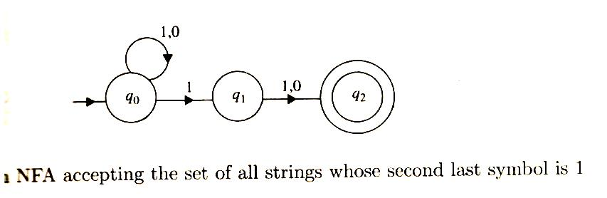
Trace of Subset Construction Scheme Algorithm
Following are NFA componets :
Q_{N} = { q0, q1, q2 }
∑ = { 0, 1 }
δ_{N} = { Transition function Refer above Diagram }
q0 = q0
F_{N} = {q2}
if N is the number of states for NFA and DFA will have 2^{N} number of states
N=3 hence DFA will have 8 states.
Following are the DFA compoinets :
Q_{D} = { {Ø}, {q0}, {q1}, {q2}, {q0,q1}, {q01,q2}, {q1,q2}, {q0,q1,q2} }
∑ = { 0, 1 }
δ_{D} = { Obtained by subset construction scheme }
q0 = {q0}
F_{N} = { Obtained by subset construction scheme }

Slide 36
δ_{D} | 0 | 1 | δ_{D} → Caclulations for inputs 0 and 1
{Ø} | {Ø} | {Ø} | δ_{D}({Ø}, 0) = δ_{N}({Ø}, 0) = {Ø} and δ_{D}({Ø}, 1) = δ_{N}({Ø}, 1) = {Ø}
→{q0} | {q0} | {q0,q1} | δ_{D}({q0}, 0) = δ_{N}(q0, 0) = {q0} and δ_{D}({q0}, 1) = δ_{N}(q0, 1) = {q0,q1}
{q1} | {q2} | {q2} | δ_{D}({q1}, 0) = δ_{N}(q1, 0) = {q2} and δ_{D}({q1}, 1) = δ_{N}(q1, 1) = {q2}
ӿ{q2} | {Ø} | {Ø} | δ_{D}({q2}, 0) = δ_{N}(q2, 0) = {Ø} and δ_{D}({q2}, 0) = δ_{N}(q2, 0) = {Ø}
{q0,q1} | {q0,q2} | {q0,q1,q2} | δ_{D}({q0,q1}, 0) = δ_{N}(q0, 0) Ụ δ_{N}(q1, 0) = {q0} Ụ { q2} = { q0,q2 } δ_{D}({q0,q1}, 1) = δ_{N}(q0, 1) Ụ δ_{N}(q1, 1) = {q0,q1} Ụ { q2} = { q0, q1,q2}
ӿ{q0,q2} | {q0} | {q0,q1} | δ_{D}({q0,q2}, 0) = δ_{N}(q0, 0) Ụ δ_{N}(q2, 0) = {q0} Ụ {Ø} = {q0} δ_{D}({q0,q2}, 1) = δ_{N}(q0, 1) Ụ δ_{N}(q2, 1) = {q0, q1} Ụ {Ø} = {q0,q1}

Slide 37
δ_{D} | 0 | 1 | Calulations for inputs 0 and 1
ӿ{q1,q2} | {q2} | {q2} | δ_{D}({q1,q2}, 0) = δ_{N}(q1, 0) Ụ δ_{N}(q2, 0) = {q2} Ụ {Ø} = {q2} δ_{D}({q1,q2}, 1) = δ_{N}(q1, 1) Ụ δ_{N}(q2, 1) = {q2} Ụ {Ø} = {q2}
ӿ{q0,q1,q2} | {q0,q2} | {q0,q1,q2} | δ_{D}({q0,q1,q2}, 0) = δ_{N}(q0, 0) Ụ δ_{N}(q1, 0)Ụδ_{N}(q2, 0) = {q0} Ụ { q2} Ụ {Ø} = { q0,q2) δ_{D}({q0,q1,q2}, 1) = δ_{N}(q0, 1) Ụ δ_{N}(q1, 1)Ụδ_{N}(q2, 1) = {q0,q1} Ụ { q2} Ụ {Ø} = { q0, q1,q2 }

Slide 38
Conversion of NFA to DFA by using Subset Construction Scheme by Lasy Evaluation
In this method we will not consider 2^{N} number of states in finding δ_{D} as not all states are relevant.
i.e few states which are not reachable from start state are irrelavant and those states should not be considered while computing δ_{D} for DFA.
This method of computing δ_{D} only for relevant state (reachable state) is called subset construction scheme by Lazy evaluation

Slide 39
1. Initialize DFA state set QD to {q0} and is the start state of DFA D which is the set containing only the start state of NFA N.
2. While (δ_{D} for all DFA state in Q_{D} is not defined) Do
Begin
For each state ‘S’ in Q_{D} and for each ‘a’ in ∑ find next state T_{D} by applying transition function δ_{N}
and add T_{D} to Q_{D} if it is not already there.
i.e δ_{D}(S, a) = Ụ δ_{N}(p, a) → T_{D}
^{p in S}
END
3. FD is final states of DFA which contains all sets of NFA’s states that include at least one final state of NFA.
i.e if State S in FD then S ∩ F_{N} <> Ø

Slide 40
Example -1 NFA to DFA conversion by Subset Construction Schmeme by set LASY EVALUATION
Let Q_{D} initialized to be {q0} i.e Q_{D}= {q0}

Slide 41
Q_{D} = { {q0}, {q0,q1}, {q0, q2}, {q0, q1, q2 } }
δ_{D} | 0 | 1 | δ_{D} → Calulations for inputs 0 and 1
→{q0} | {q0} | {q0,q1} | δ_{D}({q0}, 0) = δ_{N}(q0, 0) = {q0} → Old set Not ADDED to Q_{D} δ_{D}({q0}, 1) = δ_{N}(q0, 1) = {q0,q1} → New set for DFA added to Q_{D}
{q0,q1} | {q0,q2} | {q0,q1,q2} | δ_{D}({q0,q1}, 0) = δ_{N}(q0, 0) Ụ δ_{N}(q1, 0) = {q0} Ụ { q2} Ụ {Ø} = { q0,q2 } New set for DFA added to Q_{D} δ_{D}({q0,q1}, 1) = δ_{N}(q0, 1) Ụ δ_{N}(q1, 1) = {q0,q1} Ụ { q2} Ụ {Ø} = { q0, q1,q2} New set for DFA added to Q_{D}
ӿ{q0,q2} | {q0} | {q0,q1} | δ_{D}({q0,q2}, 0) = δ_{N}(q0, 0) Ụ δ_{N}(q2, 0) = {q0} Ụ {Ø} = {q0} → Old set Not ADDED to Q_{D} δ_{D}({q0,q2}, 1) = δ_{N}(q0, 1) Ụ δ_{N}(q2, 1) = {q0, q1} Ụ {Ø} = {q0,q1} → Old set Not ADDED to Q_{D}

Slide 42
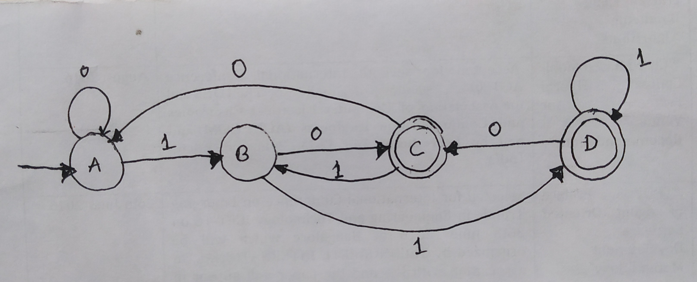
Q_{D} = { {q0}, {q0,q1}, {q0, q2}, {q0, q1, q2 } }
δ_{D} | 0 | 1 | δ_{D} → Calulations for inputs 0 and 1
ӿ{q0,q1,q2} | {q0,q2} | {q0,q1,q2} | δ_{D}({q0,q1,q2}, 0) = δ_{N}(q0, 0) Ụ δ_{N}(q1, 0)Ụδ_{N}(q2, 0) = {q0} Ụ { q2} Ụ {Ø} = { q0,q2) → Old set Not ADDED to Q_{D} δ_{D}({q0,q1,q2}, 1) = δ_{N}(q0, 1) Ụ δ_{N}(q1, 1)Ụδ_{N}(q2, 1) = {q0,q1} Ụ { q2} Ụ {Ø} = { q0, q1,q2 } → Old set Not ADDED to Q_{D}
δ_{D} for all DFA state in Q_{D} have been defined
We can rename the states and write the Final DFA diagram.
Q_{D} = { {q0} → A,
{q0,q1} → B,
{q0, q2}→ C,
{q0, q1, q2 }→ D
}

Slide 43
Exercise problems on NFA to DFA conversion
Ex-1 Ex-3
Ex-2 Ex-4
δ | 0 | 1
→p | {p, r} | q
q | {r, s} | p
*r | {p, s} | r
*s | {q, r} | Ø
δ | 0 | 1
→q₀ | {q₀, q1} | [q1]
q1 | q2 | q2
*q2 | Ø | q2
δ | 0 | 1
→p | {p, q} | p
q | {r, s} | t
r | {p, r} | t
*s | Ø | Ø
*t | Ø | Ø
δ | 0 | 1
→q₀ | {q₀, q1} | [q0]
q1 | Ø | q2
*q2 | {q0, q2} | q1

Slide 44
Є-NFA
Introduction
Formal Definition
Processing of string
Extended Transition Function δ*
What is Є-Closure? And its definition
Definition of Extended Transition Function δ*
Languages of Є-NFA
Conversion of Є-NFA to DFA using subset construction Scheme by Lazy evaluation
Algorithm
Examples
Theorems

Slide 45
Introduction
Whenever a Transition takes place from one state to another State we say that NFA or DFA has taken a move and input is consumed and the input pointer is advanced to Next char.
But some times it necessary to take a transition spontaneously without consuming or reading the input. NFA with this feature is called as Є-NFA. This gives an added programming convenience to finite automata.

Slide 46
Formal Definition
Formally we represent Є-NFA E by E={Q_{E},∑,δ_{E}, q0, F_{E}} where all components have their same interpretation as for an NFA, except that δ_{E} is now a function that takes as arguments:
1. A state in Q_{E}and
2. A member of ∑ Ụ {Є }, that is either an input symbol or the symbol Є.

Slide 47
Processing of string and Extended Transition Function δ*
Ԑ-NFA uses Є-closure() function while processing the string ‘w’ which can be defined as follows :
Є-closure of any state q contains a state q and all the states from q that are reachable with only Є-transition.
Formally we can define Є-closure of state q - ECLOSE(q) is recursively as follows :
Basis : State q is in ECLOSE(q).
INDUCTION : If state p is ECLOSE(q) and there is transition from state p to state r labeled Є then r is in ECLOSE(q)

Slide 48
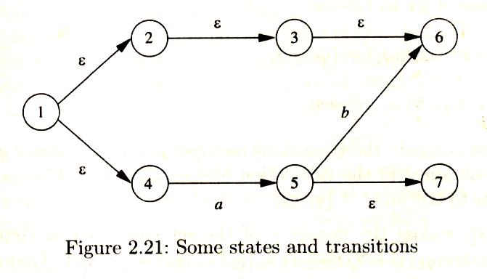
Example to use Є-closure() function
Є-closure(1) = { 1 } → By Basis state 1 is included in the set
= { 1, 2, 4 } → By Induction as from state 1, 2 and 4 are reachable only by Ԑ - Treansition
= { 1, 2, 4, 3 } → By Induction as from state 2, state 3 is reachable only by Ԑ - Treansition
= { 1, 2, 4 3, 6 } → By Induction as from state 3, state 6 is reachable only by Ԑ - Treansition
= { 1, 2, 4 3, 6 } → Computaion stops as from states 1,2, 4,3,6 no other staes can reached with
Ԑ - Treansition

Slide 49
Extended transition function δ* :
The extended transition function δ* for Є- NFA is an extension of Transition function δ of Є-NFA and is defined as follows
BASIS : δ*(q,Є) =ECLOSE(q) that is without reading any input symbols Є- NFA is in the set of states which is Є-closure of state q.
INDUCTION: Suppose w is of the form w=xa where a is the final symbol of w and x is the rest of w. Note that aЄ∑ and it cannot be Є.
Then δ*(q, w)= δ(δ*(q, x),a)
If δ*(q, x) ={p1, p2,……..pk} then
_{k}
δ*(q, w)= δ(δ*(q, x),a) = Ụ δ(pi, a) = {r1,r2…rm}
^{i=1} _{m}
= Ụ ECLOSE( rj )
^{j=1}

Slide 50
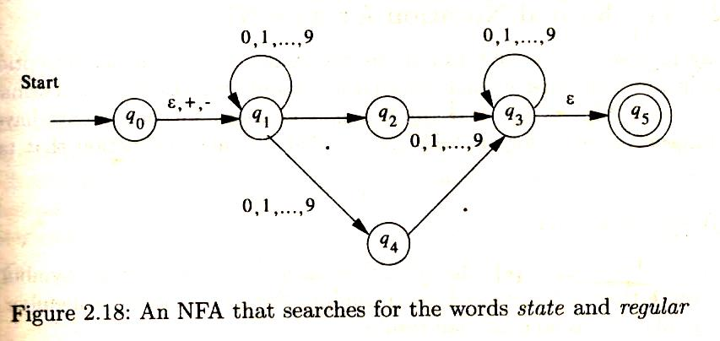
Use of Extended transition function δ* to validate the inputs : Example -1 - Computation of δ*(q0, -2•62) : δ*(q0,Ԑ) = Є-closure(q0) → By Basis = {q0,q1} δ*(q0,-) =δ(δ*(q0,Ԑ),-) = δ({q0,q1},-) ← By induction = δ({q0,-) Ụ δ(q1,-) = { q1} Ụ {Ø} = {q1} = Є-closure(q1) ← By Induction = {q1}

Slide 51
Use of Extended transition function δ* to validate the inputs : Example -1 - Computation of δ*(q0, -2•62) : δ*(q0,-2) =δ(δ*(q0,-), 2) = δ({q1}, 2) ← By induction = δ({q1}, 2) = { q1, q4} = Є-closure(q1,q4) ← By Induction = {q1,q4}
δ*(q0,-2•) =δ(δ*(q0,-2), •) = δ({q1,q4}, •) ← By induction = δ({q1}, •) Ụ δ({q4}, •) = { q2} Ụ {q3} = Є-closure(q2,q3) ← By Induction = {q2,q3,q5} δ*(q0,-2•6) =δ(δ*(q0,-2•), 6) = δ({q2,q3,q5}, 6) ← By induction = δ({q2}, 6) Ụ δ({q3}, 6) Ụ δ({q5}, 6) = { q3 } Ụ {q3} Ụ {Ø}
= {q3} = Є-closure(q3) ← By Induction = {q3,q5}

Slide 52
δ*(q0,-2•62) =δ(δ*(q0,-2•6), 2) ← By induction = δ({q3,q5}, 2) =
= δ({q3}, 2) Ụ δ({q5}, 6)
= { q3 } Ụ {Ø}
= {q3} = Є-closure(q3) ← By Induction = {q3,q5}
The string w = -2•62 is valid as Ԑ-NFA remains in {q3,q5} and contains q5, the final state
Exercise problems :
Validate the following input Decimal Numbers :
{ +8.98, 56.92 and 23..45 }

Slide 53
Languages of an Є-NFA
If E={Q,∑,δ, q0, F} is an Є-NFA then
L(E) = {w | δ*(q0,w) П F<> φ }
that is L(E) is the set of strings w in ∑ * such that δ*(q0,w) contains at least one accepting state

Slide 54
Conversion of Ԑ-NFA to DFA by using Subset Construction Scheme by Lasy Evaluation
In this method we will not consider 2^{N} number of states in finding δ_{D} as not all states are relevant.
i.e few states which are not reachable from start state are irrelavant and those states should not be considered in computing δ_{D} .
This method of computing δ_{D} for only relevant state (reachable state) is called subset construction scheme by Lazy evaluation

Slide 55
1. Initialize DFA state set QD to ECLOSE(q0) and is the start state of DFA D which is the set containing only the start state of Ԑ-NFA N.
2. While (δ_{D} for all DFA state in Q_{D} is not defined) Do
Begin
For each state ‘S’ in Q_{D} and for each ‘a’ in ∑ find next state T_{D} by applying transition function δ_{N}
and add T_{D} to Q_{D} if it is not already there.
i.e δ_{D}(S, a) = Ụ δ_{N}(p, a) → T_{D}
^{p in S}
and then Find ECLOSE(T_{D}) and add to Q_{D} if it is
not already there
END
3. FD is final states of DFA which contains all sets of Ԑ-NFA’s states that include at least one final state of Ԑ-NFA.
i.e if State S in FD then S ∩ F_{N} <> Ø

Slide 56
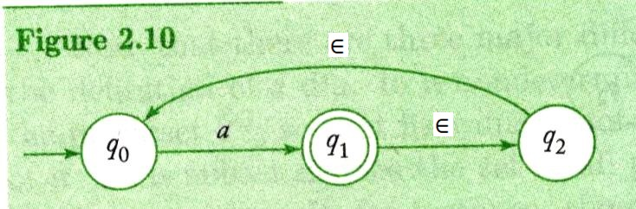
Example -1 Ԑ-NFA to DFA conversion
Q_{D}= { {q0}, {q1,q2,q0} }
Ԑ-Closure(q0) = {q0} → Initial state for DFA and added to Q_{D}
δ_{D} | a | δ_{D} → Calulations for inputs a € ∑
→{q0} | {q1,q2, q0} | δ_{D}({q0}, a) = δ_{N}(q0, a) = {q1} and Ԑ-Closure(q1) = {q1,q2,,q0} → New set for DFA added to Q_{D}
ӿ{q1,q2,q0} | {q1,q2,q0} | δ_{D}({q1,q2,q0}, a) = δ_{N}(q1, a) Ụ δ_{N}(q2, a) Ụ δ_{N}(q0, a) = {Ø} Ụ { Ø} Ụ {q1} = {q1} Ԑ-Closure(q1) = {q1,q2,q0} Not ADDED to Q_{D}
δ_{D} for all DFA state in Q_{D} have been defined

Slide 57
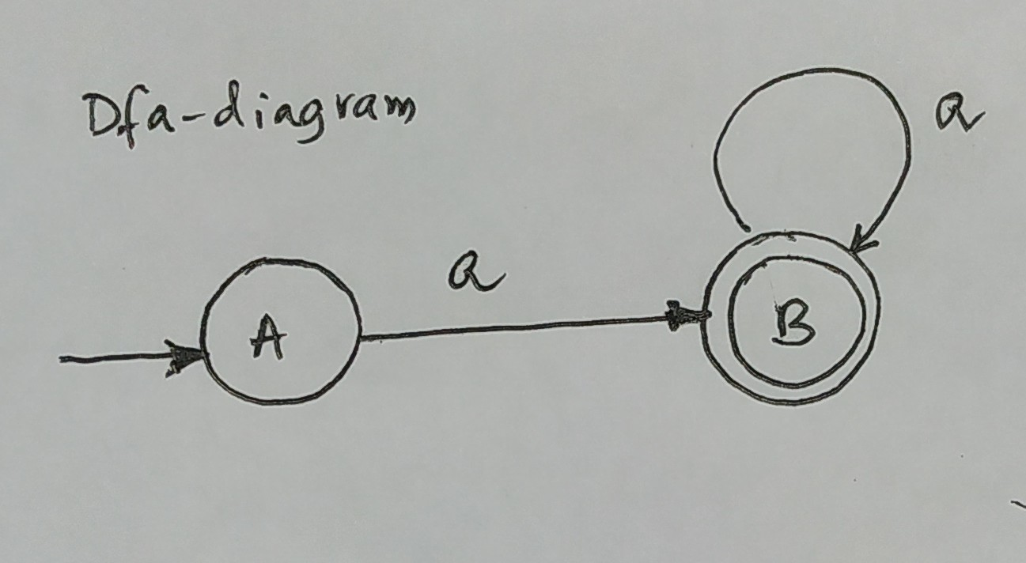
We can rename the states and write the Final DFA diagram.
Q_{D} = { {q0} → A,
{q1, q2, q0} → B,
}

Slide 58
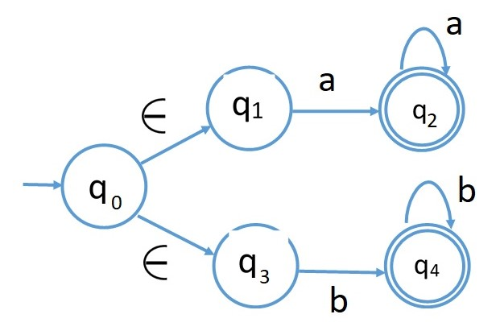
Example -2 Ԑ-NFA to DFA conversion
Q_{D} = { { q0, q1, q3 } }
Ԑ-closure (q0) = { q0, q1, q3 } → Initial state for DFA and added to Q_{D}

Slide 59
Q_{D} = { { q0, q1, q3 }, {q2}, {q4}, {Ø} }
δ_{D} | a | b | δ_{D} → Calulations for inputs a,b € ∑
→{q0,q1,q3} | {q2} | {q4} | δ_{D}({q0,q1,q3}, a) = δ_{N}(q0, a) Ụ δ_{N}(q1, a) Ụ δ_{N}(q3, a) = {Ø} Ụ {q2} Ụ {Ø} = {q2} Ԑ-Closure(q2) = {q2} → New set for DFA added to Q_{D} δ_{D}({q0,q1,q3}, b) = δ_{N}(q0, b) Ụ δ_{N}(q1, b) Ụ δ_{N}(q3, b) = {Ø} Ụ {Ø} Ụ {q4} = {q4} Ԑ-Closure(q4) = {q4} → New set for DFA added to Q_{D}
ӿ{q2} | {q2} | {Ø} | δ_{D}({q2}, a) = δ_{N}(q2, a) = {q2} Ԑ-Closure(q2) = {q2} Not ADDED to Q_{D} δ_{D}({q2}, b) = δ_{N}(q2, b) = {Ø} Ԑ-Closure(Ø) = { Ø} → New set for DFA added to Q_{D}
ӿ{q4} | {Ø} | {q4} | δ_{D}({q4}, a) = δ_{N}(q4, a) = {Ø} Ԑ-Closure(Ø) = {Ø} Not ADDED to Q_{D} δ_{D}({q4}, b) = δ_{N}(q4, b) = {q4} Ԑ-Closure(q4) = { q4} → New set for DFA added to Q_{D}
{Ø} | {Ø} | {Ø} | δ_{D}({Ø}, a) = δ_{N}({Ø}, a) = {Ø} Ԑ-Closure(Ø) = {Ø} Not ADDED to Q_{D} δ_{D}({Ø}, b) = δ_{N}({Ø} b) = {Ø} Ԑ-Closure(q4) = {Ø} Not ADDED to Q_{D}
δ_{D} for all DFA state in Q_{D} have been defined

Slide 60
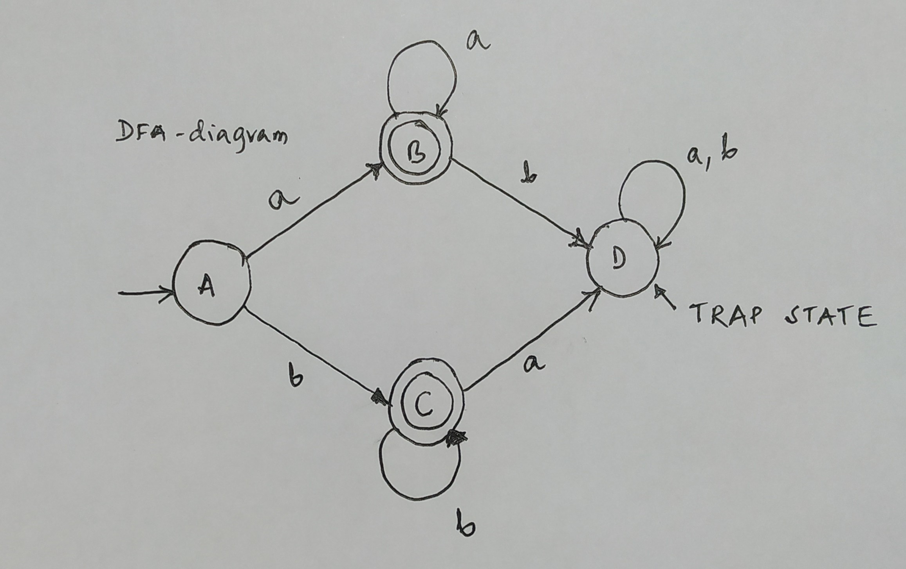
We can rename the states and write the Final DFA diagram.
Q_{D} = { {q0,q1,q3} → A,
{q2} → B,
{q4}→ C,
{Ø }→ D
}

Slide 61
Excecise problems on Ԑ-NFA
Ex-1 Consider the following Ԑ-NFA
a. Compute Ԑ-closure of each state.
b. Convert to an Equivalent DFA
Ex-1 Consider the following Ԑ-NFA
a. Compute Ԑ-closure of each state.
b. Convert to an Equivalent DFA
δ, | Ԑ | a | b
→p | {r} | { q} | {p, r}
q | Ø | {p} | Ø
*r | {p,q} | {r} | {p}
δ, | Ԑ | a | b | c
→p | {q,r} | Ø | {q } | {r}
q | Ø | {p} | {r} | {p,q}
*r | Ø | Ø | Ø | Ø
Ex-3. Convert the following Ԑ-NFA to and an equivalent DFA

Slide 62
Theorem-2
Definition : If D=(Q_{D},∑,δ_{D}, {q₀}, F_{D}) is the DFA constructed from N =(Q_{N},∑,δ_{N}, q₀, F_{N}) by the subset construction scheme then L(D) = L(N).
Proof : By induction we have to first prove on |w| is that
δ_{D}*({q₀}, w)=δ_{N}*(q0,w)
NOTE : We know that δ* function returns a set of state from NFA and δ_{D}* for DFA interprets this as one state of Q_{D.}

Slide 63
BASIS : Let |w| = 0 it means w=Є. By the basis definitions of δ* for DFA and NFA
we have δ_{D}*({q0},Є) and δ_{N}*(q0,Є) are {q₀}.
INDUCTION : Let |w| = n, break up w as w=xa where a is the final symbol of w and x is the remaining characters.
By the Induction hypothesis of δ_{N}* on w, we know that
δ_{N}*(q0,w) = δ_{N} (δ_{N}*(q0,x),a)
In order to see the transition δ_{N} on ‘a’ we must have processed x from start state q0. Let δ_{N}*(q0,x) = {p1,p2…pk}.
Therefore the inductive part of the definition of δ* for NFA tells us that
δ_{N}*(q0,w) = δ_{N}(δ_{N}*(q0,x) a)= δ_{N} ({p1,p2…pk},a)
k
= Ụ δ_{N}*(pi, a) → 1
^{i=1}

Slide 64
By induction hypothesis of δ_{D}* on ‘w’ we know that
δ_{D}*({q0}, w)= δ_{D}(δ_{D}*({q0},x),a) where w=xa such that a is the final symbol of w and x is the remaining characters.
Here in order to see the transition δ_{D} on ’a’ we must have processed ‘x’.
By subset construction scheme, δ_{D} is expressed in term δ_{N} and set of NFA states is one DFA state in Q_{D}.
i.e δ_{D}*({q0},x) = δ_{N}*(q0,x) = {p1,p2…pk}
There for δ_{D}* on w is expressed as :
δ_{D}*({q0}, w) = δ_{D}(δ_{D}*({q0},x),a)
= δ_{D}(δ_{N}*({q0},x),a) k
=δ_{D}({p1,p2..pk},a) = Ụ δ_{N}(pi, a) → 2
i=1
From 1 and 2 it demonstrates that
δ_{D}*({q0}, w)= δ_{N}*(q0,w) and w is valid only when they contain state ‘p’ in F_{N.}
This proves the argument of the theorem that L(D) = L(N), when DFA is constucted from NFA by a Subset construction Schme.

Slide 65
END of UNIT-1.

