Slide 1
Topics to be covered :
UNIT-3. CONTEXT FREE GRAMMARS(CFG) AND LANGUAGES(CFL)
Context Free Grammars and Languages : Context free Grammars, Parse Tree, Applications of Context free Grammars, Ambiguity in the grammars and Languages. Normal Forms for Context free Grammar
Upon completion you will be able to
Explain the concepts of Context free grammars and its Applications.
Write the context free grammars for languages.
Demonstrate the ambiguity in the context free grammars.
Explain the Normal forms for Context Free grammars

Slide 2
CONTEXT FREE GRAMMARS(CFG) AND LANGUAGES(CFL)
Context Free Grammars
1.1. Introduction and Formal Defination
1.2. Notational Conventions
1.3. Derivations and Parse Tree.
1.3.1. Language of a Grammar
1.3.2. Sentential Forms
1.3.3. Parse Tree
1.3.4. Examples on derivations and Parse tree
1.4. Building Context free grammars for the Languages.
1.5. Ambiguity in Grammar with Examples
1.6. Applications of Context Free Grammars
2. Normal forms for Grammars
2.1. Introduction
2.2. Eliminating Ԑ-Productions
2.3. Eliminating Unit productions
2.4. Eliminating Useless Productions.
2.5. Chmosky Normal Forms - CNF

Slide 3
1. Context Free Grammar
1.1. Introduction and Formal Defination
Up till now we studied the langauges, known as class of regular languages, that are very basic and primitives in nature. These languages are described by using the mechanism called Regular expressions and are being recognized by a finite automata (DFA).
Also, With reference to the discussion from Pumping lemma, we know that there are certain languages which are NON Regular and these langauges are large class of languages called Context free Languages.
These languages are very important and have very complex structure that involves recursive definiations.
In order to describe these langauges, we have a very powerful mechanism called the Grammar and to recognize these languages we have a Automata called Push down Automata.
The Grammar usually describes the strurcture of a sentence/construct by imposing the a heirachical structure .

Slide 4
For example a grammar for the english language describes whether the perticular sentence is well formed or not.
In otherwords, a heirachical structure of a simple sentence may be described as follows
A Simple <Sentence> is composed of :
< Noun phrase > followed by < Predicate >.
A < Noun phrase > is made up of
<Article > followed by <Noun>
and Finally < Predicate > is composed of
< Verb >.
if we associate the actual words like, “a”, and “the” with <Article>, “boy” and “dog” with < Noun > and “runs” and “walks “ with <Verbs> then the grammar tells the sentence “ a boy runs” and “ the dog walks” are well formed or not.

Slide 5
The hierchical structure of the above sentence can be described by Backus Naur Form - BNF notation as follows :
< Sentence > → < NounPhrase > < Predicate >
< NounPhrase > → < Article > < Noun >
< Predicate> → < Verb >
< Article > → a | the |...........
< Noun > → boy | dog |............
< Verb > → runs | walks |..........
In the above notation, the symbols in angular brackets are called syntactic variables or Non-terminals namely, < Sentence >, < NounPhrase > < Predicate >.
And the symbols without angular brackets are called Terminals or Tokens( primitives) namely, a, the, boy, dog, runs, walks,......
The statements of the form :< Sentence > → < NounPhrase > < Predicate > are called production rules

Slide 6
Formal Defination Grammar
As discussed about the grammar, we know that the grammar is notation to describe the structure of a sentence and Formally it can be defined as follows :
A grammar G is defined as a Quadraple
G = { V, T, S, P }
Where
V is a Finite set of Variables or Non-terminals
→They denote the set of strings that forms the language
T is a Finite set of Terminal or Tokens
→ These are the basic symbols from which the strings are formed
S € V is a special Symbol called the start symbol
→ This symbol is used to genarate the sentence of a langauge
P is a finite set of Productions.
→ These are nothing but the rules to specify the manner in which the Terminals and Non Terminals can be combined to form strings

Slide 7
Each production rule is of the following form :
<HEAD> → <BODY> it can read as head derives body
Here <HEAD> → is a Non-terminal or the left side of a production
and <BODY> → is a right side of a production consisting of zero or more terminals and Non-terminals
Example -1 : G = { V, T, S, P }
where V = { E }
T = { +, -, *, / , (, ), id, digit }
S = { E }
P = { E → E + E
| E - E
| E * E
| E / E
| ( E )
| id
| digit }
Example -2 : G = { V, T, S, P }
where V = { S, A }
T = { a, b }
S = { S }
P = { S → AS | Ԑ
A → aa | ab | ba | bb
}

Slide 8
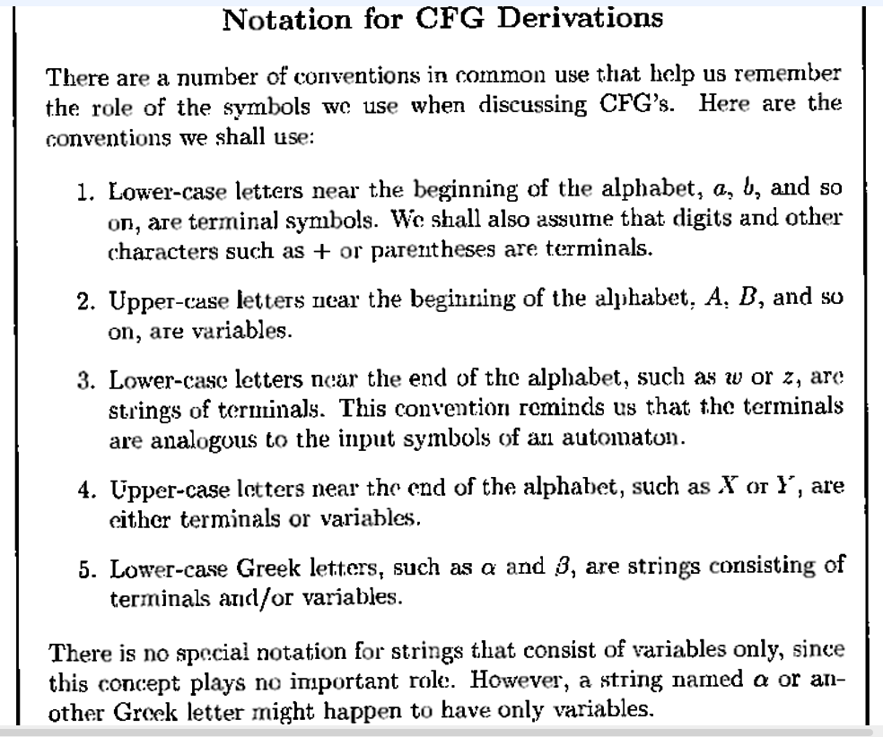
1.2. Notational Conventions

Slide 9
1.3. Derivations and Parse Tree
In order to define the langauge assicaited with Grammar G we apply the productions rules to infer that certain strings are in the language.
There are two approaches :
Approach -1 → This is more conventional approach where the production rules used from body to head. That is, we take strings known to be in the language of each of the variables of the body of production, concatenate them in the proper order, with any terminals appearing in the body, and infer that the resulting strings is in the language of the varibale in the head.
This is called recursive inference.

Slide 10
1.3. Derivations and Parse Tree
Approach -2 → In this approach we use the productions from head to body. We expand the Start Symbol using one of its productions. We further expand the resulting string by replacing one of the variables by the body of one of the productions, and so on, until we derive a string consisting entirely of terminals. The langauge of the grammar is all strings of teminals, that we can obtain in this way.
This is called as derivation process.
Example → Consider the grammar with following Productions :
E → E + E | E – E
E → ( E )
E → E * E | E / E
E → - E
E → id | digit

Slide 11
Let w = id + id, and Consider the derivation step - E ⇒ E+E , which is the initial step of expansion of start symbol → E
Since, E+E derives from E
we can replace E by E+E to get a string - E+E in the derivation step.
i.e. E ⇒ E+E
to able to do this, we have to have a production rule E→E+E in our grammar.
This is then continued until we derive a string consisting entirely of terminals.
In oherwords, in the next derivation step, We can replace id by E as we have a production rule E→id to get a string - id + E. .
i. e. E ⇒ E+E ⇒ id+E
Finally, we can replace id by E again to get a string-id+id, consisting of eniterly of terminals to end the derivation Process.
i. e. E ⇒ E+E ⇒ id+E ⇒ id+id

Slide 12

Beginning with Start Non-terminal, we identify the sequence of replacements for non-terminal symbols, until we derive a string consisting entirely of terminals is called a derivation of string id+id from E.
In general, αAβ ⇒ αγβ is a derivation step, where A→γ is a production in our grammar and α and β are arbitrary strings of terminal and non-terminal symbols.
In the derivation process, we have the choices of replacements of Non-terminal symbols and to restrict the number of choices there are two types of derivations namely, Leftmost Derivation and Rightmost Derivation.
Leftmost Derivation : A derivation is said to be Leftmost derivation if, at each step the replacements are done by considering LEFTMOST non-terminal.
We indicate Leftmost derivation by a symbol →

Slide 13

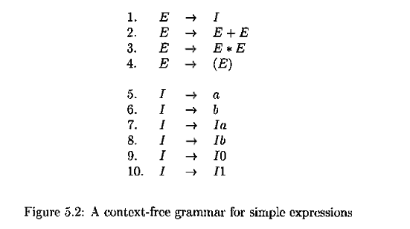
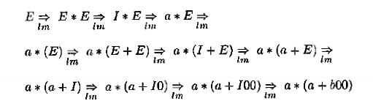

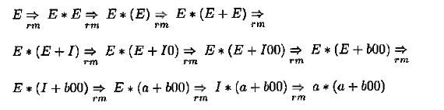
Rightmost Derivation : A derivation is said to be Rightmost derivation if, at each step the replacements are done by considering RIGHTMOST non-terminal.
We indicate the Rightmost derivation by a symbol →
Example
Leftmost Derivation For the Input → a*(a+b00)
Rightmost Derivation For the Input → a*(a+b00)

Slide 14
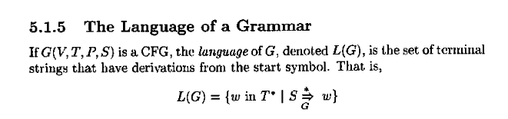
1.3.1 Language of a Grammar

Slide 15
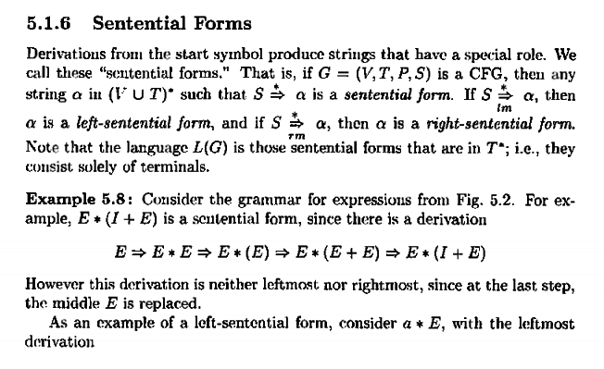

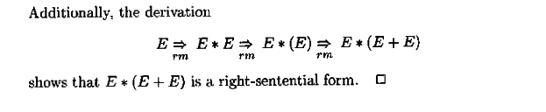
1.3.2 Sentential Form

Slide 16
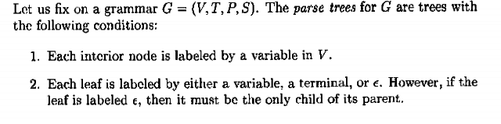
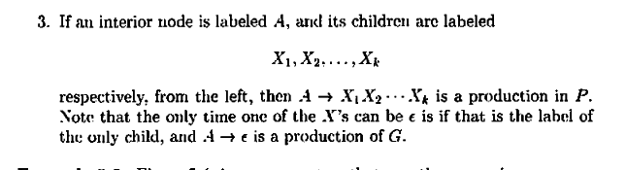
1.3.3. Parse Tree
Parse Tree is graphical representation of a derivation process which clearly shows how the symbols of a terminal strings are grouped into a substring belonging to a language.
Formaly it is defined as follows :

Slide 17
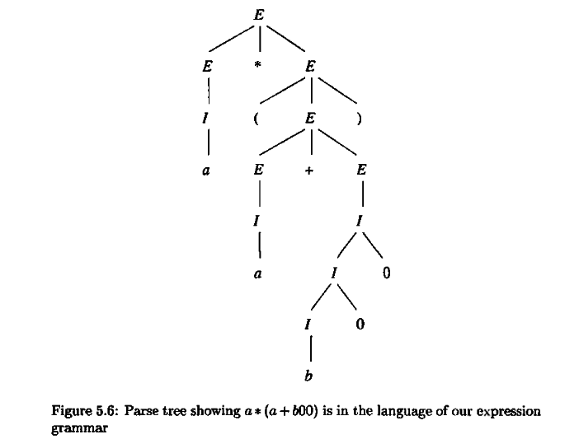
Example of Parse Tree on input string - → a*(a+b00)

Slide 18
1.3.4. Examples on Derivations and Parse Tree
Example -1
Consider the grammar G = { {S, A, B}, {a, b}, {S}, P }
P - { S → b A │a B
A → b A A │ a S │ a
B → a B B │ b S │ b
}
Write leftmost and rightmost derivation for the following sentences along with Parse tree.
i. bbaaba ii. bbbaaaba

Slide 19
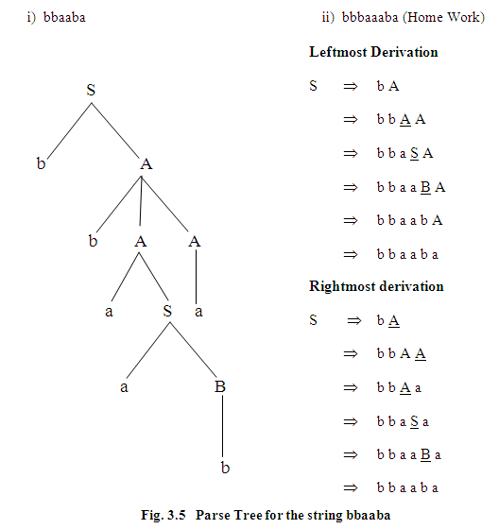
P - { S → b A │a B
A → b A A │ a S │ a
B → a B B │ b S │ b
}

Slide 20
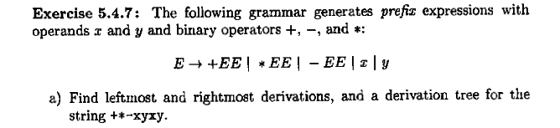
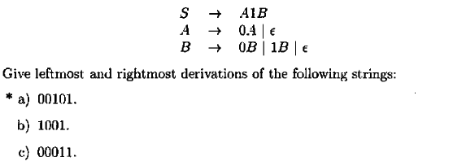
Example -2
Example -3
Example -4
S → AS│Ԑ
A → aa│ ab │ ba │bb
Give Leftmost and rightmost derivations and a parse tree for following Srings
i. aabbba ii. baabab iii. aaabbb

Slide 21
Example -5
S → aAS│a
A → SbA │ba
Give Leftmost and rightmost derivations and Parse tree for following Srings - aabbba
Example -6
S → AaAb│BbBa
A → aAb│ bAB │ d
B → aB│ bB │ a
Give Leftmost and Rightmost derivations and Parse Tree for following Srings
i. aabbba ii. badbabaadb
Example -7
E → ET+│T
T → TF*│ F
F → FP ↑│ P
P → E │ id
Give Leftmost and Rightmost derivations and Parse Tree for following Srings
i. ididid*+id+ ii. ididid↑id*id*+

Slide 22
1.4. Building Context free grammars for the Languages.
In order to learn the writing of context free grammars,We can start with following easiest steps :
A. Building Context free grammar for Regular Languages
i. Context free grammar from finite automata.
ii. From Regular Expressions
B. Building Context free grammar for Other Languages

Slide 23
A. Building Context free grammar for Regular Languages
i. Context free grammar from finite automata.
Method : Let M = { Q, ∑, δ, q0, F} be a DFA accepting the
language L. The Grammar G = {V, T, S, P} can be
constructed as follows :
V = { q0, q1...qn} → The states of DFA will be Non-Terminals
T = { ∑ } → The inputs are the Terminal Symbols.
S = q0 → The start state of DFA will be the Start Symbol
P = The productions can obtained as follows :
If δ(qi, a) = qj then introduce the productions as - qi → aqj
if qi € F then introduce the productions as - qi → Ԑ

Slide 24
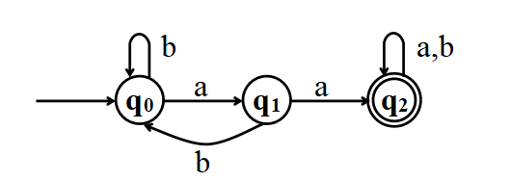
Examples :
G = { V, T, S, P}
V= {q₀, q₁, q₂} S = { q₀}
T = { a, b }
P { Refer Following table }
Example -1
δ→Transitions | Productiuons
δ(q_{0,}a) = q₁ | q₀→aq₁
δ(q₀, b) = q₀ | q₀→bq₀
δ(q₁, a) = q₂ | q₁→aq₂
δ(q₁, b) = q₀ | q₁→bq₀
δ(q₂, a) = q₂ | q₂ →aq₂
δ(q₂, b) = q₂ | q₂ →bq₂
q₂ € F | q₂ → Ԑ

Slide 25
B. Building Context free grammar for Regular Languages
ii. Context free grammar from Regular Expressions
Method : The grammar can obtained by breaking the given
regular expression into smaller one and introducing
the new variables and associated productions for the
smaller Regular expressions.
expressions.
Example - 1. Regular Expression = a*
Productions S → aS
Example - 2. Regular Expression = ab( a + b )*
Productions S → S₁S₂
S₁→ ab
S₂ →aS₂ │bS₂ │Ԑ

Slide 26
B. Building Context free grammar for other Languages
i. Obtain a grammar to genarate the following Languages
1. L = { a^{n} b^{n} | n>= 0 }
2. L = { a^{n+1} b^{n} | n>= 0 }
3. L = { a^{n} b^{n+1} | n>= 0 }
4. L = { a^{2n} b^{n} | n>= 0 }
5. L = { a^{n} b^{2n} | n>= 0 }
6. L = { ww^{R} | w € (a+b)* }
7. L = { w | n_{a}(w) = n_{b}(w) and w € (a+b)* }
8. L = { w | n_{a}(w) > n_{b}(w) and w € (a+b)* }
9. L = { w | n_{a}(w) < n_{b}(w) and w € (a+b)* }
10. L = { 0^{m}1^{m} 2^{n} | m, n>= 0 }
11. L = { a^{n} b^{n-3} | n>= 3 }

Slide 27
B. Building Context free grammar for other Languages
12. L = { a^{n} b^{n+3} | n>= 0 }
13. L = { a^{i} b^{j} c^{k} | j, k >= 0 and i=j+k }
14. L = { a^{i} b^{j} c^{k} | i, k >= 0 and j=i+k }
15. L = { a^{n} b^{m} c^{k} | m, n >= 0 and n+2m=k }
16. L = { a^{m} b^{n}| m > n, m, n >=0 }
17. L = { a^{m} b^{n}| m < n, m, n >=0 }
18. L = { a^{m} b^{n}| m <> n, m, n >=0 }
19. L = { a^{n} ww^{R} b^{n} | n>= 0, w € (a+b)*}

Slide 28
B. Building Context free grammar for other Languages
i. Obtain a grammar to genarate the following Languages
1. L = { a^{n} b^{n} | n>= 0 }
Answer = S → a S b│Ԑ
2. L = { a^{n+1} b^{n} | n>= 0 }
Answer = S → a S b│a
3. L = { a^{n} b^{n+1} | n>= 0 }
Answer = S → a S b│b
4. L = { a^{2n} b^{n} | n>= 0 }
Answer = S → aa S b│Ԑ
5. L = { a^{n} b^{2n} | n>= 0 }
Answer = S → a S bb│Ԑ

Slide 29
B. Building Context free grammar for other Languages
6. L = { ww^{R} | w € (a+b)* }
Answer = S → a S a │ b S b │a│b│Ԑ
7. L = { w | n_{a}(w) = n_{b}(w) and w € (a+b)* }
Answer = S → a S b │ b S a│Ԑ
8. L = { w | n_{a}(w) > n_{b}(w) and w € (a+b)* }
Answer = S → a S₁ b │ b S₁ a │S₁
S₁ → a │a S₁
9. L = { w | n_{a}(w) < n_{b}(w) and w € (a+b)* }
Answer = S → a S₁ b │ b S₁ a │S₁
S₁ → b │b S₁
10. L = { 0^{m}1^{m} 2^{n} | m, n>= 0 }
Answer = S → S₁ S₂
S₁→ 0 S₁1│Ԑ
S₂ → 2 S₂ │Ԑ

Slide 30
B. Building Context free grammar for other Languages
11. L = { a^{n} b^{n-3} | n>= 3 }
Answer = S → a S b │aaa
12. L = { a^{n} b^{n+3} | n>= 0 }
Answer = S → a S b │bbb
13. L = { a^{i} b^{j} c^{k} | j, k >= 0 and i=j+k }
Answer = Since i = j+k
L = { a^{j+k} b^{j} c^{k} }
L = { a^{j} a^{k} b^{j} c^{k} }
L = a^{k} a^{j} b^{j} c^{k}
S → a S c │S₁
S₁ → a S₁ b │Ԑ
14. L = { a^{i} b^{j} c^{k} | i, k >= 0 and j=i+k }
15. L = { a^{n} b^{m} c^{k} | m, n >= 0 and n+2m=k }

Slide 31
B. Building Context free grammar for other Languages
16. L = { a^{m} b^{n}| m > n, m, n >=0 }
17. L = { a^{m} b^{n}| m < n, m, n >=0 }
18. L = { a^{m} b^{n}| m <> n, m, n >=0 }

Slide 32
1.5. Ambiguity in the Grammar
A grammar produces more than one parse tree for a sentence is called as an Ambiguous Grammar. In other words there exists more than one leftmost or more than one rightmost derrivations for some sentence S.
Example : E → E + E | E – E
E → ( E )
E → E * E | E / E
E → - E
E → id | digit
Two Leftmost Derivations for → S= id+id*id
E
E
+
E
E ⇒ E+E ⇒ id+E ⇒ id+E*E
⇒ id+id*E ⇒ id+id*id
id
*
E
E
id
id
E
E
*
E
E ⇒ E*E ⇒ E+E*E ⇒ id+E*E
⇒ id+id*E ⇒ id+id*id
E
+
E
id
id
id

Slide 33
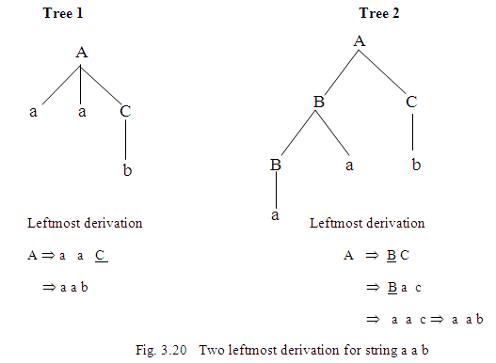
Example: Consider the following grammar
A → B C │ a a C
B → a │ B a
C → b
Prove that the grammar is ambiguous

Slide 34
Examples on Ambiguity
Example - 7 S → aB│bA
A → aS │bAA │a
B → bS │ aBB │ b
w =aaabbabbba
Example - 1 : S → AS│aaa
A → a │Aa
B → a
Example - 2 : S → aS│X
X → aX │a
Example - 3 : S → aSbS│bSaS │Ԑ
Example - 4 : S → SS│aSb │bSa │Ԑ
Example - 5 : S → AB│aaB
A → a │Aa
B → b
Example - 6 : S → aS│aSbS │Ԑ

Slide 35
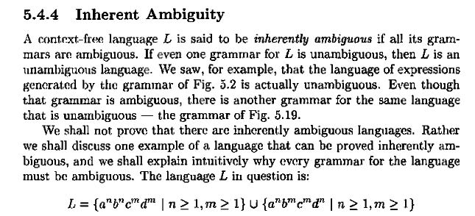
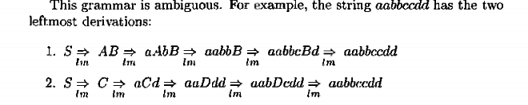
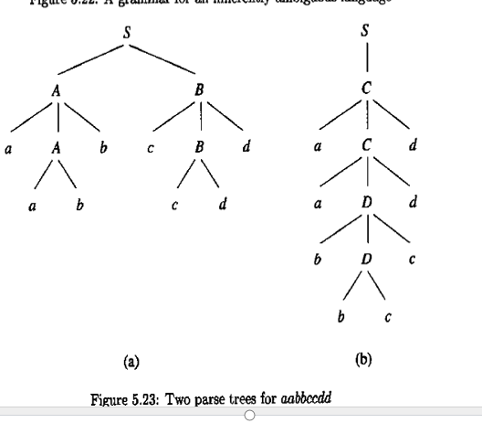
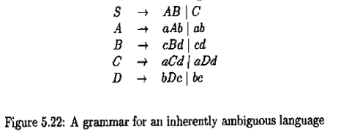

Slide 36
1.6. Applications of Comtext free grammar
•Parsers :
The Parsers are nothing but the program modules written for the Compiler that discovers the structure of source program and represents it in a Parse tree. The Context free grammars are used in describing the structure of source program for many programming languages.
•The YACC Parser Generator :
YACC Parser Genarator is a special tool on UNIX platform that uses Context free grammars as a part of Rule section of YACC specifications along with actions to genarate the Parser program module for a typical Compiler.

Slide 37
1.6. Applications of Comtext free grammar
•Markup Languages :
In the Markup language like HTML -HyperText Markup Language has two major functions : one is to create a link between documents and second is to describe the format of the document. The Context free grammars are used describe the structure of legal HTML documents and guides the processing of documents with respect the display of the document on a monitor or printer.
•XML and Document Type Definitions (DTD) :
In the development XML -Extensible Markup Language, as a part of Document Type Definitions (DTD), the Context Free Grammars are used to describe the allowable tags and how these tags can be nested, where each tag is deals with formating of text and along with its meaningfullness.

Slide 38
2. Normal Forms of Context Free Grammar
2.1. Introduction
We know that Context Free Grammars are more powerful enough to describe the syntax of most of the programming languages.
We also know that the languages that are described by the Context free grammars are called Context free langauges.
in order to take the advantage during the implementation of these context free langauges we ensure that the Conetxt free grammars are in one of the Normal froms where we impose certain restrictions in writing the productions for Context free grammar.
There are Two types of normal forms for the context free grammars :
1. Chomsky Normal Form - CNF
2. Greibach Normal Form - GNF

Slide 39
In Chomsky Normal form, all the productions are of the form : A→BC or A → a, where A, B, and C are all variables and a is terminal symbol
In Greiback Normal Form all the productions are of the form :
A→ax where A is a variable, a € T and x € V*
To get these normal forms for the grammmars, we need to make number of preliminary simplifications. Following are the simplications:
1. We must eliminate Ԑ-productions, those of the from
A →Ԑ for some variable A
2. We must eliminate Unit-productions, those of the from
A → B for some variables A and B.
3. We must eliminate useless varibales, those variables that do not appear in any derivation and genarating a terminal string from the start symbol of the grammar.

Slide 40
2.2. Eliminating Ԑ-Productions
Let G=(V,T,S,P) be a context free grammar. A production of the form A → Ԑ for some A € V is called Ԑ- production.
A variable A is said to be Nuallable, if A ⇒*Ԑ, in zero or more derivation steps are posssible. i.e in every derivation step, we come across only ‘Ԑ ‘ in the sentential form.

Slide 41
2.2. Eliminating Ԑ-Productions
1.We first find all set V_{n} of Nullable variables of G using the following steps:
a. All productions of the form A→Є put A into V_{n}
b. Repeat the following steps until no further variables are added to V_{n}
For all productions A→B₁,B₂,B₃…..B_{n} where B_{i} € V_{n} then add A to V_{n.}
2. We then construct P1(new Production set) by looking at productions in P of the form A→x₁,x₂,x₃……x_{n} for n>1,
where x_{i} € to VUT for each such production of P.
we put into P1 that productions as well as all those productions that are generated by replacing null able variables with Є in all possible combinations.

Slide 42
Working with Example :
S→ ABA
A → aA |Ԑ ,
B → bB | Ԑ
Step -1. Finding Nullable Variables V_{n} :
V_{n} = { A, B, S } → A, B are Nullable as they have Ԑ- productions and S is Nullable as its production body contains all Nullable variables
Step -2. Remove all Ԑ- productions from given grammar G and add new productions by replacing null able variables with Ԑ ie. NULL in all possible combinations. The resulting grammar is follows :
S → ABA | BA | AA | AB | A | B
A → aA | a
B → bB | b

Slide 43



Examples on Elimination of Ԑ-productions
Example -1
Example -2
Example -3
Example -4

Slide 44
2.3. Eliminating UNIT-Productions
Let G= { V, T, S, P} be a context -free -grammar.
A production of the form A → B for some variable A and B € V is called Unit production.
They can be eliminated using the following steps :
Add all Non unit productions to P1 where P1 is a new Production set.
For Each variable A find all variables such that A ⇒*B is possible that is in the derivation process from A we encounter only single variables in the sentential form to B.( no other terminal symbols ). This is obtained by constructing the dependency graph for unit productions only.
By substitution to unit productions we add new productions to P1 for each variable that is if A⇒*B is possible then add all non-unit productions of B to variable A.
Resulting grammar with P1 productions generates the same language as accepted by the original grammar G.

Slide 45
Working with Example :
S → ABA | BA | AA | AB | A | B
A → aA | a
B → bB | b
Step -1. The unit productions are S → A, S →B. Now List all Non Unit productions of Given grammar G
S → ABA | BA | AA | AB
A → aA | a
B → bB | b
Step -2. Write dependency graph for only UNIT - productions and for Each variable A find all variables such that A ⇒*B is possible.
Possible Derivation are of the from
A⇒*B for variables A and B are :
S ⇒*A and S ⇒*B
A
s
B

Slide 46
Add all productions of Variable A and B to the Varibale S and resulting grammar is follows :
S → ABA | BA | AA | AB | aA | a | bB | b
A → aA | a
B → bB | b

Slide 47
Examples on Elimination of Unit-productions
Example -1
Example - 5
S → Aa | B
A → a | bc | B,
B →A | bb
Example -2
Example - 6
S → a | aA | B | C
A→ aB
B → aA | a
C→ cCD
D → ddd
Example -3
Example -4

Slide 48
2.4. Eliminating Useless Productions
Let G = { V, T, S P} be a context free grammar, a variable A € V is said to be useful, if and only if there exits, atleast one W € L(G),
such that S ⇒....xAy⇒ .......⇒ W is possible.
In otherwords a variable A € V is useful if it appears atleast once in the derivation process and evetually leads to a terminal string w € L(G).
A variable ‘A’ is not useful is said to be Useless and associated productions are called as Useless productions.

Slide 49
Procedure to Eliminate Useless variables and Productions
1. First we identify the set of variables that can lead to a
terminal string by the following steps:
Set V1 to NULL where V₁ is set of useful variables.
Repeat the following steps until no more variables are added to V1:
For every A € V for which P has a production of the form A → x₁x₂x₃….x_{n} with all x_{i} € ( V₁ U T ), add A to V₁.
Take all the productions into P1 whose symbols are all in (V₁ U T), where P1 is set of useful productions.

Slide 50
2. We eliminate the variables from Productions P1, that cannot be reached from the start variable. For this we draw the dependency graph for the variable set V1 found in step 1.
i.e. Dependency Graph is a graph with vertices labeled with variables with an edge between vertices C and D iff there is a production of the form c->xDy.
From the dependency graph. we obtain the useful variables as follows :
if there is a direct or indirect path from vertex labeled S to the vertex labeled A then A is a useful variable. ie. the variables are reachable from vertex ‘S’ where S is Start Symbol of the Grammar.
Any vertex ‘X’ if there is no direct or indirect path from Vertex ‘S’ then the Vertex ‘X” is ignored.
Finally, the grammar G is modified that contains only useful variables and its associated productions

Slide 51
Working with the Example : S → a | aA
A→ aB
B→ aA | a
D → ddd
1. First we identify the set of variables that can lead to a terminal string by the following steps:
Steps | V1- Set of Useful variables | New Set of useful variables | Productions | Remarks
1 | Ø | S, B and D | S →a B→a D→ddd | S, B and D derive only Terminal strings, so Add S, B and D to new set of V1
2. | S, B and D Update w.r.t New Set of variables | A | S →a B→a D→ddd A →aB | Body of Production A €{S, B, D } Ụ{ T }, Add the variable ‘A’ to new Set of V1
3 | S, B D and A Update w.r.t New Set of Variables | S, B | S →a | aA B→a D→ddd A →aB B→aA | Body of Productions S and B €{S, B, D, A } Ụ{ T }. Add the variables S and B to the new Set of V1
4. | S, B, D, A No update | NiL | NIL | All productions are Considered

Slide 52
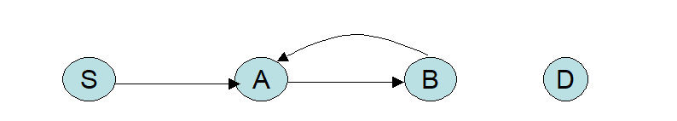
2. We eliminate the variables from Productions P1, that cannot be reached from the start variable. For this we draw the dependency graph for the variable set V1 = { S, A, B and D } found in step 1. Following is the dependency Graph :
Productions :
S → a | aA
B → a | aA
D → ddd
A → aB
From the above Dependency graph, it is obsereved that the Vertex D is Not reachable from Vertex S, hence, Vertex D is ignored. So we have only the Verices S, A and B.
Finally, modified Grammar with Useful Varibales S, A and B and their associated productions are as follows :
S → a | aA
A → aB
B → aA | a

Slide 53
Examples on Elimination of Useless-productions
Example -1
Example - 5
S → Aa | B
A → a | bc | B,
B →A | bb
Example -2
Example - 6
S → a | aA | B | C
A→ aB
B → aA | a
C→ cCD
D → ddd
Example -3
Example -4

Slide 54
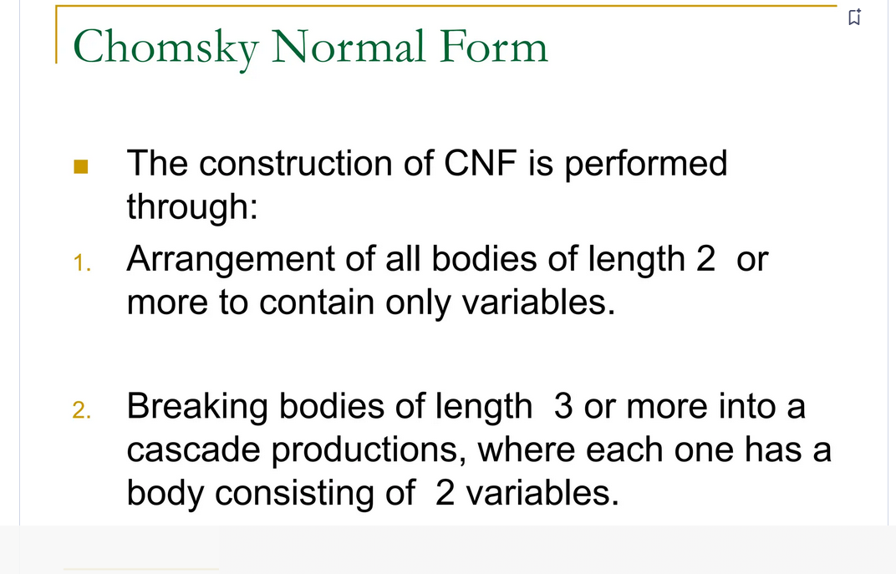
2.5. Chomsky Normal Forms
A Grammar G is said to be in Chomsky Normal form, if all of its productions are of the form : A→BC or A → a, where A, B, and C are all variables and a is terminal symbol
Note : Before the Grammar is transferred to CNF notation, the grammar must be Simplified interms of Ԑ-productions, Unit productions and Useless productions.

Slide 55
Algorithm to produce a grammar in CNF:
1. Eliminate Ԑ-productions, Unit productions and Useless symbols,
from the grammar Given grammar.
2. Elimination of terminals on the body of a productions.
a) Add all productions of the form A → BC or A → a to P1, where P1 is an intermediate set of productions
b) Consider a production A → X₁X₂…X_{n} from P.
If X_{i} is a terminal ‘a’ then
Introduce a new variable B_{a} for ‘a’and replace each X_{i} in A by B_{a}
Also Add new production B_{a} → a to P1.

Slide 56
c) Consider each production A → X₁X₂…X_{n}, where n >=3 and all X_{i}‘s are variables from P1 -the intermedaite set of productions and introduce new variables and productions as per the following order to reduce the production’s body length to 2 to P1
A →X₁C₁
C₁ → X₂C₂
C₂ → X₃C₃
----------
----------
C_{n-2} →X_{n-1}X_{n} Here C₁, C₂,.... C_{n-2} are all New variables

Slide 57
Working with Example :
S → aAD
A → aB | bAB
B → b
D → d
Step -1. Simplification of the Grammar.
Grammar is already simplified.
Step -2. Elimination of terminals on the body of a productions. i.e arrangements of production bodies of length to 2 or more to contain only variables.
S → aAD
A → aB | bAB
B → b
D → d
P1 : S → B_{a}AD
A → B_{a}B | B_{b}AB
B_{a} → a
B_{b} → b
B → b
D → d

Slide 58
Step -3. Breaking the bodies of length 3 or more into a cascade of productions.
P1 : S → B_{a}C₁
C₁ → AD
A → B_{a}B | B_{b}C2
C₂ → AB
B_{a} → a
B_{b} → b
B → b
D → d
P1: S → B_{a}AD
A → B_{a}B | B_{b}AB
B_{a} → a
B_{b} → b
B → b
D → d
Final Grammar in
CNF Notation

Slide 59
Examples on Chomsky Normal From - CNF
Example -1
Example - 5
S → Aa | B
A → a | bc | B,
B →A | bb
Example -2
Example - 6
S → a | aA | B | C
A→ aB
B → aA | a
C→ cCD
D → ddd
Example -3
Example -4

Slide 60
END of UNIT-3

