Slide 1
Part- A -Lex Programming
UNIT-5. LEX and YACC.
By Dr. M M Math,
Professor and Head CC
Department of CSE,
GIT, Belagavi

Slide 2
A LEX Tool
Introduction.
Structure of LEX program Specification
Prerequisite for Writing LEX program
Running LEX program.
USE of VI editor.
Sample LEX programmming exercises .

Slide 3
I.Introduction
What is LEX ?
LEX is a programming tool on UNIX platform that takes Lex input file specification ( which are set of descriptions of Tokens in the form Regular expression-Pattern)as an input and generates a C-routine (lex.yy.c) which is termed as lexical analyzer or Lexer or scanner.
What are Tokens ?
Are nothing but the primitives of any programming language that includes Identifiers, constants, keywords, operators and punctuation symbols,
What are REGULAR Expressions ?
It is a mechanism to describe the tokens that consists of combinations of symbols from the alphabet, digits, operators and special symbols called meta-characters

Slide 4
What is Lexical analyzer ?
It is an initial program for a typical compiler that reads the input streams of character by Character and groups them into a meaningful sequence called as a tokens.
Who developed LEX Tool ?
It is Written and developed by Eric Schmidt and Mike Lesk.
What are applications of LEX ? :
Mainly used by compiler writers to write compiler and interpreter.
Any application that looks for patterns in its inputs

Slide 5
II.Structure of LEX program Specification
The Structure of Lex program specification consists of three sections, as depicted in the following figure.
%{
SECTION -1 { Definition section }
%}
<Name> <pattern> Definition of long pattern -optional
%%
SCETION –II { RULES Sections }
%%
SECTION – III { User subroutine section }

Slide 6
A-Definition section :
It introduces any initial C program code like header files, declaration and initialization of variables used in the program. This is simply copied to the C-code being generated.
The C program code is surrounded with two special delimiters %{ and %}
It also contains declarations of simple definitions for patterns to simplify the scanner specification which is of the following form
name definition → Optional
Example:
DIGIT [0-9]+
LETTER [a-zA-Z]
NOTE : It is optional it can be used whenever long or complex patterns are to be simplified.

Slide 7
B.Rules section
The Rules section of the Lex program specifications contains a series of rules where each rule is made up of two parts separated by whitespaces and is as follows :
<pattern> <action>
<Pattern> → is a description of tokens in the form of Regular expressions written in UNIX style or regular name definition specified in the Definition section.
Example:
{DIGIT}+ {printf(“ It is number :
%s\n“,yytext ); }
[0-9]+ {printf(“ iT is number :
%s\n“,yytext ); }

Slide 8
<action> is made of action routines written using C- language and are enclosed between curly braces { and }.
It also consists of call statements to c routines written in user subroutine section of LEX specification in section III.
An <action> consisting only a vertical bar ('|') means the action is same as the action for the next rule.“
Example :
{DIGIT} { printf(“ IT is number :
%s\n“,yytext ); }
[0-9]+ { printf(“ IT is number :
%s\n“,yytext ); }

Slide 9
C.User Subroutine Section
This is a final section which consists of any legal C-code that is copied to the end of the Code generated.
It also consists of user defined c-functions which may be called in the action part of the rule section.
Finally it includes the main() function consisting of a call statement to yylex(), where yylex() is c-routine generated by LEXER.
Unless the action contains explicit return statement, yylex() would not return until it has processed the entire input.

Slide 10
III. Prerequisite for Writing LEX program
Study of Regular expression :
As a part of rule section the pattern is made up of regular expressions written in UNIX style.
The regular expression is a string made up of symbols from alphabets, digits, operators and special symbols called meta-characters.
Alphabets →{ a,b,c....z,A,B,C,....Z }
Digits → {0,1,2,...9}
Operators and Special symbols →
“ \ [ ] ^ - ? . * + | ( ) $ / { } %

Slide 11
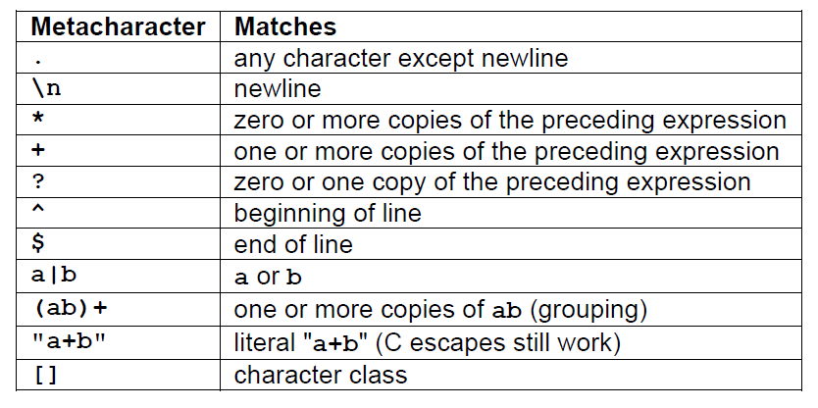
Lex- Pattern Matching Primitives or Meta Characters

Slide 12
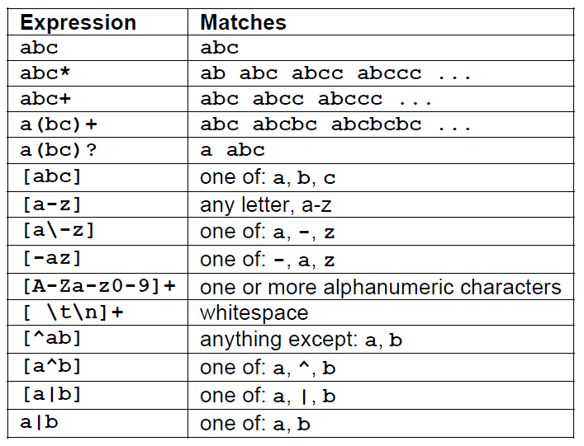
Example on pattern matching
Pattern Matching examples.

Slide 13
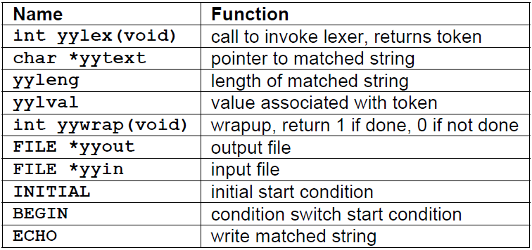
Lex predefined variables.

Slide 14
IV. Running a Lex program
Lex source program
Lex
lex.yy.c
lex.yy.c
C compiler
a.out
input
a.out
tokens
$lex xyz.l → Command for LEX Complilation
$ cc lex.yy.c –ll → Command for C - Complier
$./a.out → Command for Execution

Slide 15
V. USE of VI editor.
VI editor is screen-oriented text editor that enables you to edit lines in context with other lines in the file.
It is considered to be standard editor for unix programming
To start using vi editor − we can execute the following commands
Command | Description
vi filename | Creates a new file if it already does not exist, otherwise opens existing file
vi -R filename | Opens an existing file in read only mode.
view filename | Opens an existing file in read only mode..

Slide 16
Operation Modes
While working with vi editor you would come across following two modes −
Command mode − This mode enables you to perform administrative tasks such as saving files, executing commands, moving the cursor, cutting (yanking) and pasting lines or words, and finding and replacing. In this mode, whatever you type is interpreted as a command.
Insert mode − This mode enables you to insert text into the file. Everything that's typed in this mode is interpreted as input and finally it is put in the file .
NOTE : The vi always starts in command mode. To enter text, you must be in insert mode. To come to in insert mode you simply type i. To get out of insert mode, press the Esc key, which will put you back into command mode.

Slide 17
Getting Out of vi-editor
The command to quit out of vi is
ESC:w →This to save the file
:wq →This to Save and exit
:q! →This to Exit without saving

Slide 18
VI. Sample LEX programs
1.Write a LEX program to recognize the verbs of an English language sentence
Write a LEX program to count the number vowels and consonants in the given English language sentence.
Write a LEX program to count the number positive and negative integer numbers in a given list of numbers.
Write a LEX program recognize a simple or compound sentence of an english language.
Write a LEX program to count number of identifiers, constants and operators present in an arithmetic expression.

Slide 19
6.Write LEX program to count number of integers and float point numbers in a given list of numbers.
7.Write a LEX program to count number of comments in a C-program
8.Write a LEX program to check the entered string is an Identifier or keyword of C-language.
9.Write a LEX program to Count the number of words, lines and Characters in a given English Text.

Slide 20
10. Write a LEX program to identify Strings associated with the following Regular language on the alphabet - ∑ = {a, b }.
a(a+b)*.
b* a b*
ab(a+b)*
(a+b)* abb
L= {|w| mod 3 = 0,where w€(a+b)*}

Slide 21
Lex program for Exampl;e -1
%{
#include <stdio.h>
%}
%%
[ \t]+ {;}
is |
was |
am |
are |
were |
being |
do |
did |
does { printf("\n %s is verb ",yytext);}
[a-zA-z]+ { printf("\n %s is not a verb",yytext);}
. |
\n {;}
%%
main()
{
printf("\n Enter Text : ");
yylex();
}

Slide 22
Lex program for Exampl;e -2
%{
#include <stdio.h>
int vowel=0;
int consonent=0;
%}
%%
[ \t]+ {;}
[aeiouAEIOU] { vowel= vowel+1;}
[a-zA-z] { consonent= consonent+1;}
. |
\n {;}
%%
main()
{
printf("\n Enter Text : ");
yylex();
printf(" Number of Vowels : %d \n",vowel);
printf(" Number of consonent : %d \n",consonent);
return 0;
}

Slide 23
Lex program for Exampl;e -3
%{
#include <stdio.h>
int p=0, n=0;
%}
%%
[ \t]+ {;}
\+?[0-9]+ { p++;}
\-[0-9]+ { n++;}
\n {;}
%%
main()
{
printf("Enter numbers : ");
yylex();
printf("Positive Numbers : %d \n Negative Numbers : %d ",p,n);
}

Slide 24
Lex program for Exampl;e -4
%{
#include <stdio.h>
int comp=0;
%}
%%
[ \t]+ {;}
and |
but |
or |
neither |
either {comp=1;}
[a-zA-Z]+ {;}
. |
\n {;}
%%
main()
{
printf("Enter a Sentence : ");
yylex();
if(comp)
printf("\n Sentence is Compound statement\n",yytext);
else
printf("\n Sentence is not a Compound statement\n",yytext);
}

Slide 25
Lex program for Exampl;e -5
%{
#include <stdio.h>
int id=0, con=0, op=0;
%}
%%
[ \t]+ ;
[+\-*/] { op++;}
[0-9]+ { con++;}
[a-zA-z][a-zA-z0-9]* { id++;}
. | \n ;
%%
main()
{
printf("Enter expression : ");
yylex();
printf("Total Number of operators : %d \n",op);
printf("Total Number of Identifiers : %d \n",id);
printf("Total Number of constants : %d \n",con);
}

Slide 26
Lex program for Exampl;e -6
%{
#include <stdio.h>
int i=0, d=0;
%}
%%
\+?[0-9]+ { printf("\n %s is an integer",yytext);i++;}
\+?[0-9]+\.[0-9]+ { printf("\n %s is a Decimal ",yytext);d++;}
%%
main()
{
printf("Enter numbers : ");
yylex();
printf("Total Int Numbers : %d \n",i);
printf("Total Decimal Numbers : %d ",d);
}

Slide 27
Lex program for Exampl;e -7
%{
#include <stdio.h>
int comment=0;
%}
%%
"/*".*"*/" {comment++;}
\n {;}
%%
main()
{
printf(" Read C-program file :");
yylex();
printf("\nnumber of comments : %d \n",comment);
return 0;
}

Slide 28
Lex program for Example -8 is an excercise
Lex program for Example -9
%{
#include <stdio.h>
int wc=0, lc=0,ch=0;
%}
%%
[^ \t\n]+ {wc++; ch+=yyleng;}
\n {lc++;}
. {ch++;}
%%
main()
{
printf("\n Enter an English text : " );
yylex();
printf("\nNumber of words %d :",wc);
printf("\nNumber of lines %d :",lc);
printf("\nNumber of words %d :",ch);
}

Slide 29
Lex program for Example - 10 - A
%{
#include <stdio.h>
int flag=0;
%}
%%
[ \t]+ {;}
[ab]*[a][ab]* { flag =1;}
[ab]* { flag =0;}
. |
\n {;}
%%
main()
{
printf("Enter string :");
yylex();
if (flag)
printf(" \nvalid \n");
else
printf(" \ninvalid ------- \n");
return 0;
}

Slide 30
Lex program for Example - 10 - B and C are for Exercise
Lex program for Example - 10 - D
%{
#include <stdio.h>
int flag=0;
%}
%%
[ \t]+ {;}
[ab]*abb { flag =1;}
[ab]* { flag =0;}
. |
\n {;}
%%
main()
{
printf("Enter string :");
yylex();
if (flag)
printf(" \nvalid \n");
else
printf(" \ninvalid ------- \n");
return 0;
}

Slide 31
Lex program for Example - 10 - E
%{
#include <stdio.h>
int flag=0;
%}
%%
[ \t]+ {;}
([ab][ab][ab])* { flag =1;}
[ab]* { flag =0;}
. |
\n {;}
%%
main()
{
printf("Enter string :");
yylex();
if (flag)
printf(" \nvalid \n");
else
printf(" \ninvalid ------- \n");
return 0;
}

Slide 32
END of LEX Programming.

