Slide 1
Ansible for the Windows Admin
or, Declarative Configuration From the Dark Side

Slide 2
What is Ansible?
Agentless
Declarative configuration tool with human-readable configuration
Agentless
Distributed, “server-less” program
Agentless

Slide 3
Reasons to Ignore Ansible
It’s just for linux
I don’t know python
I already use DSC
I’m Scared Of Case Sensitive Programs

Slide 4
Terminology
task - instructions for an action against a machine or machines
play - a combination of tasks and a host or hosts to run them against
playbook - a combination of multiple plays in sequential order
hosts/inventory – file with a list of machines to act upon
vars/facts – variables, either stored in a file or retrieved from a host
list - in json and yaml = array in powershell
dictionary - in json and yaml = hashtable in powershell

Slide 5
Data File Formats
JSON | YAML
{ "value": 1, "simple_list": [ 1, 2, { "property": "value", "second": "othervalue" } ] } | value: 1 simple_list: - 1 - 2 - property: value second: othervalue

Slide 6
YAML – YAML Ain’t a Markup Language

Slide 7
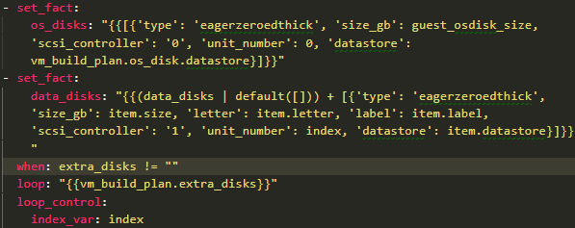
YAML – YAML Ain’t a Programming Language
But it’s close!
Ansible can get data back from a task
parse data, do loops and conditionals, variable substitution
{{variablename}}
Can get complex fast. Don’t do this:

Slide 8
Ansible Variables
- command line values (eg “-u user”) - role defaults - inventory file or script group vars - inventory group_vars/all - playbook group_vars/all - inventory group_vars/* - playbook group_vars/* - inventory file or script host vars - inventory host_vars/* - playbook host_vars/* - host facts / cached set_facts | - play vars - play vars_prompt - play vars_files - role vars (defined in role/vars/main.yml) - block vars (only for tasks in block) - task vars (only for the task) - include_vars - set_facts / registered vars - role (and include_role) params - include params - extra vars (always win precedence)

Slide 9
Ansible-Playbook Command Line
ansible-playbook [options] playbook.yml [playbook2 ...]
--step: ask for confirmation before running each task
--limit: restrict the playbook to running only against specified machines, despite the inventory file or group membership
-v(vvvv): Verbosity levels 1-5
-e: specify extra variables either individually or with “@filename”. These take precedence over all other variables
--check: like “whatif”, runs the playbook but won’t make any changes. MODULE DEPENDENT

