Slide 1
WaveImperio
A new wave in the field of AI and Automation.
The flow of future in the palm of your hands.

Slide 2
We aim to:
Solve the problem of energy wastage.
Solve the inability to control electrical appliances remotely.
By using this product we can:
Monitor the energy used for specific appliances over a period of time .
Automate electrical appliances to turn ON/OFF at pre-set time intervals .

Slide 3
01
TECHNOLOGY USED: Wireless Communication and Automation

Slide 4
What is
MQTT?
MQTT stands for Message Queuing Telemetry Transport. It is a lightweight messaging protocol for use in cases where clients need a small code footprint and are connected to unreliable networks or networks with limited bandwidth resources.

Slide 5
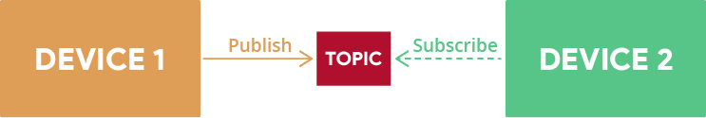
MQTT – Publish/Subscribe
The first concept is the publish and subscribe system. In a publish and subscribe system, a device can publish a message on a topic, or it can be subscribed to a particular topic to receive messages
For example Device 1 publishes on a topic.
Device 2 is subscribed to the same topic that device 1 is publishing in.
So, device 2 receives the message.

Slide 6
MQTT - MESSAGES
Messages are the information that you want to exchange between your devices. It can be a message like a command or data like sensor readings, for example.

Slide 7
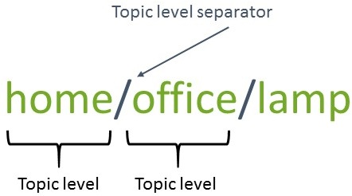
MQTT – Topics
Another important concept is the topics. Topics are the way you register interest for incoming messages or how you specify where you want to publish the message.
Topics are represented with strings separated by a forward slash. Each forward slash indicates a topic level. Here’s an example of how you would create a topic for a lamp in your home office:

Slide 8
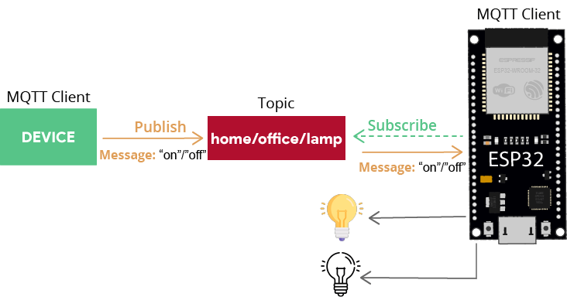
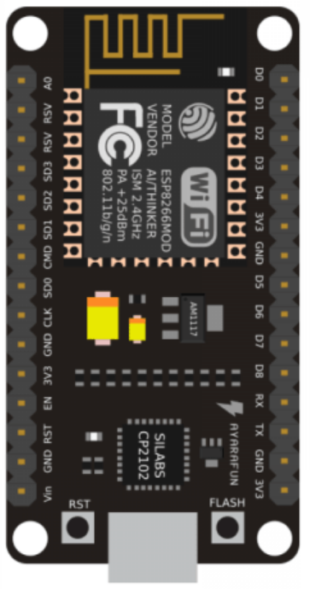
If you would like to turn on a lamp in your home office using MQTT you can imagine the following scenario:

Slide 9
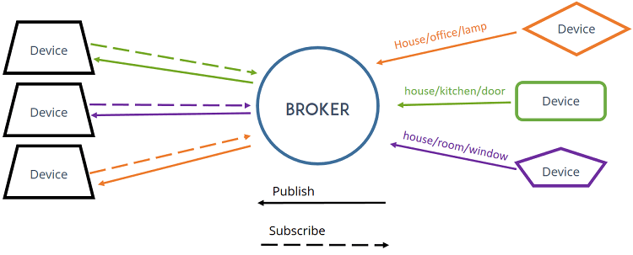
MQTT – Broker
Finally, another important concept is the broker.
The MQTT broker is responsible for receiving all messages, filtering the messages, deciding who is interested in them, and then publishing the message to all subscribed clients.

Slide 10
02
Why are we using
MQTT?
You can enter a subtitle here if you need it

Slide 11
Advantages of MQTT :
Low network usage due to minimized data packets.
Efficient distribution of data.
Successful implementation of remote sensing and control.
Fast efficient message delivery.
Optimizes network bandwidth.
Efficient data transmission and quick to implement , due to its being a light-weight protocol.
Uses small amounts of power , which is good for connected devices.

Slide 12
Hardware used :
A.
NodeMCU ESP8266
B.
Four Channel Relay Module

Slide 13
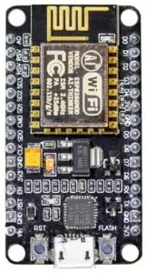
NodeMCU ESP8266 :
The NodeMCU (Node MicroController Unit) is an open-source software and hardware development environment built around an inexpensive System-on-a-Chip (SoC) called the ESP8266.
It contains crucial elements of a computer:
CPU
RAM
NETWORKING (WIFI)
Modern operating system and SDK

Slide 14
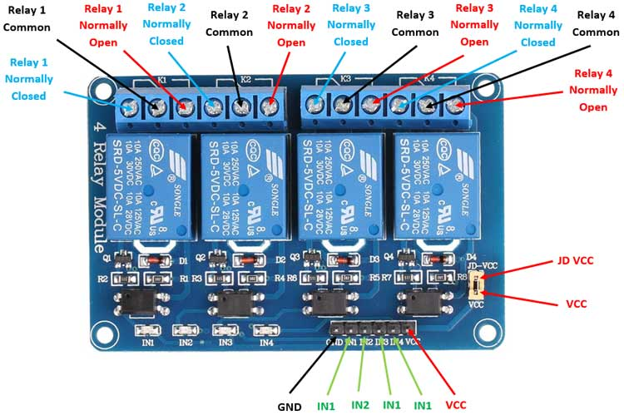
FOUR CHANNEL RELAY MODULE :
This is a 5V 4-Channel Relay interface board, be able to control various appliances and other equipment with large current. It can be controlled directly by Microcontroller
which can be used to control high voltage, high current load such as motor, solenoid valves, lamps and AC load. It is designed to interface with microcontroller such as Arduino, PIC and etc. The relays terminal (COM, NO and NC) is being brought out with screw terminal.

Slide 15
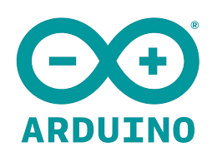

Software Used :
A.
Arduino IDE
B.
MQTT Server (adafruit)

Slide 16
THANKS A LOT!

