Slide 1
Vector Valued Image Regularization with PDE
Aneesh Garg (180050007)
Dhananjay Singh (180050029)

Slide 2
Introduction
Regularization Algorithms
What are they?
Where are they used?
How do they work?

Slide 3
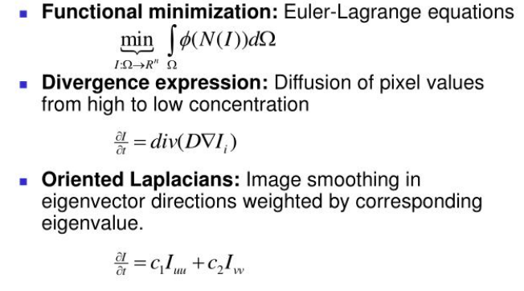
Image Regularization

Slide 4
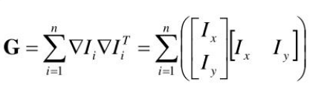
Structure Tensor
Nonlinear regularization PDE’s to vector-valued images
Eigenvalues and Eigenvectors
Corners and Edges

Slide 5


Geometric Meaning of Oriented Laplacians
2D image regularization as juxtaposition of oriented laplacians
H is the Hessian matrix and T is a 2x2 Tensor matrix
Solution for above PDE is :

Slide 6

Tensor Field
ƛ and 𝛉 are defined to be the spectral elements of a Gaussian smoothed version of the structure tensor G
This allows us to retrieve a more coherent vector geometry and giving a better approximation of the vector discontinuities directions

Slide 7

Oriented Gaussian Kernel
This is the G obtained in the previous solution
When T is not constant (which is generally the case), the previous PDE becomes nonlinear
And can be viewed as the application of temporally and spatially varying local masks G over the image I

Slide 8
Implementation
(Method)

Slide 9
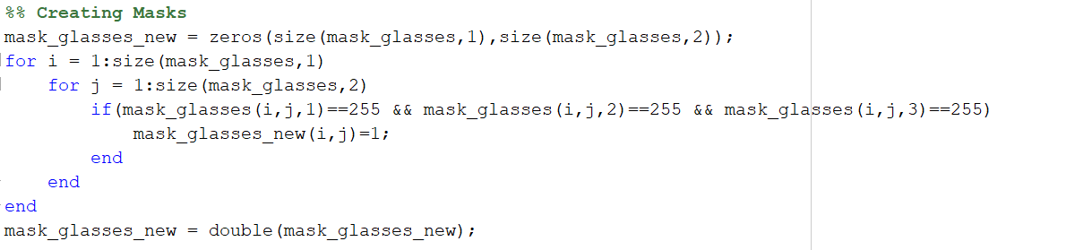
Creation of Binary Mask

Slide 10


Image Gradients
Computed gradients across x and y direction using sobel operator
This will be used to compute structure tensor at each point

Slide 11
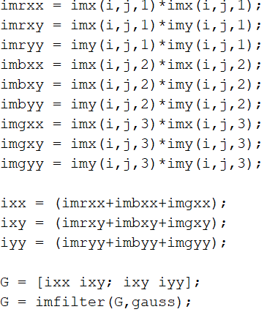
Evaluating Structure Tensor
Evaluated structure tensor at the hole and then convolved it with gaussian mask to get the gaussian smoothed structure tensor

Slide 12
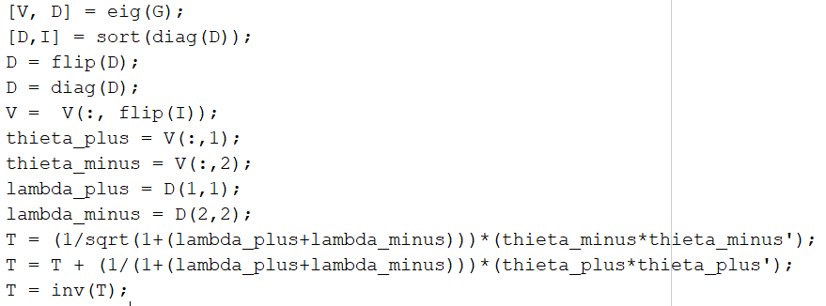
Evaluating Tensor field
Evaluated
Eigenvalues and eigenvectors of structure tensor and created tensor field

Slide 13
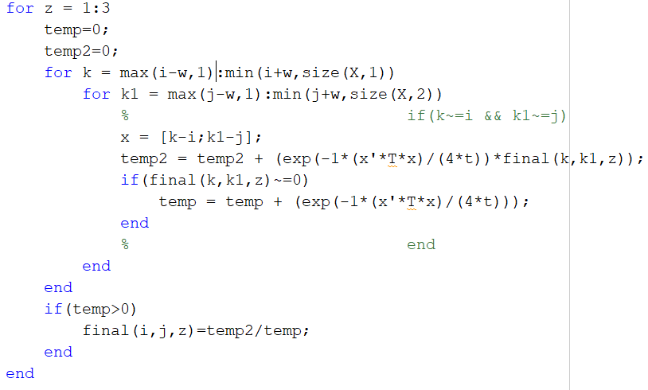
Applying G^{(T,t)}(x) locally
Took weighted average of neighbouring intensities.
Weights being determined by G^{(T,t)}(x)
Thus, computed the new intensity at the hole at i,j

Slide 14
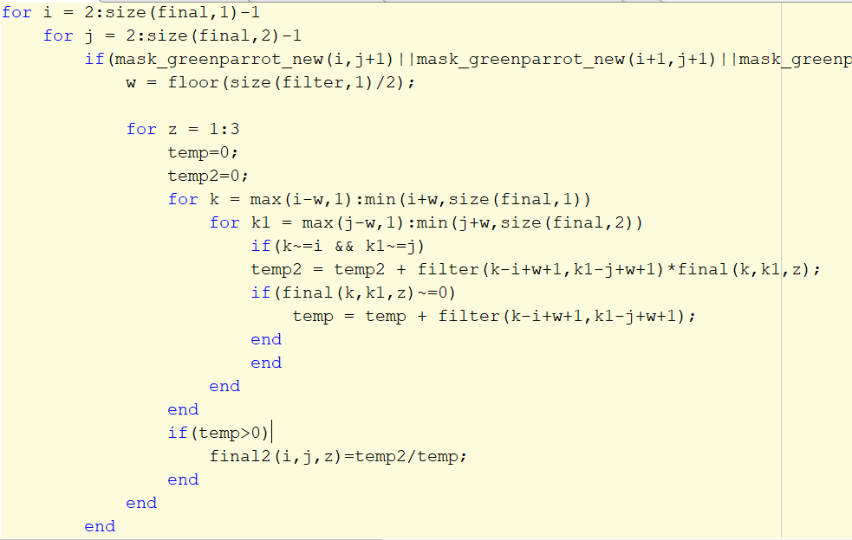
Gaussian Smoothening
Smoothening the edges created by completely filling the missing parts through inpainting

Slide 15
Applications

Slide 16
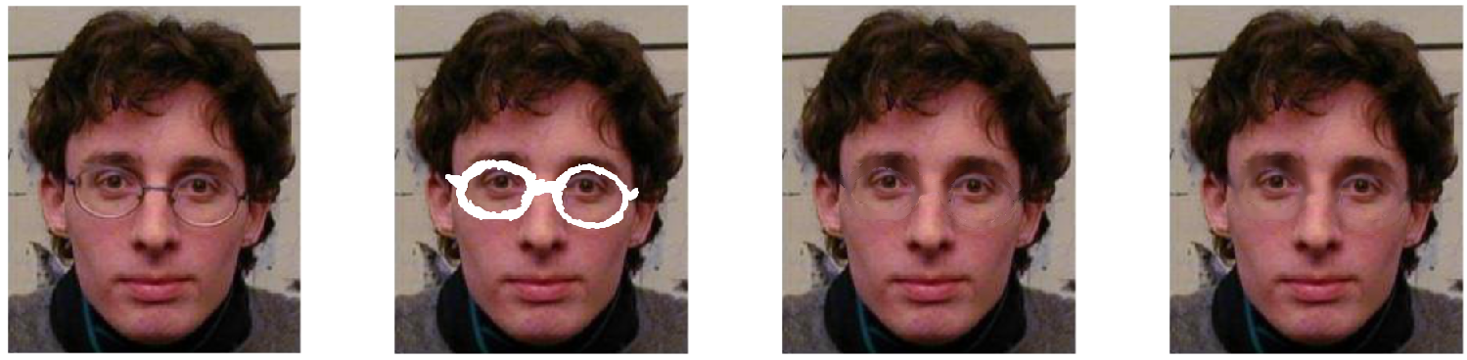
Inpainting - 1
Parameters : Neighbourhood = 5x5, t=100, maxiter = 1

Slide 17
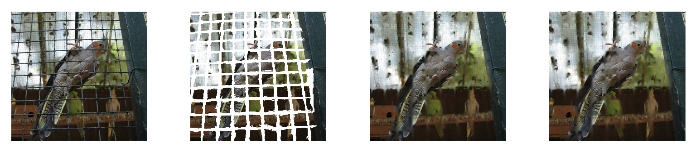
Inpainting - 2
Parameters : Neighbourhood = 11x11, t=100, maxiter = 1

Slide 18
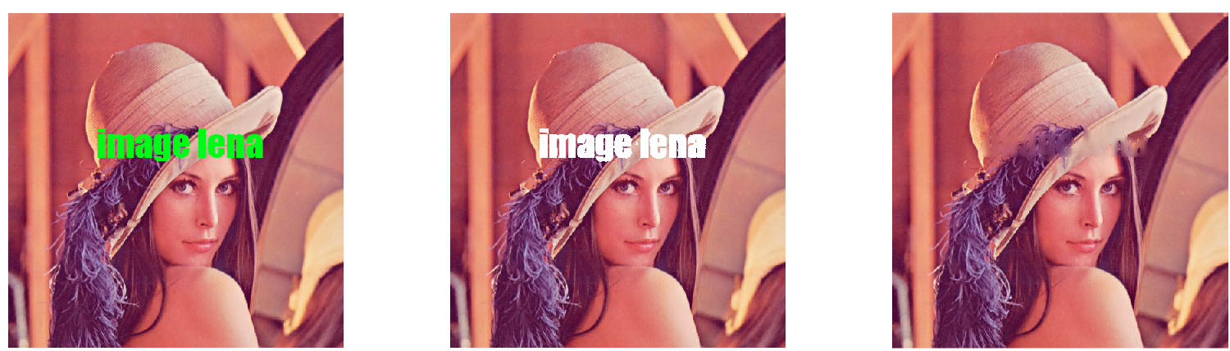
Inpainting - 3
Parameters : Neighbourhood = 11x11, t=100, maxiter = 1

Slide 19
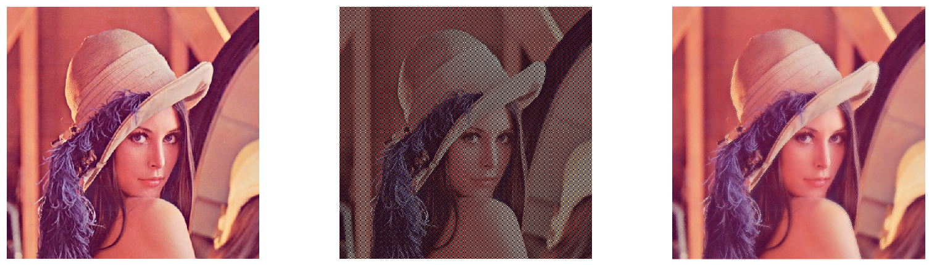
Image Restoration - 1
Parameters : neighbourhood = 11x11, t=1000, maxiter = 1
SSIM of the final inpainted image and the original image = 0.969360

Slide 20
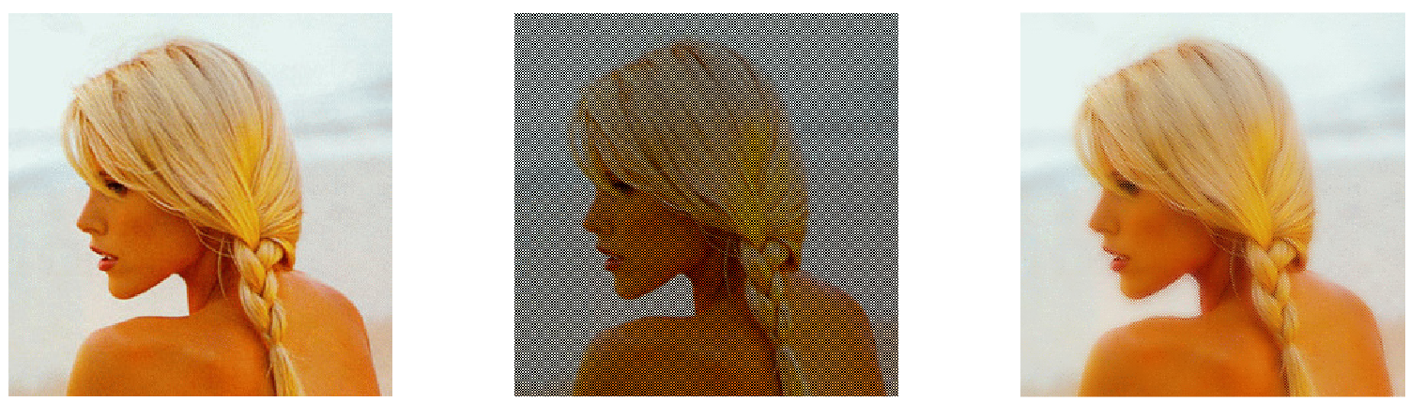
Image Restoration - 2
Parameters : neighbourhood = 11x11, t=1000, maxiter=1
SSIM of the final inpainted image and the original image = 0.922200

Slide 21
Observations
As the width of the mask increases, the effectiveness of our algorithm decreases. This is evident from the fact that as the width increases there is a greater loss of information which makes it hard to reconstruct.
Our results are very sensitive to the neighbourhood size, i.e., they increase/decrease very rapidly with change in neighbourhood size.
Our results do depend on the number of iterations, but they start to converge as the number of iterations reaches a high value.

Slide 22
Observations
Our results very slightly depend on the time parameter, i.e., for observing a significant change in the results, a large change in time parameter is required.
This algorithm yields very good results in a continuous region, but at the edges we do not observe such good results. This is due to the fact, that it is hard for the algorithm to distinguish between the two sides across the edge and ends up assigning a value somewhere in between.

Slide 23
Thank You !

