Slide 1

Problem Statement
Provide Insights for a Strategic Merger in the OTT Domain
Domain: Telecom & Streaming Services
Function: Strategy & Operations
Merging Companies: Lio-Cinema and Jot-star

Slide 2
Introduction
Lio, a leading telecommunications provider in India, is planning a strategic merger with Jotstar, one of the country’s most prominent streaming platforms. This potential partnership aims to combine Lio-Cinema’s expansive subscriber base and Jotstar’s diverse content library to revolutionize digital streaming in India.
Goal : The goal is to gain insights into individual platform performance, content consumption patterns, subscriber growth, Inactivity behavior, upgrade and downgrade trends.

Slide 3
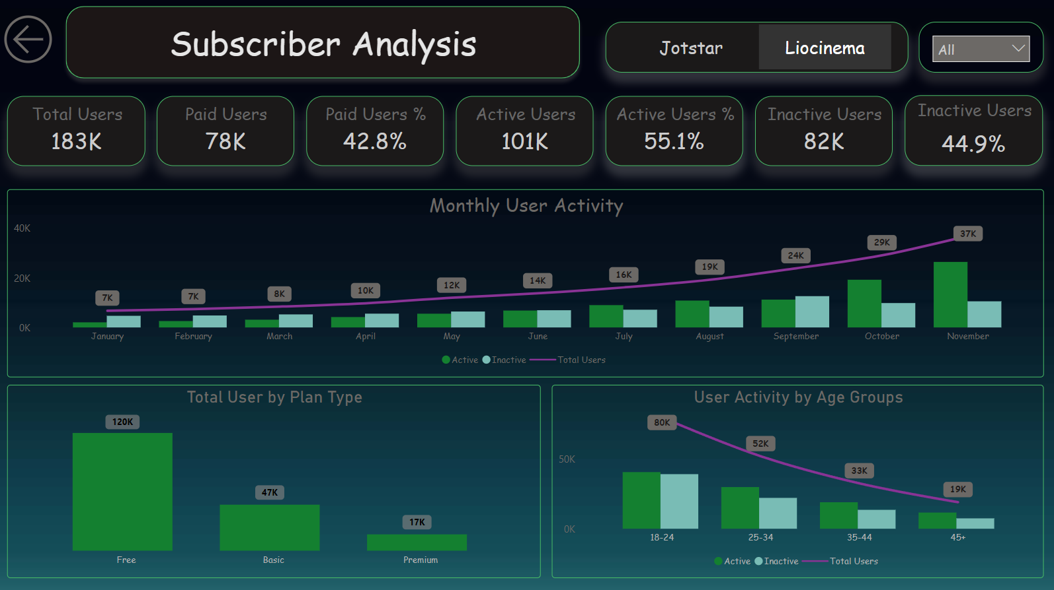

Slide 4
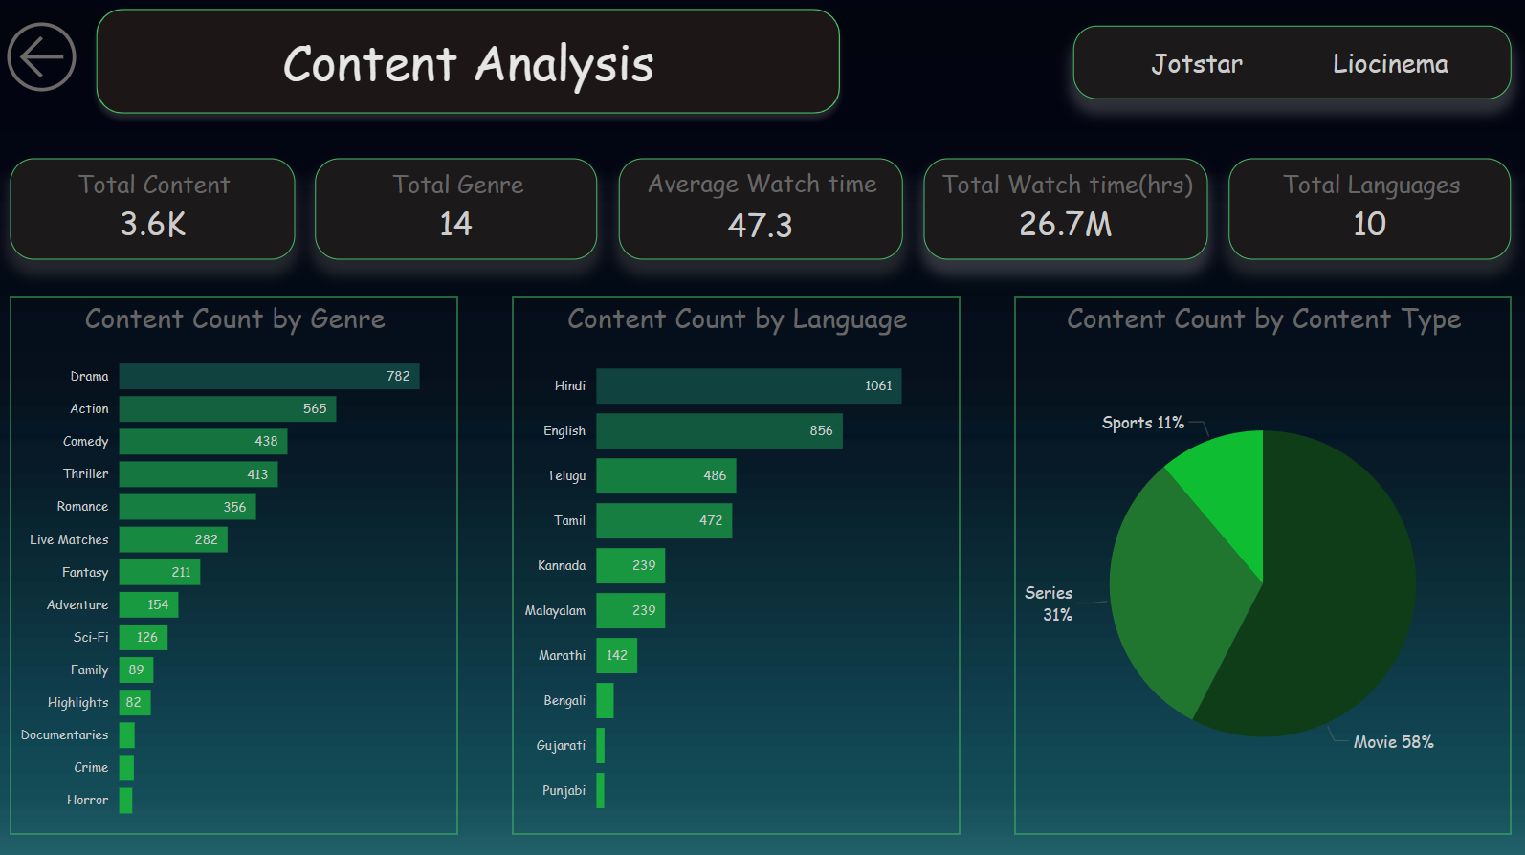

Slide 5
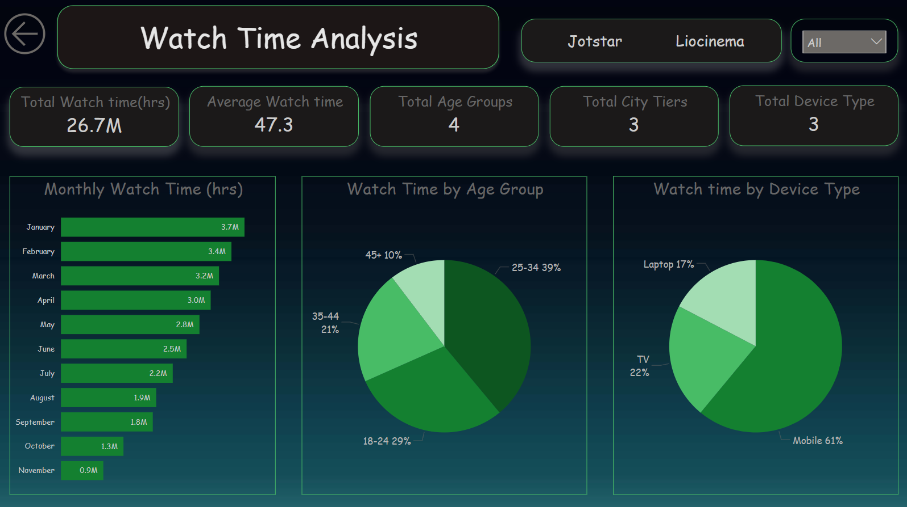

Slide 6
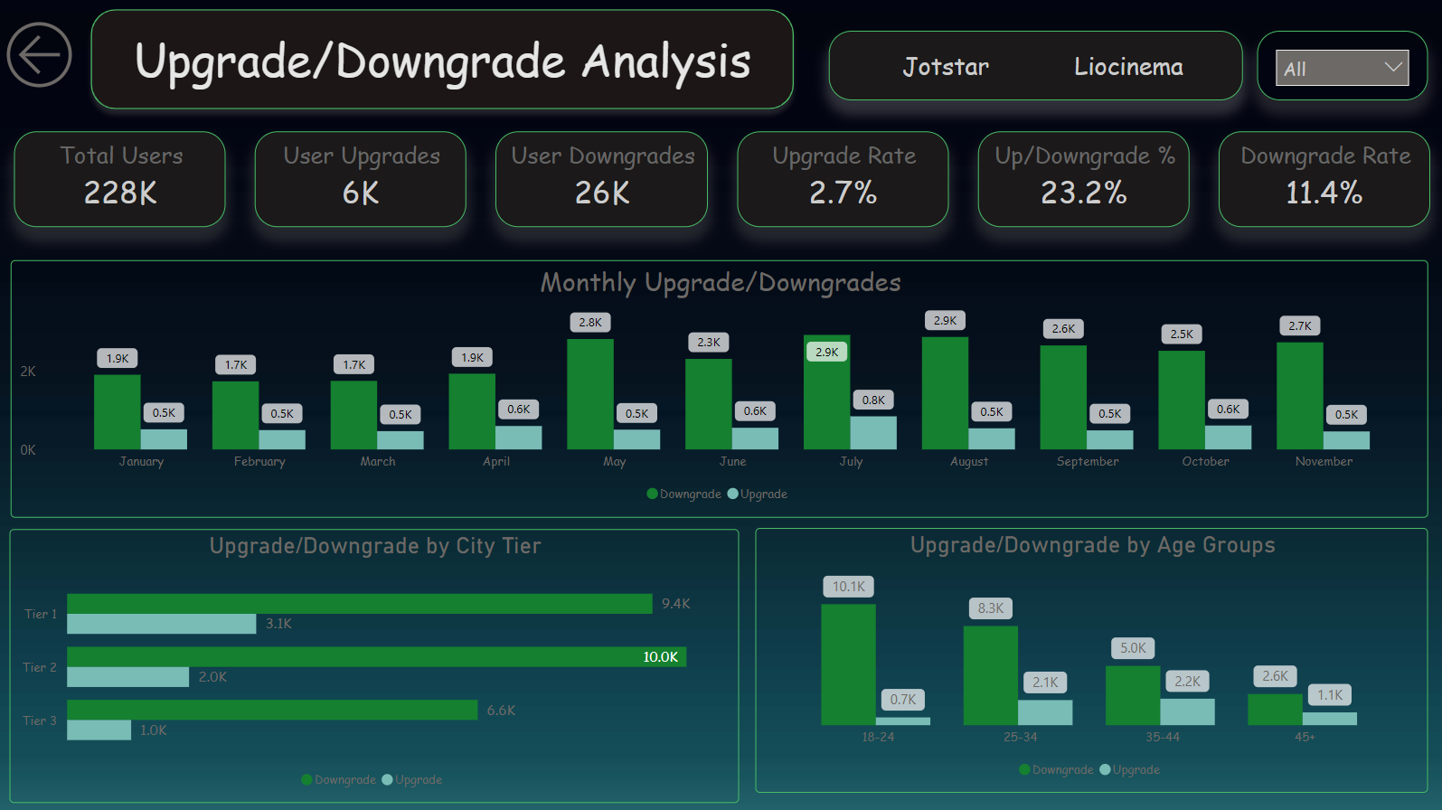

Slide 7
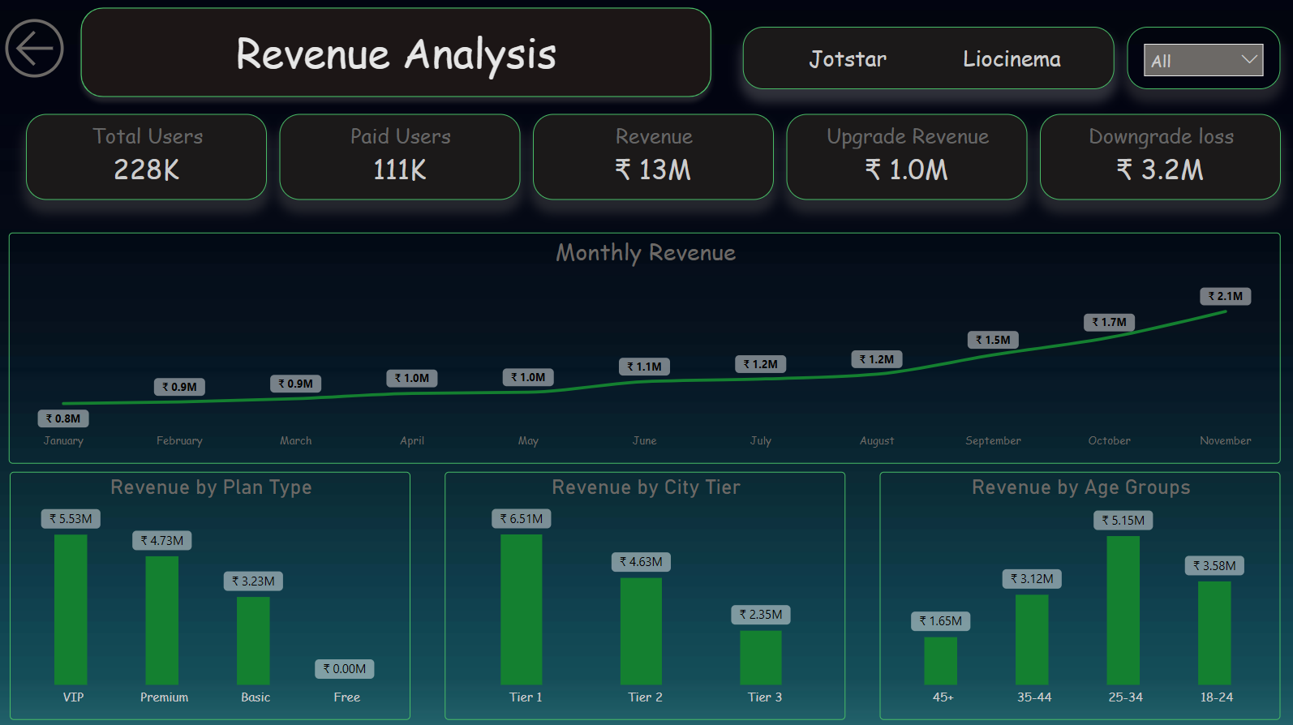

Slide 8
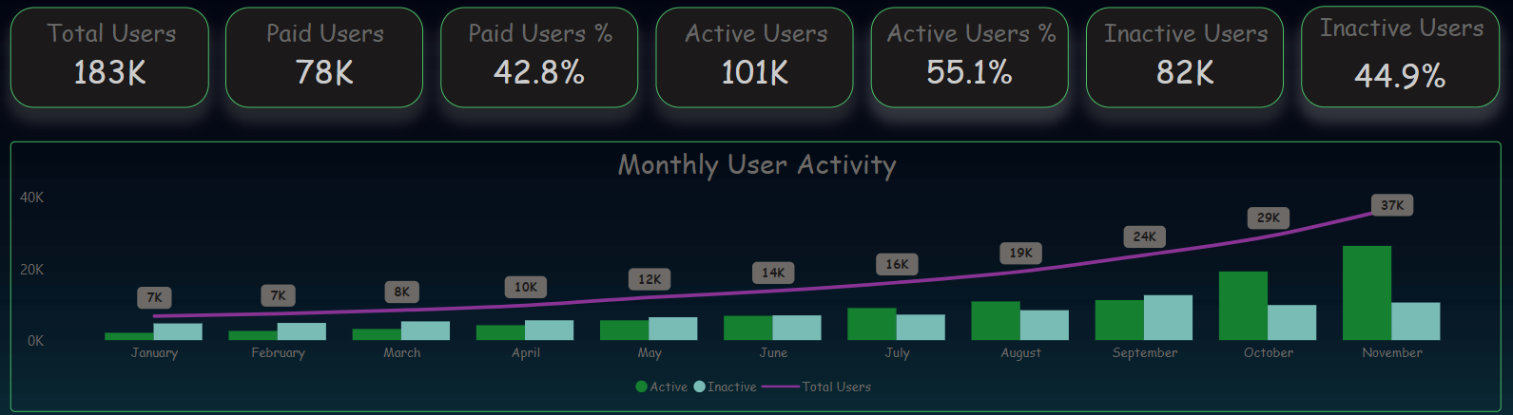
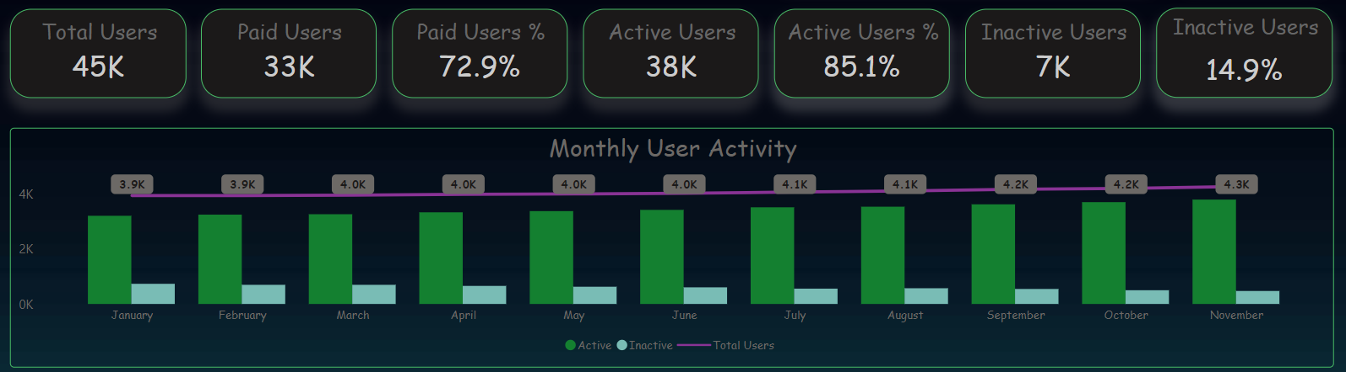
1. User Activity trend for Lio-Cinema and Jot-star (January – November 2024)
Lio-Cinema
Jot-star

Slide 9
From analysis:
Lio-Cinema has more total users as well as paid users than Jot-star.
But the paid percentage of Jot-star is much higher as compared to Lio-Cinema.
For activity the though Jot-star lacks the count of active users still it has higher activity when compared to Lio-cinema.
November has the highest user activity for both the OTT platforms.

Slide 10
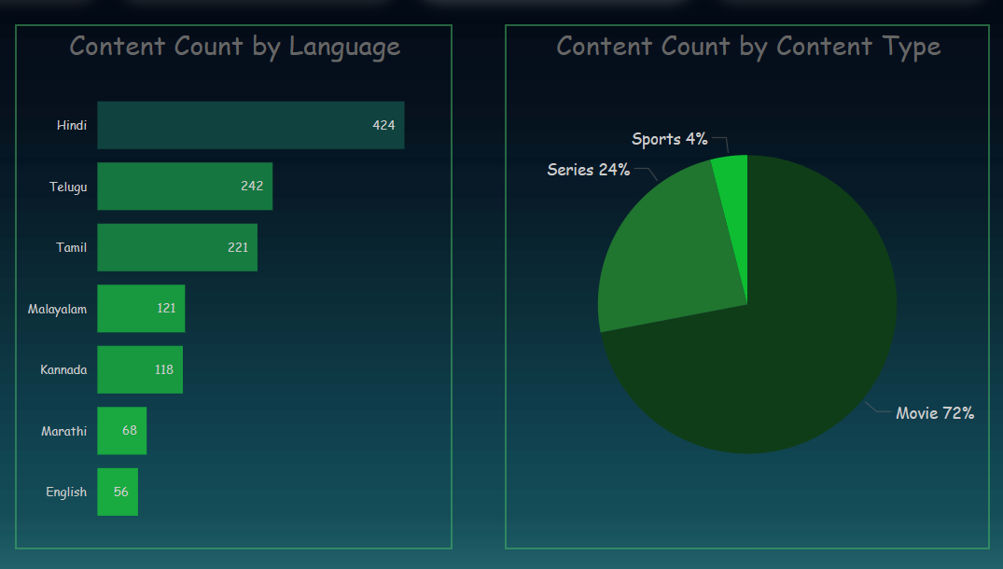
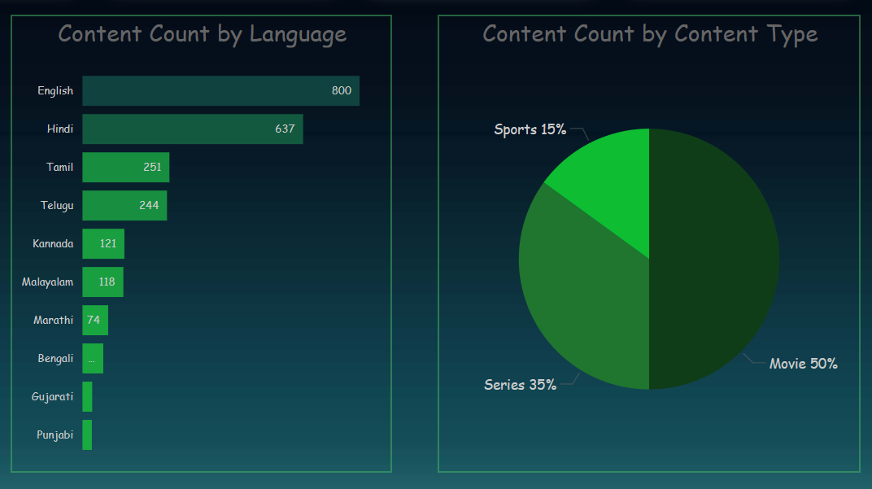
2. Compare contents available on Lio-Cinema & Jot-star based on language and content type
Lio-Cinema
Jot-star

Slide 11
From analysis:
Jot-star leads Lio-Cinema in total content count.
Jot-star has more content in different languages than Lio-Cinema
For Lio-Cinema Hindi language has the largest content available, while Jot-star English has the highest largest content available.
Both has the largest movie content compared to the other content types.

Slide 12
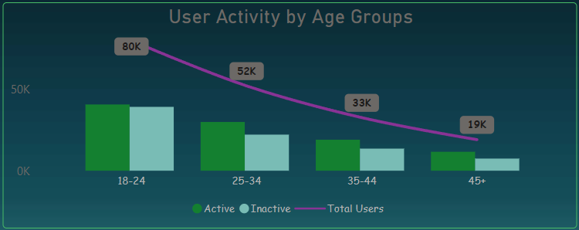
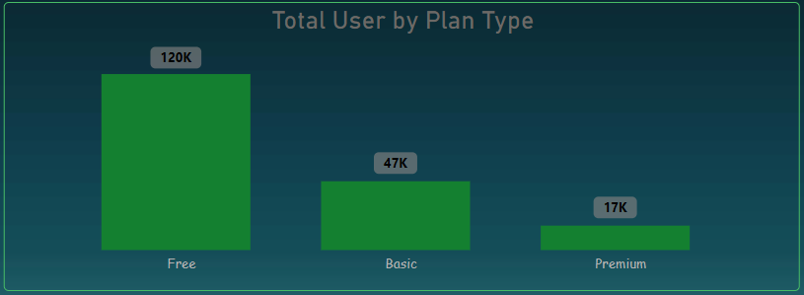
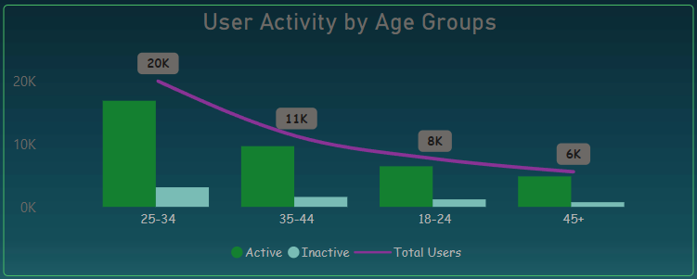
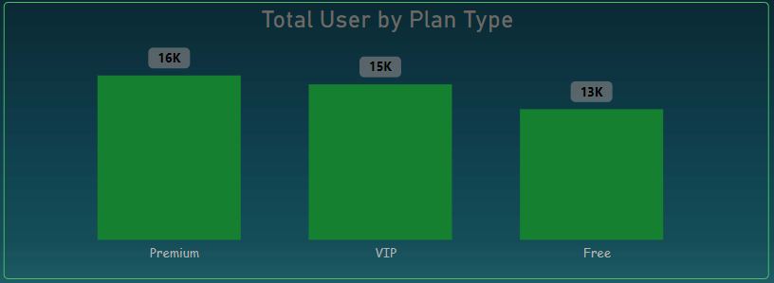
3. Demographic distribution of age group and subscription plan
Lio-Cinema
Jot-star

Slide 13
From analysis:
For Lio-cinema age group 18-24 show highest user activity, while for Jot-star age group 25-34 has highest user activity
From the chart User Activity by Age Groups it is seen that youngsters and adults till the age of 30 consume more content than people from other ages.
Lio-Cinema has the highest unpaid i.e. free plan users, while Jot-star has highest premium plan users

Slide 14
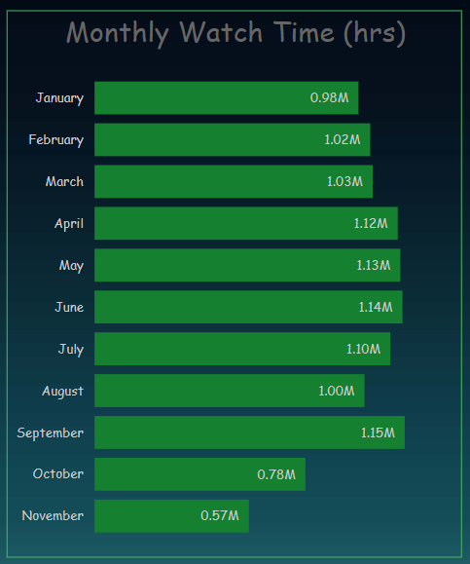
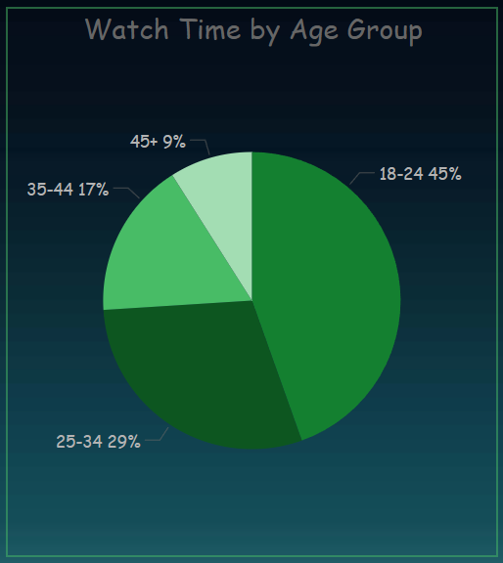
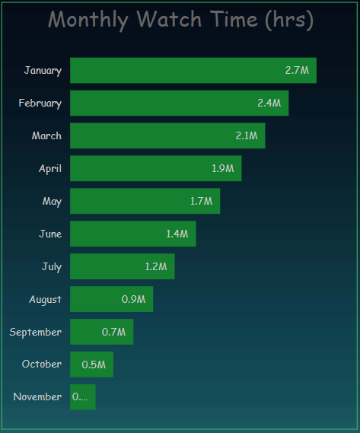
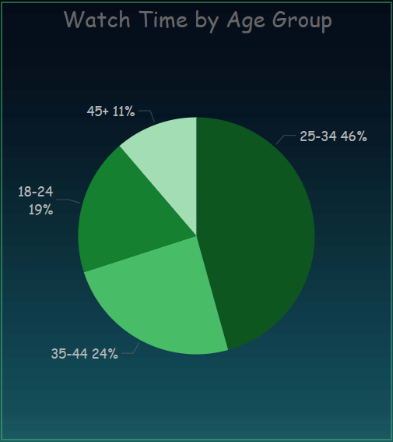
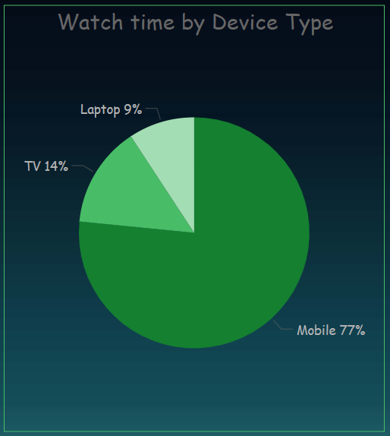
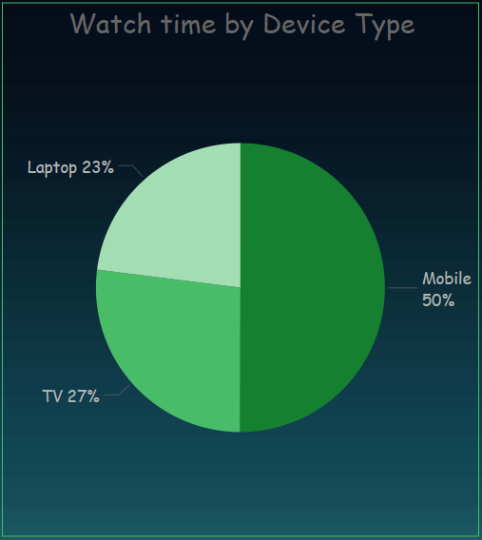
4. Watch time Analysis for the 2024 , age group & device type
Lio-Cinema
Jot-star

Slide 15
From analysis:
For Lio-Cinema September month has the highest watch time(hrs), while Jot-star has January month has the highest watch time(hrs).
Age group 18-24 has highest watch time in Lio-Cinema, and age group 25-34 has highest watch time.
For both the OTT platforms Mobile is the most preferred device type.

Slide 16
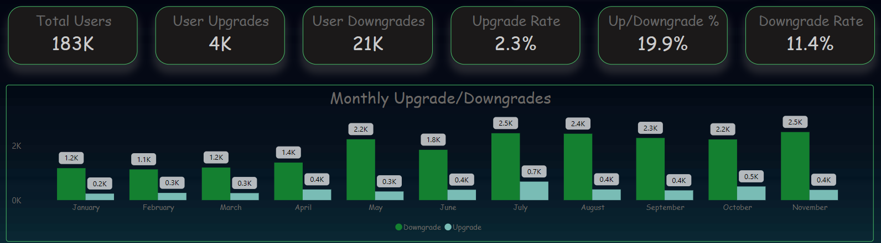
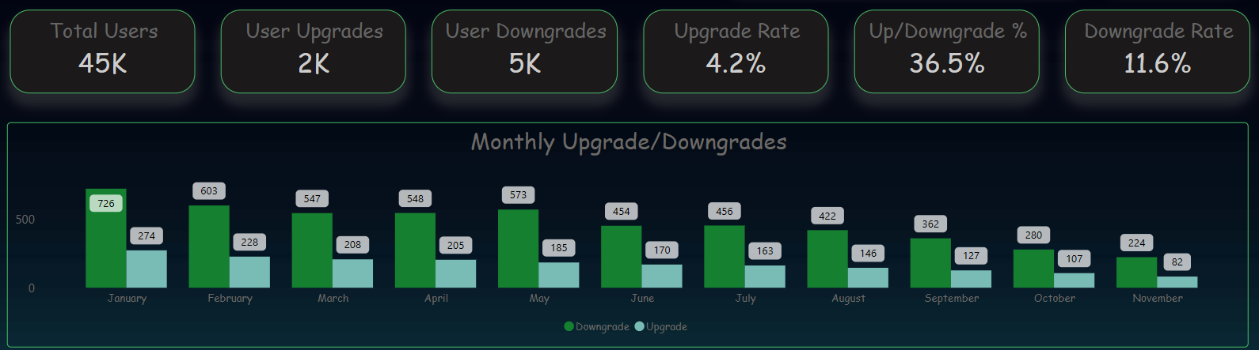
5. User Upgrade/Downgrade trend for Lio-Cinema and Jot-star (January – November 2024)
Lio-Cinema
Jot-star

Slide 17
From analysis:
For Lio-Cinema the month with the highest plan upgrades are July and November.
And the highest downgrades are seen in July.
For Jot-star the month with the highest plan upgrades is February.
And the highest downgrades are seen January.
Considering the up/downgrade % Jot-star has the highest ratio.

Slide 18
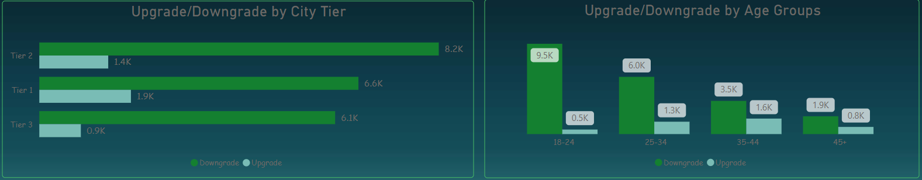
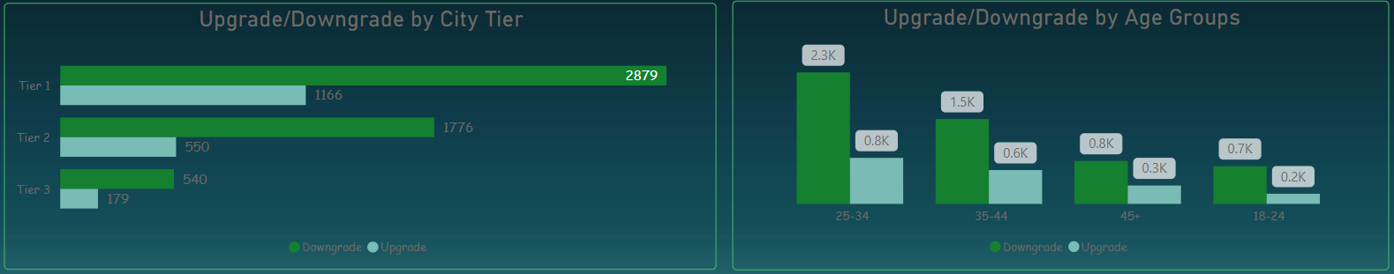
6. Upgrade/Downgrade trend by city tier and age group
Lio-Cinema
Jot-star

Slide 19
From analysis:
For Lio-Cinema Tier 2 city shows the highest upgrades while Tier 1 city in case of Jot-star.
18-24 Age group of Lio-Cinema shows the highest upgrades.
And 25-34 Age group of Jot-star show the highest upgrades.

Slide 20
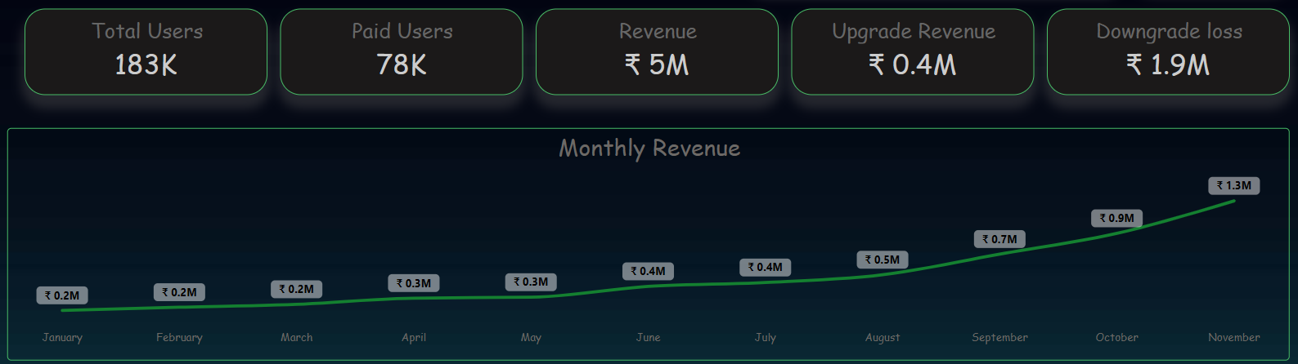
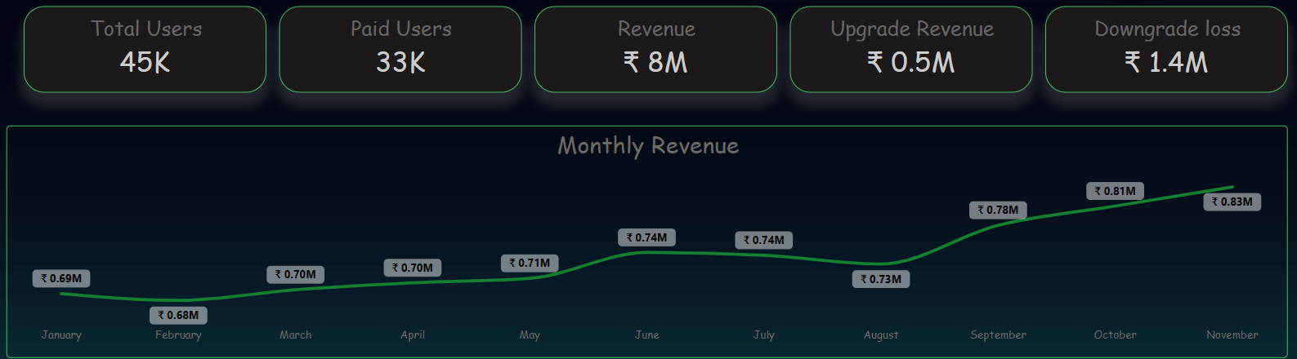
7. Revenue Analysis of Lio-Cinema and Jot-star for 2024 (January - November)
Lio-Cinema
Jot-star

Slide 21
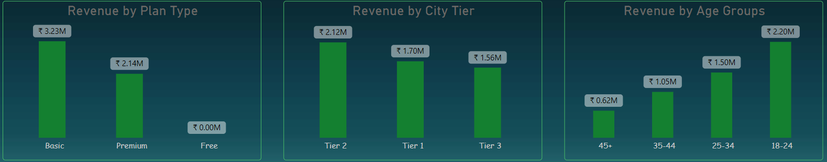
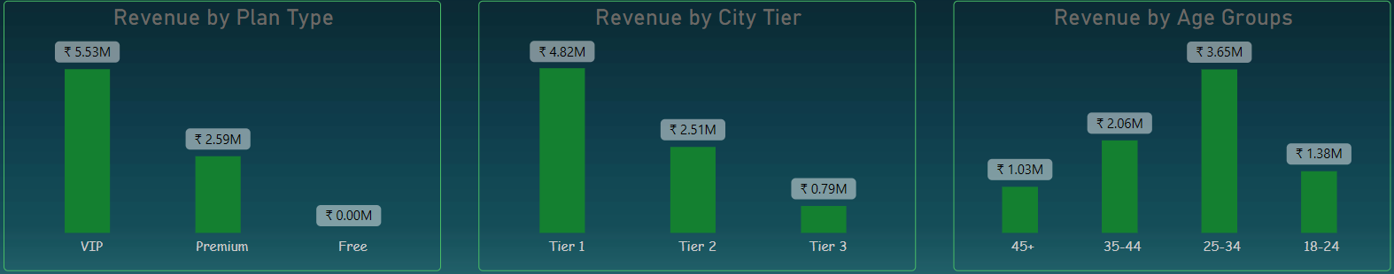
8. Revenue Analysis by plan type, city tier & age group
Lio-Cinema
Jot-star

Slide 22
From analysis:
Lio-Cinema generates more annual revenue compared to Jot-star.
November month has shown the highest monthly revenue generated by both if these OTT platforms.
Total of Rs. 13 Million is the sum annual revenue.
For Lio-Cinema highest revenue is generated by Basic plan type, while VIP plan generated the highest revenue for Jot-star.

