Slide 1
Hospital Management System using PostgreSQL and Springboot
Dhananjay Hirey – 12310048 KO022SH
Roll. No. 30

Slide 2
Introduction
This project focuses on the design and development of a Hospital Management System Backend using Spring Boot as the core framework and PostgreSQL as the relational database.
The system is developed following industry-standard layered architecture, ensuring clean separation of concerns, maintainability, and scalability.
It provides RESTful APIs to manage doctors, patients, medicines, billing receipts, and medicine stock while enforcing real-world hospital business rules such as stock validation and billing calculations.

Slide 3

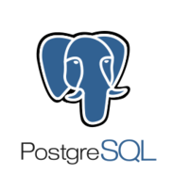
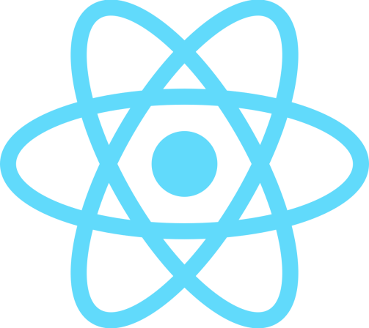

Tech Stack
Backend: SpringBoot
Frontend: React+TailwindCSS
Database: Containerized PostgreSQL being accessed through Hibernate ORM

Slide 4
Maven Commands Used
1. Clean install and build without tests: .\mvnw.cmd clean install –DskipTests
2. Run the file: java "-Duser.timezone=UTC" -jar target/hospitalManagementSystem-0.0.1-SNAPSHOT.jar

Slide 5
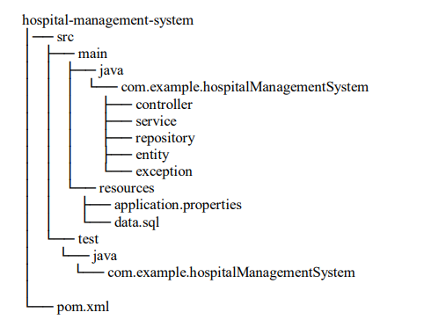
Project Structure

Slide 6
Build Lifecycle Management Maven
manages the entire build lifecycle of the project through predefined phases:
1. validate – Validates project structure
2. compile – Compiles source code
3. test – Executes unit tests
4. package – Packages the application into a JAR file
5. install – Installs the JAR into local repository
6. deploy – Prepares for deployment (optional)

Slide 7
Advantages of Using Maven
Centralized dependency management
Reduced configuration overhead
Easy integration with CI/CD pipelines
Improved project scalability and maintainability

