Slide 1
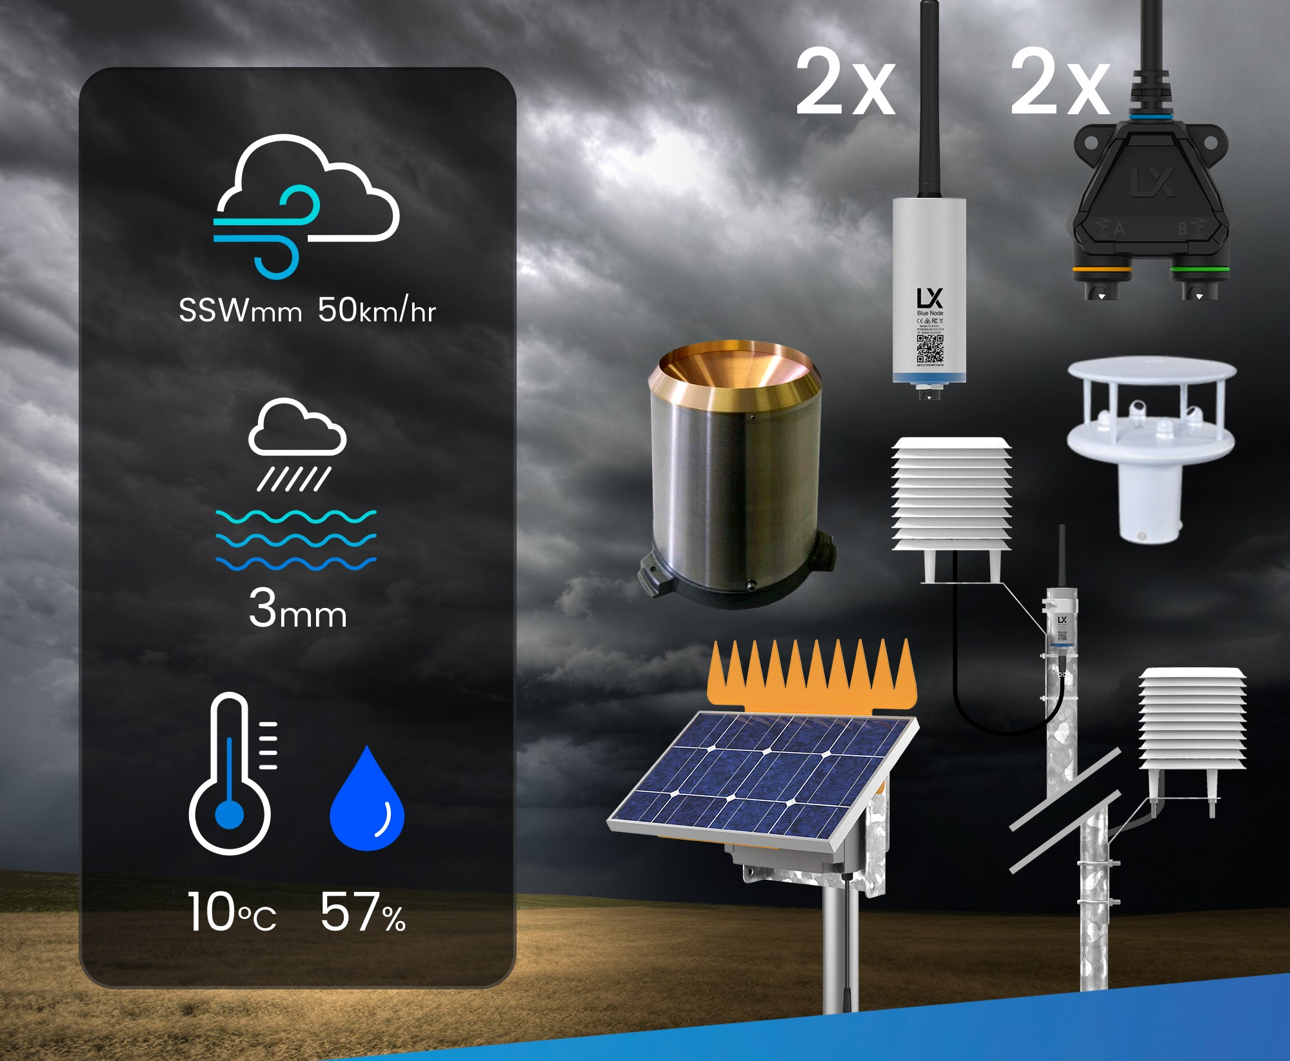
Smart Weather Station
Name -A.D.L.B Alwitigala
UH ID -21000157
Module Name -Individual Major Project
Module Code -6FTC1167
Supervisor -Mr. Chandima Tennakoon

Slide 2
Content
1
Introduction
2
Literature Review
3
Methodology
4
Results and discussions
5
Conclusions
6
Further Developments
7
Project Management Review

Slide 3

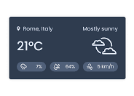

Introduction
Project Background
In areas with unpredictably changing climatic shifts the development of a Smart Weather Station with an integrated prediction model marks a revolutionary achievement in the field of weather monitoring and forecasting.
To fulfill this need a Smart Weather Station was built to mesure the weather parameters in real time and user will be able to observe the real-time weather data in a user-friendly dash board by browsing the internet.
In addition, a rain and wind speed prediction report is also available for the user

Slide 4
Introduction
Aims and Objectives
Aim
A product, made as a single unit-wise weather station with high accuracy, allowing users to keep it fixed or portable. Which updates the real-time weather data and provides a weather prediction report for upcoming day.
Objectives
Design and build a Smart Weather Station that can monitor various weather parameters such as temperature, humidity, wind speed, UV intensity and rain, then display the real time weather data in an OLED display.
Enable a system to remotely monitor the relevant parameters of relevant properties using a web interface and make it accessible with a user-friendly dash board
Make a data base to store all monitored weather data and analyze the data over a period of time.
Using the stored weather data develop a predictive model to predict the future weather.

Slide 5
Literature Review
History of Weather Stations
History of Weather Forecasting
Current Technologies
The Tower of the Winds located in the Roman Agora of Athens and it is considered the first meteorological station in the world.
The first national weather service in the United States commenced operations in 1871, with responsibility assigned to the U.S. Army Signal Corps.
The original purpose of the service was to provide storm warnings for the Atlantic and Gulf coasts and for the Great Lakes
Radiosondes measure weather parameters like temperature, humidity, and wind speed using weather balloons.
Computerized NWS numerical forecast models generate accurate weather forecasts based on observed data.

Slide 6
Literature Review
Similar Research Papers
A SMART WEATHER STATION BASED ON SENSOR TECHNOLOGY
Smart Sustainable Mini Weather Station
Machine Learning Based Weather Prediction Model for Short Term Weather Prediction in Sri Lanka
Smart Weather Forecasting Using Machine Learning: A Case Study in Tennessee
The project has been carried out by Miloš Đorđević & Danijel Danković who studies at Faculty of Electronic Engineering, University of Niš, Serbia.
The system allows for automated data collection and remote access to weather information
The project was carried by Anshika Gupta, Ankita Tripati & Reuben Coutinho Dept.
The proposed system is developed by using esp32 micro-controller platform six different sensors, and collected data is transmitted to a mobile app.
The study processes a weather prediction weather prediction model based on machine learning techniques, specifically Long Short-Term Memory (LSTM) networks, which can identify complex non liner patterns in past weather data.
The paper address challenges in weather perdition, and high energy consumption of large scaling computer systems.
The paper provides an overview of machine learning in weather forecasting, discusses related works, and presents the methodology of the proposed technique..

Slide 7
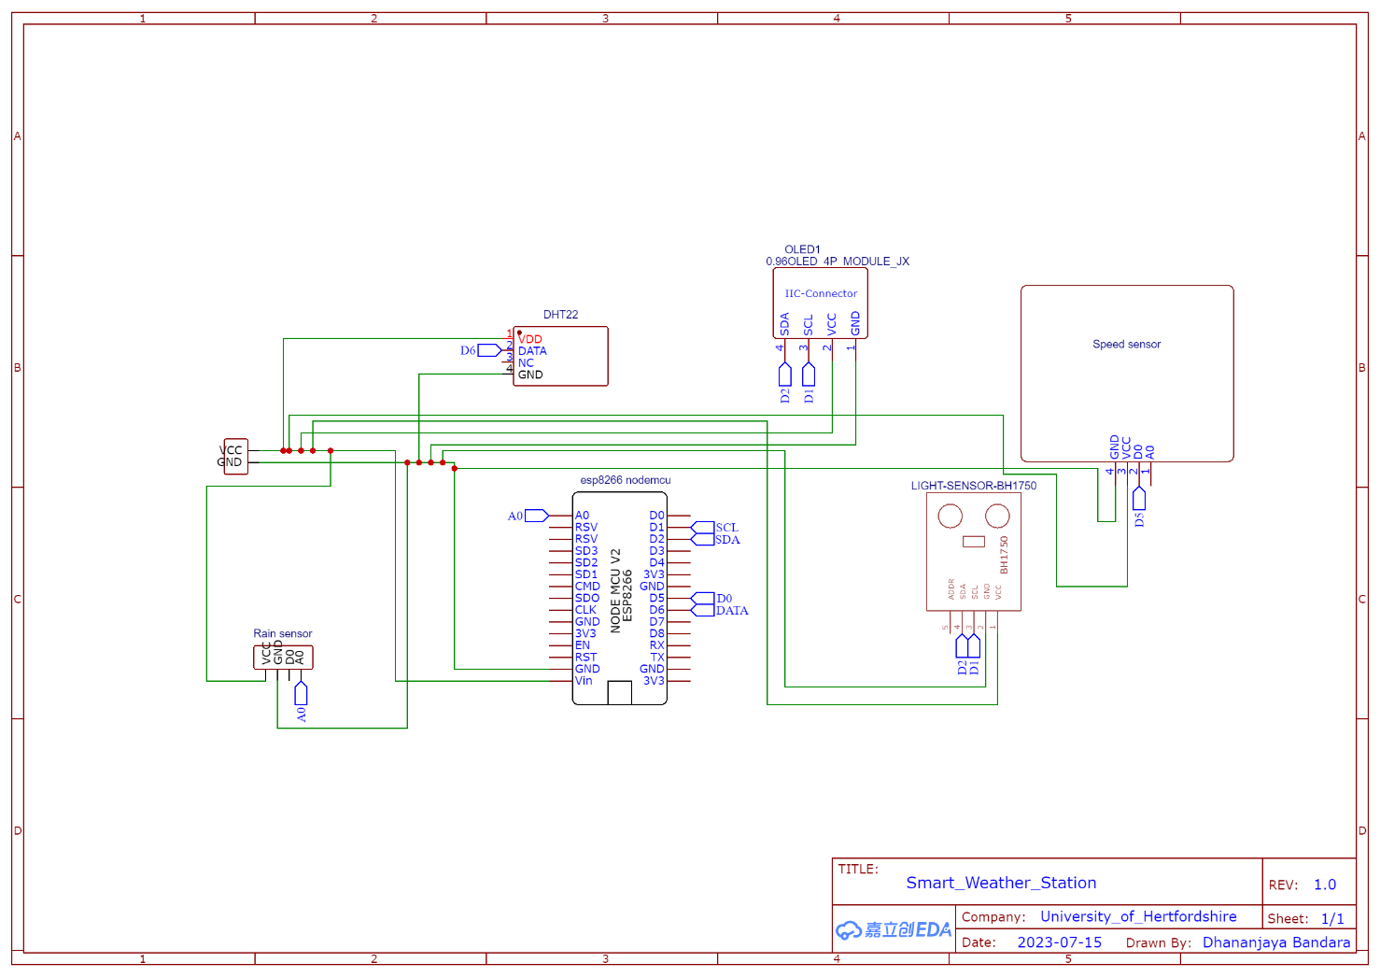
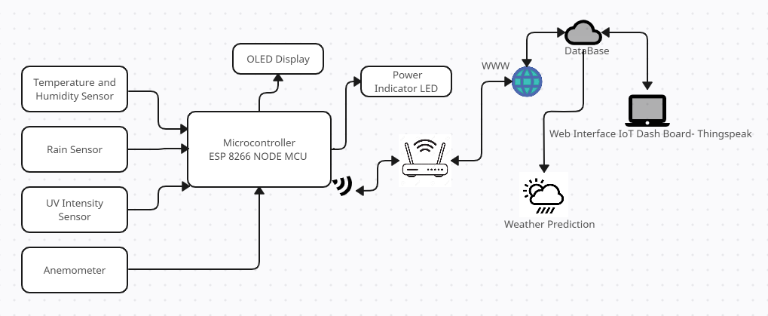
Methodology
General System Block Diagram
System Connectivity Diagram

Slide 8
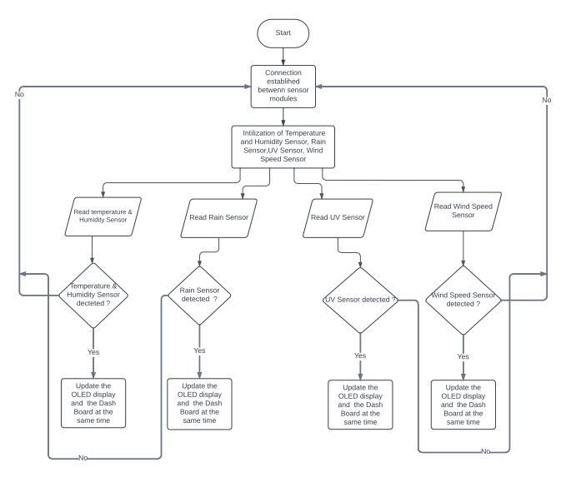
Methodology
System Flow Chart

Slide 9
Methodology
Project Implementation
01
03
05
Connecting All Three Implementations Together
Software Implementation
Hardware Implementation
IoT Platform Implementation
Product Finalization and Modeling the Prediction Model
02
04

Slide 10
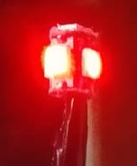
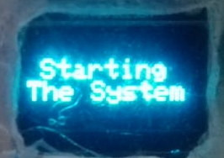
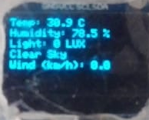
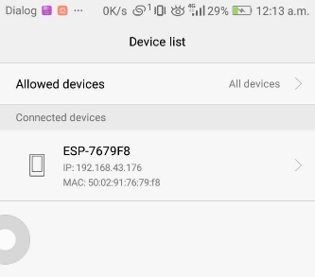
Results and Discussions
Test | Task | Measured Unit | Model | Output | Results
Test 1 | Turn the Power ON | Power Indicator | The Complete System model | Power On Indicator Lit Up
 | Starting the System Unit | OLED Display | The Complete System model | A Starting Message Displayed
 | Displaying the Weather Parameters in Real-Time | All Weather Parameters Monitoring Units | The Complete System model | All Weather Parameters Displayed In OLED Display
 | Connecting the System to internet Using Wi-Fi Hotspot | The Wi-Fi Module of the Microcontroller | The Complete System model | A message displayed in the Mobile Phone
 | Connection Established | The Weather Station and the IoT Dashboard is functioning at Similar Time | The Complete System model and the Dashboard | The OLED Display and the Dashboard is Displaying the Same Parameters
Test Case 01 -
The entire hardware system testing

Slide 11
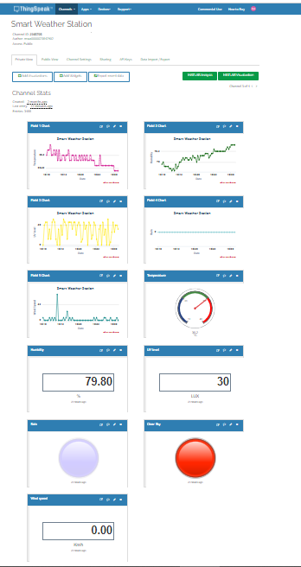
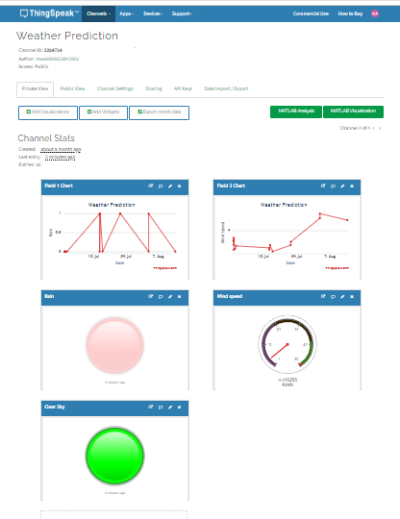

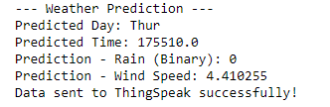
Results and Discussions
Test Case 02-
Real-time weather data IoT dashboard testing
Test Case 03- Weather prediction IoT dashboard testing
Test Case 04- Weather prediction program testing

Slide 12
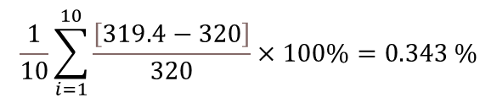
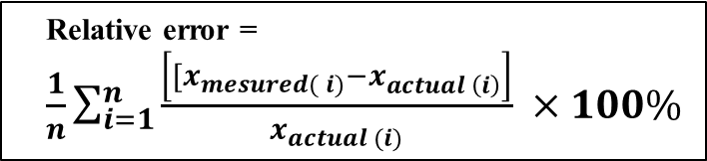
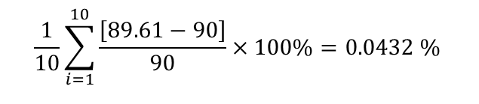
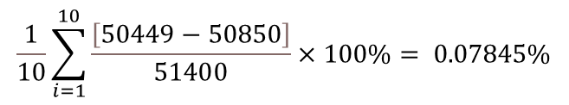

Results and Discussions
Reliability of the system
Actual Value |  |  |  | Measured Value
Temperature | Humidity | UV Level | Wind Speed | Temperature | Humidity | UV Level | Wind Speed
31.7 | 84.8 | 5003 | 9.54 | 32 | 86 | 5000 | 9
31.8 | 85.9 | 3653 | 9.25 | 32 | 84 | 3800 | 9
31.7 | 85.4 | 6426 | 8.34 | 32 | 84 | 5600 | 9
31.8 | 84.6 | 5699 | 8.19 | 32 | 84 | 5500 | 9
31.8 | 84.7 | 4287 | 8.34 | 32 | 84 | 4300 | 8
31.8 | 85 | 4163 | 9.31 | 32 | 85 | 4000 | 9
31.8 | 85.3 | 3665 | 9.21 | 32 | 84 | 3700 | 9
31.8 | 84.7 | 6032 | 9.13 | 32 | 84 | 6000 | 9
31.9 | 85.3 | 7416 | 9.23 | 32 | 84 | 7400 | 9
31.9 | 85.6 | 4005 | 8.67 | 32 | 84 | 4000 | 9
Relative error = $\frac{1}{n}\sum_{i=1}^{n}{\frac{\left[{[x}_{mesured( i)}−x_{actual \left(i\right)}\right]}{x_{actual (i)}}} ×100\%$
Relative error of temperature =
Relative error of Wind Speed =
The relative error percentage of the system is less than 1%.
The system can be identified as a reliable system for weather monitoring.
$$\frac{1}{10}\sum_{i=1}^{10}{\frac{\left[319.4−320\right]}{320}}×100\%=0.343 \%$$
$$\frac{1}{10}\sum_{i=1}^{10}{\frac{\left[89.61−90\right]}{90}}×100\%=0.0432 \%$$
Relative error of humidity =
Relative error of UV level =
$$\frac{1}{10}\sum_{i=1}^{10}{\frac{\left[851.3−852\right]}{852}}×100\%=0.083 \%$$
$$\frac{1}{10}\sum_{i=1}^{10}{\frac{\left[50449−50850\right]}{51400}}×100\%= 0.07845\%$$

Slide 13
Conclusion
The development of a Smart Weather Station equipped with a prediction model marks a significant step forward in accurate weather monitoring and forecasting, especially in regions like Sri Lanka prone to rapid and unpredictable climate changes.
The prototype Smart Weather Station developed in this project comprises a network of specializes sensors, each meticulously chosen for its ability to capture essential weather parameters including temperature, humidity, UV level, Wind Speed and rainfall.
These sensors feed real time data in to a user friendly IoT dashboard.
The integration of an OLED display enhances local accessibility by providing immediate weather insights at the Weather Station location.
One of the standout features of this project is the implementation of a predictive model, a complex task that required meticulous data collection, analysis and training.
This model enhances the station's capabilities by offering forecasts based on collected weather data by itself over a period of time.

Slide 14
Further Developments
Develop a mobile app.
The System can expand its range of monitored parameters by adding more sensors.
Geographical expansion could involve deploying multiple Smart Weather Stations across different geographics locations
Implementing more efficient power management and exploring renewable energy sources like solar panel

Slide 15
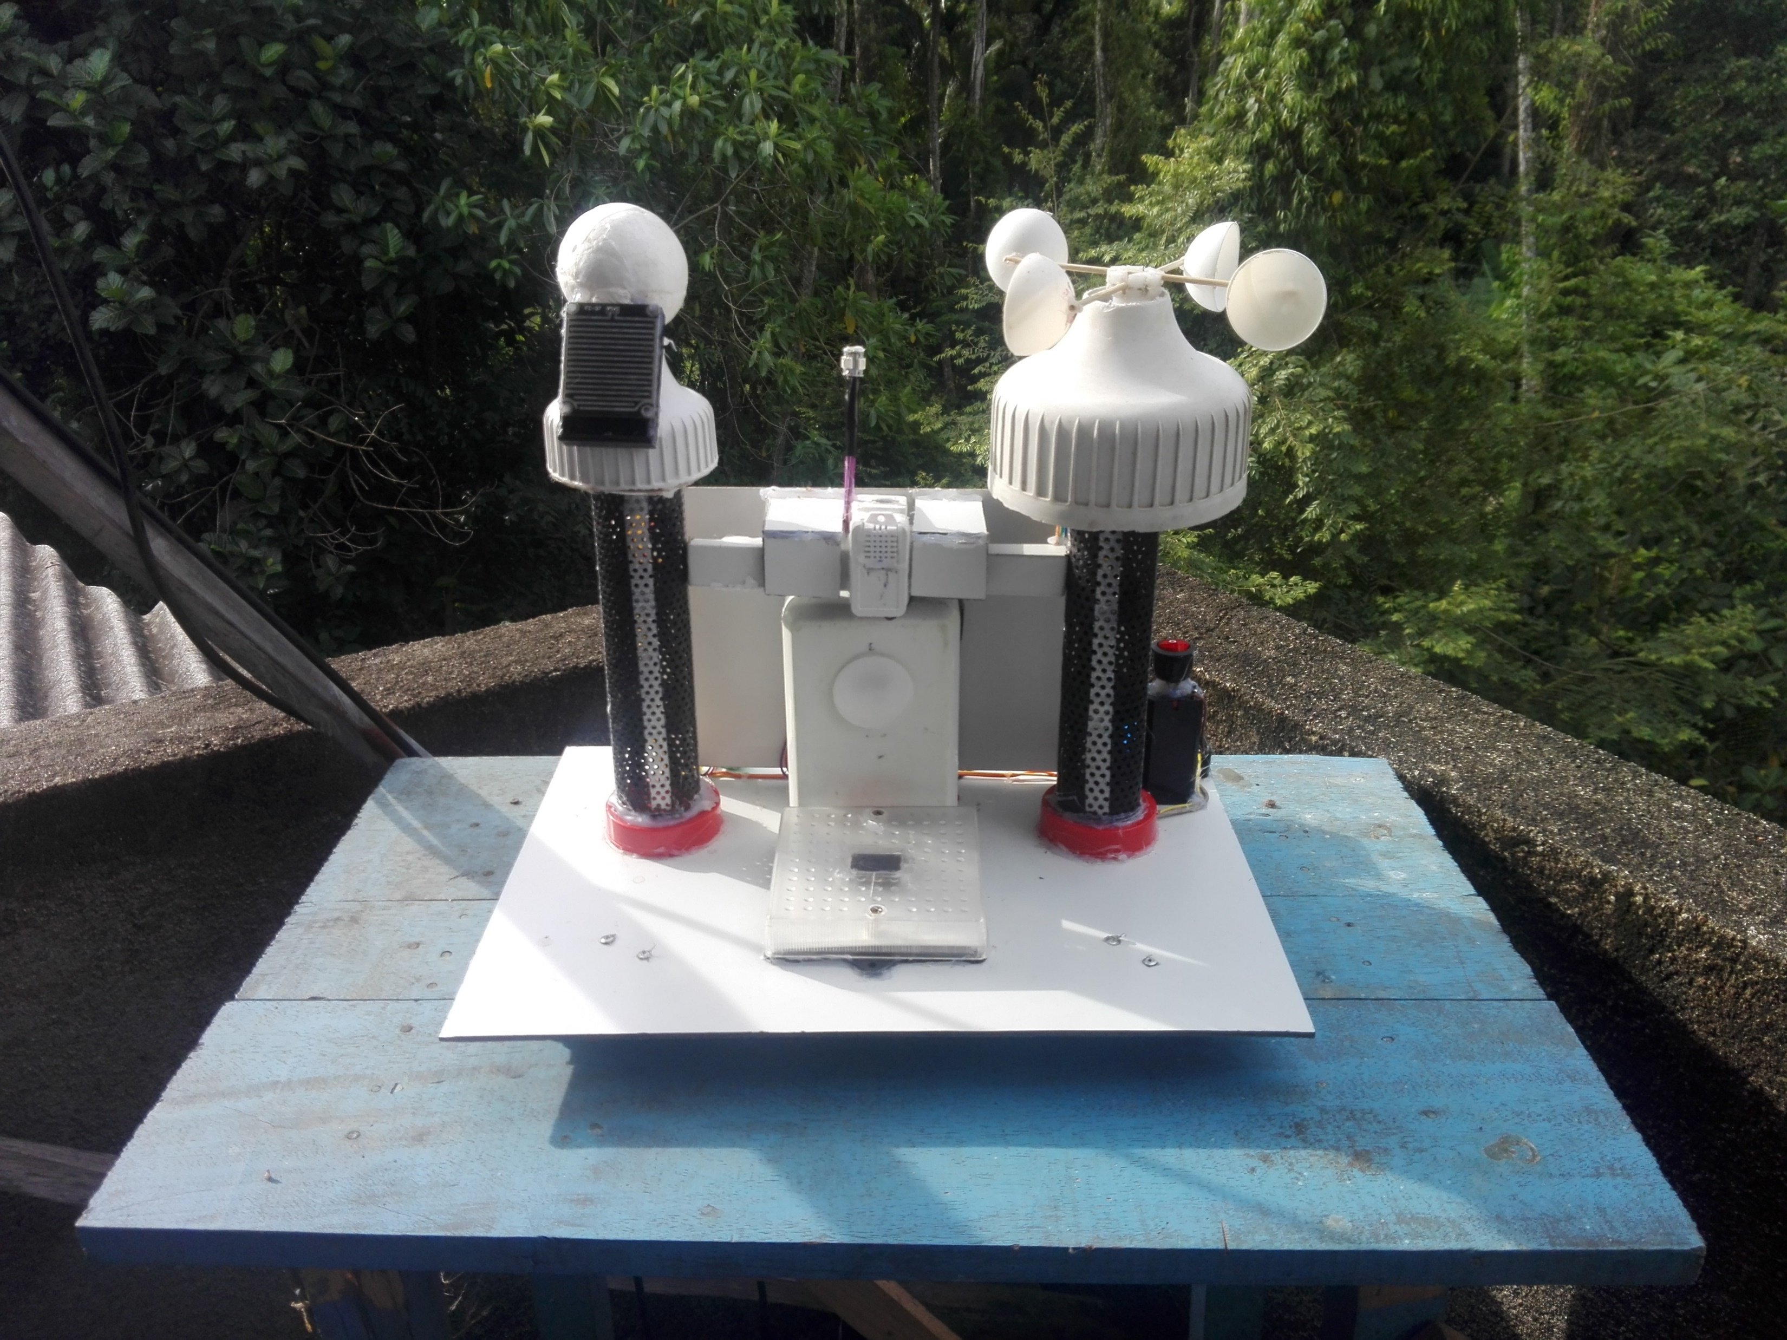
Project Management Review
Cost Aspects
The planned cost is 15360LKR, and the actual cost is 12050LKR.
Cost Deference is 3310LKR.
The product could be made under the budget
Some changes were made to the planned system discussed with the project supervisor.
Marketability
The product can be made within a lower budget
Easily customizable.
Can be applicable for domestic and industrial sectors.

Slide 16
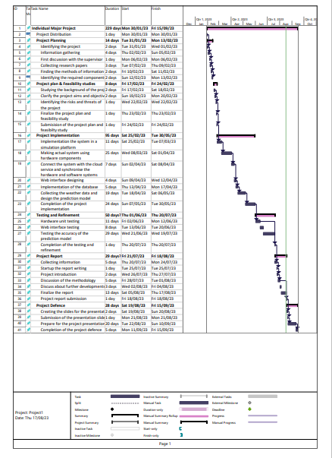
Project Management Review
Time Plan
There were slight changes in initial Gantt chart and the final Gantt chart.
There were some changes in the project implementation section
The time was managed in parallel with other tasks

Slide 17
Thank You!

