Slide 1
[220 / 319] Files
Meena Syamkumar
Andy Kuemmel

Slide 2
Relation to Recent Topics...
1
file objects are a type of iterator (lecture 25)
2
exceptions occur a lot with files (lecture 26)
not found, out of space, no permissions, etc

Slide 3
Learning Objectives Today
Basic file interactions
opening/closing
reading/writing
OS module
listdir, mkdir, exists, isdir, isfile, join
File exceptions
Encodings

Slide 4
Learning Objectives Today
Basic file interactions
opening/closing
reading/writing
OS module
listdir, mkdir, exists, isdir, isfile, join
File exceptions
Encodings

Slide 5
File objects
built-in open function
f = open(path) # read data from f # OR # write data to f f.close()
file object
file path

Slide 6
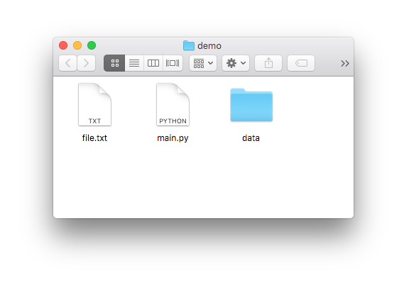
File objects
built-in open function
main.py:
f = open(path) # read data from f # OR # write data to f f.close()
file object
file path
we’re running the code here

Slide 7
File objects
built-in open function
main.py:
f = open(“file.txt”) # read data from f # OR # write data to f f.close()
file object
file path
suppose we want to open file.txt

Slide 8
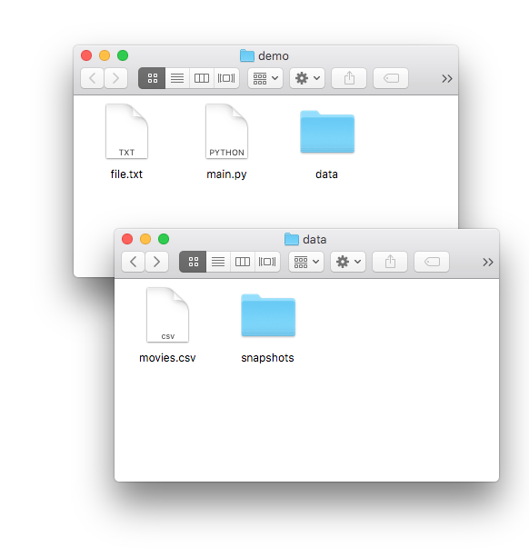
File objects
built-in open function
main.py:
f = open( “data/movies.csv”) # read data from f # OR # write data to f f.close()
file object
file path
data/movies.csv

Slide 9
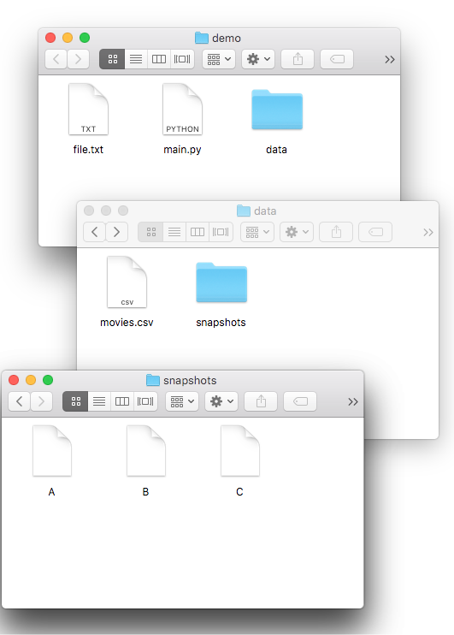
File objects
built-in open function
main.py:
main.py:
f = open( “data/snapshots/A”) # read data from f # OR # write data to f f.close()
file object
file path
data/snapshots/A

Slide 10
File objects
main.py:
main.py:
f = open(“file.txt”) # read data from f # OR # write data to f f.close()

Slide 11
File objects
main.py:
main.py:
f = open(“file.txt”) # read data from f # OR # write data to f f.close()
using file

Slide 12

File objects
imagine a file object as a sandwich…
f = open(…)
use file
main.py:
f.close()
main.py:
f = open(“file.txt”) # read data from f # OR # write data to f f.close()
using file
Reasons for closing
avoid data loss
limited number of open files
cleanup

Slide 13
Learning Objectives Today
Basic file interactions
opening/closing
reading/writing
OS module
listdir, mkdir, exists, isdir, isfile, join
File exceptions
Encodings

Slide 14
Reading a file
f = open(“file.txt”) # read data from f # OR # write data to f f.close()
I promise to always close my files

Slide 15
Reading a file
f = open(“file.txt”) data = f.read()
print(data) f.close()
I promise to always close my files
Option 1
data is: “I promise\nto always\nclose my files”
read() method
fetch entire file contents
return as a string

Slide 16
Reading a file
f = open(“file.txt”) # read data from f # OR # write data to f f.close()
Option 2
file objects are iterators!

Slide 17
The Vocabulary
of Iteration
file object
dict.keys() dict.values()
convert it
to a list
list
str
tuple
range
is a
is a
sequence
iterator
call next(f)
can be
converted
to a
is an
is an
can give you an
iterable
can go here
for x in :
# some code
iterate over f with a for loop

Slide 18
The Vocabulary
of Iteration
file object
dict.keys() dict.values()
f = open("file.txt")
lines = list(f)
f.close()
convert it
to a list
list
str
tuple
range
f = open("file.txt")
first = next(f)
f.close()
is a
is a
sequence
iterator
call next(f)
can be
converted
to a
is an
is an
can give you an
f = open("file.txt")
for l in f:
print(l)
f.close()
iterable
can go here
for x in :
# some code
iterate over f with a for loop

Slide 19
Write a file
f = open(“file.txt”) # read data from f # OR # write data to f f.close()
I promise to always close my files

Slide 20
Write a file
“w” mode indicates we want to write to this file
f = open(“file.txt”, “w”) # read data from f # OR # write data to f f.close()
I promise to always close my files

Slide 21
Write a file
“w” mode indicates we want to write to this file
f = open(“file.txt”, “w”) f.write(“hello”) f.write(“ world\n”) f.write(“!!!!!\n”) f.close()
I promise to always close my files
let’s run it!

Slide 22
Write a file
“w” mode indicates we want to write to this file
f = open(“file.txt”, “w”) f.write(“hello”) f.write(“ world\n”) f.write(“!!!!!\n”) f.close()
opening with “w” is
dangerous. It immediately
wipes out your file.
(or creates a new one if there isn’t already a file.txt)

Slide 23
Write a file
“w” mode indicates we want to write to this file
f = open(“file.txt”, “w”) f.write(“hello”) f.write(“ world\n”) f.write(“!!!!!\n”) f.close()
hello

Slide 24
Write a file
“w” mode indicates we want to write to this file
f = open(“file.txt”, “w”) f.write(“hello”) f.write(“ world\n”) f.write(“!!!!!\n”) f.close()
hello world

Slide 25
Write a file
“w” mode indicates we want to write to this file
f = open(“file.txt”, “w”) f.write(“hello”) f.write(“ world\n”) f.write(“!!!!!\n”) f.close()
hello world
!!!!!!

Slide 26
Write a file
“w” mode indicates we want to write to this file
f = open(“file.txt”, “w”) f.write(“hello”) f.write(“ world\n”) f.write(“!!!!!\n”) f.close()
hello world
!!!!!!
be careful with newlines
(write doesn't add them like print does)

Slide 27
Learning Objectives Today
Basic file interactions
opening/closing
reading/writing
OS module
listdir, mkdir, exists, isdir, isfile, join
File exceptions
Encodings

Slide 28
OS Module (Operating System)
Many functions in os and os.path for working w/ files
os.listdir
os.mkdir
os.path.exists
os.path.isfile
os.path.isdir
os.path.join

Slide 29
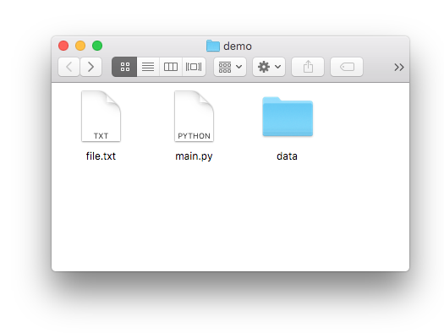
OS Module (Operating System)
Many functions in os and os.path for working w/ files
os.listdir
os.mkdir
os.path.exists
os.path.isfile
os.path.isdir
os.path.join
>>> import os
>>> os.listdir(“.”) [“file.txt”, “main.py”, “data”]

Slide 30
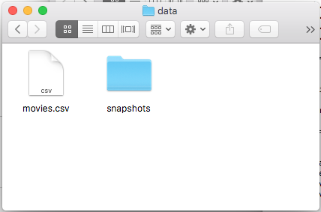
OS Module (Operating System)
Many functions in os and os.path for working w/ files
os.listdir
os.mkdir
os.path.exists
os.path.isfile
os.path.isdir
os.path.join
>>> import os
>>> os.listdir(“data”) [“movies.csv”, “snapshots”]

Slide 31
OS Module (Operating System)
Many functions in os and os.path for working w/ files
os.listdir
os.mkdir
os.path.exists
os.path.isfile
os.path.isdir
os.path.join
>>> import os
>>> os.mkdir(“test”)

Slide 32
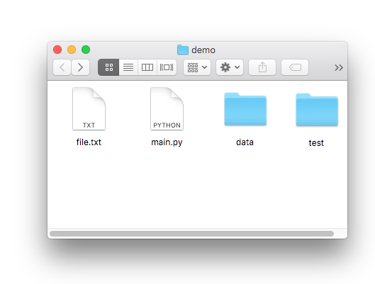
OS Module (Operating System)
Many functions in os and os.path for working w/ files
os.listdir
os.mkdir
os.path.exists
os.path.isfile
os.path.isdir
os.path.join
>>> import os
>>> os.mkdir(“test”)

Slide 33
OS Module (Operating System)
Many functions in os and os.path for working w/ files
os.listdir
os.mkdir
os.path.exists
os.path.isfile
os.path.isdir
os.path.join
>>> import os
>>> os.path.exists(“file.txt”) True

Slide 34
OS Module (Operating System)
Many functions in os and os.path for working w/ files
os.listdir
os.mkdir
os.path.exists
os.path.isfile
os.path.isdir
os.path.join
>>> import os
>>> os.path.exists(“haha.txt”) False

Slide 35
OS Module (Operating System)
Many functions in os and os.path for working w/ files
os.listdir
os.mkdir
os.path.exists
os.path.isfile
os.path.isdir
os.path.join
>>> import os
>>> os.path.isfile(“haha.txt”) False

Slide 36
OS Module (Operating System)
Many functions in os and os.path for working w/ files
os.listdir
os.mkdir
os.path.exists
os.path.isfile
os.path.isdir
os.path.join
>>> import os
>>> os.path.isfile(“file.txt”) True

Slide 37
OS Module (Operating System)
Many functions in os and os.path for working w/ files
os.listdir
os.mkdir
os.path.exists
os.path.isfile
os.path.isdir
os.path.join
>>> import os
>>> os.path.isfile(“data”) False

Slide 38
OS Module (Operating System)
Many functions in os and os.path for working w/ files
os.listdir
os.mkdir
os.path.exists
os.path.isfile
os.path.isdir
os.path.join
>>> import os
>>> os.path.isdir(“data”) True

Slide 39
OS Module (Operating System)
Many functions in os and os.path for working w/ files
os.listdir
os.mkdir
os.path.exists
os.path.isfile
os.path.isdir
os.path.join
>>> import os
>>> os.path.join(“data”, “movies.csv”) data/movies.csv
on Mac/Linux

Slide 40
OS Module (Operating System)
Many functions in os and os.path for working w/ files
os.listdir
os.mkdir
os.path.exists
os.path.isfile
os.path.isdir
os.path.join
>>> import os
>>> os.path.join(“data”, “movies.csv”) data\movies.csv
on Windows

Slide 41
Windows
Linux
Your project:
path = "\".join("data", "movies.csv")
f = open(path)
...
...
submit
you run test.py
we run test.py

Slide 42
Learning Objectives Today
Basic file interactions
opening/closing
reading/writing
OS module
listdir, mkdir, exists, isdir, isfile, join
File exceptions
Encodings

Slide 43
Exceptions
Working with files leads to many exceptions
missing files
lacking permissions
not enough space
mixing up directories and files
corrupt formats
etc, etc

Slide 44
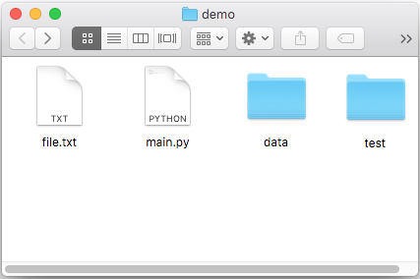
Exceptions
Working with files leads to many exceptions
missing files
lacking permissions
not enough space
mixing up directories and files
corrupt formats
etc, etc
import os
os.mkdir('dump')
f = open(os.path.join('dump', 'out.txt'), 'w')
f.write('hi')
f.close()

Slide 45
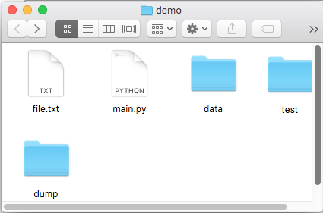
Exceptions
Working with files leads to many exceptions
missing files
lacking permissions
not enough space
mixing up directories and files
corrupt formats
etc, etc
run once
import os
os.mkdir('dump')
f = open(os.path.join('dump', 'out.txt'), 'w')
f.write('hi')
f.close()

Slide 46
Exceptions
Working with files leads to many exceptions
missing files
lacking permissions
not enough space
mixing up directories and files
corrupt formats
etc, etc
run again: CRASH!
import os
os.mkdir('dump')
f = open(os.path.join('dump', 'out.txt'), 'w')
f.write('hi')
f.close()
Traceback (most recent call last):
File "test2.py", line 3, in <module>
os.mkdir('dump')
FileExistsError: [Errno 17] File exists: 'dump'

Slide 47
Exceptions
Working with files leads to many exceptions
missing files
lacking permissions
not enough space
mixing up directories and files
corrupt formats
etc, etc
run again with try/except
import os
try:
os.mkdir('dump')
except FileExistsError:
pass # ignore it if dump already existed
f = open(os.path.join('dump', 'out.txt'), 'w')
f.write('hi')
f.close()

Slide 48
Learning Objectives Today
Basic file interactions
opening/closing
reading/writing
OS module
listdir, mkdir, exists, isdir, isfile, join
File exceptions
Encodings

Slide 49
Exercise: person 1 encodes a word with encoding 1,
person 2 decodes with encoding 2
Word:
ukulele
A 00001
B 00010
C 00011
D 00100
E 00000
F 00110
G 00111
H 01000
I 01001
J 01010
K 01011
L 11111
M 01101
N 01110
O 01111
P 10000
Q 10001
R 10010
S 10011
T 10100
U 10101
V 10110
W 10111
X 11000
Y 11001
Z 11010
A 00001
B 00010
C 00011
D 00100
E 00000
F 00110
G 00111
H 01000
I 01001
J 01010
K 01111
L 10101
M 01101
N 01110
O 01011
P 10000
Q 10001
R 10010
S 10011
T 10100
U 01100
V 10110
W 10111
X 11000
Y 11001
Z 11010
encoding 1
encoding 2

Slide 50
Exercise: person 1 encodes a word with encoding 1,
person 2 decodes with encoding 2
Word:
ukulele
lol?e?e
A 00001
B 00010
C 00011
D 00100
E 00000
F 00110
G 00111
H 01000
I 01001
J 01010
K 01011
L 11111
M 01101
N 01110
O 01111
P 10000
Q 10001
R 10010
S 10011
T 10100
U 10101
V 10110
W 10111
X 11000
Y 11001
Z 11010
A 00001
B 00010
C 00011
D 00100
E 00000
F 00110
G 00111
H 01000
I 01001
J 01010
K 01111
L 10101
M 01101
N 01110
O 01011
P 10000
Q 10001
R 10010
S 10011
T 10100
U 01100
V 10110
W 10111
X 11000
Y 11001
Z 11010
encoding 1
encoding 2

Slide 51
Encoding Defaults Done Wrong
Mac
Windows
f = open('example.txt', 'w', encoding='utf-8')
f.write('baño')
f.close()
f = open('example.txt', ‘r',
encoding='cp1252')
print(f.read())
f.close()
example.txt
example.txt
Windows computer prints “baÃ±o” instead of “baño”

Slide 52
Encoding Defaults Done Wrong
Mac
Windows
f = open('example.txt', 'w', encoding='utf-8')
f.write('baño')
f.close()
f = open('example.txt', ‘r',
encoding='cp1252')
print(f.read())
f.close()
example.txt
example.txt
Takeaway: if you see weird characters printed by
your program, it’s a good time to learn more about encodings

Slide 53
Coding Demos

Slide 54
Demo 1: add numbers in a file
Goal: read all lines from a file as integers and add them
Input:
file containing 50 million numbers between 0 and 100
Output:
The sum of the numbers
Example: prompt> python sum.py 2499463617
Two ways:
Put all lines in a list first
Directly use iterable file
Bonus: create generator function
that does the str => int conversion

Slide 55
Challenge - Demo 1: Score Tracker
Goal: tally up points, and print who is winning
Input:
Person who just scored
Output:
Everybody’s score
Example: prompt> python point.py alice alice: 1
prompt> python point.py bob alice: 1 bob: 1
prompt> python point.py alice alice: 2 bob: 1

Slide 56
Challenge - Demo 2: File Finder
Goal: search directories (recursively) for a given file name, then print that file
Input:
The filename to search for
Output:
The contents of that file

Slide 57
Challenge - Demo 3: sorting files by line length
Goal: output file contents, with shortest line first
Input:
a text file
Output:
print lines sorted

