Slide 1
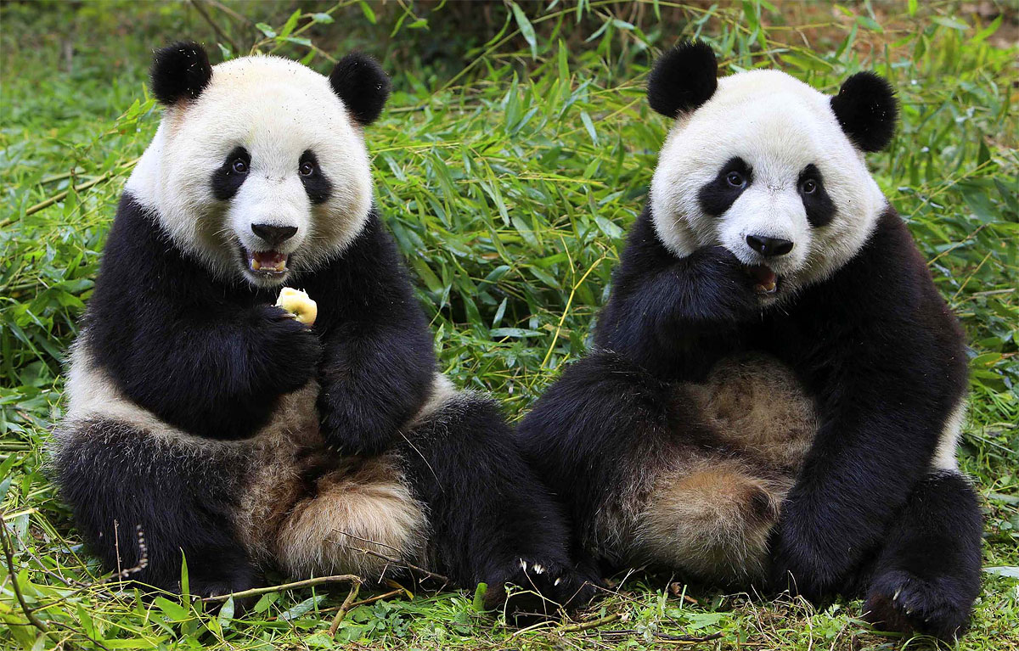
[220] Pandas 1
Meena Syamkumar
Mike Doescher

